Slide 1
Workflow Management
Week 10 · Applied Computing in Health Data Science · PUBH 6854 / 4201
Declare what depends on what. Let the engine do the rest.

Slide 2
It dies at 2 a.m.
1
2
3
4
5
6
7
8
9
10
11
12
13
14
Fri 6 p.m.: launch
Sat 2 a.m.: crash
Mon: now what?
1
2
3
Which outputs are good?
Is step 8's file complete, or cut off?
Restart from step 1?
Notes:
Script: Motivation. Friday evening launch, crash at step 9 overnight, Monday morning: which outputs are good?

Slide 3
You have four scripts
filter.py
→
count.py
→
merge.py
→
plot.py
You run them by hand, in order. It works.
Then it's Tuesday.
“Can you change the filter threshold from 0.10 to 0.30?”
Notes:
Script: The problem. Then Cmd-Tab to iTerm2: cat run_all.sh, run it twice.

Slide 4
Four pains of loose scripts
1
No memory
2
Doesn't know dependencies
Redoes everything, or you comment out lines by hand and hope.
You know. The script doesn't.
3
Parameters drift
4
Fails badly
Which threshold made this figure? Six weeks later, nobody knows.
Step 9 of 14 crashes. Which outputs are good? Restart from step 1?
Notes:
Script: Four pains. Hands up for any you've hit.

Slide 5
Managing failure is the hard part
By hand: sbatch
With a workflow manager
Submit every job yourself
Track job IDs
Chain jobs with dependencies
Open each log to check it worked
Rerun failures by hand
Checks every declared output exists
Removes half-written files
Stops cleanly at the failure
Resumes from the failure
Retries flaky jobs, keeps logs
sbatch submits a script to the cluster's scheduler (Slurm). You then babysit it.
Notes:
Script: sbatch = submit a script to the cluster scheduler (Slurm). Your story: since ~2018, no sbatch. The tool also checks that jobs succeeded.

Slide 6
Build systems came first
→
→
1976
Same idea
2012
Make
Build systems
Snakemake
Stuart Feldman, Bell Labs. Rebuild only what is out of date.
Ant, Rake, MSBuild, and Make-like tools in every ecosystem.
Make-style rules for science (Köster & Rahmann).
Why Make exists: a colleague lost a morning debugging a program whose fix had never been recompiled.
Source: Wikipedia, “Make (software)”
Notes:
Script: Make, Stuart Feldman, Bell Labs, early version April 1976 (Wikipedia). A colleague lost a morning debugging a program whose fix was never recompiled. Snakemake: Koster and Rahmann 2012.

Slide 7
The one big idea
For every file: what it's made from, and how to make it.
matrix.png
←
matrix.tsv
←
counts/*
←
filtered/*
←
raw/*
You ask for this
The engine works backwards: “What do I need? Does it exist? Is it up to date?”
It only runs what it has to.
Notes:
Script: Core ideas. Write down dependencies, not steps. Pull, not push. Make: 1970s.

Slide 8
Anatomy of a rule
rule filter_variants:
input:
"data/raw/{sample}.tsv",
output:
"results/filtered/{sample}.tsv",
params:
min_vaf=config["min_vaf"],
shell:
"python scripts/filter_variants.py
--input {input} --output {output}
--min-vaf {params.min_vaf}"
1
input
what I need
2
output
what I make
3
params
knobs that aren't files
4
shell
the command
Notes:
Script: Read it like a sentence. {input} and {output} get filled in, so you never type a path twice.

Slide 9
Wildcards: one rule, every sample
sample = S01
sample = S02
results/filtered/{sample}.tsv
matches
sample = S03
sample = S04
sample = S05
sample = S06
Ask for results/filtered/S03.tsv → Snakemake sets sample = S03 → looks for data/raw/S03.tsv.
Sixty samples? Same rule.
Notes:
Script: {sample} is a pattern. Sixty samples, same rule.

Slide 10
expand() and rule all
expand: fill in a pattern for every sample
expand("results/counts/{sample}.tsv", sample=SAMPLES)
rule all: the shopping list. Only an input.
rule all:
input:
"results/matrix.png",
It does nothing itself. Snakemake starts here and works backwards.
Notes:
Script: expand fills in the wildcard for every value in a list. rule all is the shopping list.

Slide 11
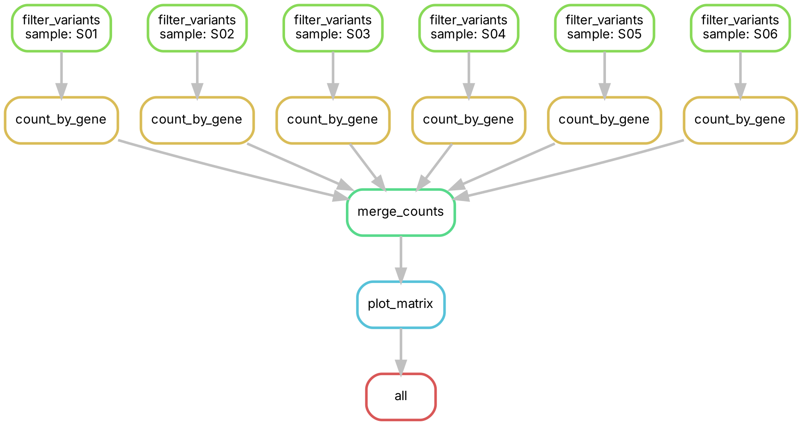
The DAG: built from your inputs and outputs
Each box is a job. Arrows mean “needs”.
Six lanes with nothing between them run in parallel, for free.
Notes:
Script: Directed, acyclic. You never draw this. Six filter jobs can run at once.

Slide 12
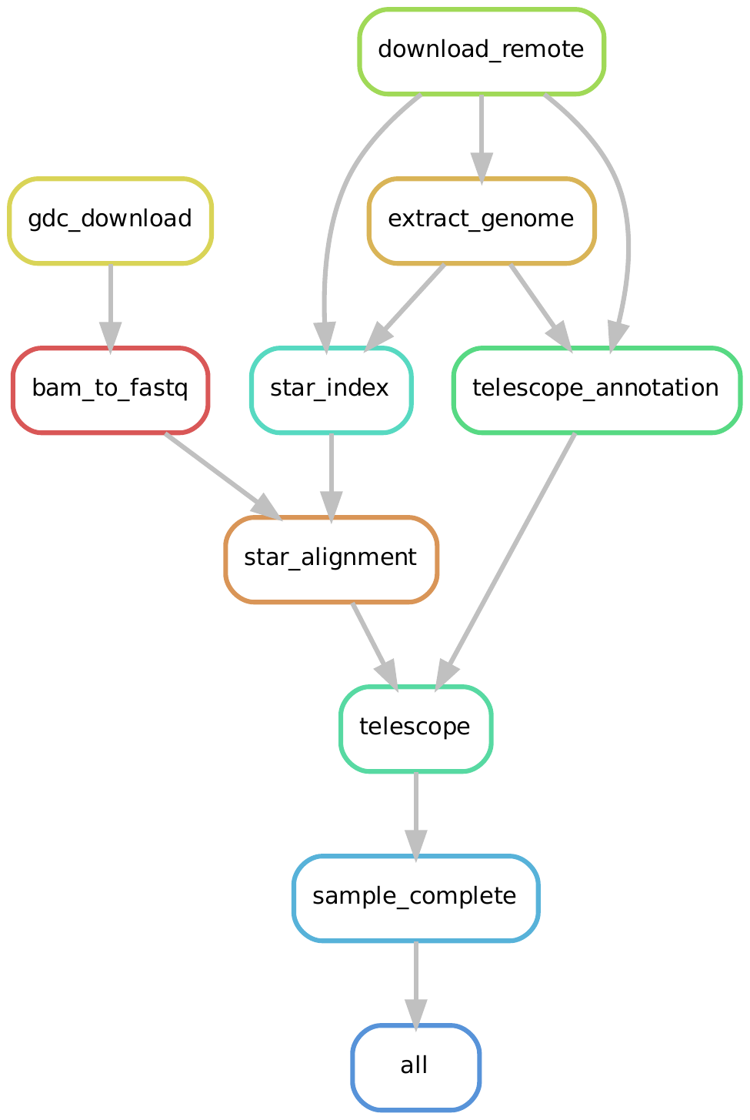
The same idea, at scale
A real pipeline: 9 rules + all
Locus-specific HERV expression in lymphoma: GDC download, BAM to FASTQ, STAR alignment, Telescope.
Each box is a rule, not a job. Same ingredients as our demo: wildcards, expand, rule all.
Singh et al. (2025) iScience 28(6):112541
Notes:
Script: Real pipeline from Singh et al. 2025 iScience: 50 DLBCL samples through GDC download, BAM to FASTQ, STAR, Telescope. 9 rules + all. Each box is a rule, not a job.

Slide 13
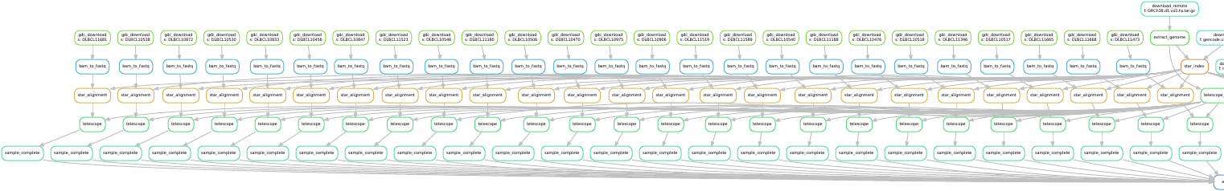
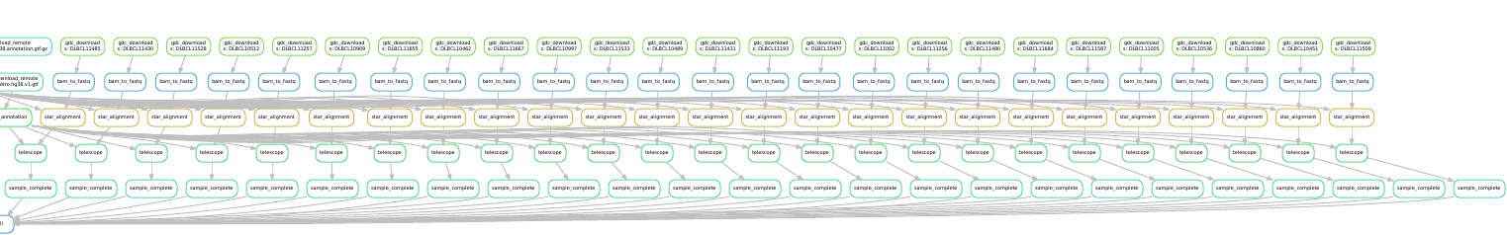
One pipeline, about 257 jobs
50 samples × 5 steps + shared reference jobs. You write 9 rules.
One graph, cut in two to fit the slide.
Notes:
Script: 50 samples x 5 steps = 250 per-sample jobs, plus 7 shared reference jobs (by my count from the PDF). You wrote 9 rules. One graph, cut in two to fit.

Slide 14
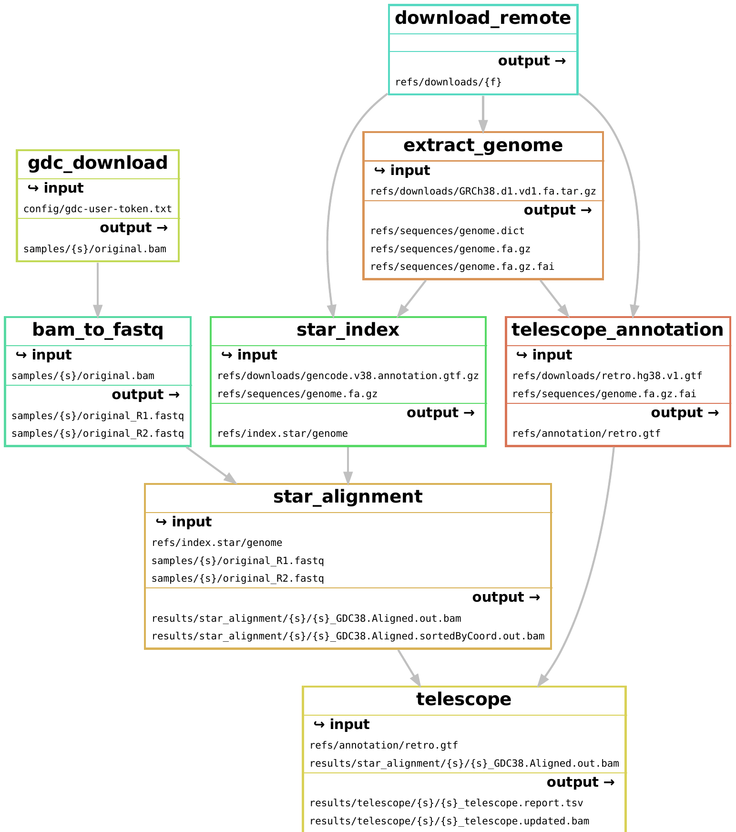
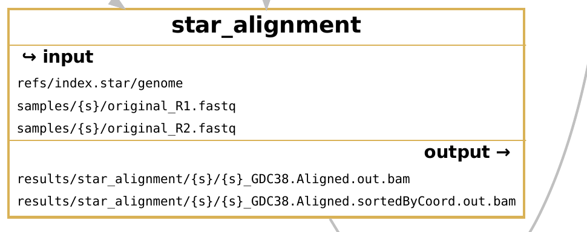
The filegraph: files in and out
Zoom: star_alignment
Each box lists the files it needs and the files it makes. {s} is the sample wildcard.
Notes:
Script: Filegraph shows each rule box with its input and output files. Zoom: star_alignment. Wildcard {s} is the sample.

Slide 15
Live demo
In the terminal. Predict each job count before the dry run.
1
2
3
4
5
Dry run first
Rerun only what changed
Parameters are remembered
Read an error
Survive a failure

Slide 16
What reruns, and why
0
5
15
0
jobs
jobs
jobs
jobs
Nothing changed
Edit one input (S03)
min_vaf 0.10 → 0.30
touch, same content
Nothing to be done
Only that sample's chain
Params changed: everything
A timestamp alone isn't enough
Every rerun comes with a reason: read the reason: lines.
Notes:
Recap after the demo. Measured on Snakemake 9.27.1.

Slide 17
Reading an error
MissingInputException in rule filter_variants
Missing input files for rule filter_variants:
output: results/filtered/S01.tsv
wildcards: sample=S01
affected files:
data/raw/S01.tsvv
1
Which rule
filter_variants
2
Which wildcard value
sample=S01
3
Which file is missing
two v's: a typo
Read the last lines first. Then ask an AI what they mean, before asking how to fix it.
Notes:
Recap of the typo demo. Read the last lines first, then ask what they mean.

Slide 18
Failure and resume
13
1
2
jobs finished and kept
failed: partial output removed
jobs to resume: plot, all
Nothing upstream reruns.
Flaky node? snakemake --retries 2 reruns a failed job before giving up.
Notes:
Script: Demo D6. The plot step fails; Snakemake keeps the 13 good jobs, removes the half-written file, and the rerun only does plot + all (2 jobs).

Slide 19
Three engines, three ecosystems
Snakemake
Nextflow
Cromwell / WDL
Pros
Pros
Pros
Full Python in rules
Make-style file rules
Plugins: Slurm, K8s, cloud
nf-core pipelines
Cloud executors built in
Wide container support
WARP: Broad pipelines
Terra + AnVIL (NHGRI)
Dockstore sharing
Cons
Cons
Cons
Fewer curated pipelines
Groovy on Java 17+
Steeper learning curve
Hard to self-host
Backends: AWS, GCP Batch
Mostly ecosystem and preference. Snakemake: you write your own analysis. Nextflow and Cromwell: ready-made production pipelines.
Notes:
Script: Mostly ecosystem and preference. Nextflow: Apache 2.0, developed by Seqera (company). Cromwell: at the Broad, use Cromwell; hard to self-host outside Terra. Snakemake: you write your own analysis in Python.

Slide 20
Same workflow, different places
One Snakefile
Your laptop
A cluster
The cloud
this course
Snakemake submits the jobs: no sbatch
Kubernetes, AWS, Google, Azure Batch via plugins
You change how jobs are launched, not the pipeline.
Notes:
Script: We are not using a cluster in this course.

Slide 21
Software per step: the Week 2 payoff
rule plot_matrix:
input:
"results/matrix.tsv",
output:
"results/matrix.png",
conda:
"envs/plot.yaml"
shell:
"python scripts/plot_matrix.py ..."
The workflow records the order of steps and the exact software for each one.
“Works on my machine”: hand someone the Snakefile, the environment files and the config.
Sketch only: not run in class.
Notes:
Script: Slide only, not run in class. Sketch of the conda: directive.

Slide 22
How to choose
1
2
3
A validated pipeline exists
You're writing your own
Where you work
Use it (nf-core, WARP). Don't rewrite it.
Snakemake: full Python, quick to iterate.
Use what your lab and collaborators use. At the Broad: Cromwell.
Lab 5: Snakemake or Nextflow, your choice. A Snakefile is documentation.
Notes:
Script: If a validated pipeline exists, use it. If you're writing your own, Snakemake. Otherwise use what your lab uses. Lab 5: Snakemake or Nextflow, your choice.

Slide 23
Three takeaways
Declare dependencies, not steps
1
Inputs, outputs, a command. The engine handles order, parallelism and what's up to date.
A rerun does only what changed, and says why
2
Dry-run first, always. Read the reason: lines.
The manager handles failure, so you don't babysit
3
It detects failed jobs, cleans up partial files, and resumes from the failure.
Notes:
Script: Wrap-up.

Slide 24
This week
Wed Oct 28
Practical, in pairs: loose scripts to Snakefile, plus checking an AI-drafted Snakefile. Bring the week10 environment.
Wed Oct 28, 11:59pm
Lab 4 due
Wed Nov 4
Lab 5 due: Snakemake or Nextflow, your choice
Wed Nov 11
Informal final-project check-in
Next week: prompt engineering and generative AI.
Notes:
Script: Wrap-up. The AI-drafted Snakefile check moves to Wednesday's practical.

