Slide 1
PUBH 6854 / PUBH 4201
Applied Computing in Health Data Science
Week 2 — Reproducible Research Fundamentals
Matthew Bendall, PhD · Monday, August 31, 2026 · SPH 300

Slide 2
PICKING UP FROM LAST WEEK
You've inherited a folder with no README
Today we start answering what you'd want to know first.
10 min
Why reproducibility fails in practice
10 min
Dependency management, concepts
30 min
Virtual environments — live demo
20 min
Containers — concept + live demo
3 min
Containers in the cloud & on HPC
10 min
Using generative AI to troubleshoot
3 min
Discussion
Highlighted block gets the most time today — it's this class's lowest-confidence topic.
2

Slide 3
WHY REPRODUCIBILITY FAILS IN PRACTICE
"Works on my machine"
A familiar sentence. An expensive problem.
1
2
3
Day 1
Month 6
The result
You run the analysis. It works. You submit the paper.
A reviewer — or you, on a new laptop — tries to rerun it.
A different answer, a crash, or nothing at all.
3
Notes:
has this happened to anyone here already, even on a class assignment?

Slide 4
WHY REPRODUCIBILITY FAILS IN PRACTICE
What actually goes wrong
1
Dependency drift
A package you relied on quietly updated — and changed behavior — since you last ran this.
2
Undocumented manual steps
"Oh, you also need to..." — the setup step that only lives in someone's memory.
3
Missing random seeds
Stochastic methods (train/test splits, bootstraps, MCMC) give a different answer every run unless you fix the seed.
4
A different machine entirely
OS, hardware, and pre-installed system libraries you never thought to write down.
4

Slide 5
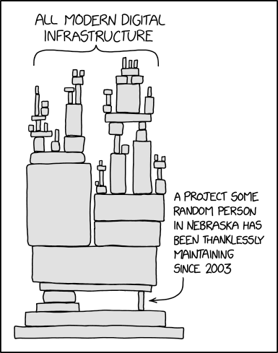
WHY REPRODUCIBILITY FAILS IN PRACTICE
This isn't a new problem
Randall Munroe, "Dependency," xkcd #2347
Every layer we've talked about today — OS, packages, versions — is really a chain of dependencies, and that chain doesn't stop at your laptop. It runs through packages maintained by volunteers, on their own time, often unpaid.
That's not a reason to panic — it's a reason to pin versions, document your environment, and test that your setup actually rebuilds from scratch, instead of assuming the ground underneath it holds still.
Comic: © Randall Munroe, xkcd.com/2347 — licensed CC BY-NC 2.5. Used here for non-commercial classroom teaching.
5

Slide 6
DEPENDENCY MANAGEMENT CONCEPTS
A “dependency” has three layers
Most reproducibility problems live in one you weren't tracking.
Operating system
Ubuntu vs. macOS vs. Windows; system libraries like libssl or glibc.
Language packages
pandas, dplyr, biopython — installed via pip, conda, or CRAN.
Package versions
pandas 1.5 vs. 2.2 behave differently. The version is the dependency.
6

Slide 7
“A scientific result should be re-derivable years later — not just re-runnable today.”
Version pinning is a contract with your future self and with every collaborator who opens this project after you.
7

Slide 8
VIRTUAL ENVIRONMENTS — LIVE DEMO
Your toolbox, by language
conda / mamba
uv
renv
Python (+ non-Python deps)
Python (pure)
R
Handles compilers and system libraries too, not just Python packages. This course's primary Python tool.
Much faster; newer standard. Doesn't manage non-Python dependencies the way conda does.
Snapshots exact package versions per-project. The R-side equivalent of everything else on this slide.
pixi
Python (+ non-Python deps)
A Rust-based tool that sits on top of the conda-forge/bioconda ecosystem, but resolves conda and PyPI packages into one project-local lockfile.
8
Notes:
Today's lowest-confidence topic in the class survey — we go slower here on purpose.

Slide 9
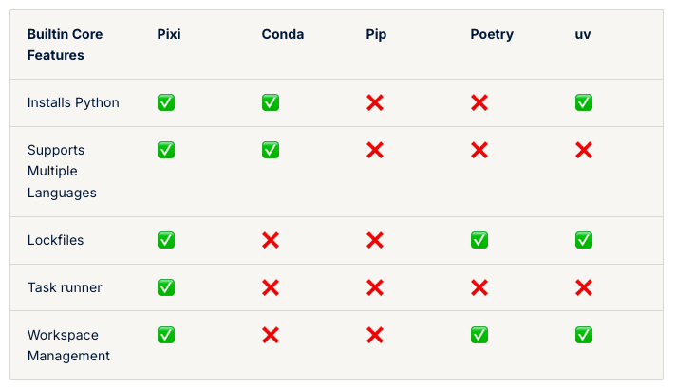
VIRTUAL ENVIRONMENTS — LIVE DEMO
A fast, modern , and reproducible package management tool
We won’t cover this for this semester, but good to know
pixi
Python (+ non-Python deps)
A Rust-based tool that sits on top of the conda-forge/bioconda ecosystem, but resolves conda and PyPI packages into one project-local lockfile.
8
Notes:
Today's lowest-confidence topic in the class survey — we go slower here on purpose.

Slide 10
VIRTUAL ENVIRONMENTS — LIVE DEMO
Live demo: build it, then export it
$ mamba create -n week2-demo-1 python=3.13 pandas=2.2.3 bioconda::samtools
$ conda activate week2-demo-1
$ python lectures/week02-reproducible-research-fundamentals/analyze.py
$ conda env export --from-history > environment.yml
--from-history exports only what you explicitly asked for — not every transitive dependency with an exact build string, which is what usually breaks on someone else's machine.
9

Slide 11
VIRTUAL ENVIRONMENTS — LIVE DEMO
The actual test: recreate from nothing but the file
Your laptop
environment.yml
A “fresh” machine
environment.yml exported
the only thing that travels
mamba env create -f environment.yml
If the output matches — patients.describe() gives the same numbers — your environment file works. This is exactly what a Lab 1 grader will do to your submission.
10

Slide 12
VIRTUAL ENVIRONMENTS — LIVE DEMO
Same idea, three vocabularies
What you want to do
conda / mamba
uv
renv
Start a project
mamba create -n env
uv init
renv::init()
Add a package
mamba install pkg
uv add pkg
install.packages()
Save the lockfile
conda env export
( uv.lock is automatic )
renv::snapshot()
Rebuild elsewhere
mamba env create -f
uv sync
renv::restore()
11

Slide 13
VIRTUAL ENVIRONMENTS — LIVE DEMO
When it breaks: a dependency conflict
This is the resolver doing its job — not a broken tool.
Encountered problems while solving: - package pandas-2.2.x requires numpy>=1.23, but none of the providers can be installed
Two packages you asked for don't fit together — better to hear it now than to have your analysis silently break later. In the practical, you'll cause this error on purpose, then fix it.
12

Slide 14
CONTAINERS
A virtual environment isn't the whole picture
It pins your language packages. It doesn't pin the OS underneath them.
Virtual environment
Container (Docker)
• Python / R packages
Everything a venv pins, plus:
• Package versions
• The operating system
• Nothing about the OS
• System libraries
• Nothing about system libraries
• “Which Python even”
13

Slide 15
CONTAINERS
Anatomy of a Dockerfile
A recipe for building the same machine, every time.
FROM condaforge/miniforge3
start from a known base image
WORKDIR /workspace
set the working directory
COPY live-demo1.yml environment.yml
bring in your environment file
COPY analyze.py .
copy the analysis script
RUN mamba env create -f environment.yml
build the environment, inside the image
14

Slide 16
CONTAINERS
Live demo: same result, two machines
$ docker build -t live-demo1 . $ docker run –rm -it live-demo1 /bin/bash
Gives you a shell into an isolated Linux environment, within your laptop. Run it on two different laptops in the room: same output.
Discussion: what's one thing that could still differ between two people's laptops, even with the same image?
15
Notes:
Discussion: what's one thing that could still differ between two people's laptops, even with the same image? (hardware/CPU architecture, GPU availability — keep this in your pocket for the wrap-up prompt.)

Slide 17
CONTAINERS
Do you need a container, or is a lockfile enough?
An environment file is enough
Reach for a container
• Your teammates use the same OS
• You're deploying to a shared cluster or the cloud
• No system-level (non-language) dependencies
• System libraries or exact OS behavior matter
• “Install and run” is genuinely simple
• You want a stranger to run it with zero setup steps
16

Slide 18
A BRIEF ASIDE
Containers in the cloud & on HPC
Shared clusters don't run Docker directly
Most HPC/shared-cluster systems use Singularity/Apptainer instead — same idea, different tool, for shared multi-user security reasons. This course doesn't use an HPC cluster, but you'll likely run into this if you ever work on one.
Container registries
Docker Hub and similar registries let you publish an image once and pull it anywhere — including onto a shared cluster.
Conceptual only, for your general knowledge. Week 10 (Workflow Management & Remote Computing) has hands-on remote/SSH practice via pwn.college for anyone who wants that experience — it's not a continuation of containers specifically, just useful vocabulary for when you meet Singularity or a registry in the wild.
17

Slide 19
GENERATIVE AI FOR TROUBLESHOOTING
Your strongest skill, meets your weakest topic
The class rates GenAI use 3.52/5 confidence — and environments 1.57/5. Let's put them together.
1
2
3
Paste the exact error
Ask what it means first
Sanity-check the fix
Not a paraphrase — the model needs the real text, including version numbers.
Before asking for a fix. Understanding the error is worth more than a copy-paste answer.
Before you run it. The next slide shows why.
18

Slide 20
GENERATIVE AI FOR TROUBLESHOOTING
Same error, two AI answers
✓
This one helped
✗
This one was confidently wrong
Correctly explained the numpy/pandas version conflict and suggested loosening the pin — verified by rerunning the resolver.
Suggested a completely unrelated fix (reinstalling Python itself) that would not have solved the actual conflict — stated with total confidence.
This is the whole point: verify, don't trust. Document both the prompt and what you kept vs. changed — that's your AI_USAGE.md for Lab 1.
19

Slide 21
DISCUSSION
Your renv.lock (or environment.yml) is committed — but the analysis still doesn't reproduce on a colleague's machine.
What are 3 things that could still be different?
Hold that thought — you'll cause and diagnose exactly this kind of gap yourself in this afternoon's practical.
20

Slide 22
LOOKING AHEAD
Wednesday, Sep 2 — Practical
A guided, live-along setup session
Before Wednesday
• Not an independent lab start — we build it together, step by step
Install conda/mamba (Miniforge), uv, and Docker Desktop
• conda/mamba, uv, renv, and a Dockerfile, in one session
Install the renv R package
• Directly scaffolds Lab 1 (due this week)
Do the required readings (Carpentries × 2, Turing Way, renv intro)
• More instructor/TA circulation than usual — ask early and often
Written step-by-step install guide: README.md in this week's folder
21
Notes:
README.md quickstart posted before today's lecture per the Aug 28 survey analysis. Confirm Lab 1 submission mechanism before students ask.

