Slide 1
Learning with Online Constraints:
Shifting Concepts and Active Learning
Claire Monteleoni
MIT CSAIL
PhD Thesis Defense
August 11th, 2006
Supervisor: Tommi Jaakkola, MIT CSAIL
Committee: Piotr Indyk, MIT CSAIL
Sanjoy Dasgupta, UC San Diego

Slide 2


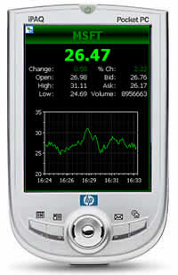

Online learning, sequential prediction
Forecasting, real-time decision making, streaming applications,
online classification,
resource-constrained learning.
Notes:
-Suppose you want to get rich: Suppose you receive a stream of real-time stock-market data, and you want to predict changes in stock behavior in order to manage your portfolio.
-But that example might not motivate people in this room as much as: Supposed you don’t want to get spam: Suppose you just want to train your spam filters to evolve over time, by labeling new messages as “junk” or “not junk.”
-Or suppose you want to do these, or other tasks, on a handheld device.
These are problems of: Forecasting, real-time decision making, streaming applications, online classification,
resource-constrained learning.

Slide 3
Learning with Online Constraints
We study learning under these online constraints:
1. Access to the data observations is one-at-a-time only.
  Once a data point has been observed, it might never be seen again.
  Learner makes a prediction on each observation.
! Models forecasting, temporal prediction problems (internet, stock market, the weather), and high-dimensional streaming
data applications
2. Time and memory usage must not scale with data.
  Algorithms may not store previously seen data and perform batch learning.
! Models resource-constrained learning, e.g. on small devices
Notes:
-This thesis is concerned with meeting both constraints simultaneously.
-Forecasting is a case where you need to predict online, at the time the next prediction is needed. And sometimes the distribution of observations changes with time.
-Streaming problems have so much data that you can only look at some of it, based on what you can hold in memory, so you need to predict online.
-Second constraint also applies to fact that any comp. learner is resource constrained.
-It also applies to time-varying prob: you don’t WANT to store memory of distant past.

Slide 4
Outline of Contributions
 | iid assumption, Supervised | iid assumption, Active | No assumptions, Supervised
Analysis techniques | Mistake-complexity | Label-complexity | Regret
Algorithms | Modified Perceptron update | DKM online active learning algorithm | Optimal discretization for Learn-α algorithm
Theory | Lower bound for Perceptron: Ω(1/ε²) Upper bound for modified update: Õ(d log 1/ε) | Lower bound for Perceptron: Ω(1/ε²) Upper bounds for DKM algorithm: Õ(d log 1/ε), and further analysis. | Lower bound for shifting algorithms: can be Ω(T) depending on sequence.
Applications | Optical character recognition | Optical character recognition | Energy management in wireless networks
Notes:
-Thesis covers active and supervised, negative res. (LBs) and positive (Ubs), algs and theory, and 2 apps.

Slide 5
Outline of Contributions
 | iid assumption, Supervised | iid assumption, Active | No assumptions, Supervised
Analysis techniques | Mistake-complexity | Label-complexity | Regret
Algorithms | Modified Perceptron update | DKM online active learning algorithm | Optimal discretization for Learn-α algorithm
Theory | Lower bound for Perceptron: Ω(1/ε²) Upper bound for modified update: Õ(d log 1/ε) | Lower bound for Perceptron: Ω(1/ε²) Upper bounds for DKM algorithm: Õ(d log 1/ε), and further analysis. | Lower bound for shifting algorithms: can be Ω(T) depending on sequence.
Applications | Optical character recognition | Optical character recognition | Energy management in wireless networks

Slide 6
Outline of Contributions
 | iid assumption, Supervised | iid assumption, Active | No assumptions, Supervised
Analysis techniques | Mistake-complexity | Label-complexity | Regret
Algorithms | Modified Perceptron update | DKM online active learning algorithm | Optimal discretization for Learn-α algorithm
Theory | Lower bound for Perceptron: Ω(1/ε²) Upper bound for modified update: Õ(d log 1/ε) | Lower bound for Perceptron: Ω(1/ε²) Upper bounds for DKM algorithm: Õ(d log 1/ε), and further analysis. | Lower bound for shifting algorithms: can be Ω(T) depending on sequence.
Applications | Optical character recognition | Optical character recognition | Energy management in wireless networks
Notes:
-We’ll start with a very simple setting, just to warm up and build intuition.

Slide 7
Supervised, iid setting
Supervised online classification:
Labeled examples (x,y) received one at a time.
Learner predicts at each time step t: v_{t}(x_{t}).
Independently, identically distributed (iid) framework:
Assume observations x2X are drawn independently from a fixed probability distribution, D.
No prior over concept class H assumed (non-Bayesian setting).
The error rate of a classifier v is measured on distribution D: err(h) = P_{x~D}[v(x) ≠ y]
Goal: minimize number of mistakes to learn the concept (whp) to a fixed final error rate, ε, on input distribution.
Notes:
-To warm up, and build intuition, let’s first just start with a v. simple analysis framework for online algorithms.
-Predict w/o looking at the label. (can use prediction mistakes to update hypoth).
-Error rate is wrt the FULL input distribution.
-State we want to meet Goal only WHP!

Slide 8


Problem framework
Target:
Current hypothesis:
Error region:
Assumptions:
u is through origin
Separability (realizable case)
D=U, i.e. x~Uniform on S
error rate:
u
v_{t}
θ_{t}
ξ_{t}
Notes:
This will also be framework for most of the results presented in active iid case.
State what is meant by realizable.
Picture is proj onto u-v_t plane.
Because the instance is separable, I.e. u has no error, the generalization error is exactly the error in approximating u, I.e. \epsilon.

Slide 9
Related work: Perceptron
Perceptron: a simple online algorithm:
If y_{t} ≠ SIGN(v_{t} ¢ x_{t}), then: Filtering rule
v_{t+1} = v_{t} + y_{t} x_{t} Update step
Distribution-free mistake bound O(1/γ²), if exists margin γ.
Theorem [Baum‘89]: Perceptron, given sequential labeled examples from the uniform distribution, can converge to generalization error ε after Õ(d/ε²) mistakes.
Notes:
- State that in the sup. and active iid settings, UPPER bounds just hold WHP.
- tilde suppresses the high prob param and terms log d, log log 1/e

Slide 10
Contributions in supervised, iid case
[Dasgupta, Kalai & M, COLT 2005]
A lower bound on mistakes for Perceptron of Ω(1/ε²).
A modified Perceptron update with a Õ(d log 1/ε) mistake bound.

Slide 11
Perceptron
Perceptron update: v_{t+1} = v_{t} + y_{t} x_{t}
→ error does not decrease monotonically.
v_{t+1}
v_{t}
u
x_{t}

Slide 12
Mistake lower bound for Perceptron
Theorem 1: The Perceptron algorithm requires Ω(1/ε²) mistakes to reach generalization error ε w.r.t. the uniform distribution.
Proof idea: Lemma: For θ_{t} < c, the Perceptron update will increase θ_{t} unless kv_{t}k
is large: Ω(1/sin θ_{t}). But, kv_{t}k growth rate:
So to decrease θ_{t}
need t ¸ 1/sin²θ_{t}.
Under uniform,
ε_{t} / θ_{t} ¸ sin θ_{t}.
v_{t+1}
v_{t}
u
x_{t}
Notes:
- State: so we actually get a LB on updates, regardless of the sequence, and updates are only made on mistakes.
- c is around 1/3, for \eta = 1.
- note: UB on norm of v from standard perc mistake bound.
-This can motivate our algorithm, because small theta_t means the only errors are on x’s you’re unsure of, so you’d want to be making smaller updates here.

Slide 13
A modified Perceptron update
Standard Perceptron update:
v_{t+1} = v_{t} + y_{t} x_{t}
Instead, weight the update by “confidence” w.r.t. current hypothesis v_{t}:
v_{t+1} = v_{t} + 2 y_{t} |v_{t} ¢ x_{t}| x_{t} (v₁ = y₀x₀)
(similar to update in [Blum,Frieze,Kannan&Vempala‘96], [Hampson&Kibler‘99])
Unlike Perceptron:
  Error decreases monotonically:
  cos(θ_{t+1}) = u ¢ v_{t+1} = u ¢ v_{t} + 2 |v_{t} ¢ x_{t}||u ¢ x_{t}|
  ¸ u ¢ v_{t} = cos(θ_{t})
  kv_{t}k =1 (due to factor of 2)

Slide 14
A modified Perceptron update
Perceptron update: v_{t+1} = v_{t} + y_{t} x_{t}
Modified Perceptron update: v_{t+1} = v_{t} + 2 y_{t} |v_{t} ¢ x_{t}| x_{t}
v_{t+1}
v_{t+1}
v_{t}
u
v_{t+1}
v_{t}
x_{t}

Slide 15


Mistake bound
Theorem 2: In the supervised setting, the modified Perceptron converges to generalization error ε after Õ(d log 1/ε) mistakes.
Proof idea: The exponential convergence follows from a multiplicative decrease in θ_{t}:
On an update,
! We lower bound 2|v_{t} ¢ x_{t}||u ¢ x_{t}|, with high probability, using our distributional assumption.

Slide 16

Mistake bound
Theorem 2: In the supervised setting, the modified Perceptron converges to generalization error ε after Õ(d log 1/ε) mistakes.
Lemma (band): For any fixed a: kak=1, γ · 1 and for x~U on S:
Apply to |v_{t} ¢ x| and |u ¢ x| ) 2|v_{t} ¢ x_{t}||u ¢ x_{t}| is
large enough in expectation (using size of ξ_{t}).
a
k
{
{x : |a ¢ x| · k} =
Notes:
Use RHS of band lemma.

Slide 17
Outline of Contributions
 | iid assumption, Supervised | iid assumption, Active | No assumptions, Supervised
Analysis techniques | Mistake-complexity | Label-complexity | Regret
Algorithms | Modified Perceptron update | DKM online active learning algorithm | Optimal discretization for Learn-α algorithm
Theory | Lower bound for Perceptron: Ω(1/ε²) Upper bound for modified update: Õ(d log 1/ε) | Lower bound for Perceptron: Ω(1/ε²) Upper bounds for DKM algorithm: Õ(d log 1/ε), and further analysis. | Lower bound for shifting algorithms: can be Ω(T) depending on sequence.
Applications | Optical character recognition | Optical character recognition | Energy management in wireless networks
Notes:
-To segue: but really we were interested in this iid setting, because of its use in modeling Active Learning.

Slide 18
Active learning
Machine learning applications, e.g.
Medical diagnosis
Document/webpage classification
Speech recognition
Unlabeled data is abundant, but labels are expensive.
Active learning is a useful model here.
Allows for intelligent choices of which examples to label.
Label-complexity: the number of labeled examples required to learn via active learning.
! can be much lower than the PAC sample complexity!
Notes:
-To segue: but really we were interested in this iid setting, because of its use in modeling Active Learning.
-In act. Learning, smart choice of which examples to label can yield label bounds that are lower than sample complexity!

Slide 19

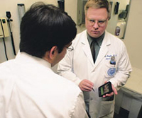

Online active learning: motivations
Online active learning can be useful, e.g. for active learning on small devices, handhelds.
Applications such as human-interactive training of
Optical character recognition (OCR)
On the job uses by doctors, etc.
Email/spam filtering
Notes:
Scenario: user writes characters. Device occasionally queries a label (user must type into keypad). Of course label-minimization preferred by users.

Slide 20
PAC-like selective sampling framework
Online active learning framework
Selective sampling [Cohn,Atlas&Ladner92]:
Given: stream (or pool) of unlabeled examples, x2X, drawn i.i.d. from input distribution, D over X.
Learner may request labels on examples in the stream/pool.
(Noiseless) o_x0013_racle access to correct labels, y2Y.
Constant cost per label
The error rate of any classifier v is measured on distribution D:
err(h) = P_{x~D}[v(x) ≠ y]
PAC-like case: no prior on hypotheses assumed (non-Bayesian).
Goal: minimize number of labels to learn the concept (whp) to a fixed final error rate, ε, on input distribution.
We impose online constraints on time and memory.
Notes:
-Well studied query learning model unrealistic in practice: querying any part of the input space. These queries are hard for even a human to label!
-Though we don’t rule it out by the problem constraints, due to the iid assump we also bound the total unlabeled samples.
-Online constraints:
Space: Learner cannot store all previously seen examples (and then perform batch learning).
Time: Running time of learner’s belief update step should not scale with number of seen examples/mistakes.

Slide 21
Measures of complexity
PAC sample complexity:
Supervised setting: number of (labeled) examples, sampled iid from D, to reach error rate ε.
Mistake-complexity:
Supervised setting: number of mistakes to reach error rate ε.
Label-complexity:
Active setting: number of label queries to reach error rate ε.
Error complexity:
Total prediction errors made on (labeled and/or unlabeled) examples, before reaching error rate ε.
Supervised setting: equal to mistake-complexity.
Active setting: mistakes are a subset of total errors on which learner queries a label.
Notes:
-Though some of these have already been introduced, we now have enough measures of compl that its worth mapping them out just to keep them straight.
- all of these measures are computed WHP.
-These error rates are wrt to D.

Slide 22
Related work: Query by Committee
Analysis under selective sampling model, of Query By Committee algorithm [Seung,Opper&Sompolinsky‘92] :
Theorem [Freund,Seung,Shamir&Tishby ‘97]: Under Bayesian assumptions, when selective sampling from the uniform, QBC can learn a half-space through the origin to generalization error ε, using Õ(d log 1/ε) labels.
! But not online: space required, and time complexity of the update both scale with number of seen mistakes!
Notes:
-BUT ALSO BAYESIAN: these probabilistic guarantees are also with respect to a distribution over targets. Our guarantees are with respect to any fixed target and do not need this assumption.
{-Can explain it if time. Complexity is due to maintaining exact v. space. Idea is sample 2x and see if they agree.}

Slide 23
OPT
Fact: Under this framework, any algorithm requires
Ω(d log 1/ε) labels to output a hypothesis within generalization error at most ε.
Proof idea: Can pack (1/ε)^{d} spherical
caps of radius ε on surface of unit
ball in R^{d}. The bound is just the
number of bits to write the answer.
{cf. 20 Questions: each label query
can at best halve the remaining options.}
ε
Notes:
-So any procedure to give an h within eps of u would need to differentiate between this many regions -- would take d log 1/e bits to write down the answer.
[E.g. 20 questions -- each label query AT BEST halves the set of remaining choices. -- since you don’t know where the target is. I.e. if you cut by more than half, target could be on the LARGER side.]
.

Slide 24
Contributions for online active learning
[Dasgupta, Kalai & M, COLT 2005]
A lower bound for Perceptron in active learning context, paired with any active learning rule, of Ω(1/ε²) labels.
An online active learning algorithm and a label bound of
Õ(d log 1/ε).
A bound of Õ(d log 1/ε) on total errors (labeled or unlabeled).
[M, 2006]
Further analyses, including a label bound for DKM of
Õ(poly(1/λ) d log 1/ε) under λ-similar to uniform distributions.

Slide 25
Lower bound on labels for Perceptron
Corollary 1: The Perceptron algorithm, using any active learning rule, requires Ω(1/ε²) labels to reach generalization error ε w.r.t. the uniform distribution.
Proof: Theorem 1 provides a Ω(1/ε²) lower bound on updates. A label is required to identify each mistake, and updates are only performed on mistakes.
Notes:
And we only make updates on mistakes.

Slide 26

Active learning rule
Goal: Filter to label just those points in the error region.
! but θ_{t}, and thus ξ_{t} unknown!
Define labeling region:
Tradeoff in choosing threshold s_{t}:
If too high, may wait too long for an error.
If too low, resulting update is too small.
Choose threshold s_{t} adaptively:
Start high.
Halve, if no error in R consecutive labels
v_{t}
u
s_{t}
{
L
Notes:
- Our OLAL alg is our modified Perc with an AL rule.
- Filter to choose what to label, and still filter labeled examples to only update on mistakes.

Slide 27
Label bound
Theorem 3: In the active learning setting, the modified Perceptron, using the adaptive filtering rule, will converge to generalization error ε after Õ(d log 1/ε) labels.
Corollary: The total errors (labeled and unlabeled) will be Õ(d log 1/ε).

Slide 28

Proof technique
Proof outline: We show the following lemmas hold with sufficient probability:
Lemma 1. s_{t} does not decrease too quickly:
Lemma 2. We query labels on a constant fraction of ξ_{t}.
Lemma 3. With constant probability the update is good.
By algorithm, ~1/R labels are updates. 9 R = Õ(1).
) Can thus bound labels and total errors by mistakes.
Notes:
We need lemma 1 for 2 and 3 to hold.
L1 this LB is shown by showing that when x has a very small margin with v it is likely to be an error, so then s_t won’t get halved because you hit an error.
L2 We query for labels on a const frac of errors
L3 Of the errors we hit, a const frac are good (mult decrease of error) -- yields same form of bound as sup.
By alg, Labels are only about R times more than updates
By L2, errors are only a const times more than updates
The update bound -- turns out to be same as mistake bound, so final implication (high level idea -- oversimplifying.)

Slide 29
Related work
Negative results:
Homogenous linear separators under arbitrary distributions and
non-homogeneous under uniform: Ω(1/ε) [Dasgupta‘04].
Arbitrary (concept, distribution)-pairs that are “ρ-splittable”:
Ω(1/ρ) [Dasgupta‘05].
Agnostic setting where best in class has generalization error β: Ω(β²/ε²) [Kääriäinen‘06].
Upper bounds on label-complexity for intractable schemes:
General concepts and input distributions, realizable [D‘05].
Linear separators under uniform, an agnostic scenario:
Õ(d² log 1/ε) [Balcan,Beygelzimer&Langford‘06].
Algorithms analyzed in other frameworks:
Individual sequences: [Cesa-Bianchi,Gentile&Zaniboni‘04].
Bayesian assumption: linear separators under the uniform, realizable case, using QBC [SOS‘92], Õ(d log 1/ε) [FSST‘97].
Notes:
Define agnostic.
These are not under uniform though, which is why show the final Table.

Slide 30
[DKM05] in context
samples mistakes labels total errors online?
PAC
complexity
[Long‘03]
[Long‘95]
Perceptron
[Baum‘97]
CAL
[BBL‘06]
QBC
[FSST‘97]
[DKM‘05]
Õ(d/ε) Ω(d/ε)
Õ(d/ε³) Ω(1/ε²) | Õ(d/ε²) Ω(1/ε²) | Ω(1/ε²) |  | p
Õ((d²/ε) log 1/ε) | Õ(d² log 1/ε) | Õ(d² log 1/ε) |  | X
Õ(d/ε log 1/ε) | Õ(d log 1/ε) | Õ(d log 1/ε) |  | X
Õ(d/ε log 1/ε) | Õ(d log 1/ε) | Õ(d log 1/ε) | Õ(d log 1/ε) | p
Notes:
State that this is under Unif (even those PAC bnds).

Slide 31
Further analysis: version space
Version space V_{t} is set of hypotheses in concept class still consistent with all t labeled examples seen.
Theorem 4: There exists a linearly separable sequence Σ of t examples such that running DKM on Σ will yield a hypothesis v_{t} that misclassifies a data point x 2 Σ.
) DKM’s hypothesis need not be in version space.
This motivates target region approach:
Define pseudo-metric d(h,h’) = P_{x » D} [h(x) ≠ h’(x)]
Target region H* = B_{d}(u, ε) {Reached by DKM after Õ(d log 1/ε) labels}
V₁ = B_{d}(u, 0) µ H*, however:
Lemma(s): For any finite t, neither V_{t} µ H* nor H*µ V_{t} need hold.
Notes:
-version space has been mainly focused on in AL lit.
-optional say, this could be “fixed” with batch access.

Slide 32

Further analysis: relax distrib. for DKM
Relax distributional assumption.
Analysis under input distribution, D, λ-similar to uniform:

Theorem 5: When the input distribution is λ-similar to uniform, the DKM online active learning algorithm will converge to generalization error ε after Õ(poly(1/λ) d log 1/ε) labels and total errors (labeled or unlabeled).
Log(1/λ) dependence shown for intractable scheme [D05].
Linear dependence on 1/λ shown, under Bayesian assumption, for QBC (violates online constraints) [FSST97].
Notes:
-A is any measurable set, subset of X.
-So this is the first bound of this form we’re aware of for online alg, let alone one analyzed w/o Bayesian assumpt.

Slide 33
Outline of Contributions
 | iid assumption, Supervised | iid assumption, Active | No assumptions, Supervised
Analysis techniques | Mistake-complexity | Label-complexity | Regret
Algorithms | Modified Perceptron update | DKM online active learning algorithm | Optimal discretization for Learn-α algorithm
Theory | Lower bound for Perceptron: Ω(1/ε²) Upper bound for modified update: Õ(d log 1/ε) | Lower bound for Perceptron: Ω(1/ε²) Upper bounds for DKM algorithm: Õ(d log 1/ε), and further analysis. | Lower bound for shifting algorithms: can be Ω(T) depending on sequence.
Applications | Optical character recognition | Optical character recognition | Energy management in wireless networks

Slide 34
Non-stochastic setting
Remove all statistical assumptions.
No assumptions on observation sequence.
E.g., observations can even be generated online by an adaptive adversary.
Framework models supervised learning:
Regression, estimation or classification.
Many prediction loss functions:
- many concept classes
- problem need not be realizable
Analyze regret: difference in cumulative prediction loss from that of the optimal (in hind-sight) comparator algorithm for the particular sequence observed.
Notes:
I’m glossing over what the comparison class is here.

Slide 35
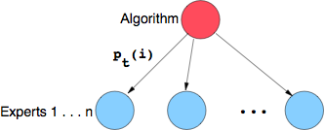
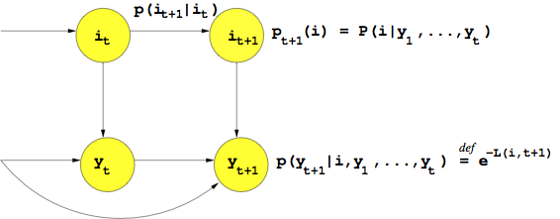

Related work: shifting algorithms
Learner maintains distribution
over n “experts.”
[Littlestone&Warmuth‘89]
Tracking best fixed expert:
P( i | j ) = δ(i,j)
[Herbster&Warmuth‘98]
Model shifting concepts via:
Notes:
-It does not matter how experts make predictions. There can be arbitrary dependence between experts or on time.
-Modular with respect to a large class of loss functions. Equate loss with -log prob of observation (example) given the hidden variable (best expert).

Slide 36
Contributions in non-stochastic case
[M & Jaakkola, NIPS 2003]
A lower bound on regret for shifting algorithms.
Value of bound is sequence dependent.
Can be Ω(T), depending on the sequence of length T.
[M, Balakrishnan, Feamster & Jaakkola, 2004]
Application of Algorithm Learn-α to energy-management in wireless networks, in network simulation.

Slide 37
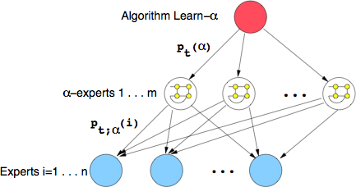
Review of our previous work
[M, 2003] [M & Jaakkola, NIPS 2003]
Upper bound on regret for Learn-α algorithm of O(log T).
Learn-α algorithm: Track best α−expert: shifting sub-algorithm
(each running with different α value).
Notes:
- LB on prev algs show that the UB on our alg from prev work is a real advance.
-We now describe the alg since we’re going to discuss an app.

Slide 38

Application of Learn-α to wireless
Energy/Latency tradeoff for 802.11 wireless nodes:
Awake state consumes too much energy.
Sleep state cannot receive packets.
IEEE 802.11 Power Saving Mode:
Base station buffers packets for sleeping node.
Node wakes at regular intervals (S = 100 ms) to process buffered packets, B. ! Latency introduced due to buffering.
Apply Learn-α to adapt sleep duration to shifting network activity.
Simultaneously learn rate of shifting online.
Experts: discretization of possible sleeping times, e.g. 100 ms.
Minimize loss function convex in energy, latency:
Notes:
-Good alg for mobile wireless nodes, since network activity varies across time and location. Can’t just learn alpha in batch first, for a specific location, cuz you may be plopped down somewhere else.
-When applying an experts alg in practice you can actually CHOOSE the experts
- we also used 1/S_t for the energy term.

Slide 39
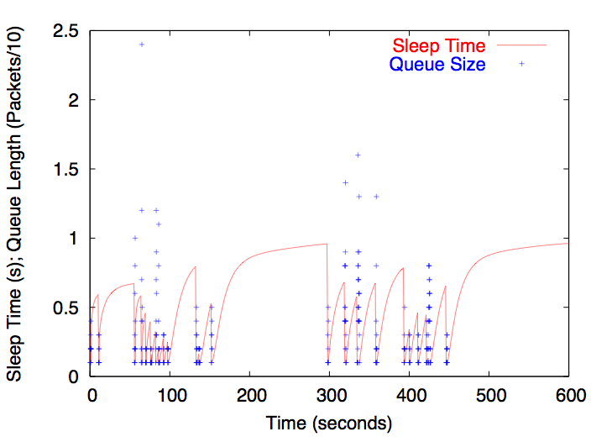
Application of Learn-α to wireless
Evolution of sleep times

Slide 40
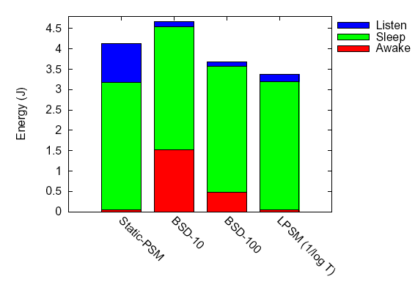
Application of Learn-α to wireless
Energy usage: reduced by 7-20% from 802.11 PSM
Average latency 1.02x that of 802.11 PSM
Notes:
And latency was not more than 1.2x that of 802.11 PSM

Slide 41
Outline of Contributions
 | iid assumption, Supervised | iid assumption, Active | No assumptions, Supervised
Analysis techniques | Mistake-complexity | Label-complexity | Regret
Algorithms | Modified Perceptron update | DKM online active learning algorithm | Optimal discretization for Learn-α algorithm
Theory | Lower bound for Perceptron: Ω(1/ε²) Upper bound for modified update: Õ(d log 1/ε) | Lower bound for Perceptron: Ω(1/ε²) Upper bounds for DKM algorithm: Õ(d log 1/ε), and further analysis. | Lower bound for shifting algorithms: can be Ω(T) depending on sequence.
Applications | Optical character recognition | Optical character recognition | Energy management in wireless networks

Slide 42
Future work and open problems
Online learning:
Does Perceptron lower bound hold for other variants?
E.g. adaptive learning rate, η = f(t).
Generalize regret lower bound to arbitrary first-order Markov transition dynamics (cf. upper bound).
Online active learning:
DKM extensions:
Margin version for exponential convergence, without d dependence.
Relax separability assumption:
Allow “margin” of tolerated error.
Fully agnostic case faces lower bound of [K‘06].
Further distributional relaxation?
This bound is not possible under arbitrary distributions [D‘04].
Adapt Learn-α, for active learning in non-stochastic setting?
Cost-sensitive labels.
Notes:
-Perc has learning rate eta: a const btw 0 and 1. If eta can adapt, need LB hold?
-And now I’m going to describe an OP in AL. (need not have Online soln).

Slide 43
Open problem: efficient, general AL
[M, COLT Open Problem 2006]
Efficient algorithms for active learning under general input distributions, D.
! Current label-complexity upper bounds for general distributions are based on intractable schemes!
Provide an algorithm such that w.h.p.:
After L label queries, algorithm's hypothesis v obeys:
    P_{x » D}[v(x) ≠ u(x)] < ε.
L is at most the PAC sample complexity, and for a general class of input distributions, L is significantly lower.
Running time is at most poly(d, 1/ε).
! Open even for half-spaces, realizable, batch case, D known!
Notes:
-v(x) denotes prediction. u is target or best in class.
-Defining suitably general class of input distributions is interesting. I.e. is the lambda-similar to uniform class general enough? If so, my result, if the lambda dep is considered tight enough.
On the other hand if it’s too general, e.g. in the case of half-spaces, under arb distrs get a 1/eps LB but UB is d/eps log 1/eps so not much room! Have to make input distribution not completely general then….
- Other open variants: D, is unknown to learner. Agnostic case, certain scenarios. Add the online constraint.
Same goal, other concept classes, or a general concept learner.

Slide 44

Thank you!
And many thanks to:
Advisor: Tommi Jaakkola
Committee: Sanjoy Dasgupta, Piotr Indyk
Coauthors: Hari Balakrishnan, Sanjoy Dasgupta,
Nick Feamster, Tommi Jaakkola, Adam Tauman Kalai, Matti Kääriäinen
Numerous colleagues and friends.
My family!

