Slide 1
A general agnostic active learning algorithm
Claire Monteleoni
UC San Diego
Joint work with Sanjoy Dasgupta and Daniel Hsu, UCSD.

Slide 2
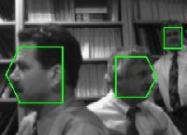

Active learning
Many machine learning applications, e.g.
Image classification, object recognition
Document/webpage classification
Speech recognition
Spam filtering
Unlabeled data is abundant, but labels are expensive.
Active learning is a useful model here.
Allows for intelligent choices of which examples to label.
Label complexity: the number of labeled examples required to learn via active learning.
! can be much lower than the sample complexity!

Slide 3
When is a label needed?
Is a label query needed?
  Linearly separable case:
  There may not be a perfect linear separator (agnostic case):
  Either case:
NO
YES
NO

Slide 4
Approach and contributions
Start with one of the earliest, and simplest active learning schemes: selective sampling.
Extend to the agnostic setting, and generalize, via reduction to supervised learning, making algorithm as efficient as the supervised version.
Provide fallback guarantee: label complexity bound no worse than sample complexity of the supervised problem.
Show significant reductions in label complexity (vs. sample complexity) for many families of hypothesis class.
Techniques also yield an interesting, non-intuitive result: bypass classic active learning sampling problem.

Slide 5
PAC-like selective sampling framework
PAC-like active learning model
Framework due to [Cohn, Atlas & Ladner ‘94]
Distribution D over X £ Y, X some input space, Y = {§1}.
PAC-like case: no prior on hypotheses assumed (non-Bayesian).
Given: stream (or pool) of unlabeled examples, x2X, drawn i.i.d. from marginal, D_{X} over X.
Learner may request labels on examples in the stream/pool.
Oracle access to labels y2{§1} from conditional at x, D_{Y | x} .
Constant cost per label.
The error rate of any classifier h is measured on distribution D:
err(h) = P_{(x, y)~D}[h(x) ≠ y]
Goal: minimize number of labels to learn the concept (whp) to a fixed final error rate, ε, on input distribution.

Slide 6
Selective sampling algorithm
Region of uncertainty [CAL ‘94]: subset of data space for which there exist hypotheses (in H) consistent with all previous data, that disagree.
Example: hypothesis class, H = {linear separators}. Separable assumption.
Algorithm: Selective sampling [Cohn, Atlas & Ladner ‘94] (orig. NIPS 1989):
For each point in the stream, if point falls in region of uncertainty, request label.
Easy to represent the region of uncertainty for certain, separable problems. BUT, in this work we address:
- What about agnostic case?
- General hypothesis classes?
! Reduction!

Slide 7
Agnostic active learning
What if problem is not realizable (separable by some h 2 H)?
! Agnostic case: goal is to learn with error at most η + ε, where η is the best error rate (on D) of a hypothesis in H.
Lower bound: Ω((η/ε)²) labels [Kääriäinen ‘06].
[Balcan, Beygelzimer & Langford ‘06] prove general fallback guarantees, and label complexity bounds for some hypothesis classes and distributions for a computationally prohibitive scheme.
Agnostic active learning via reduction:
We extend selective sampling: simply querying for labels on points that are uncertain, to agnostic case:
Re-defining uncertainty via reduction to supervised learning.

Slide 8
Algorithm:
Initialize empty sets S,T.
For each n 2 {1,…,m}
Receive x » D_{X}
For each y? 2 {§1}, let h_{y}? = Learn_{H}(S [ {(x,y?)}, T).
If (for either y? 2 {§1}, h_{y}? does not exist, or
err(h_{-y}?, S [ T) - err(h_{y}?, S [ T) > Δ_{n})
S Ã S [ {(x,y?)} %% S’s labels are guessed
Else request y from oracle.
T Ã T [ {(x, y)} %% T’s labels are queried
Return h_{f} = Learn_{H}(S, T).
Subroutine: supervised learning (with constraints):
On inputs: A,B ½ X £ {§1}
Learn_{H}(A, B) returns h 2 H consistent with A and with minimum error on B (or nothing if not possible).
err(h, A) returns empirical error of h 2 H on A.
Notes:
We divide the points seen so far into sets S, and T, both labeled:
T = {points that were uncertain at the time, so we queried the oracle}.
S = {points for which we were certain enough to guess the label}.
Reduction to supervised learning: to decide whether to query for a label:
Hallucinate each label y? in {+/-1}
h₊₁ = h in H that is consistent with S[(x,+1), with minimum error on T.
h₋₁ = h in H that is consistent with S[(x,-1), with minimum error on T.
Only proceed if they both exist. If only one
Exists, add that label on point to S.
Compare error of h₊₁ and h₋₁ and request a label only if the difference is small:
If |err(h₊₁) - err(h₋₁)| < Δ, query oracle for y, add (x, y) to T.
Otherwise (there is a large error difference), set y? to the label which
yields the lower error. Add (x, y?) to S.

Slide 9
Bounds on label complexity
Theorem (fallback guarantee): With high probability, algorithm returns a hypothesis in H with error at most η + ε, after requesting at most
Õ((d/ε)(1 + η/ε)) labels.
Asympotically, the usual PAC sample complexity of supervised learning.
Tighter label complexity bounds for hypothesis classes with constant disagreement coefficient, θ (label complexity measure [Hanneke‘07]).
Theorem (θ label complexity): With high probability, algorithm returns a hypothesis with error at most η + ε, after requesting at most
Õ(θd(log²(1/ε)+ (η/ε)²)) labels. If η ¼ ε, Õ(θd log²(1/ε)).
- Nearly matches lower bound of Ω((η/ε)²), exactly matches η,ε dep.
- Better θ dependence than known results, e.g. [BBL‘06].
- E.g. linear separators (uniform distr.): θ / d^{1/2}, so Õ(d^{3/2}(log²(1/ε)) labels.

Slide 10
Setting active learning threshold
Need to instantiate Δ_{n}: threshold on how small the error difference between h₊₁ and h₋₁ must be in order for us to query a label.
Remember: we query a label if |err(h₊₁, S_{n}[T_{n}) - err(h₋₁, S_{n}[T_{n})| < Δ_{n} .
To be used within the algorithm, it must depend on observable quantities.
E.g. we do not observe the true (oracle) labels for x 2 S.
To compare hypotheses error rates, the threshold, Δ_{n}, should relate empirical error to true error, e.g. via (iid) generalization bounds.
However S_{n} [ T_{n} (though observable) is not an iid sample!
S_{n} has made-up labels!
T_{n} was filtered by active learning, so not iid from D!
This is the classic active learning sampling problem.

Slide 11
Avoiding classic AL sampling problem
S defines a realizable problem on a subset of the points:
h* 2 H is consistent with all points in S (lemma).
Perform error comparison (on S [ T) only on hypotheses consistent with S.
Error differences can only occur in U: the subset of X for which there exist hypotheses consistent with S, that disagree.
No need to compute U!
T Å U is iid! (From D_{U}: we requested every label from iid stream falling in U)
S⁺ S⁻
U
Notes:
Just to conceptualize, consider halfspaces as hypothesis class.
The algorithm induces a realizable problem on a subset of the data.
Use that problem to limit the set of hypotheses over which to perform error comparison.
The subset of data contributing to differences in error of hypotheses in this set, is actually an iid sample!
SO we are able to bound error differences, using iid gen bounds!
-T is all points without thick borders, and we’ve labeled all points so far.
-U is any pt in X that can be labeled differently by two hypoths
consistent with S (not drawn, but don’t need to compute it!)
T intersect U is the set of points whose labels are
Not unequivocally implied by consistency with S.
It is an iid sample from the distribution confined to region of the data space
in which hypotheses consistent with S can disagree.
(I.e. the region of the dataspace that contributes to error differences for hypoths consistent with S.)
It’s an iid sample based on how the alg works: label all “uncertain”
points, in the iid stream. Everything in T was uncertain at the time.

Slide 12
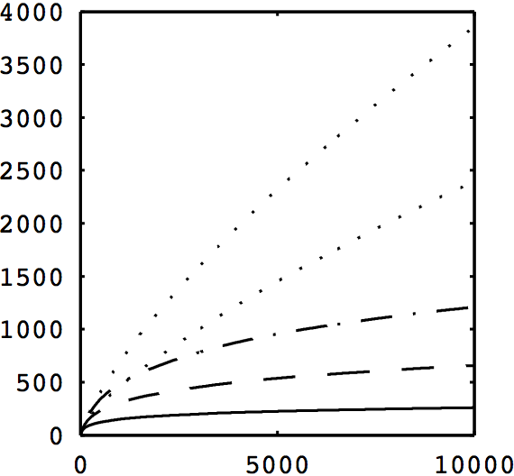
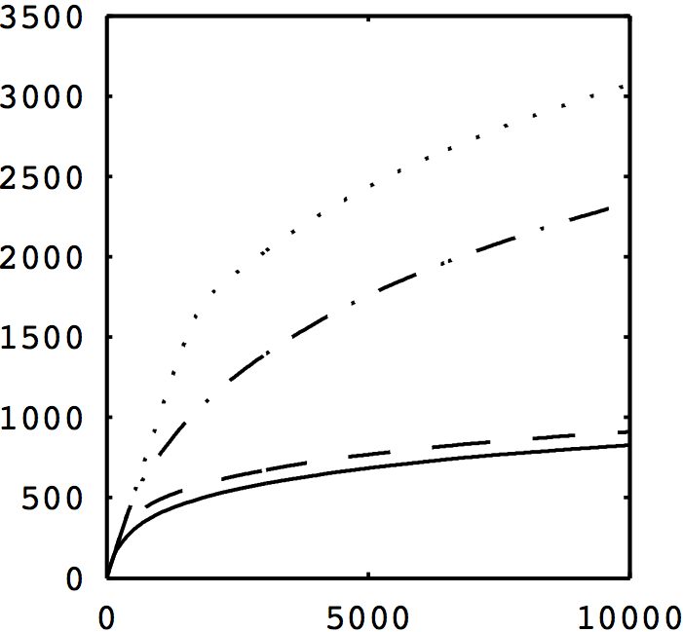
Experiments
Hypothesis classes in R¹:
Thresholds: h*(x) = sign(x - 0.5) Intervals: h*(x) = I(x2[low, high])
p₊ = P_{x»DX}[h*(x) = +1]
Number of label queries versus points received in stream.
Red: supervised learning. Blue: random misclassification, Green: Tsybakov boundary noise model.
η=0.2
p₊=0.1, η=0.1
η=0.1
p₊=0.2, η=0.1
η=0.2
p₊=0.1, η=0
η=0.1
p₊=0.2, η=0
η=0

Slide 13
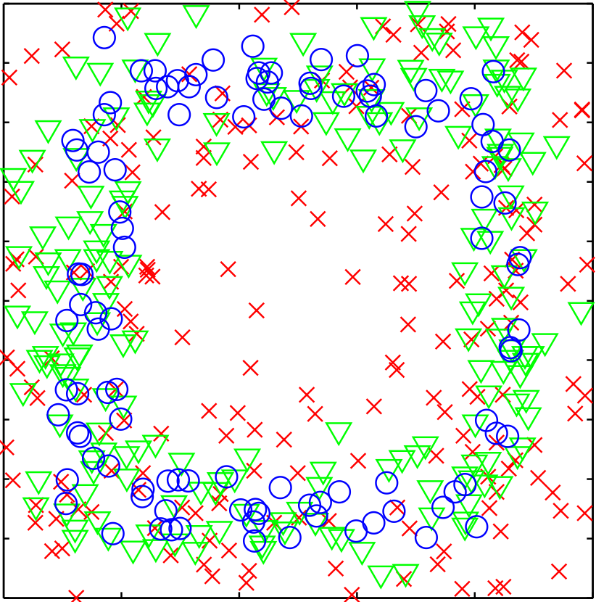
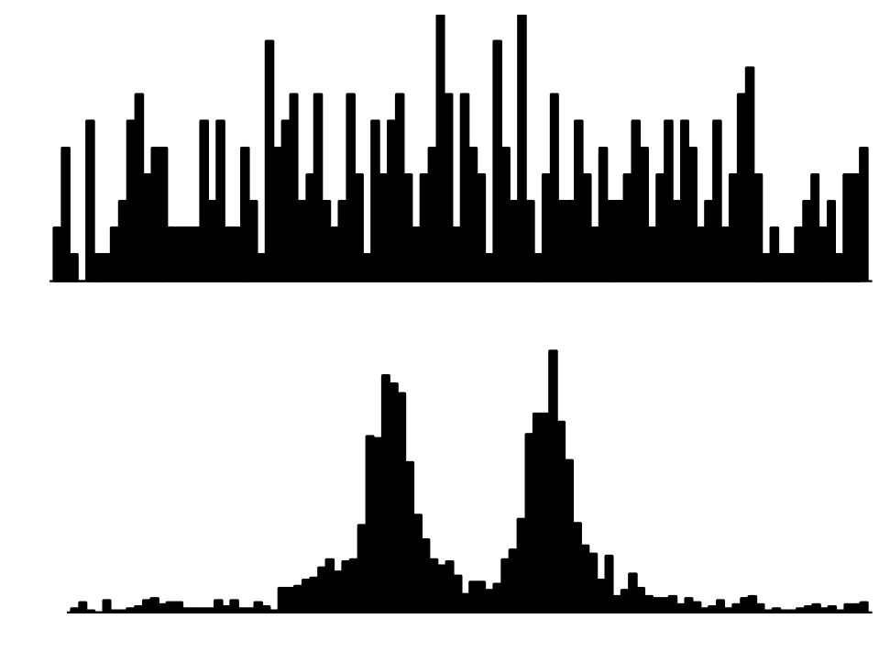
Experiments
Interval in R¹: Interval in R² (Axis-parallel boxes):
h*(x) = I(x2[0.4, 0.6]) h*(x) = I(x2[0.15, 0.85]²)
Temporal breakdown of label request locations. Queries: 1-200, 201-400, 401-509.
Label queries: 1-400:
0
0.5
1
0
0.5
1
All label queries (1-2141).
0
0.2
0.4
0.6
0.8
1
Notes:
Intervals: uniform input distribution,
random misclassification rate 0.1. m=10,000
Boxes: uniform input distribution,
random misclassification rate 0.01, m=1000

Slide 14
Conclusions and future work
First positive result in active learning that is for general concepts, distributions, and need not be computationally prohibitive.
First positive answers to open problem [Monteleoni ‘06] on efficient active learning under arbitrary distributions (for concepts with efficient supervised learning algorithms minimizing absolute loss (ERM)).
Surprising result, interesting technique: avoids canonical AL sampling problem!
Future work:
Currently we only analyze absolute 0-1 loss, which is hard to optimize for some concept classes (e.g. hardness of agnostic supervised learning of halfspaces).
Analyzing a convex upper bound on 0-1 loss could lead to implementation via an SVM-variant.
Algorithm is extremely simple: lazily check every uncertain point’s label.
- For a specific concept classes and input distributions, apply more aggressive querying rules to tighten label complexity bounds.
- For a general method though, is this the best one can hope to do?

Slide 15
Thank you!
And thanks to coauthors:
Sanjoy Dasgupta
Daniel Hsu

Slide 16
Some analysis details
Lemma (bounding error differences): with high probability,
err(h, S[T) - err(h’, S[T) · err_{D}(h) - err_{D}(h’)
+ β_{n}² + β_{n}(err(h, S[T)^{1/2} + err(h’, S[T)^{1/2})
with β_{n}=Õ((d log n)/n)^{1/2}), d=VCdim(H).
High-level proof idea: h,h’ 2 H consistent with S make the same errors on S!, the truly labeled version, so:
err(h, S[T) - err(h’, S[T) = err(h, S![T) - err(h’, S![T)
S! [ T is an iid sample from D: it is simply the entire iid stream.
So we can use a normalized uniform convergence bound [Vapnik & Chervonenkis ‘71] that relates empirical error on an iid sample to the true error rate, to bound error differences on S[T.
So let Δ_{n} = β²_{n} + β_{n}(err(h, S[T)^{1/2} + err(h’, S[T)^{1/2}), which we can compute!
Lemma: h* = arg min_{h 2 H} err(h), is consistent with S_{n}, 8 n¸0.
(Use lemma above and induction). Thus S is a realizable problem.

