Slide 1
Practical Online Active Learning
for Classification
Claire Monteleoni
(MIT / UCSD)
Matti Kääriäinen
(University of Helsinki)

Slide 2

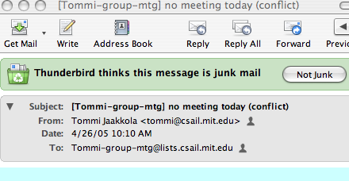
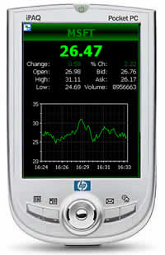

Online learning
Forecasting, real-time decision making, streaming applications,
online classification,
resource-constrained learning.
Notes:
-Suppose you want to get rich: Suppose you receive a stream of real-time stock-market data, and you want to predict changes in stock behavior in order to manage your portfolio.
-But that example might not motivate people in this room as much as: Supposed you don’t want to get spam: Suppose you just want to train your spam filters to evolve over time, by labeling new messages as “junk” or “not junk.”
-Or suppose you want to do these, or other tasks, on a handheld device.
These are problems of: Forecasting, real-time decision making, streaming applications, online classification,
resource-constrained learning.

Slide 3
Online learning
[M 2006] studies learning under these online constraints:
1. Access to the data observations is one-at-a-time only.
  Once a data point has been observed, it might never be seen again.
  Learner makes a prediction on each observation.
! Models forecasting, temporal prediction problems (internet, stock market, the weather), high-dimensional, and/or streaming data applications.
2. Time and memory usage must not scale with data.
  Algorithms may not store previously seen data and perform batch learning.
! Models resource-constrained learning, e.g. on small devices.
Notes:
-My concern in OLL is in meeting both constraints simultaneously.
-Forecasting is a case where you need to predict online, at the time the next prediction is needed.
--And sometimes the distribution of observations changes with time.
-Streaming problems have so much data that you can only look at some of it,
based on what you can hold in memory, so you need to predict online.
-Second constraint also applies to fact that any comp. learner is resource constrained.
-It also applies to time-varying prob: you don’t WANT to store memory of distant past.

Slide 4
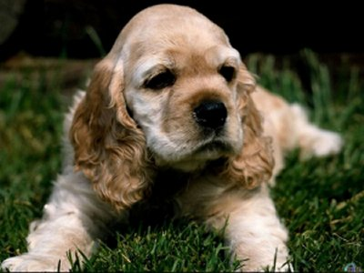
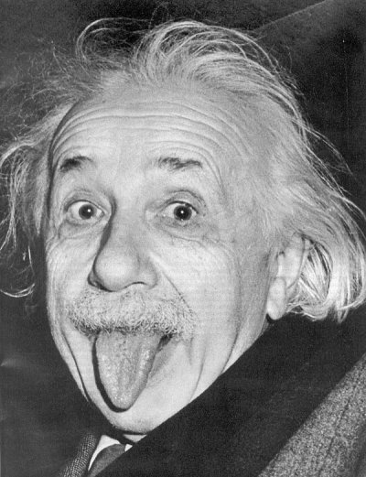
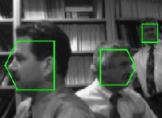
Active learning
Machine learning & vision applications:
Image classification
Object detection/classification in video
Document/webpage classification
Unlabeled data is abundant, but labels are expensive.
Active learning is a useful model here.
Allows for intelligent choices of which examples to label.
Goal: given stream (or pool) of unlabeled data, use fewer labels to learn (to a fixed accuracy) than via supervised learning.
Notes:
-To comp. to semi-sup model, gives learner more freedom bc labeled set is not chosen in advance.
-In act. Learning, smart choice of which examples to label can yield label bounds that are lower than sample complexity!

Slide 5










Online active learning: model
Notes:
Now we combine these two models, yielding online active learning.
Here’s a toy example to clarify the model.
Setting: Italian version of “Subway Series” (Yankees playing Mets in NYC.) -- the two Milanese soccer teams are facing off in Milan.
You are being paid by a multinational advertising firm to learn the binary classification from cars to which team the driver is a fan of.
Cars arrive one by one, and are unlabeled (we assume no stickers or flags on the cars). You can query for labels by waving the flag of a team at the car. If and only if the driver gets out and beats you up, he is a fan of the other team.
You want to learn to classify to a fixed accuracy, querying for the fewest labels.

Slide 6

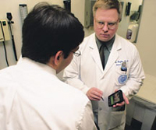

Online active learning: applications
Data-rich applications:
Image/webpage relevance filtering
Speech recognition
Your favorite data-rich vision/video application!
Resource-constrained applications:
Human-interactive learning on small devices:
OCR on handhelds used by doctors, etc.
Email/spam filtering
Your favorite resource-constrained vision/video application!
Notes:
Here’s a flavor of possible apps.
Scenario: user writes characters. Device occasionally queries a label (user must type into keypad). Of course label-minimization preferred by users.

Slide 7
Outline of talk
Online learning
Formal framework
(Supervised) online learning algorithms studied
Perceptron
Modified-Perceptron (DKM)
Online active learning
Formal framework
Online active learning algorithms
Query-by-committee
Active modified-Perceptron (DKM)
Margin-based (CBGZ)
Application to OCR
Motivation
Results
Conclusions and future work
Notes:
I will be going over the definitions of OLL used in design of our alg, not CBGZ because it’s analyzed in a different framework.

Slide 8
Online learning (supervised, iid setting)
Supervised online classification:
Labeled examples (x,y) received one at a time.
Learner predicts at each time step t: v_{t}(x_{t}).
Independently, identically distributed (iid) framework:
Assume observations x2X are drawn independently from a fixed probability distribution, D.
No prior over concept class H assumed (non-Bayesian setting).
The error rate of a classifier v is measured on distribution D:
err(h) = P_{x~D}[v(x) ≠ y]
Goal: minimize number of mistakes to learn the concept (w.h.p.) to a fixed final error rate, ε, on input distribution.
Notes:
-Study iid for e.g. image recognition, where online is bc of high dim data, not necess bc data change w time.
-Predict w/o looking at the label. (can use prediction mistakes to update hypoth).
-Some assumpts are abt how DKM was designed only.

Slide 9


Problem framework
Target:
Current hypothesis:
Error region:
Assumptions:
u is through origin
Separability (realizable case)
D=U, i.e. x~Uniform on S
error rate:
u
v_{t}
θ_{t}
ξ_{t}
Notes:
This will also be framework for most of the results presented in active iid case.
Algorithm is also kernelizable.
Picture is proj onto u-v_t plane.
Because the instance is separable, I.e. u has no error, the generalization error is exactly the error in approximating u, I.e. \epsilon.

Slide 10
Performance guarantees
Distribution-free mistake bound for Perceptron of O(1/γ²), if exists margin γ.
Uniform, i.i.d, separable setting:
[Baum 1989]: An upper bound on mistakes for Perceptron on Õ(d/ε²).
[Dasgupta, Kalai & M, COLT 2005]:
A lower bound for Perceptron of Ω(1/ε²) mistakes.
An modified-Perceptron algorithm, and a mistake bound of
Õ(d log 1/ε).
Notes:
So we know in the iid uniform setting, it’s better to use mod-Perc than perc.

Slide 11
Perceptron
Perceptron update: v_{t+1} = v_{t} + y_{t} x_{t}
→ error does not decrease monotonically.
v_{t+1}
v_{t}
u
x_{t}

Slide 12
A modified Perceptron update
Standard Perceptron update:
v_{t+1} = v_{t} + y_{t} x_{t}
Instead, weight the update by “confidence” w.r.t. current hypothesis v_{t}:
v_{t+1} = v_{t} + 2 y_{t} |v_{t} ¢ x_{t}| x_{t} (v₁ = y₀x₀)
(similar to update in [Blum,Frieze,Kannan&Vempala‘96], [Hampson&Kibler‘99])
Unlike Perceptron:
  Error decreases monotonically:
  cos(θ_{t+1}) = u ¢ v_{t+1} = u ¢ v_{t} + 2 |v_{t} ¢ x_{t}||u ¢ x_{t}|
  ¸ u ¢ v_{t} = cos(θ_{t})
  kv_{t}k =1 (due to factor of 2)

Slide 13
A modified Perceptron update
Perceptron update: v_{t+1} = v_{t} + y_{t} x_{t}
Modified Perceptron update: v_{t+1} = v_{t} + 2 y_{t} |v_{t} ¢ x_{t}| x_{t}
v_{t+1}
v_{t+1}
v_{t}
u
v_{t+1}
v_{t}
x_{t}

Slide 14
PAC-like selective sampling framework
Online active learning framework
Selective sampling [Cohn,Atlas&Ladner‘94]:
Given: stream (or pool) of unlabeled examples, x2X, drawn i.i.d. from input distribution, D over X.
Learner may request labels on examples in the stream/pool.
(Noiseless) o_x0013_racle access to correct labels, y2Y.
Constant cost per label
The error rate of any classifier v is measured on distribution D:
err(h) = P_{x~D}[v(x) ≠ y]
PAC-like case: no prior on hypotheses assumed (non-Bayesian).
Goal: minimize number of labels to learn the concept (whp) to a fixed final error rate, ε, on input distribution.
We impose online constraints on time and memory.
Notes:
Some assumps (iid) used in design of DKM only.
-Well studied query learning model unrealistic in practice: querying any part of the input space. These queries are hard for even a human to label!
-Though we don’t rule it out by the problem constraints, due to the iid assump we also bound the total unlabeled samples.
-Online constraints:
Space: Learner cannot store all previously seen examples (and then perform batch learning).
Time: Running time of learner’s belief update step should not scale with number of seen examples/mistakes.

Slide 15
Performance Guarantees
Bayesian, not-online, uniform, i.i.d, separable setting:
[Freund,Seung,Shamir&Tishby ‘97]: Upper bound on labels for Query-by-committee algorithm [SOS‘92] of Õ(d log 1/ε).
Uniform, i.i.d, separable setting:
[Dasgupta, Kalai & M, COLT 2005]
A lower bound for Perceptron in active learning context, paired with any active learning rule, of Ω(1/ε²) labels.
An online active learning algorithm and a label bound of
Õ(d log 1/ε).
A bound of Õ(d log 1/ε) on total errors (labeled or unlabeled).
OPT: Ω(d log 1/ε) lower bound on labels for any active learning algorithm.
Notes:
QBC receives examples sequentially but holds onto all labeled
examples so not online.
OPT: Can pack (1/ε)^{d} spherical caps of radius ε
on surface of unit ball in R^{d}. The bound is just the
number of bits to write the answer.
So we know in the iid uniform setting, it’s better
to use mod-Perc than perc. for AL too.

Slide 16

Active learning rule
Goal: Filter to label just those points in the error region.
! but θ_{t}, and thus ξ_{t} unknown!
Define labeling region:
Tradeoff in choosing threshold s_{t}:
If too high, may wait too long for an error.
If too low, resulting update is too small.
Choose threshold s_{t} adaptively:
Start high.
Halve, if no error in R consecutive labels
v_{t}
u
s_{t}
{
L
Notes:
- Our OLAL alg is our modified Perc with an AL rule.
- Filter to choose what to label, and still filter labeled examples to only update on mistakes.

Slide 17
OCR application
We apply online active learning to OCR [M‘06; M&K‘07]:
Due to its potential efficacy for OCR on small devices.
To empirically observe performance when relax distributional and separability assumptions.
To start bridging theory and practice.
Notes:
Here begins the contribution with Kaariainen of this workshop paper
(which was in part of my thesis).
Model for OCR on handhelds:
in online training for OCR on handhelds, the device can
occasionally query for a label through e.g. keypad.
Human users will probably favor few correction events.

Slide 18
Algorithms
Stated DKM implicitly. For this non-uniform application, start threshold at 1.
[Cesa-Bianchi,Gentile & Zaniboni ‘06] algorithm (parameter b):
Filtering rule: flip a coin w.p. b/(b + |x ¢ v_{t}|)
Update rule: standard Perceptron.
CBGZ analysis framework:
No assumptions on sequence (need not be iid).
Relative bounds on error w.r.t. best linear classifier (regret).
Fraction of labels queried depends on b.
Other margin-based (batch) methods:
Un-analyzed: [Tong&Koller‘01] [Lewis&Gale‘94].
Recently analyzed: [Balcan,Broder & Zhang COLT 2007].

Slide 19
Evaluation framework
Experiments with all 6 combinations of:
Update rule 2 {Perceptron, DKM modified Perceptron}
Active learning logic 2 {DKM, C-BGZ, random}
MNIST (d=784) and USPS (d=256) OCR data.
7 problems, with approx 10,000 examples each.
5 random restarts of 10-fold cross-validation.
Parameters were first tuned to reach a target ε per problem, on hold-out sets of approx 2,000 examples, using 10-fold cross-validation.
Notes:
-Random sampling is equiv to supervised, iid from D.

Slide 20
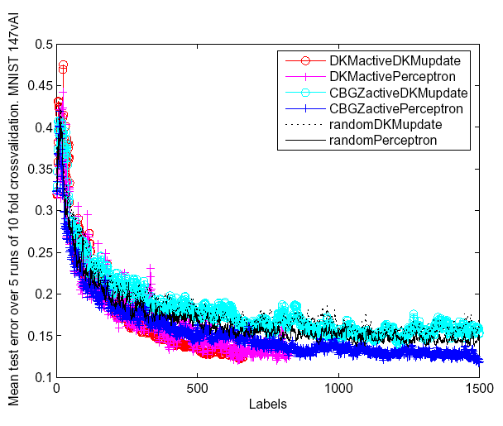
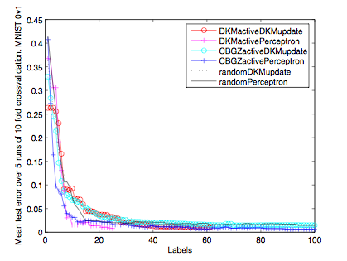
Learning curves
Extremely easy:
Unseparable.
Notes:
First we show some qualitative results.

Slide 21
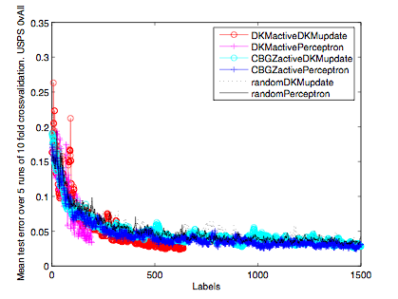
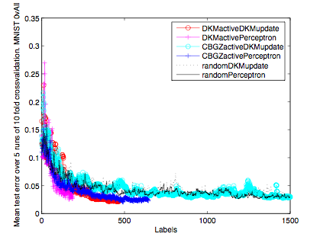
Learning curves
Notes:
DKMactivePerceptron reduced test error fastest, but
DKMsquared and CBGZ continue querying for more labels
eventually attaining lower error.
--> We will discuss this later about setting of R.

Slide 22
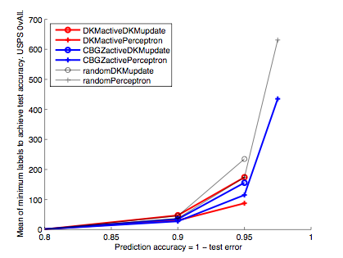
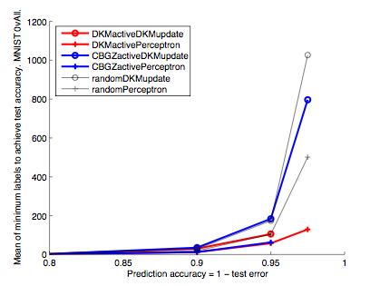
Statistical efficiency
Notes:
Some quantitative results.
We only plot epsilons s.t. all 5 runs of the alg reached it.

Slide 23
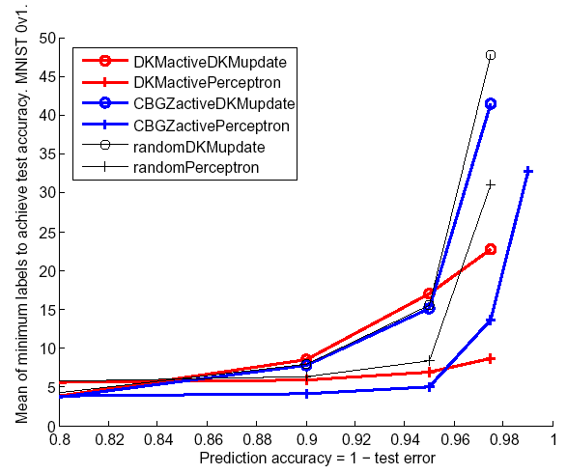
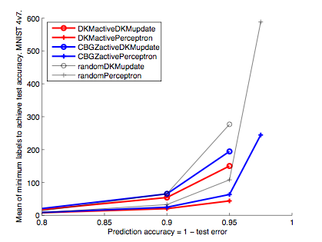
Statistical efficiency
Notes:
We see that DKMactive methods, even when they have higher
label values per an eps, have slower growth rate as eps
decreases. These important results aren’t picked up in our
further quant results which only look at one eps val per prob.

Slide 24
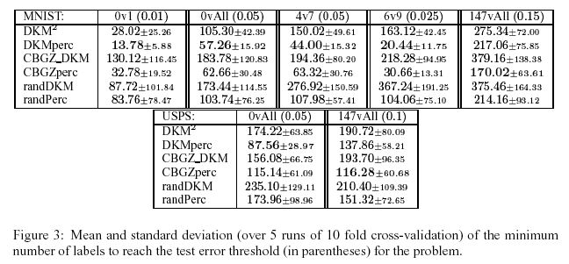
More results
Mean § standard deviation, labels to reach ε threshold per problem (in parentheses).
Active learning always quite outperformed random sampling:
Random sampling perc. used 1.26–6.08x as many labels as active.
Factor was at least 2 for more than half of the problems.

Slide 25
More results and discussion
Individual hypotheses tested on tabular results (to fixed ε):
Both active learning rules, with both subalgorithms, performed better than their random sampling counterparts.
Difference between the top performers, DKMactivePerceptron and CBGZactivePerceptron, was not significant.
Perceptron outperformed Modified-perceptron (DKMupdate), when used as sub-algorithm to any active rule.
DKMactive outperformed CBGZactive, with DKMupdate.
Possible sources of error:
Fairness:
Tuning entails higher label usage, which was not accounted for.
Modified-perceptron (DKMupdate) was not tuned (no parameters!).
Two parameter algorithms should have been tuned jointly.
DKMactive’s R relates to fold length however tuning set << data.
Overfitting: were parameters overfit to holdout set for tuned algs?
Notes:
Stat signif only done on these results that were to one, fixed eps
which doesn’t account for the nice perf we saw in graphs.
About Perc vs. mod-Perc, could be due to non-unif, or unsep
(bounds only proven for unif sep)
OR these sources of error
(When you study something long enough, e.g. by writing
a thesis chapter on it(!) you come up with lots of poss. sources error.
R issue: if small, will quickly halve active learning thresh if not
mistakes. This can cause steep descent of error wrt labels,
BUT once thresh (s) is small enough, might not query any
more labels in fold!

Slide 26
Conclusions and future work
Motivated and explained online active learning methods.
If your problem is not online, you are better off using batch methods with active learning.
Active learning uses much fewer labels than supervised (random sampling).
Future work:
Other applications!
Kernelization.
Cost-sensitive labels.
Margin version for exponential convergence, without d dependence.
Relax separability assumption (Agnostic case faces lower bound [K‘06]).
Distributional relaxation? (Bound not possible under any distribution [D‘04]).

Slide 27
Thank you!
Thanks to coauthor:
Matti Kääriäinen
Many thanks to:
Sanjoy Dasgupta
Tommi Jaakkola
Adam Tauman Kalai
Luis Perez-Breva
Jason Rennie

