Slide 1
Healthy Habits for Data Science
Day 1: Open Science, Project organization

Slide 2
Open science concepts
Open Access
Open Data
Open Educational resources
Open Source (code)
Open Protocols

Slide 3

Findable
Accessible
Interoperable
Reusable

Slide 4
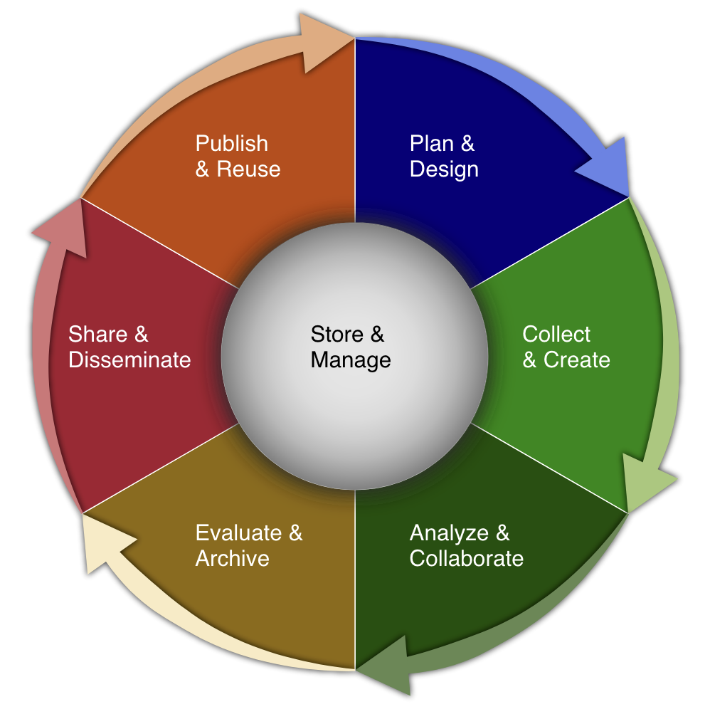
HMS Biomedical Data Lifecycle
https://datamanagement.hms.harvard.edu/
https://hlrdm.library.harvard.edu/

Slide 5





3-2-1 Rule for data backups
3 copies
2 formats
1 offsite

Slide 6
Avoidable problems
Research methods dead end
Poorly documented hand-me-down data
Loss of data due to hardware failure/natural disaster
Data not available for reanalysis
Excel conversion problems

Slide 7
Paper : https://doi.org/10.7554/eLife.81979
GitHub: https://github.com/shahlab/LTEE_gene_expression_2/

Slide 8
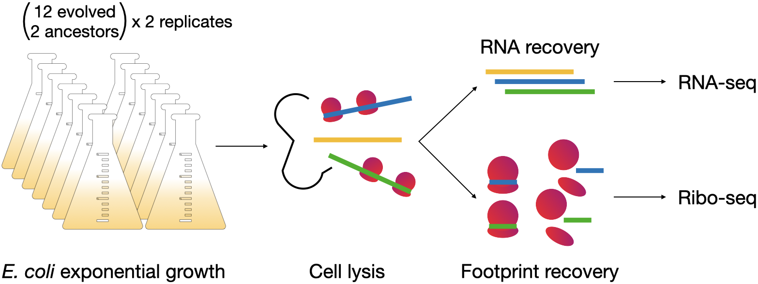
"The landscape of transcriptional and translational changes over 22 years of bacterial adaptation” Favate et al 2022
Are genes differentially expressed between the evolved lines and the ancestor? And how does that affect fitness?

Slide 9
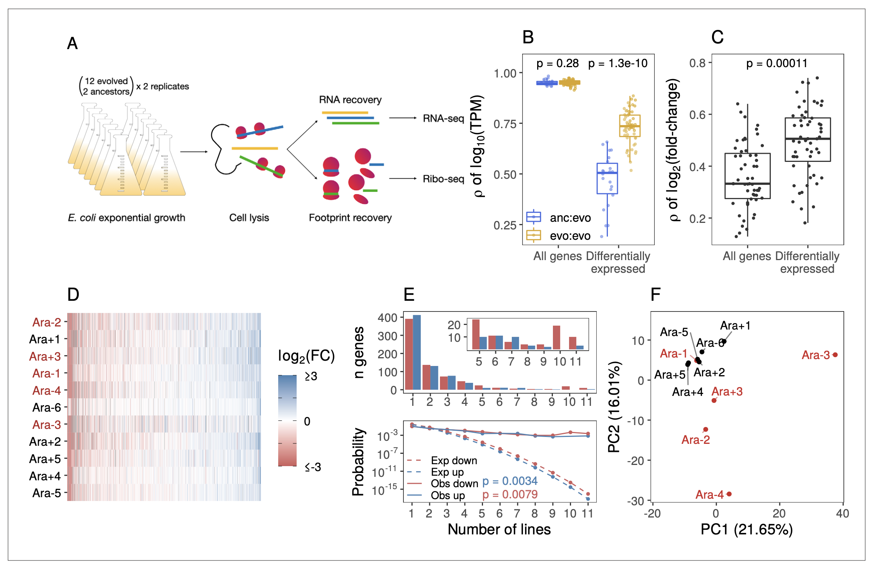

Slide 10
Sequencing
download from sequencing facility
Clean-up
de-multiplex
Analysis
quantify reads
Plotting
deplete rRNA
differential expression
ggplot in R
remove primers
rename files
trim ends
de-duplicate
clean/combine data
Fastq
Fastq
CSVs
Jpg/Tiff

Slide 11
Sequencing
Clean-up
Analysis
Plotting
data, raw
data, clean
numbers,
analyzed data
images

Slide 12
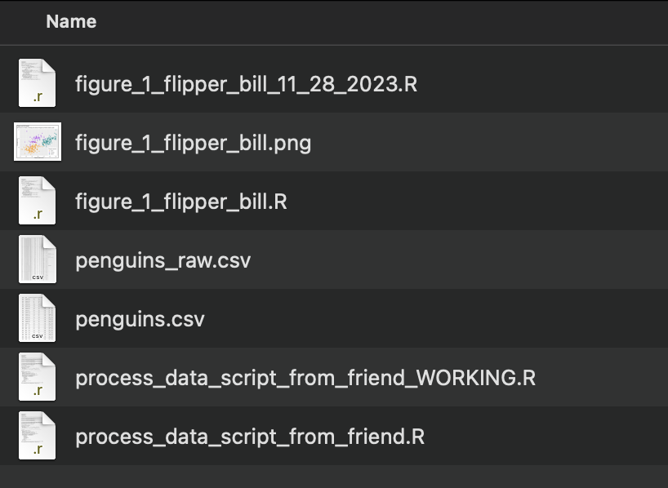

Slide 13
Sequencing
Clean-up
Analysis
Plotting
data, raw
data, clean
numbers, analyzed data
images

Slide 14
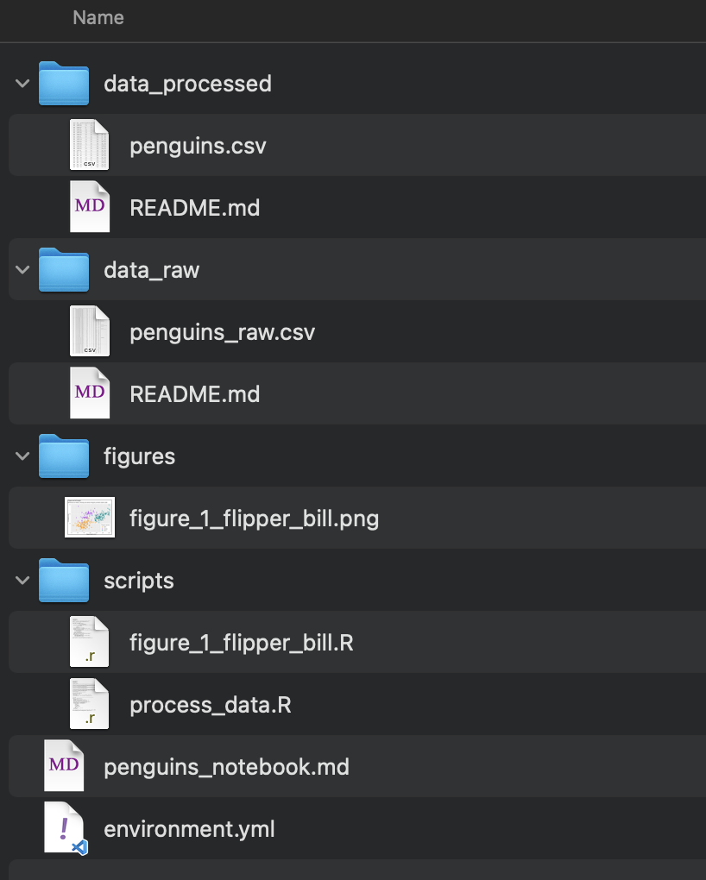

Slide 15
/n/
├─ home/
│ ├─ lei/
│ ├─ jharvard/
├─ holylfs/
│ ├─ LABS/
│ │ ├─ jharvard_lab/
│ │ │ ├─ Everyone/
│ │ │ ├─ Lab/
│ │ │ ├─ Users/
├─ holyscratch01/
│ ├─ jharvard

Slide 16
Log in to FASRC cluster
Navigate to your lab’s folder in /holyscratch01/
Make a folder YOUR_USERNAME/healthy-habits
Copy today’s data into your folder
cp /n/holylfs05/LABS/informatics/Everyone/workshop-data/healthy-habits-2024/day1/* .
Make subfolders “software”, “data_raw”, and “scripts” and organize the files using mv
Make a project directory on your own computer
Use your preferred method (scp, rsync, Filezilla, etc) to copy the text files over to your computer from the cluster

Slide 17
Sequencing
Clean-up
Analysis
Plotting
Fastq
Fastq
CSVs
Jpg/Tiff
Public Repo
NAS
RC storage
HDD/SSD
Harvard dataverse
NAS
RC storage
Not super important to store
Public Repo
Paper supplement
HDD/SSD
Your computer
Cluster Lab directory
Public Repo
Paper
HDD/SSD

