Slide 1
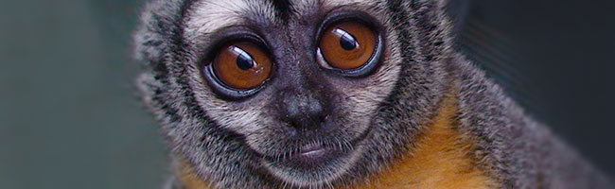


Pedigree sequencing and mutation rate variation in primates
Gregg Thomas
@greggwcthomas
University of Montana
April 15, 2021
12-minute talk
Notes:
Hi, my name is Gregg Thomas and I’m currently a postdoc at the University of Montana. Thanks for listening to my talk today, where I’ll be speaking about work done during my PhD at Indiana regarding mutation rates in primates.

Slide 2
Mutation is a fundamental process
Notes:
So, mutation is a fundamental process for much of biology, and evolutionary biology in particular. Mutations, which are spontaneous changes to the linear sequence of DNA, provide the novel material on which other forces of evolution can act.

Slide 3
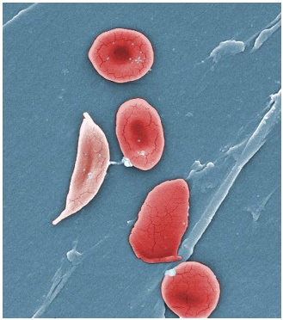
Mutation is a fundamental process
Mutations can cause disease
Notes:
Importantly, mutations can have both short- and long-term effects on fitness. In the short-term, a mutation can affect an individual’s fitness by causing disease.

Slide 4
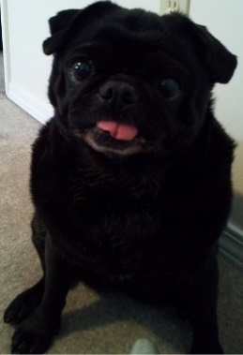
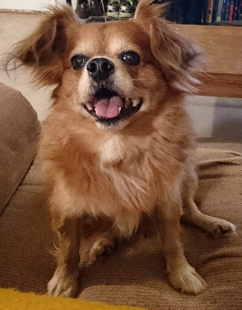
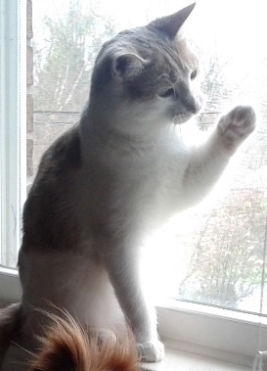
Mutation is a fundamental process
Different species
Mutations can cause disease
Same species
Mutations maintain variation and lead to divergence
Notes:
And in the long term, mutations can rise in frequency within a population to be acted upon by selection and genetic drift to maintain genetic variation both within and between species, leading to the great diversity we see in nature.

Slide 5
Understanding the mutation rate is key for many aspects of biology
Different species
Mutations can cause disease
Same species
Mutations maintain variation and lead to divergence
Notes:
So, that means the rate at which mutations accumulate can have big impacts over these different timescales, and the mutation rate itself is a key parameter in much of our understanding of population genetics and evolutionary biology.

Slide 6
The mutation rate is a trait that can evolve
Different species
Mutations can cause disease
Same species
Mutations maintain variation and lead to divergence
Notes:
So then, its also important to note that the mutation rate itself is a trait that can evolve. Since many mutations are thought to be the products of errors during DNA replication, the proteins that mediate those processes can themselves accumulate mutations that are subject to the forces of evolution.

Slide 7
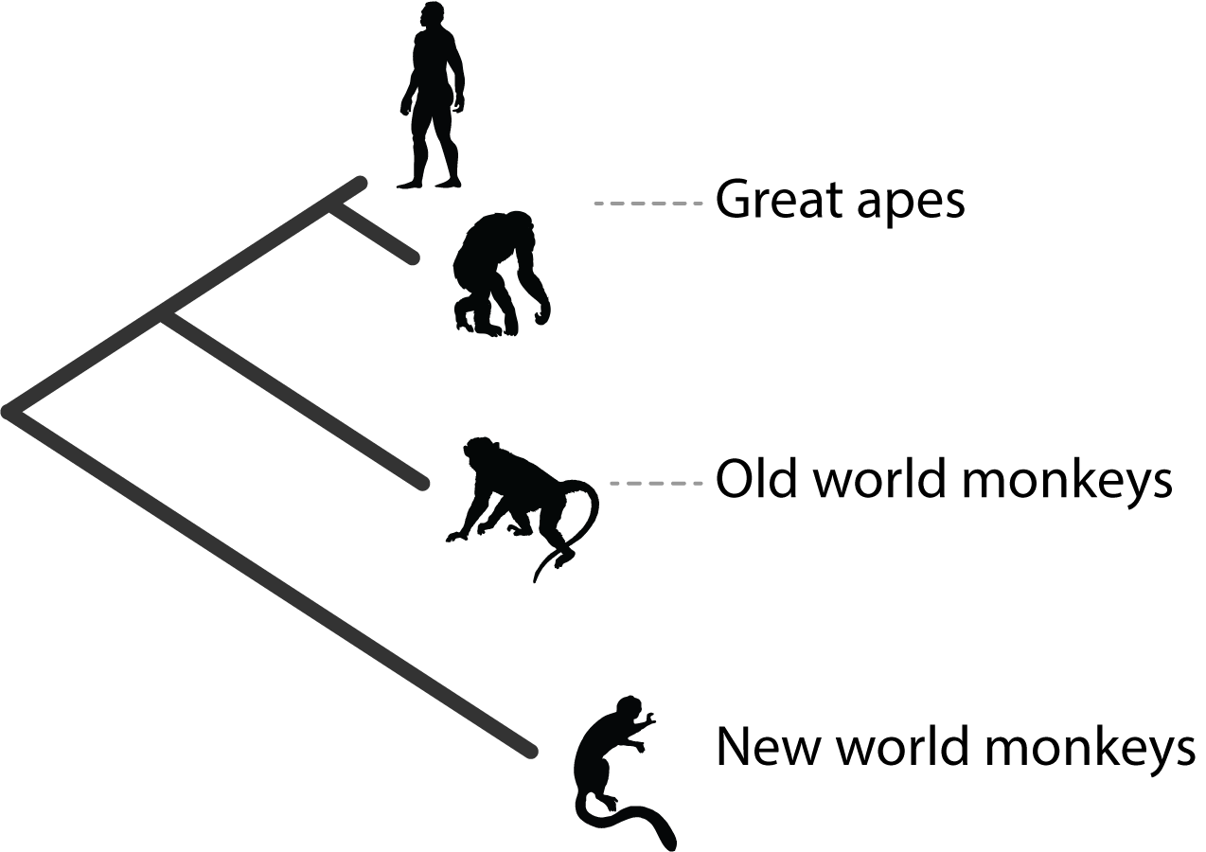
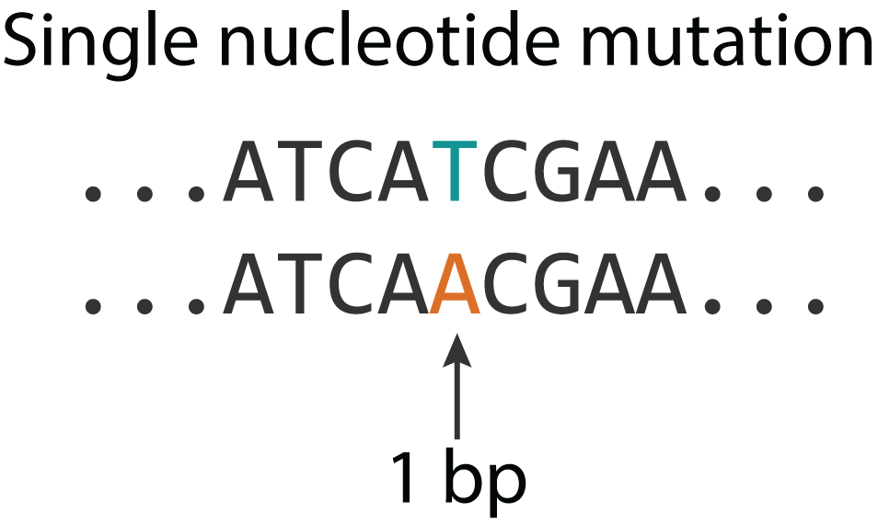
The Hominoid slowdown for single nucleotide mutations
Adapted from Yi 2013
Notes:
And primates in particular are a great system to study rates because the formed one of the first observations of rate variation back in the 1960’s when Morris Goodman used comparative serological studies from serum albumin proteins to posit that great apes have slower rates of evolution than old or new world monkeys, here with rates being represented by branch lengths.

Slide 8
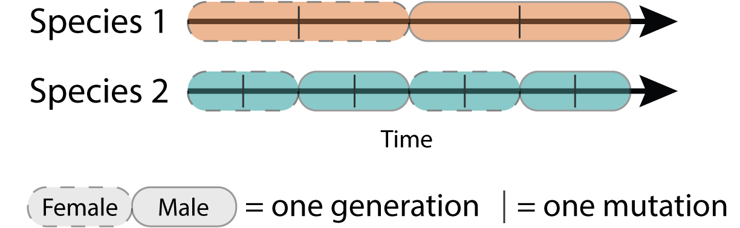
The Hominoid slowdown is predicted by the generation-time model
Notes:
The observed slowdown in great apes led to hypotheses to explain it, with the general consensus falling on the generation-time effect. This model supposes that species with longer generations, like great apes, will undergo fewer rounds of germline cell division in the same time period as a species with a shorter generation time. This means that species will accumulate fewer mutations in that time period.

Slide 9
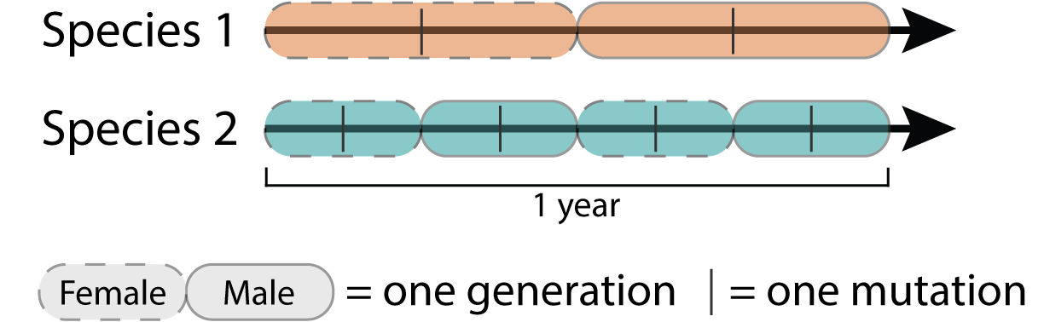
The Hominoid slowdown is predicted by the generation-time model
Notes:
The observed slowdown in great apes led to hypotheses to explain it, with the general consensus falling on the generation-time effect. This model supposes that species with longer generations, like great apes, will undergo fewer rounds of germline cell division in the same time period as a species with a shorter generation time. This means that species will accumulate fewer mutations in that time period.

Slide 10

The Hominoid slowdown is predicted by the generation-time model
$$μ_{y}$$
Species 1 |  | 1
Species 2 |  | 4
Notes:
Here with this toy example, you can see that over this time period, the orange species with longer generation time has accumulated 2 total mutations while the blue species has accumulated 4. If we and say this time period covers exactly 2 years, this breaks down to a mutation rate per year of 1 for orange and 2 for blue.

Slide 11

The generation-time model assumes a constant number of mutations per generation
$$μ_{g}$$
$$μ_{y}$$
Species 1 | 1 | 1
Species 2 | 1 | 4
Notes:
However, we can also convert these rates to per generation. And in order for the generation-time model to explain the hominoid slowdown, it has to assume that the mutation rate per generation is the same between species, or that the rate per generation in the longer generation time species is lower than that in the shorter generation time species.

Slide 12

Pedigree sequencing allow us to directly estimate the mutation rate per generation
$$μ_{g}$$
The mutation rate per generation
Notes:
And counting up all of those loci gives us the mutation rate per generation. Pedigree sequencing can also be used to phase mutations, which lets us know whether they came from mom or dad.

Slide 13
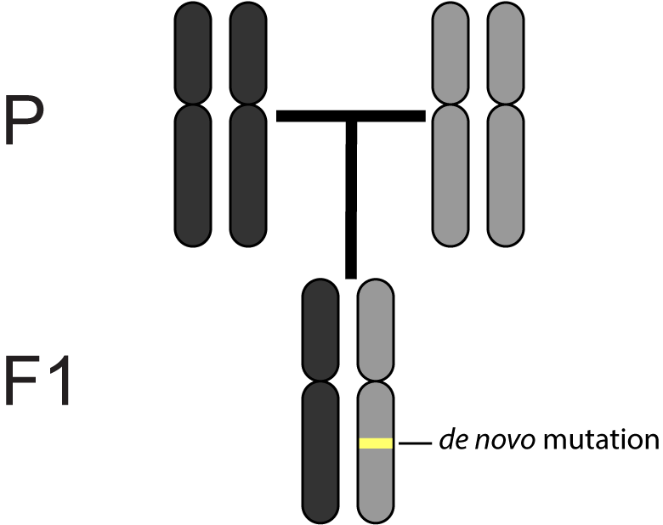
Pedigree sequencing allow us to directly estimate the mutation rate per generation
$$μ_{g}$$
The mutation rate per generation
Notes:
And counting up all of those loci gives us the mutation rate per generation. Pedigree sequencing can also be used to phase mutations, which lets us know whether they came from mom or dad.

Slide 14
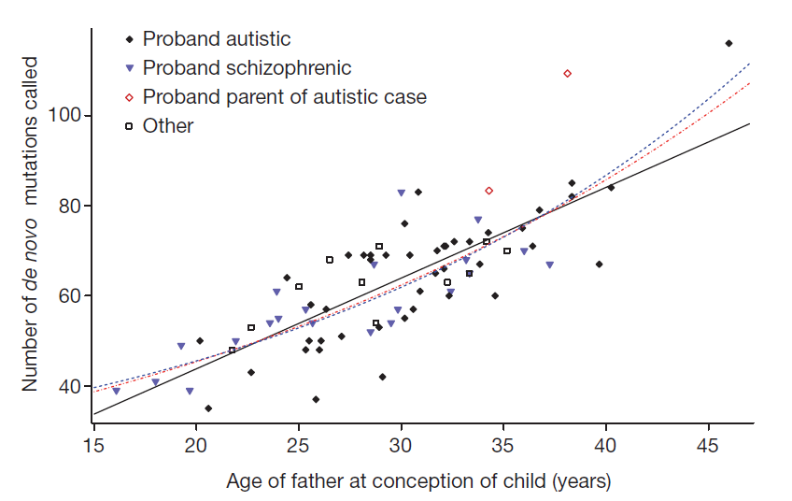
The mutation rate per generation is not constant
Human trios
# mutations
Father's age
Kong et al. 2012
Notes:
And one of the first observations with a large human pedigree study came from Kong et al. in 2012, where they noticed that the mutation rate per generation depends largely on the age of the father.

Slide 15
The mutation rate per generation is not constant
Human trios
# mutations
This is known as the paternal age effect
Father's age
Kong et al. 2012
Notes:
This is called the paternal age effect and means that for every year of the father’s life after puberty, they accumulated and pass on about 2 more mutations.

Slide 16
The paternal age effect contradicts the generation-time model
$$μ_{g}$$
$$μ_{y}$$
Species 1 | 1 | 1
Species 2 | 1 | 4
Notes:
The model rather than looking like this,

Slide 17
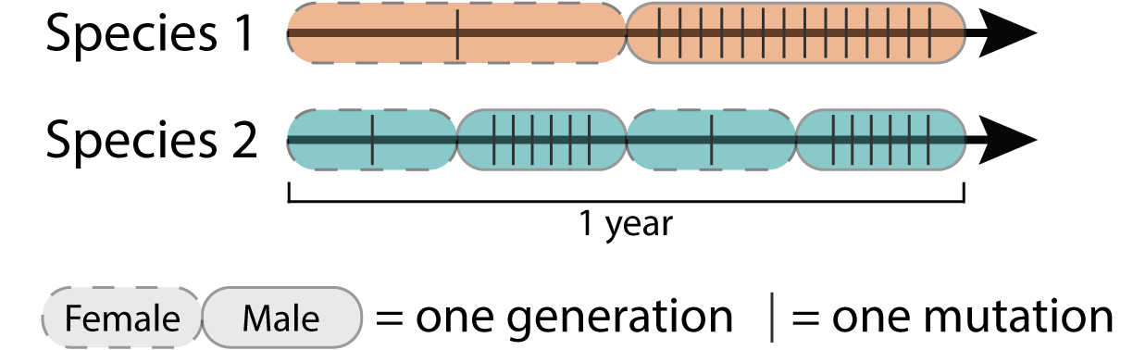
The paternal age effect contradicts the generation-time model
$$μ_{g}$$
$$μ_{y}$$
Species 1 | 7.5 | 15
Species 2 | 7 | 14
Notes:
May look more like this, with individuals accumulating mutations throughout their lifespan. And you’ll notice that in this toy example, the blue species with shorter generation time now has lower muy!

Slide 18
Is there mutation rate variation in primates?
Can this variation reconcile the paternal age effect and the Hominoid slowdown?
Notes:
So with these conflicting patterns in hand we wanted to investigate exactly how mutation rates vary in primates, and whether this variation can reconcile the paternal age effect, which says that longer living things accumulate more mutations, and the hominoid slowdown, which seems to say the opposite.

Slide 19
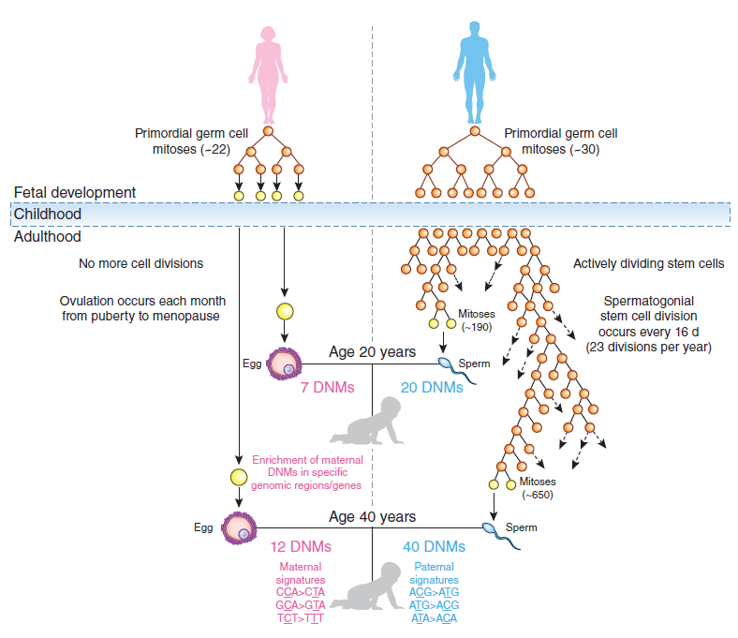
How can mutation rate per generation vary?
Goriely 2016
Notes:
And the first thing we had to do was to think about how mutation rates can vary. So, in thinking about how the germline divides we developed a model.

Slide 20
How can mutation rate per generation vary?
Pre-puberty males
The mammalian germline exists in three distinct stages where mutations can accumulate
Females
Post-puberty males
Goriely 2016
Notes:
And this model breaks down the germline into three distinct life stages,

Slide 21
How can mutation rate per generation vary?
Pre-puberty males
The mammalian germline exists in three distinct stages where mutations can accumulate
Increase or decrese:
The number of cell divisions in any stage
The number of mutations per division in any stage
The duration of time the germline spends in males after puberty
Females
Post-puberty males
Goriely 2016
Notes:
and changing the number of cell divisions or number of mutations per division in any of those periods could change the mutation rate per generation.

Slide 22
How can mutation rate per generation vary?
Pre-puberty males
The mammalian germline exists in three distinct stages where mutations can accumulate
Increase or decrese:
The number of cell divisions in any stage
The number of mutations per division in any stage
The duration of time the germline spends in males after puberty
Females
Post-puberty males
Goriely 2016
Notes:
But importantly, also changing the amount of time the males spends post-puberty, either by changing the age of puberty or the age at reproduction, can also change the mutation rate because this allows for more or fewer cell divisions to occur. This is the paternal age effect and it is not true of the other two life stages, where there is a fixed number of cell divisions regardless of the duration of time.

Slide 23

Primate pedigree sequencing
Humans (9 trio studies)
Chimpanzees (2 trio studies)
Notes:
…and sequenced a set of parent-offspring trios in an Old World monkey, the rhesus macaque, and a New World monkey, owl monkeys.

Slide 24
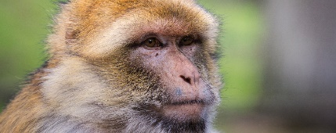
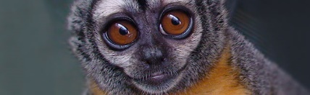
Primate pedigree sequencing
Humans (9 trio studies)
Chimpanzees (2 trio studies)
Macaca mulatta(14 trios)
Aotus nancymaae (14 trios)
Notes:
…and sequenced a set of parent-offspring trios in an Old World monkey, the rhesus macaque, and a New World monkey, owl monkeys.

Slide 25
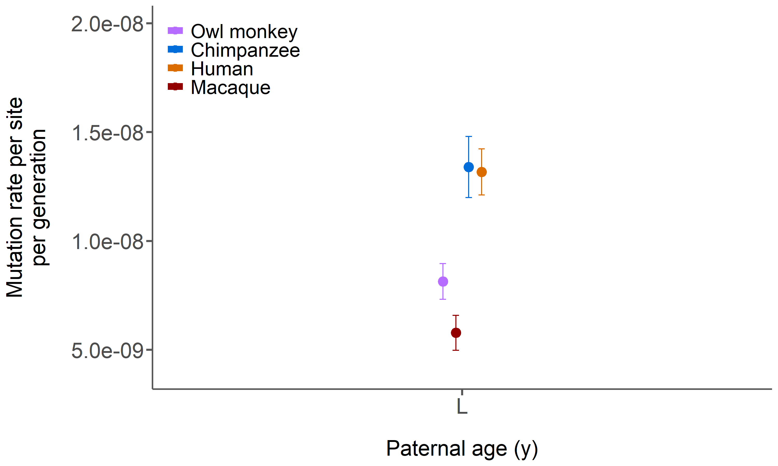
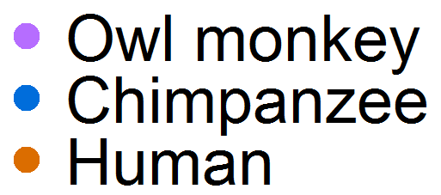
Owl monkey and macaque mutation rates
Owl monkey:
0.81 x 10⁻⁸ average across 14 trios
Macaque:
0.58 x 10⁻⁸ average across 14 trios
Notes:
And after a lot of variant calling and filtering, we come up with these rates for those 2 species: 0.81 for owl monkeys and 0.58 for macaques. These rates actually do fit with the generation-time model, with the longer generation species, macaques, having lower rates.

Slide 26
The owl monkey and macaque rates are lower than great apes
Chimpanzee:
1.34 x 10⁻⁸ average across 2 studies
Human:
1.32 x 10⁻⁸ average across 9 studies
Owl monkey:
0.81 x 10⁻⁸ average across 14 trios
Macaque:
0.58 x 10⁻⁸ average across 14 trios
Notes:
But when we compare this to the great apes, which have the lowest rates per year, we find the opposite pattern. They average around 1.3 mutations per generation. This violates the assumption of the generation time effect and is opposed to the Hominoid slowdown for yearly rates.

Slide 27
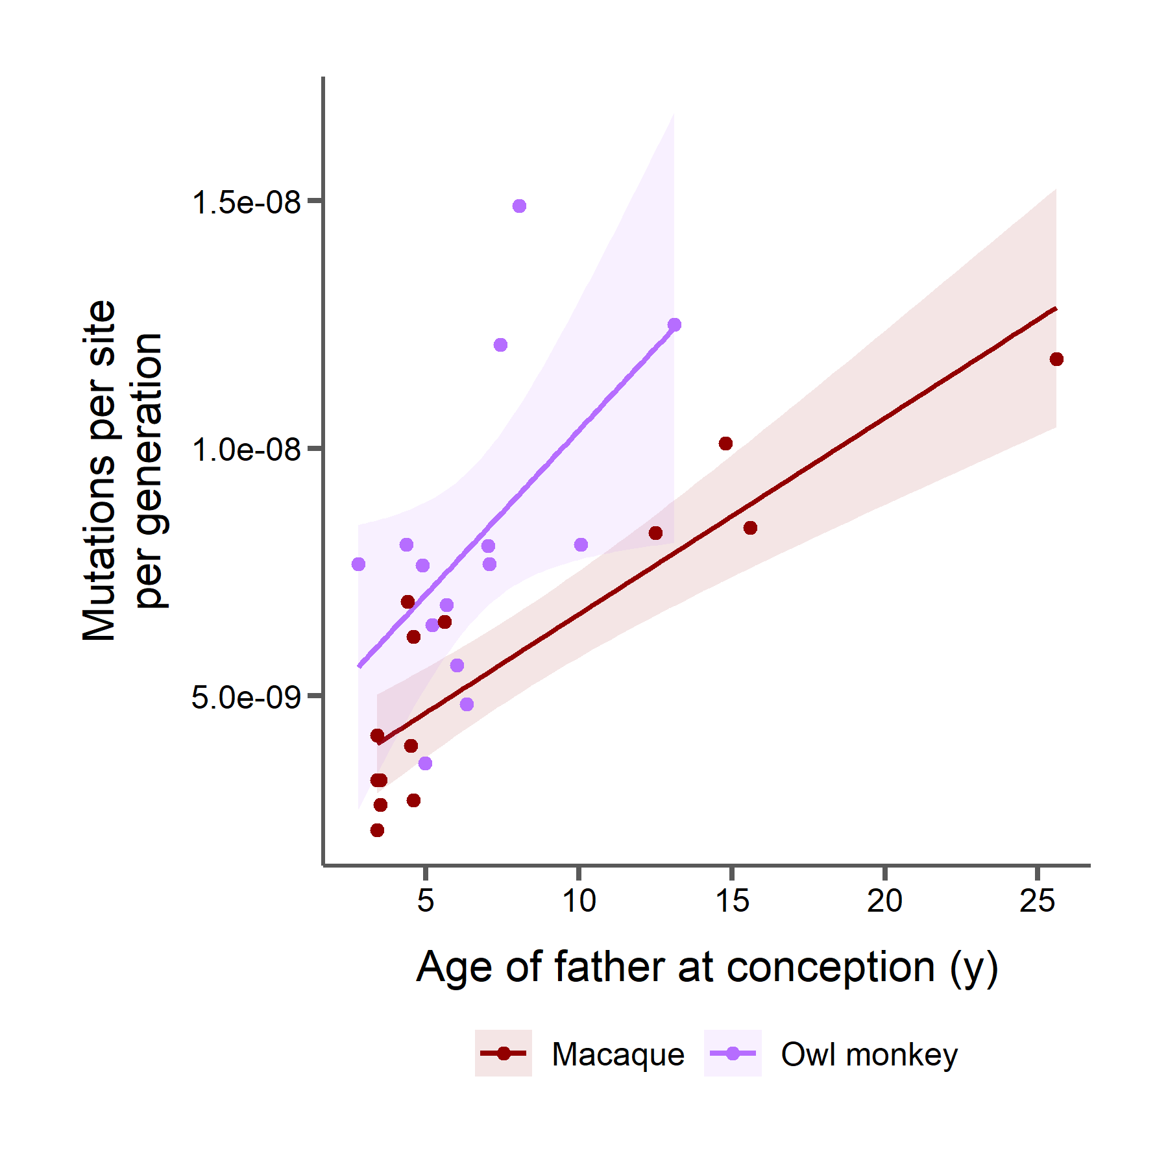
Similar paternal age effects in owl monkeys and macaques
Roughly 2 mutations per year of the father
Notes:
In our samples of owl monkeys and macaques we also observe a paternal age effect. These age effects are similar to one another and both similar to humans, meaning these species pass on about 2 more mutations per year of the father’s life.
2.92 mutations per year of the father

Slide 28
Point estimates do not capture the paternal age effect
Chimpanzee:
1.34 x 10⁻⁸ average across 2 studies
Human:
1.32 x 10⁻⁸ average across 9 studies
Owl monkey:
0.81 x 10⁻⁸ average across 14 trios
Macaque:
0.58 x 10⁻⁸ average across 14 trios
Notes:
So when we look at these rates as an average its important to remember

Slide 29
How can we compare rates between species while accounting for paternal age effects?
Chimpanzee: 24 yrs
Human: 31 yrs
Owl monkey: 6.6 yrs
Macaque: 7.5 yrs
Notes:
that these are an average across a linear function of parental age, and the ages in our samples vary.

Slide 30
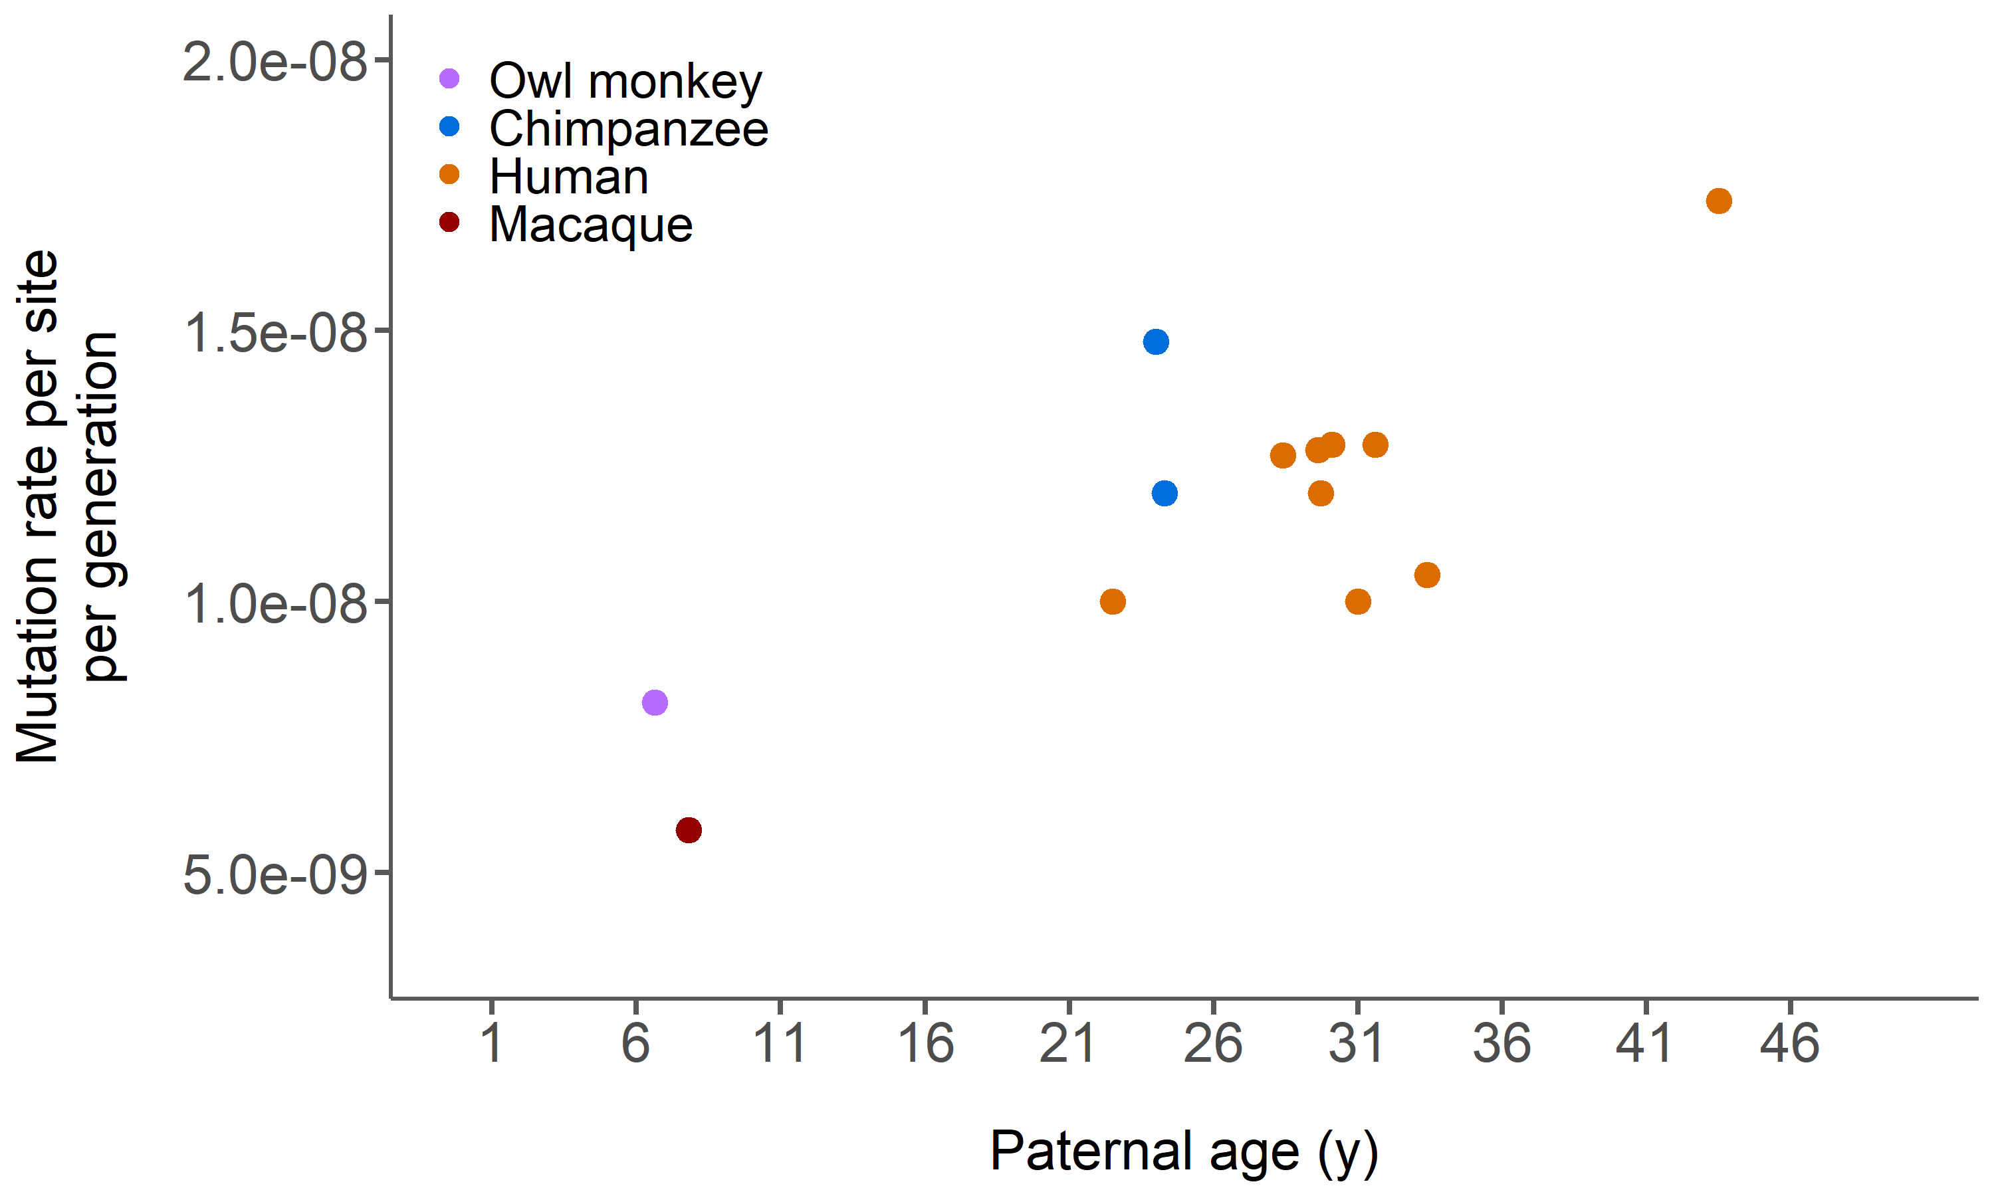
Age of reproduction is crucial in determining mutation rates per generation
Each point = 1 study
Notes:
So instead of looking at point estimates for a species, we can add an x-axis here for paternal age. And just by doing this I think it starts to become obvious that the rate differences we observe even between speciesmay be highly dependent on the age of the sample

Slide 31

Human studies give us a mutation rate function for a given age of puberty
Model fit using parameter estimates from Kong et al. data
Each point = 1 study
Vertical lines = puberty age
Dashed line = model predictions
Owl monkey
Chimp
Macaque
Notes:
And when we do that we get a similar line to the observed paternal age line for humans. In fact, its identical since we derived the parameters from that data. So then we can ask what happens when we change the parameters for these other species, specifically we’re interested in the age of puberty, which is easily observable and varies.

Slide 32
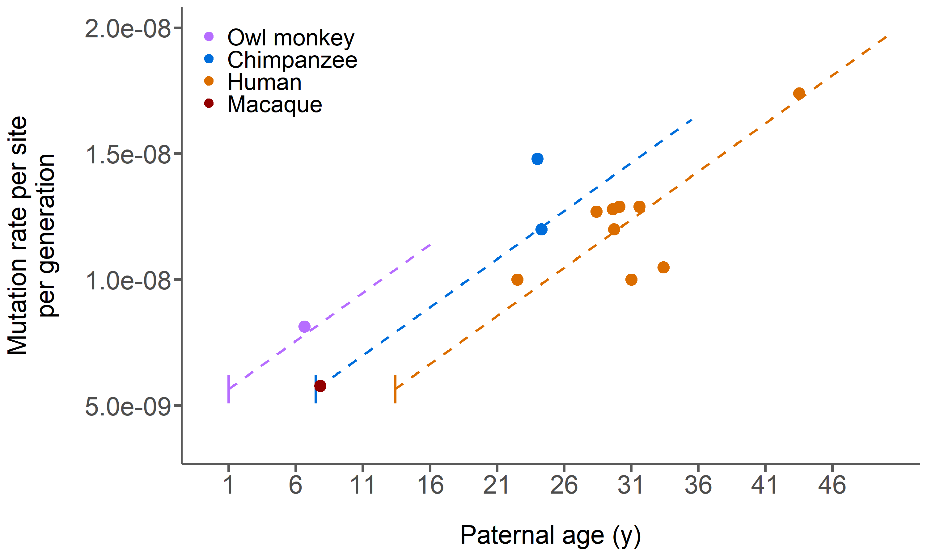
Altering puberty age predicts mutation rates for chimpanzee and owl monkey
Model fit using parameter estimates from Kong et al. data
Same parameters except puberty age
Each point = 1 study
Vertical lines = puberty age
Dashed lines = model predictions
Notes:
And when we do that for chimps and owl monkeys we find that the observed points from studies seem to match our predictions.

Slide 33
A human at age 25 passes on the same number of mutations as an owl monkey at age 12
Each point = 1 study
Vertical lines = puberty age
Dashed lines = model predictions
Notes:
This has some interesting implications. For instance, this means that a human at age 25 and an owl monkey at age 12 pass on roughly the same number of mutations to their offspring. So, if one measures mutation rates from samples with these average paternal ages, we would observe the same mutation rate per generation.

Slide 34
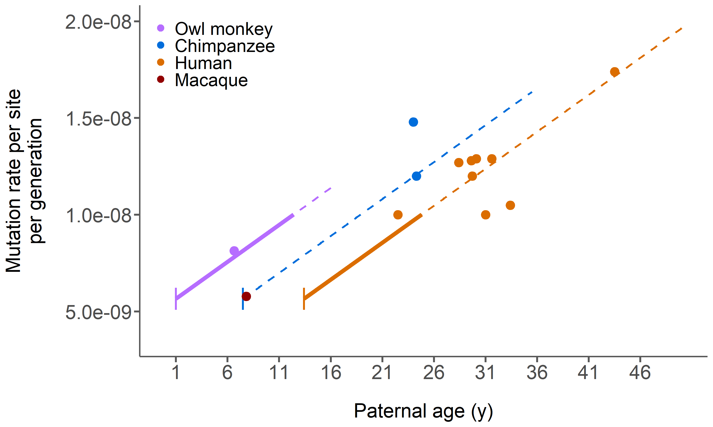
A human at age 25 passes on the same number of mutations as an owl monkey at age 12
Each point = 1 study
Vertical lines = puberty age
Dashed lines = model predictions
Notes:
And that’s because at those ages, the amount of time spent replicating the germline is the same. In other words, the reproductive longevity is equal at those ages.

Slide 35
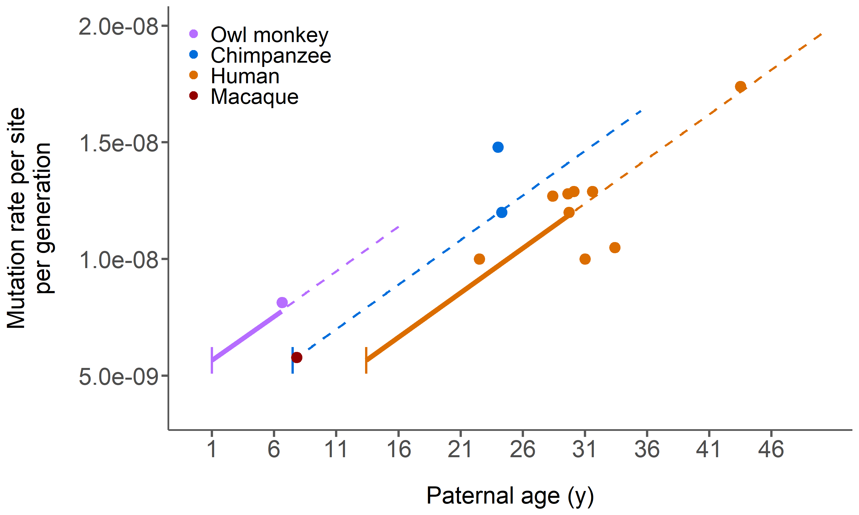
Measuring samples at different ages leads to differences in rate estimates
Each point = 1 study
Vertical lines = puberty age
Dashed lines = model predictions
Notes:
The rate differences we do observe among these species are actually an artifact of sampling at different reproductive longevities, rather than being caused by changes to the mutational machinery.

Slide 36
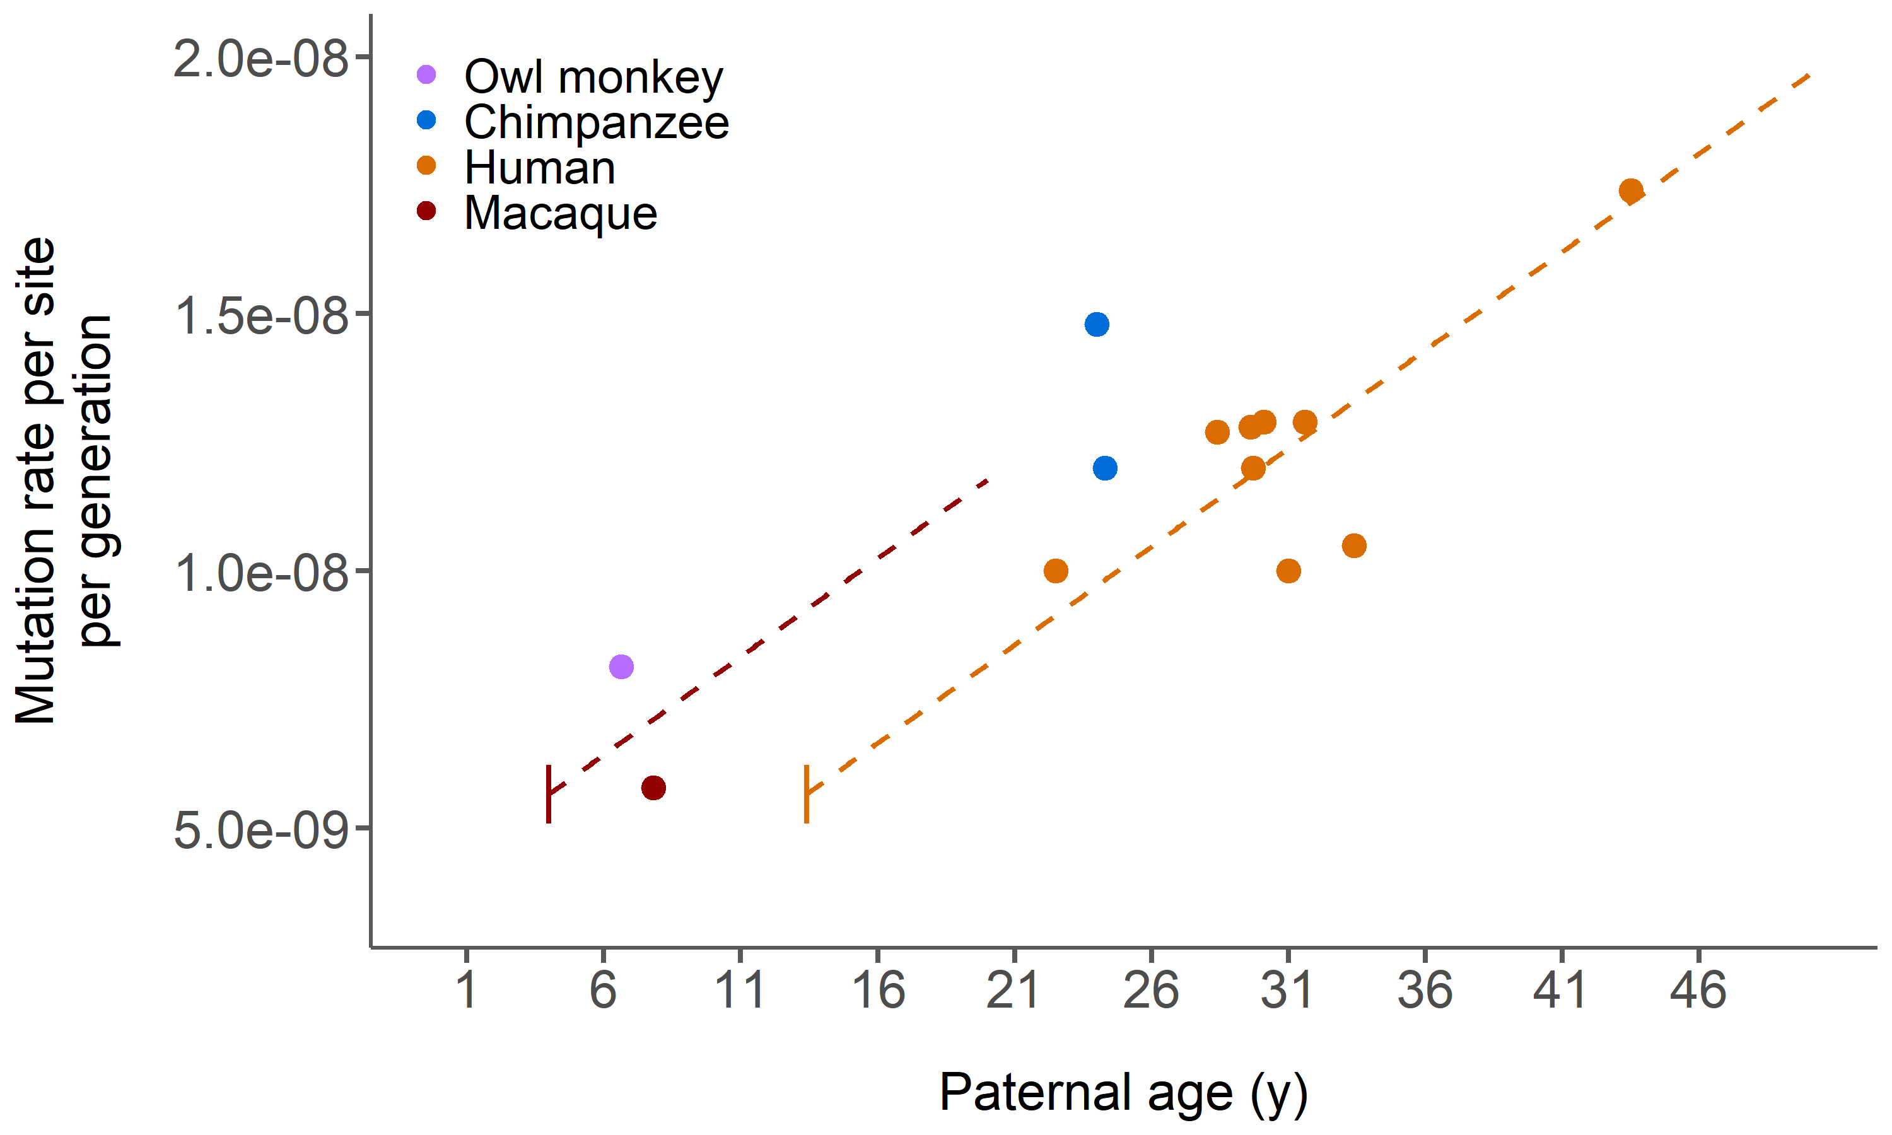
Earlier puberty age alone doesn’t explain the lower macaque rate
Each point = 1 study
Vertical lines = puberty age
Dashed lines = model predictions
Notes:
The macaque data tells a slightly different story. While shifting only the age of puberty in the model gets us pretty close to the observed rate, it is somewhat lower than the prediction.

Slide 37
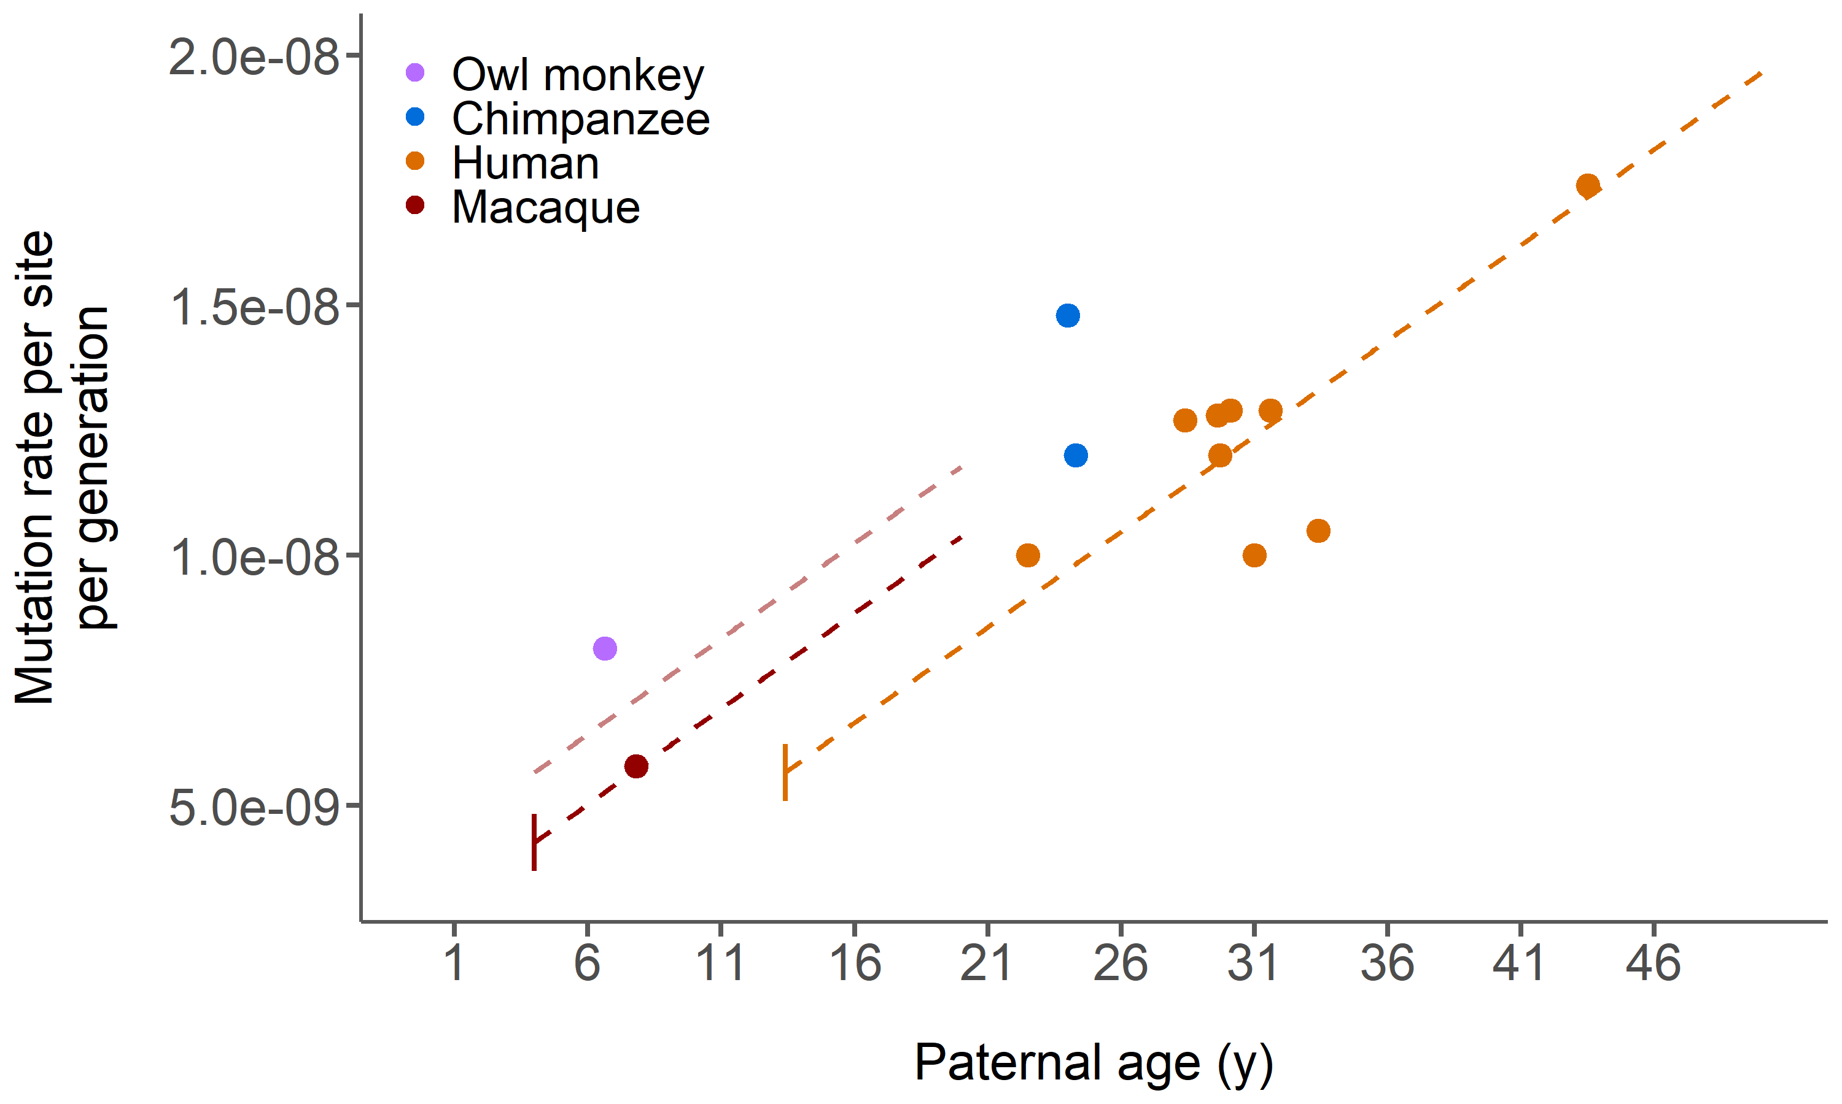
Fewer mutations accumulating before puberty in macaques
Each point = 1 study
Vertical lines = puberty age
Dashed lines = model predictions
Notes:
To explain this, we would also have to shift the number of mutations in either males before puberty. At puberty macaques have accumulated only about half the expected number based on human estimates. This can occur either by decreasing the number of cell divisions or the mutation rate per cell division.

Slide 38
Later age of puberty may offset the affects of the paternal age effect
$$μ_{g}$$
$$μ_{y}$$
Species 1 | 7.5 | 15
Species 2 | 7 | 14
Notes:
So where does this leave us with respect to the generation-time model and the Hominoid slowdown? When we left off, we said that mutations that accumulate throughout the generation of an organism contradict the generation-time model, which could lead to the longer generation time species in orange actually having a higher rate per year as well. Well, with our new pedigree data we’ve seen nothing to refute this: primates broadly tend to have similar mutation rates per generation when the age of the father is taken into account, and the one exception, the lower than expected mutation rate in macaques, would actually lead to a lower mutation rate per year as well.
Well, this data and our paternal age model can help refine this picture here. Rather than accruing throughout the lifetime of an individual, we know that

Slide 39
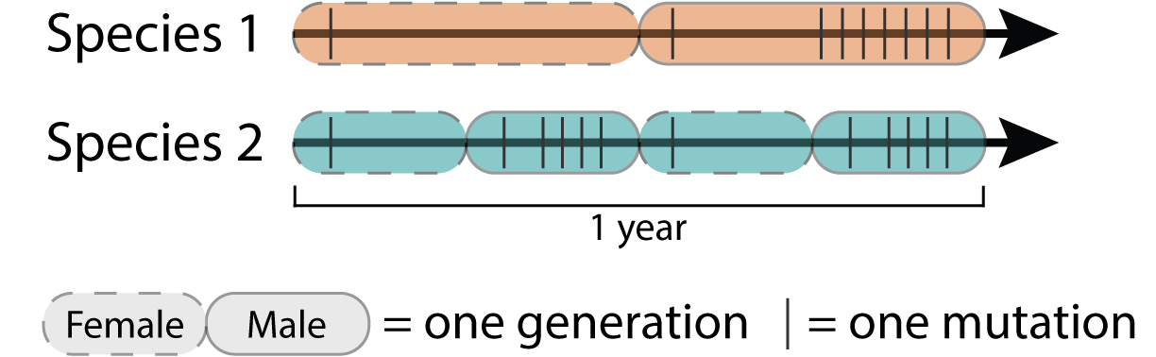
Later age of puberty may offset the affects of the paternal age effect
$$μ_{g}$$
$$μ_{y}$$
Species 1 | 4.5 | 9
Species 2 | 3 | 12
Notes:
The age of puberty plays a big role. Between birth and sexual maturity there is a gap in which the germline isn’t replicating in males which does help to reconcile the paternal age effect and the generation-time model – longer generation times tend to have later puberty ages so indeed they may be replicating their germline less over absolute time.

Slide 40
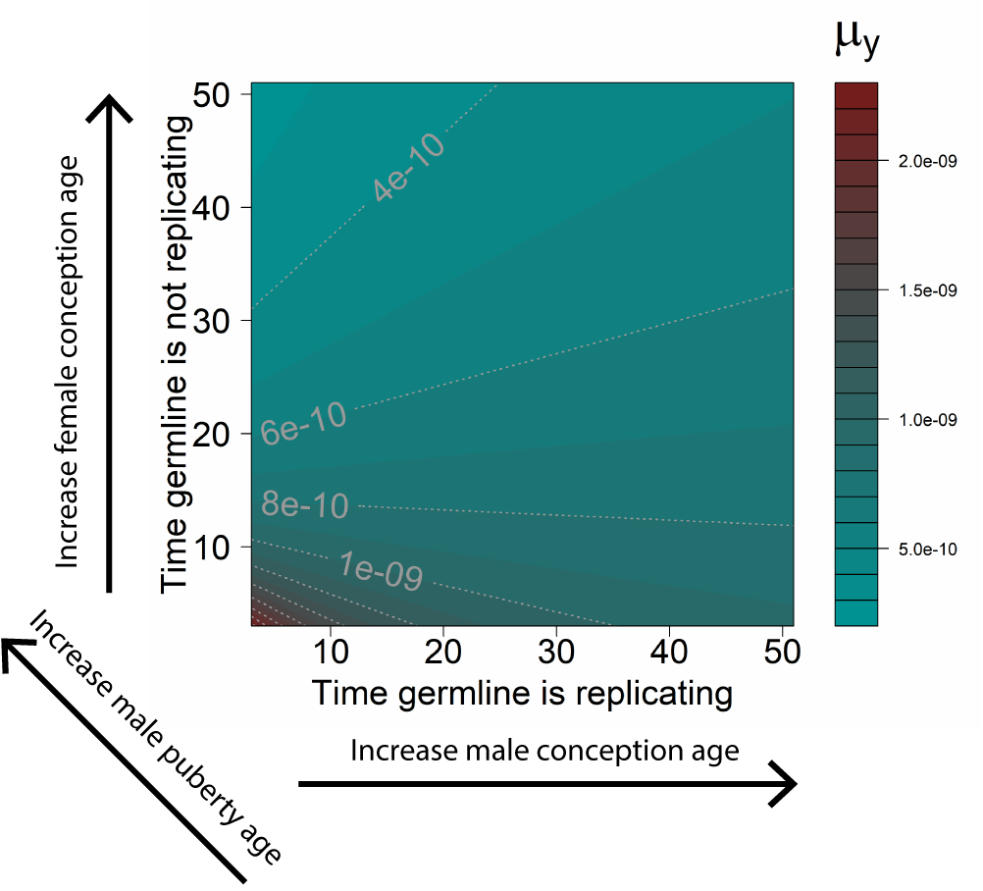
Life history traits play major role in determining mutation rate per year
Notes:
And leads us to a scenario where the paternal age effect leads to apparently higher mutation rates per generation in species with longer generation times, but also can lead to a slowdown over absolute time periods, that we observe in the Hominoid slowdown, and that we also see when using pedigree estimates of mutation rate as shown by the dots on this contour plot.

Slide 41
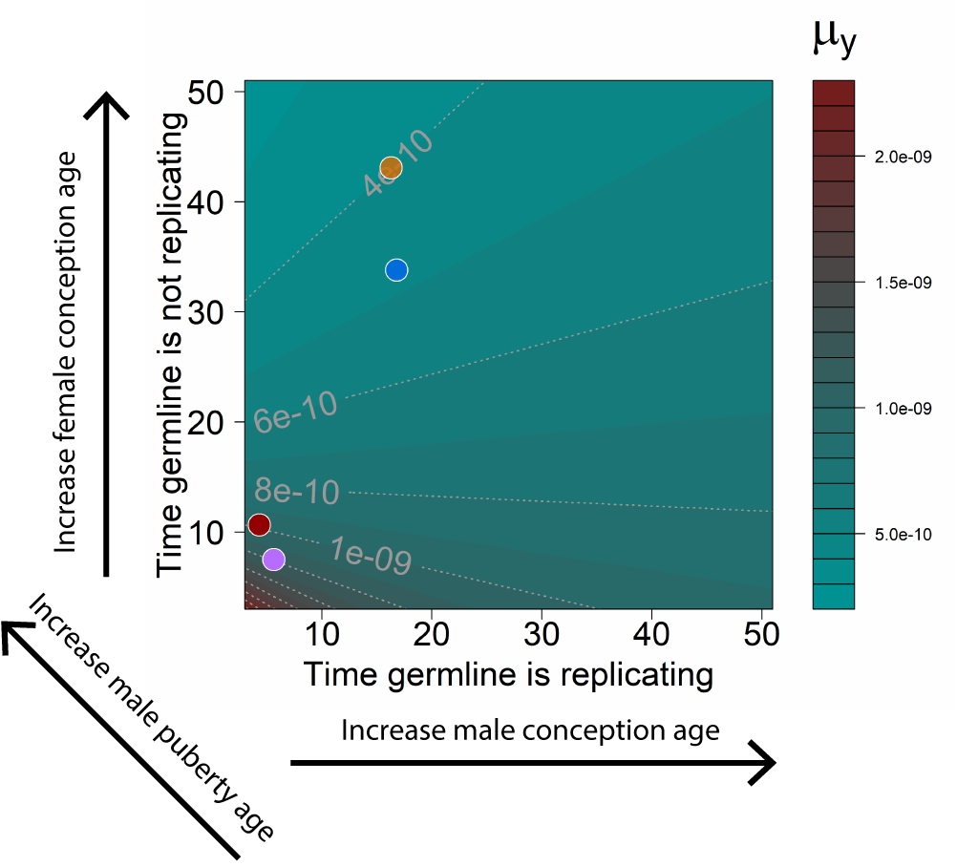
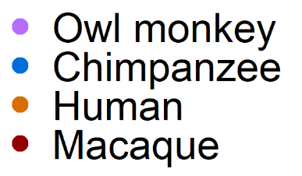
Pedigree estimates of yearly rates also support a Hominoid slowdown
Notes:
And leads us to a scenario where the paternal age effect leads to apparently higher mutation rates per generation in species with longer generation times, but also can lead to a slowdown over absolute time periods, that we observe in the Hominoid slowdown, and that we also see when using pedigree estimates of mutation rate as shown by the dots on this contour plot.

Slide 42
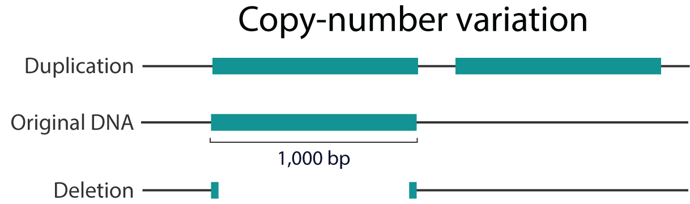
Do copy-number variants exhibit age effects?
?

Slide 43
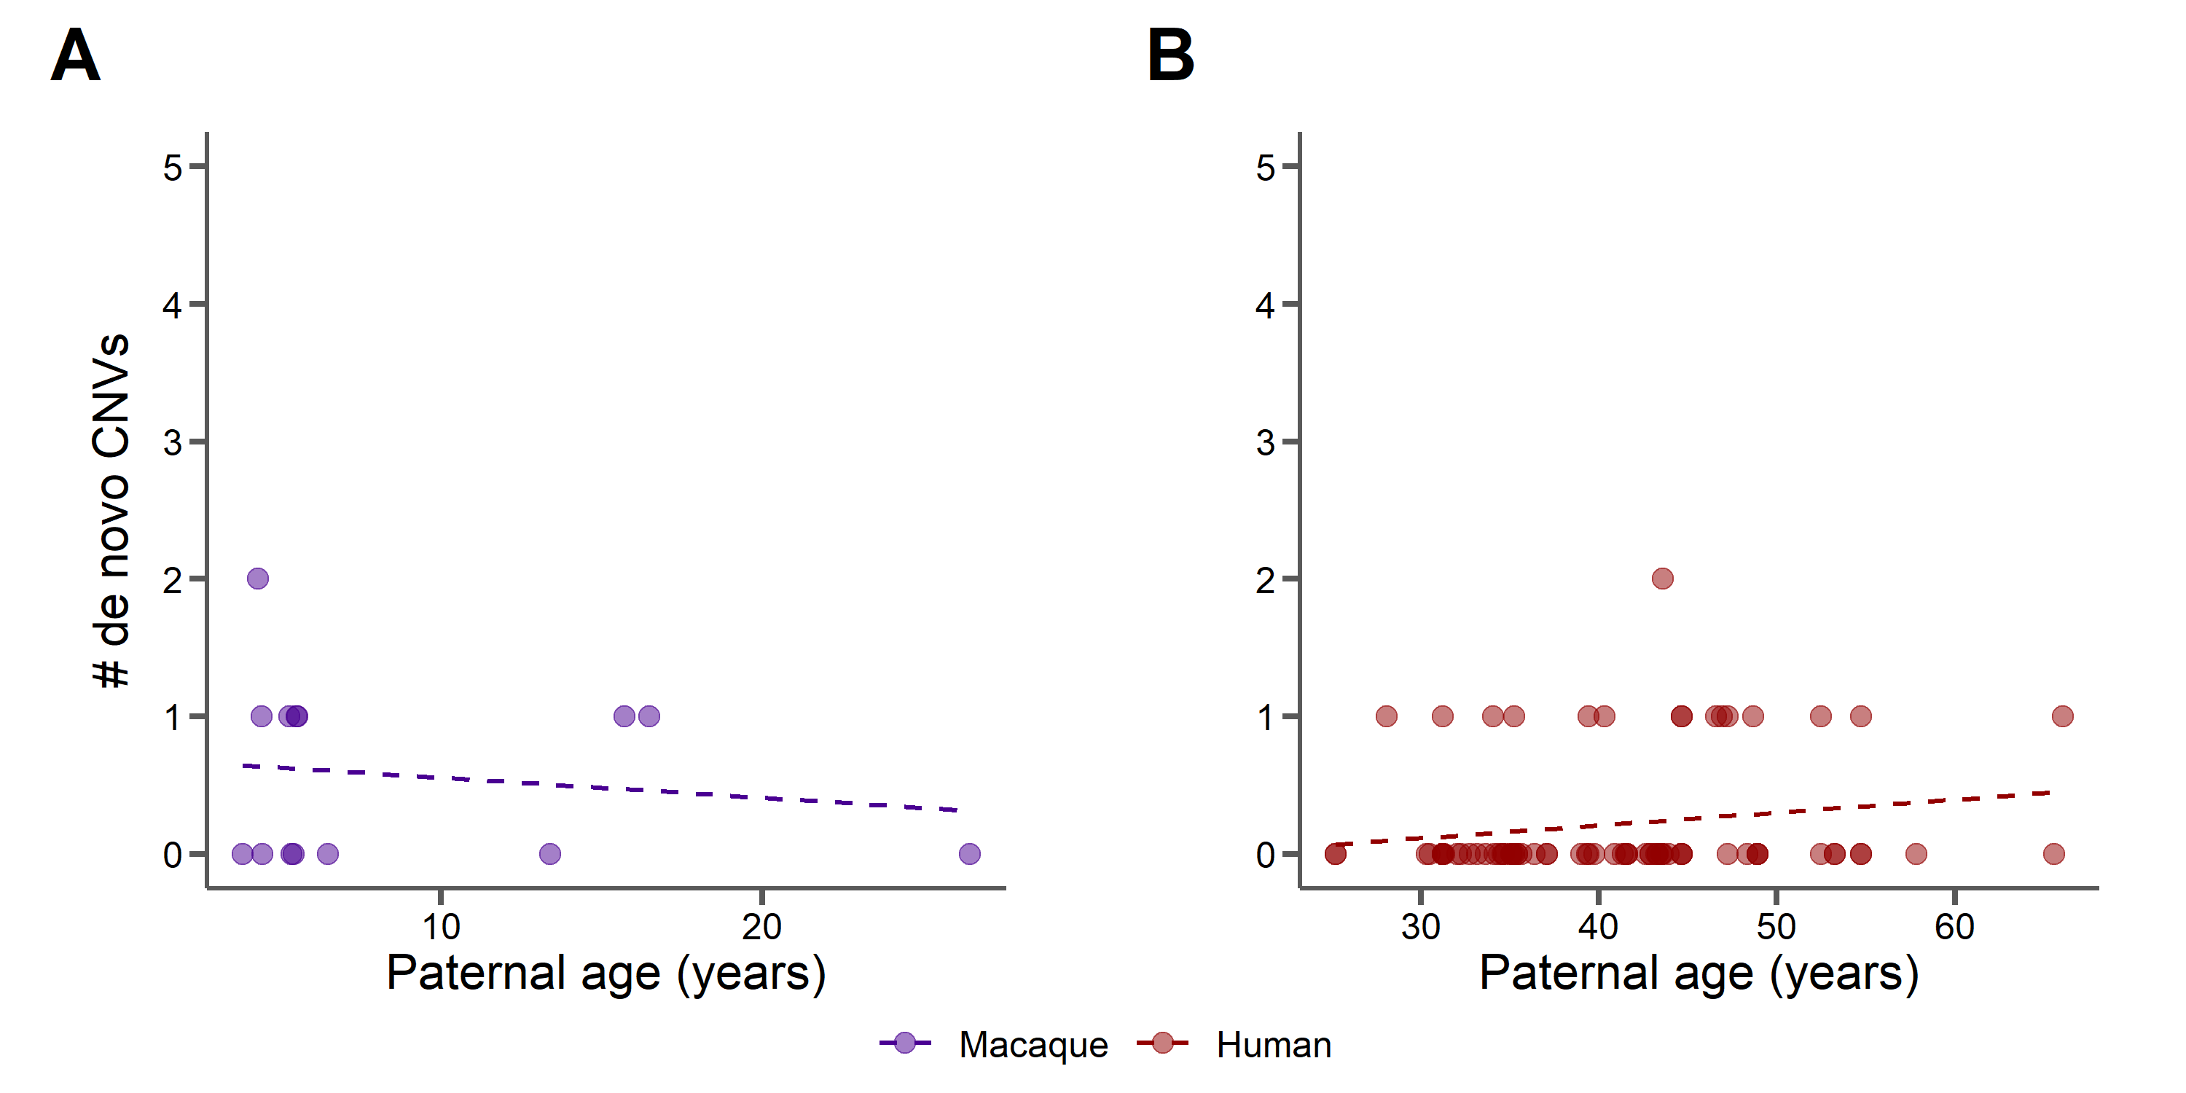
No age effects for de novo copy-number variants

Slide 44
CNVs at neutral sites are expected to follow the generation-time model
Notes:
The observed slowdown in great apes led to hypotheses to explain it, with the general consensus falling on the generation-time effect. This model supposes that species with longer generations, like great apes, will undergo fewer rounds of germline cell division in the same time period as a species with a shorter generation time. This means that species will accumulate fewer mutations in that time period.

Slide 45
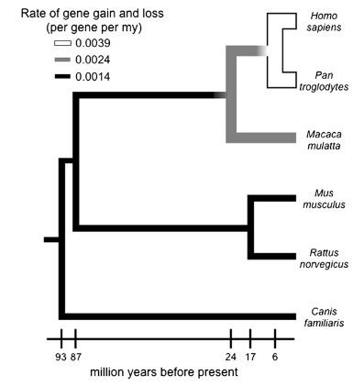
Great apes have increased rates of gene gain/loss
Hahn et al. 2007

Slide 46
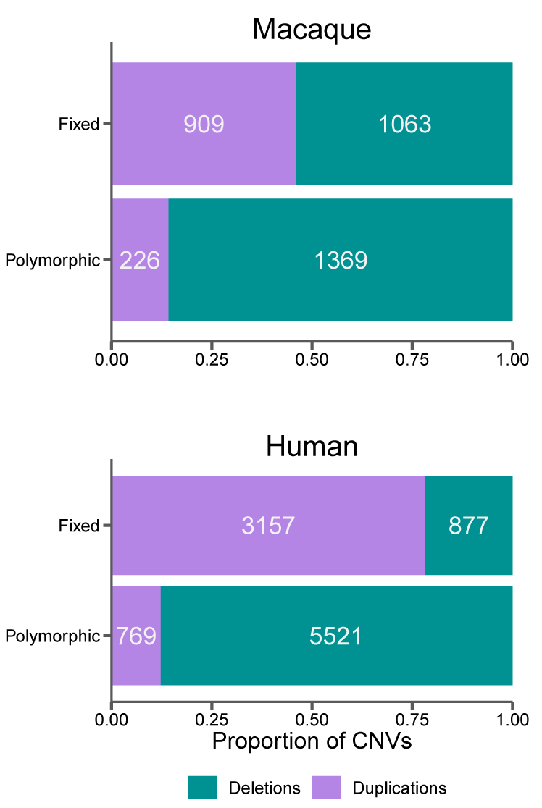
Selection may be influencing the long-term evolution of CNVs
Hahn et al. 2007

Slide 47

Acknowledgements
Indiana University
Matt Hahn
Richard Wang
Arthi Puri
Jelena Nguyen
Predrag Radivojac
University of Montana
Jeff Good + Good lab
Baylor College of Medicine
Jeff Rogers
Muthuswamy Raveendran
R. Alan Harris
University of Texas
(Bastrop colony)
Christian Abee
Lawrence Williams
The Precision Health Initiative

Slide 48
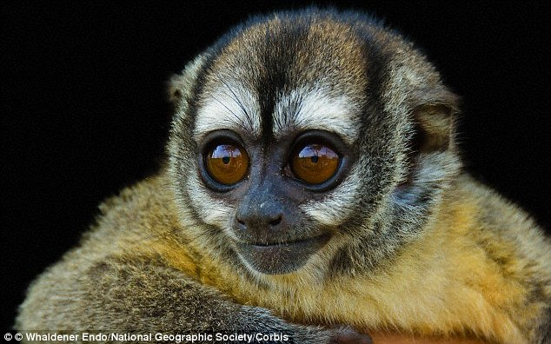
Thanks

Slide 49
Take home points
Primates have similar mutation rates per generation when paternal age is accounted for.
Macaques have fewer than expected mutations before puberty in males.
The age of puberty and the female generation time negate the paternal age effect for yearly mutation rates, leading to the Hominoid slowdown.
CNVs exhibit no paternal age effects, but selection is likely shaping their evolution.

