Slide 1

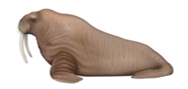

Cetacea
Pinnipedia
Sirenia
Hydrodynamic body structure with reduced neck length | Sensory adaptations
Changes in respiration and cardiac patterns | Variations in bone density
Insulating blubber layer

