Slide 1
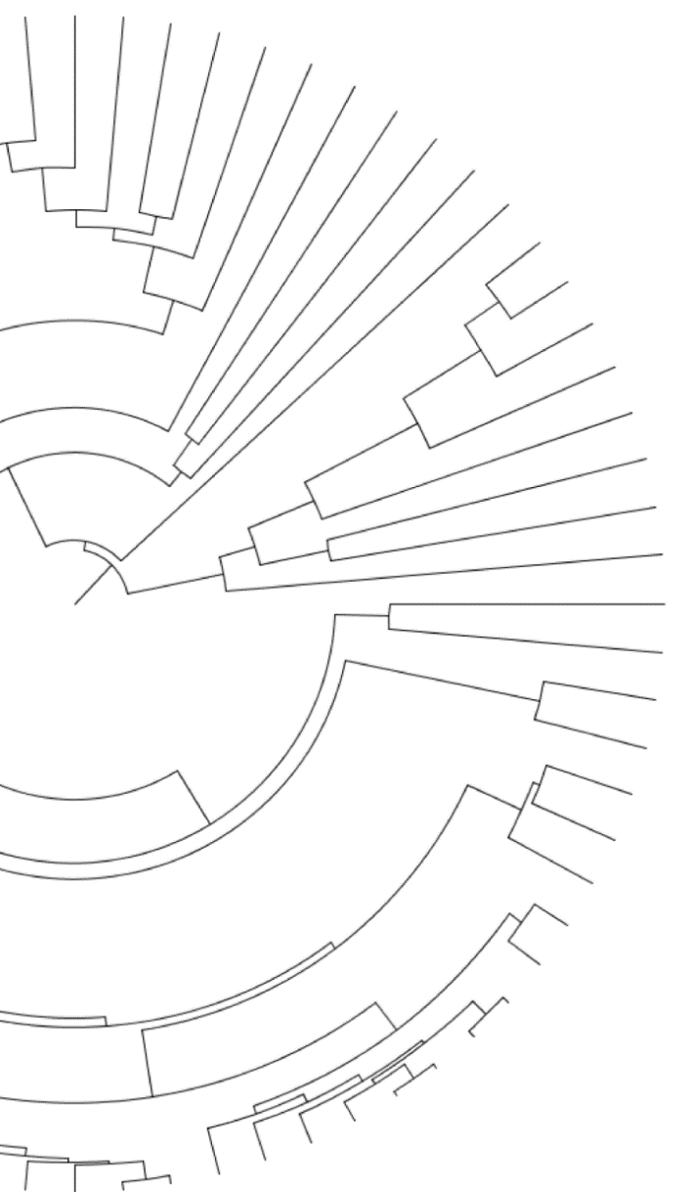



Prioritizing loci for ILS-aware rate analyses using phylogenetic concordance factors
Gregg Thomas
gwct.github.io

Slide 2
Prioritizing loci for ILS-aware rate analyses using phylogenetic concordance factors
(aka PhyloAcc part 2)
Gregg Thomas
gwct.github.io

Slide 3

ATCATCGAAGGTA

Slide 4





AACATCGGAGCCA
AACATCGGAGCCA
AACATCGGAGCCA
ATCATCGAAGGTA
GACGTCATAGCGC
= Flightless

Slide 5
AACATCGGAGCCA
AACATCGGAGCCA
AACATCGGAGCCA
ATCATCGAAGGTA
Accelerated
GACGTCATAGCGC
= Flightless
Accelerated

Slide 6
AACATCGGAGCCA
AACATCGGAGCCA
PhyloAcc v1
AACATCGGAGCCA
Hu et al. 2019
ATCATCGAAGGTA
Accelerated
GACGTCATAGCGC
= Flightless
Accelerated

Slide 7

PhyloAcc v1
Hu et al. 2019
283,369 non-coding loci
62 mammal species
2,106 loci accelerated in marine mammals
Hu et al. 2019

Slide 8
284,001 non-coding loci
42 bird species
806 loci accelerated in ratites
Sackton et al. 2019
Hu et al. 2019
PhyloAcc v1
Hu et al. 2019
283,369 non-coding loci
62 mammal species
2,106 loci accelerated in marine mammals
Hu et al. 2019

Slide 9
AACATCGGAGCCA
AACATCGGAGCCA
PhyloAcc v1
AACATCGGAGCCA
Hu et al. 2019
ATCATCGAAGGTA
Accelerated
GACGTCATAGCGC
= Flightless
Accelerated

Slide 10
AACATCGGAGCCA
AACATCGGAGCCA
PhyloAcc v1
Phylogenetic discordance poses a problem for inferring rates of molecular evolution
AACATCGGAGCCA
Hu et al. 2019
ATCATCGAAGGTA
Accelerated
GACGTCATAGCGC
= Flightless
Accelerated

Slide 11
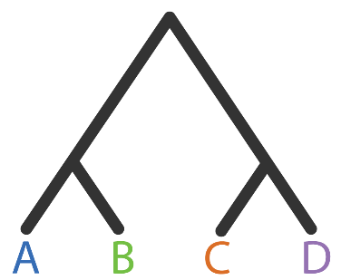
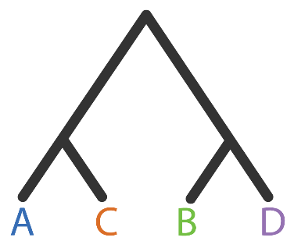
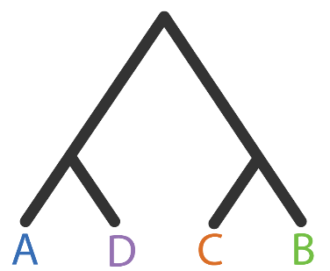
Phylogenies from different loci can disagree with each other
Gene tree 1
Gene tree 2
Gene tree 3

Slide 12
Phylogenies from different loci can disagree with an inferred species tree
Concordant
Discordant 1
Discordant 2
Gene tree 1
Gene tree 2
Gene tree 3
Species tree

Slide 13


Mapping traits or variation onto a species tree from discordant loci can cause incorrect inferences
Species tree
Gene tree
Adapted from Mendes & Hahn 2016

Slide 14

Mapping traits or variation onto a species tree from discordant loci can cause incorrect inferences
Species tree
Gene tree
1 mutation on branch (B,C)
Adapted from Mendes & Hahn 2016

Slide 15

Mapping traits or variation onto a species tree from discordant loci can cause incorrect inferences
Species tree
Gene tree
1 mutation on branch (B,C)
Adapted from Mendes & Hahn 2016

Slide 16
Mapping traits or variation onto a species tree from discordant loci can cause incorrect inferences
Species tree
Gene tree
1 mutation on branch (A,B,C)
1 mutation on branch (A)
1 mutation on branch (B,C)
Adapted from Mendes & Hahn 2016

Slide 17
AACATCGGAGCCA
AACATCGGAGCCA
PhyloAcc v1
AACATCGGAGCCA
Hu et al. 2019
ATCATCGAAGGTA
Accelerated
GACGTCATAGCGC
= Flightless
Accelerated

Slide 18


AACATCGGAGCCA
AACATCGGAGCCA
AACATCGGAGCCA
Yan et al. in prep
ATCATCGAAGGTA
Accelerated
GACGTCATAGCGC
= Flightless
Accelerated

Slide 19
AACATCGGAGCCA
713 out of 806 originally found to be accelerated in ratites are still found when using the gene tree model
AACATCGGAGCCA
AACATCGGAGCCA
Yan et al. in prep
ATCATCGAAGGTA
Accelerated
GACGTCATAGCGC
= Flightless
Accelerated

Slide 20
AACATCGGAGCCA
713 out of 806 originally found to be accelerated in ratites are still found when using the gene tree model
AACATCGGAGCCA
AACATCGGAGCCA
Gene tree models take much longer to run
Yan et al. in prep
ATCATCGAAGGTA
Accelerated
GACGTCATAGCGC
= Flightless
Accelerated

Slide 21
Runtime for Bayesian phylogenetic inference can be exorbitant
1 hour per locus
(4 threads)
284,000 loci
Sackton et al. 2019

Slide 22
Runtime for Bayesian phylogenetic inference can be exorbitant
1 hour per locus
(4 threads)
284,000 loci
32 years
Sackton et al. 2019

Slide 23
Runtime for Bayesian phylogenetic inference can be exorbitant
15 minutes per locus
(16 threads)
284,000 loci
8 years
Sackton et al. 2019

Slide 24
Runtime for Bayesian phylogenetic inference can be exorbitant
2 minutes per locus
(128 threads)
284,000 loci
1 year
Sackton et al. 2019

Slide 25
Runtime for Bayesian phylogenetic inference can be exorbitant
Some algorithms are inherently computationally intensive
2 minutes per locus
(128 threads)
284,000 loci
1 year
Sackton et al. 2019

Slide 26
Goals for efficiency and usability

Slide 27
Goals for efficiency and usability
Use phylogenetic signal from the data to inform model selection with site concordance factors
Goal 1:

Slide 28
Goals for efficiency and usability
Use phylogenetic signal from the data to inform model selection with site concordance factors
Goal 1:
Facilitate batching of loci for parallel runs on HPCs
Goal 2:

Slide 29
Goals for efficiency and usability
Use phylogenetic signal from the data to inform model selection with site concordance factors
Goal 1:
Facilitate batching of loci for parallel runs on HPCs
Goal 2:

Slide 30
Site concordance factors measure phylogenetic discordance
Concordant
Discordant 1
Discordant 2

Slide 31
Site concordance factors measure phylogenetic discordance
Concordant
Discordant 1
Discordant 2
A | G | A | C | G | A | G | G | T
B | G | A | A | T | A | T | G | T
C | T | A | C | G | C | T | G | T
D | T | A | C | T | C | G | G | A

Slide 32
Site concordance factors measure phylogenetic discordance
Concordant
Discordant 1
Discordant 2
A | G | A | C | G | A | G | G | T
B | G | A | A | T | A | T | G | T
C | T | A | C | G | C | T | G | T
D | T | A | C | T | C | G | G | A

Slide 33
Site concordance factors measure phylogenetic discordance
Concordant
Discordant 1
Discordant 2
A | G | A | C | G | A | G | G | T
B | G | A | A | T | A | T | G | T
C | T | A | C | G | C | T | G | T
D | T | A | C | T | C | G | G | A

Slide 34
Site concordance factors measure phylogenetic discordance
Concordant
For each branch in the species tree:
$$sCF_{quartet}=\frac{Number of alignment sites with concordant grouping }{Total number of decisive alignment sites}$$
Minh et al. 2019, IQ-TREE 2
A | G | A | C | G | A | G | G | T
B | G | A | A | T | A | T | G | T
C | T | A | C | G | C | T | G | T
D | T | A | C | T | C | G | G | A

Slide 35
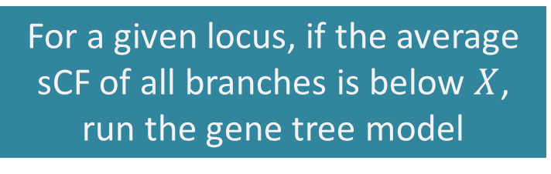
Using average site concordance to partition loci to different phylogenetic models
For a given locus, if the average sCF of all branches is below $X$, run the gene tree model

Slide 36
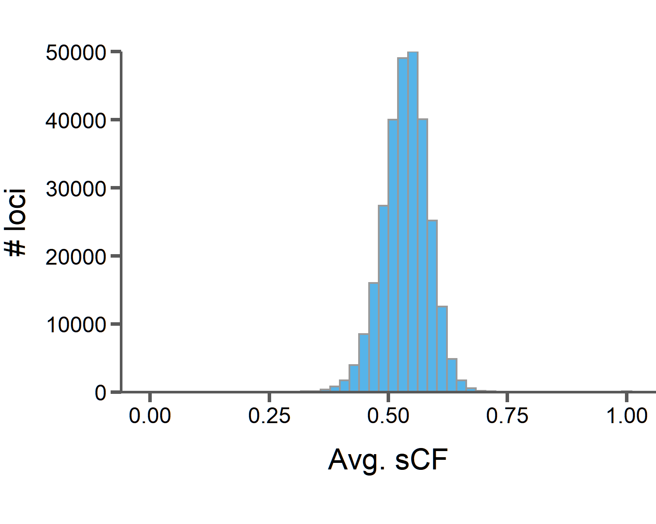
Using average site concordance to partition loci to different phylogenetic models
For a given locus, if the average sCF of all branches is below $X$, run the gene tree model

Slide 37
Using average site concordance to partition loci to different phylogenetic models
For a given locus, if the average sCF of all branches is below $X$, run the gene tree model
Avg. sCF = 0.4
1,659 loci for gene tree model
17 days with 16 threads

Slide 38
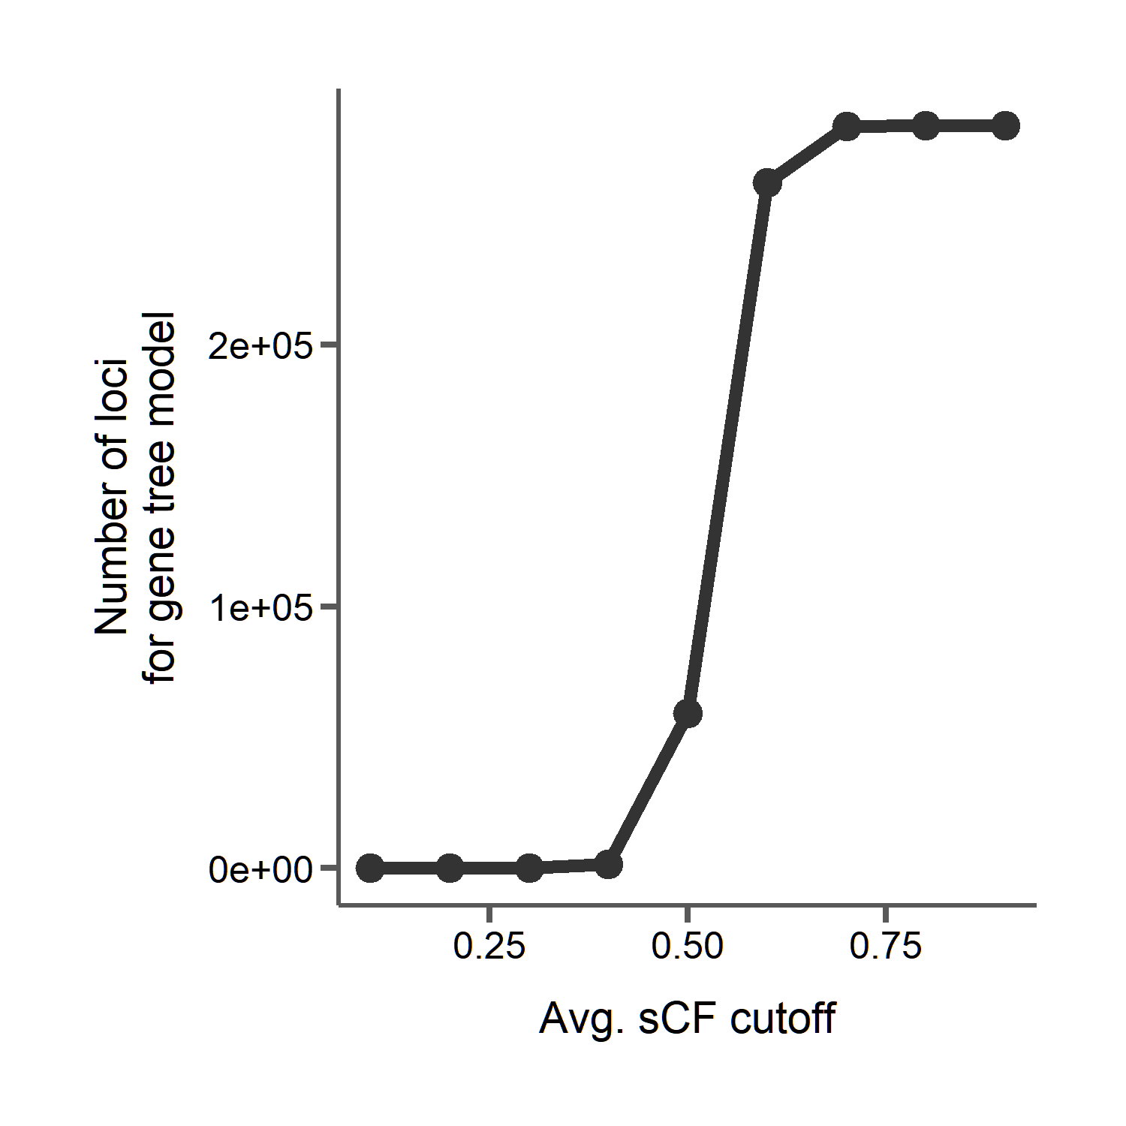
Using average site concordance to partition loci to different phylogenetic models

Slide 39
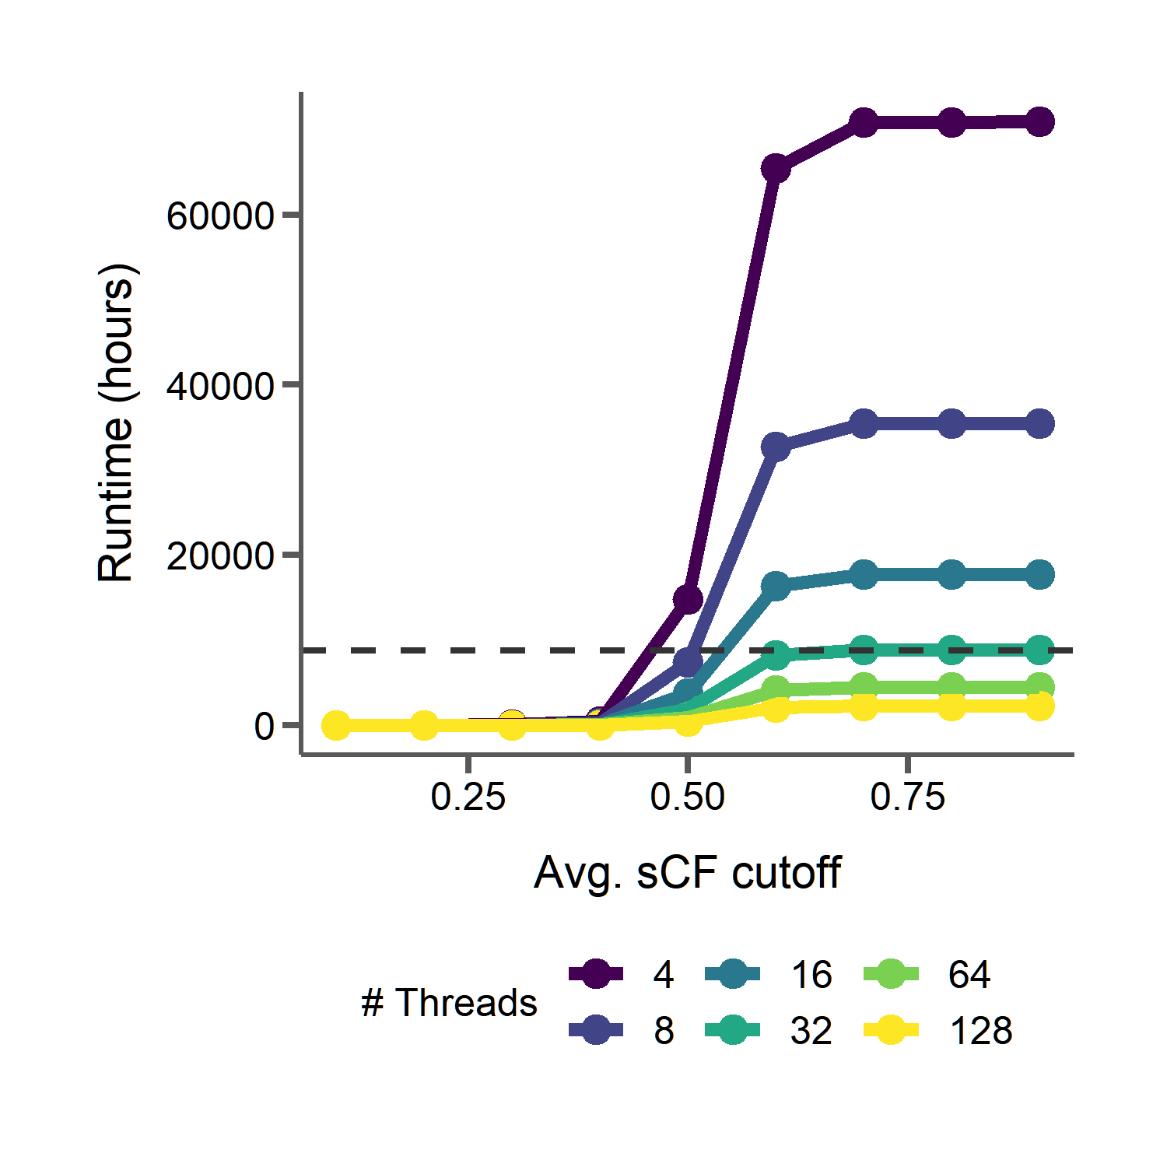
Using average site concordance to partition loci to different phylogenetic models
1 year

Slide 40
Goals for efficiency and usability
Use phylogenetic signal from the data to inform model selection with site concordance factors
Goal 1:
Facilitate batching of loci for parallel runs on HPCs
Goal 2:

Slide 41
Not all situations require the most complicated model
Goals for efficiency and usability
Use phylogenetic signal from the data to inform model selection with site concordance factors
Goal 1:
Facilitate batching of loci for parallel runs on HPCs
Goal 2:

Slide 42
Not all situations require the most complicated model
Goals for efficiency and usability
Use phylogenetic signal from the data to inform model selection with site concordance factors
Goal 1:
Trade years of CPU time for ~1 hour to calculate sCF
Drastically reduce the number of compute cycles and energy used
Facilitate batching of loci for parallel runs on HPCs
Goal 2:

Slide 43
Not all situations require the most complicated model
Goals for efficiency and usability
Use phylogenetic signal from the data to inform model selection with site concordance factors
Goal 1:
Trade years of CPU time for ~1 hour to calculate sCF
Drastically reduce the number of compute cycles and energy used
No need to pre-estimate gene trees
Facilitate batching of loci for parallel runs on HPCs
Goal 2:

Slide 44
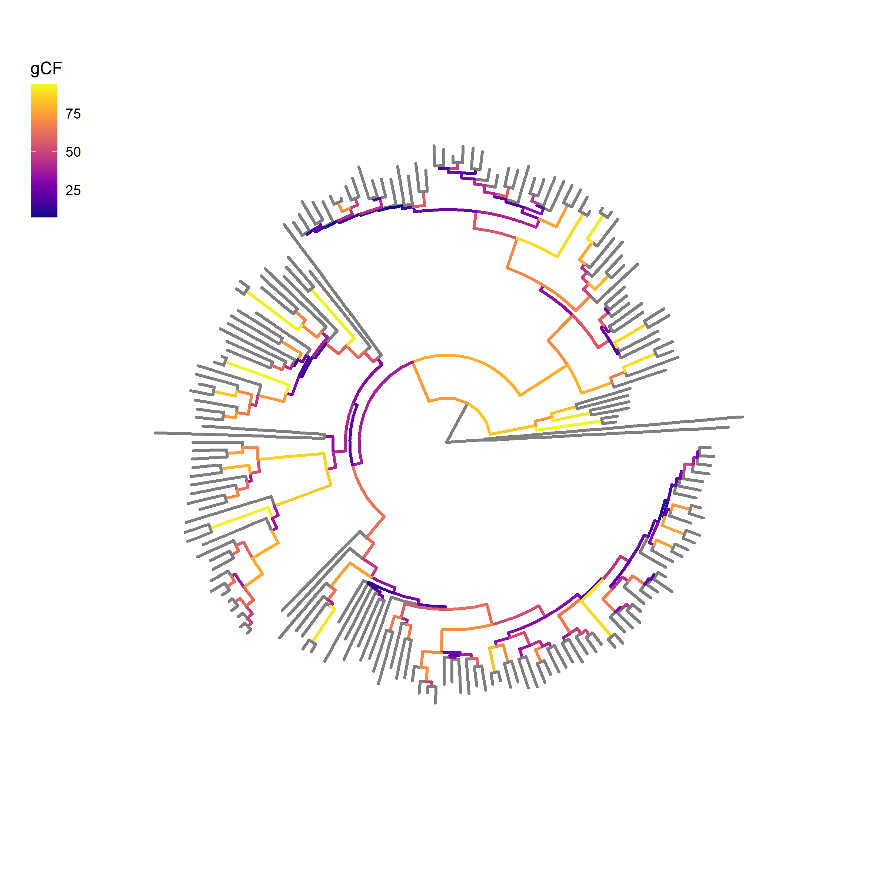
Concordance factors can also be used to reduce tree-size
~12,000 genes
188 species rodent phylogeny

Slide 45
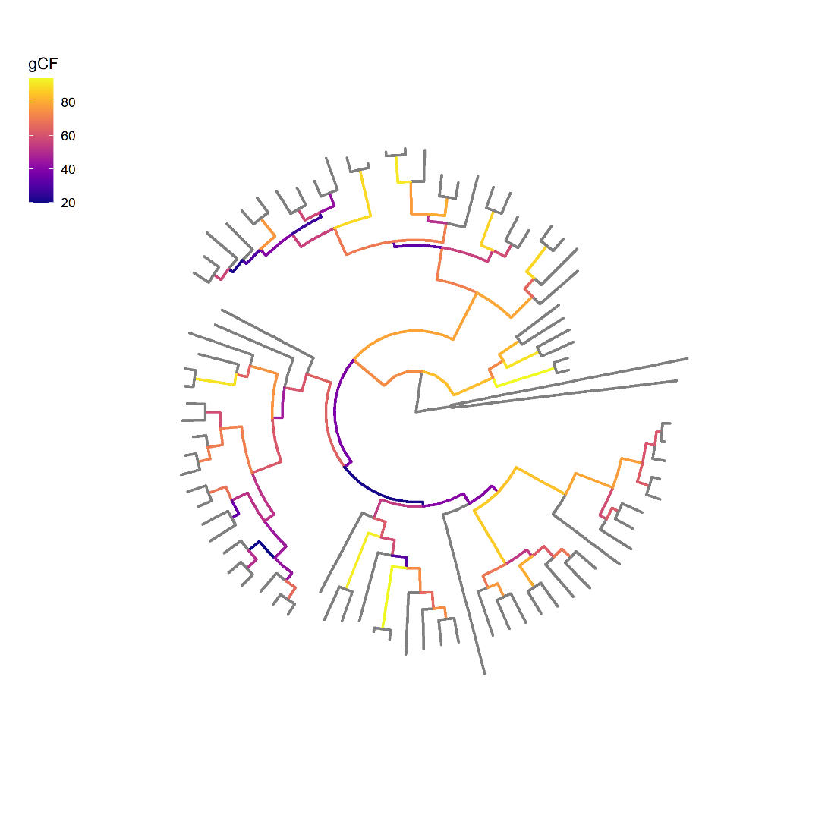
Concordance factors can also be used to reduce tree-size
~12,000 genes
Prune based on concordance and branch length
188 species rodent phylogeny
83 species pruned rodent phylogeny

Slide 46

Concordance factors can also be used to reduce tree-size
~12,000 genes
Prune based on concordance and branch length
https://github.com/gwct/bonsai
188 species rodent phylogeny
83 species pruned rodent phylogeny

Slide 47
Goals for efficiency and usability
Use phylogenetic signal from the data to inform model selection with site concordance factors
Goal 1:
Facilitate batching of loci for parallel runs on HPCs
Goal 2:

Slide 48
Inputs
+
PhyloAcc C++
Rates
Alignments
+
Neutral rates

Slide 49
Inputs
+
PhyloAcc
Python interface
Alignments
+
Neutral rates

Slide 50
Gene tree batch
Inputs
Gene tree batch
Species tree batch
Species tree batch
Species tree batch
+
PhyloAcc
Python interface
Alignments
Species tree batch
.
.
.
+
Neutral rates
Filtered loci
Snakemake script for job submission

Slide 51

Gene tree batch
PhyloAcc-GT C++
Inputs
Gene tree batch
PhyloAcc-GT C++
Species tree batch
PhyloAcc C++
Species tree batch
PhyloAcc C++
Species tree batch
PhyloAcc C++
+
PhyloAcc
Python interface
Rates
Alignments
Species tree batch
PhyloAcc-GT C++
.
.
.
+
PhyloAcc C++
Neutral rates
Filtered loci
Snakemake script for job submission

Slide 52
Gene tree batch
PhyloAcc-GT C++
Inputs
Gene tree batch
PhyloAcc-GT C++
Species tree batch
PhyloAcc C++
Species tree batch
PhyloAcc C++
Species tree batch
PhyloAcc C++
+
PhyloAcc
Python interface
Rates
Alignments
Species tree batch
PhyloAcc-GT C++
.
.
.
+
PhyloAcc C++
Neutral rates
Filtered loci
Snakemake script for job submission

Slide 53
Batching loci by model type can also drastically reduce runtime for PhyloAcc
1 year

Slide 54
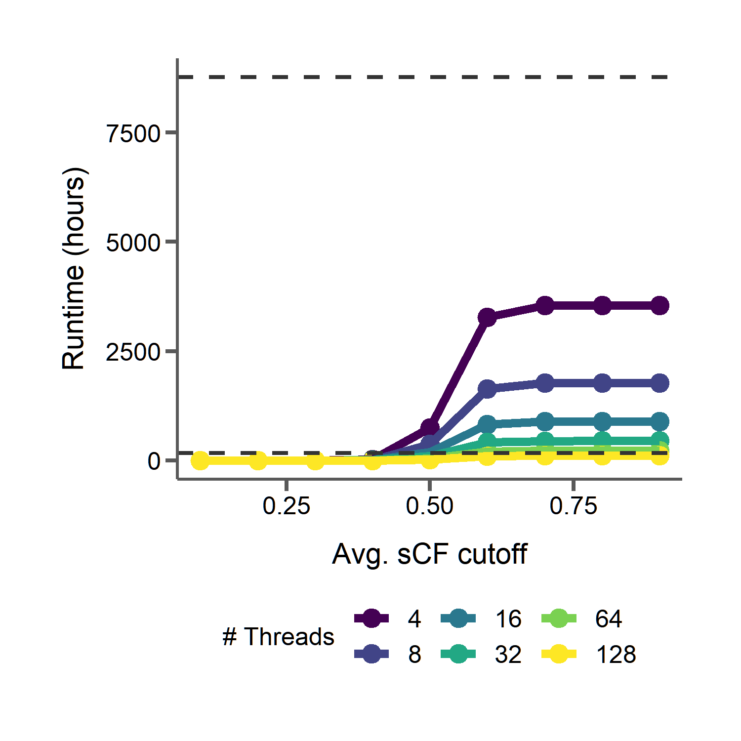
Batching loci by model type can also drastically reduce runtime for PhyloAcc
1 year
20 batches
1 year
1 week

Slide 55
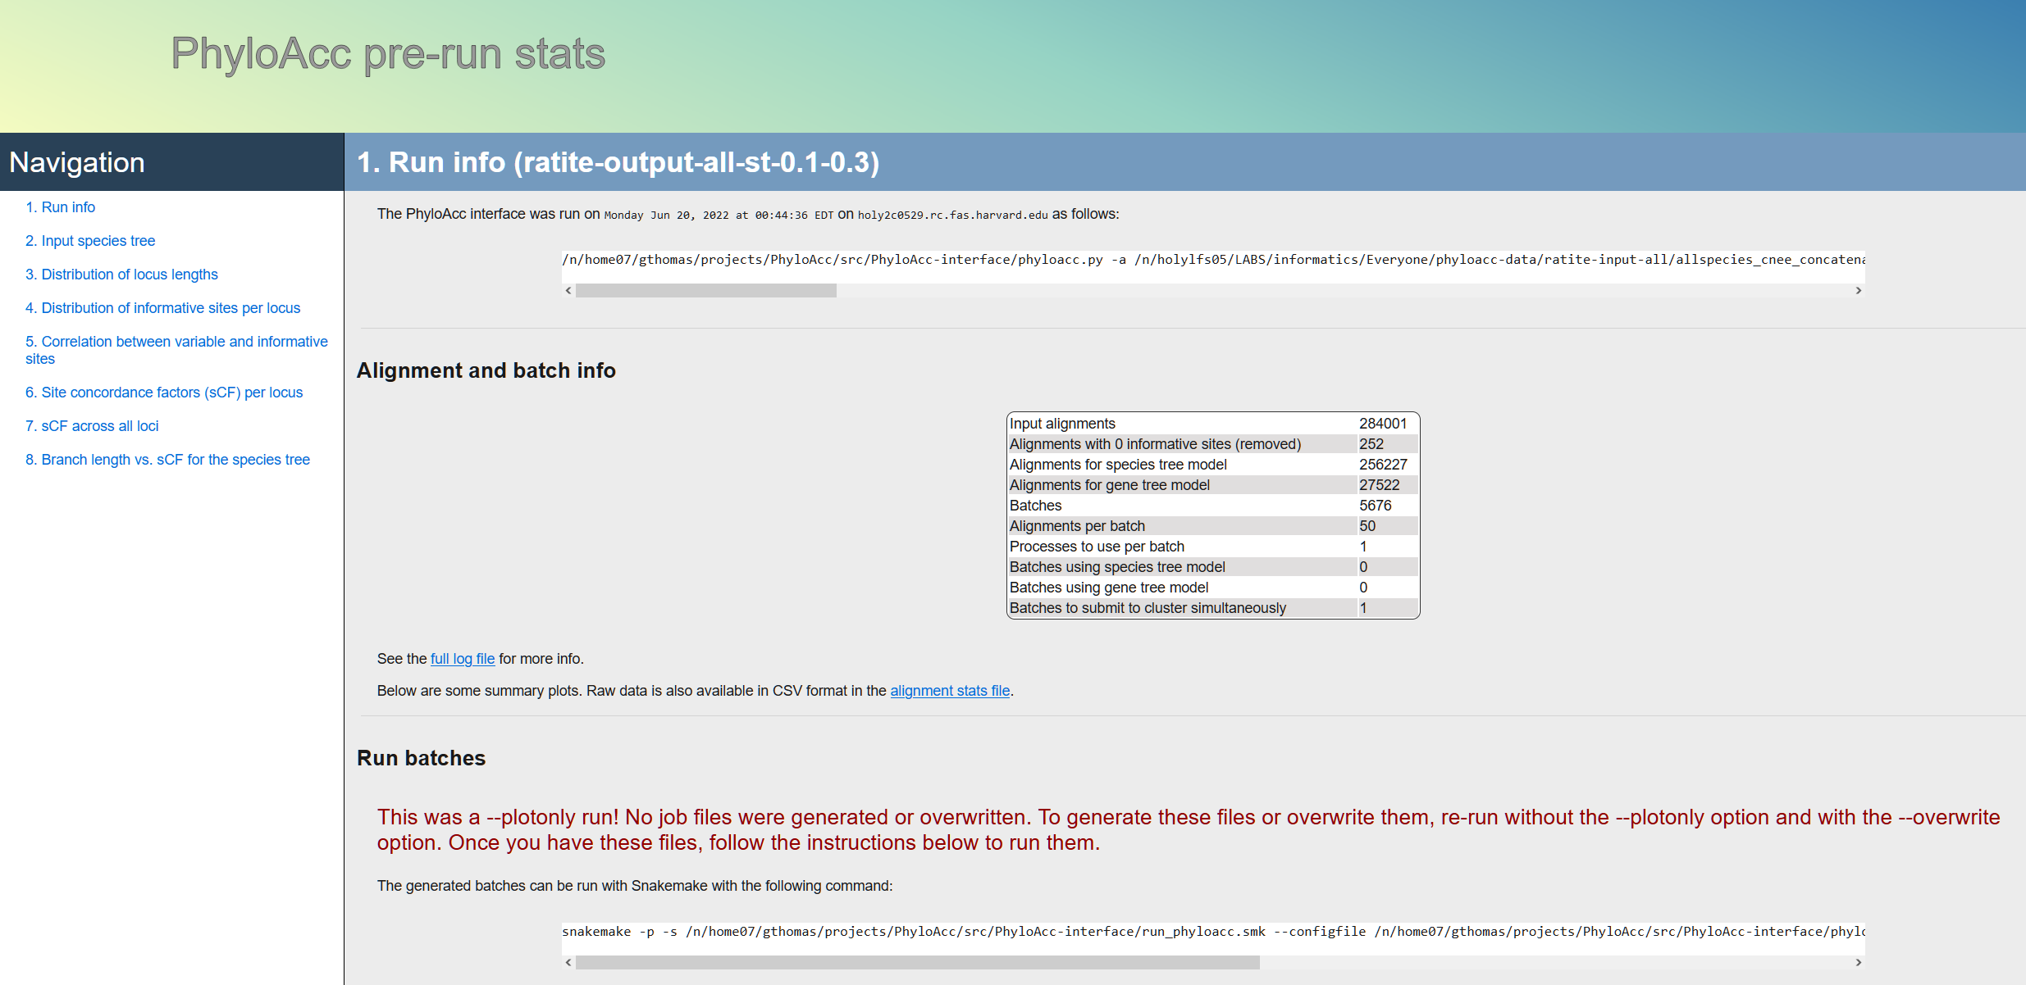

Slide 56
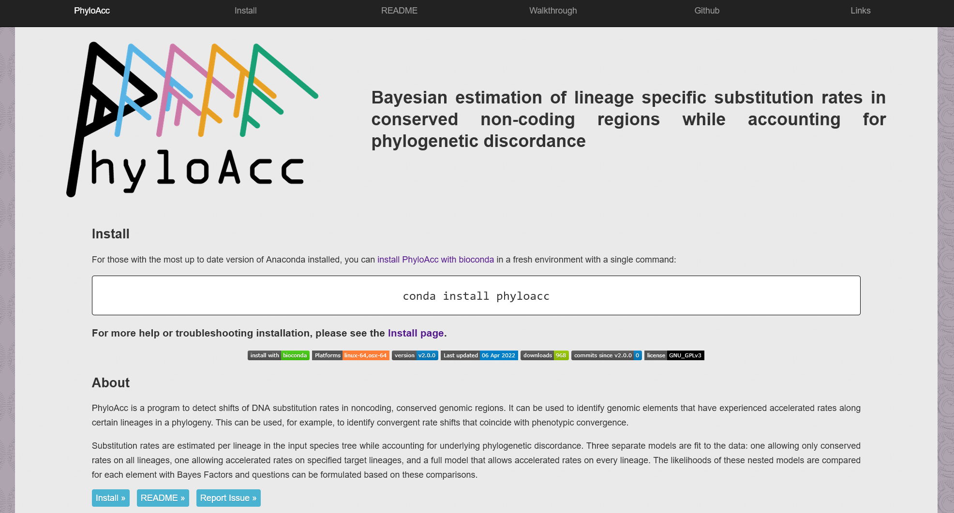
https://phyloacc.github.io/

Slide 57






Tim Sackton | Han Yan | Scott Edwards
Zhirui Hu | Jun Liu | Nathan Weeks
Patrick Gemmell | Taehee Lee | Subir Shakya
Adam Freedman | Danielle Khost | Daren Card
Acknowledgements
Jeff Good | Emily Kopania | Carl Hutter
Jake Esselstyn | Kevin Rowe | Sebastian Mortimer
Clara Boothby

Slide 58
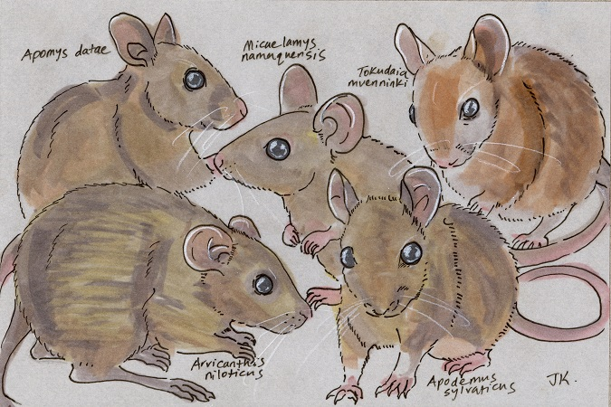
Thanks
Molecular and morphological evolution across the most species-rich radiation in mammals (Poster board 105) TODAY!
http://dailymammal.com/murines-five-ways/

