Slide 1
Accounting for sequencing error in phylogenetics
Gregg Thomas
Indiana University
Society of Systematic Biologists Conference, Ann Arbor, MI
05.21.15

Slide 2
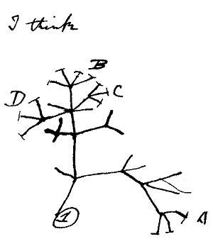
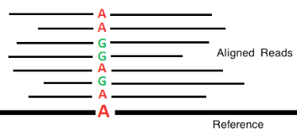
Evolution
Genomics
Phylogenetics

Slide 3
Evolution
Genomics
Phylogenetics
Gene family evolution
Convergent evolution
Mutation rate variation
Divergence time estimation

Slide 4
Evolution
Error prone!
Genomics
Phylogenetics
Gene family evolution
Convergent evolution
Mutation rate variation
Divergence time estimation

Slide 5
Evolution
Error prone!
Genomics
Phylogenetics
Gene copy number error
Gene family evolution
Convergent evolution
Mutation rate variation
Divergence time estimation

Slide 6
Evolution
Error prone!
Genomics
Phylogenetics
Gene copy number error
Gene family evolution
Convergent evolution
Mutation rate variation
Divergence time estimation
Base calling errors

Slide 7
Accounting for error by probabilistic modeling
Incorporate more information from next generation sequencing into the phylogenetic reconstruction process

Slide 8
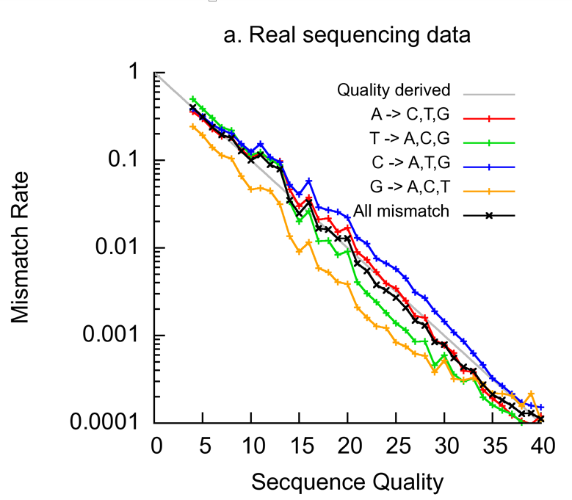
Next generation sequence data is error prone
Quality Score
Hu et al, 2012

Slide 9
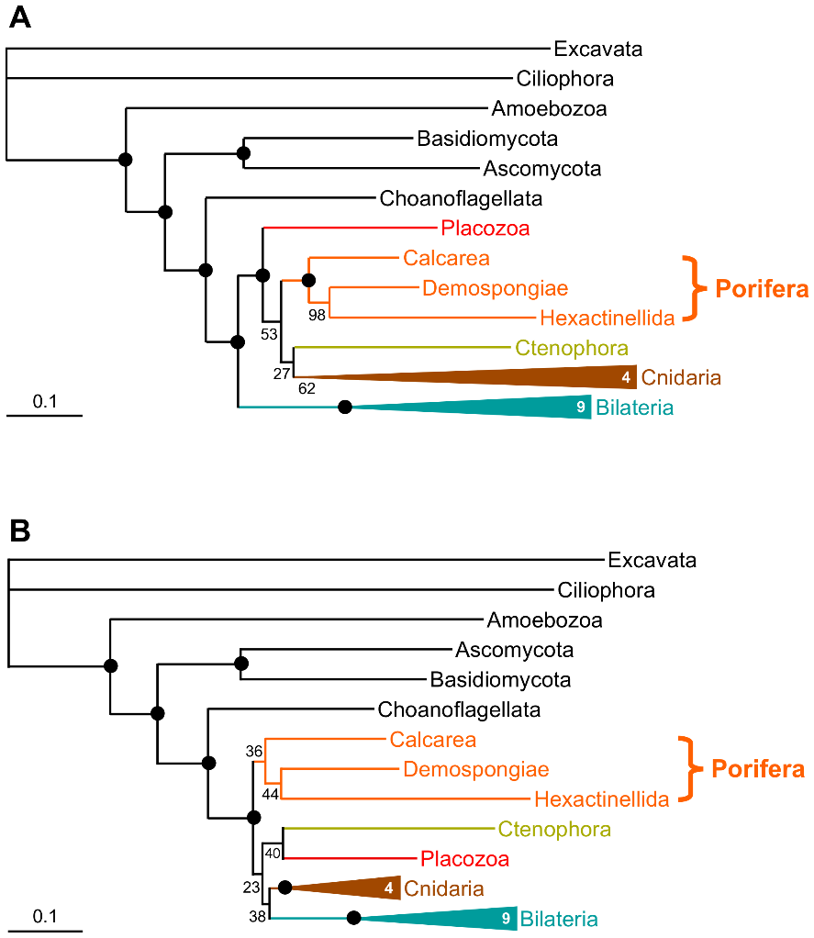
Next generation sequence data is error prone
Quality Score
Hu et al, 2012
Philippe et al, 2012

Slide 10
Phylogenetic reconstructions start with observed state probabilities of 1 or 0
A | T | C | G
1 | 0 | 0 | 0
A
A | T | C | G
0 | 0 | 0 | 1
G
A | T | C | G
1 | 0 | 0 | 0
A

Slide 11
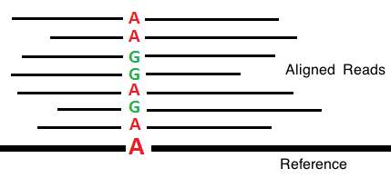
Next generation sequencing gives us more information
A | T | C | G
1 | 0 | 0 | 0
A
G
Aligned reads
G
Assembly
A | T | C | G
1 | 0 | 0 | 0
A

Slide 12
Model observed states probabilistically
A | T | C | G
0.8 | 0 | 0.1 | 0.1
A
A | T | C | G
0.6 | 0 | 0 | 0.4
G
A | T | C | G
0.9 | 0.1 | 0 | 0
A

Slide 13
Capturing uncertainty from NGS
Aligned reads
G
Assembly

Slide 14
Capturing uncertainty from NGS
Aligned reads
G
Assembly
No quality information

Slide 15
Capturing uncertainty from NGS
Each read has a quality score
Aligned reads
G
Assembly

Slide 16
Capturing uncertainty from NGS
Each read has a quality score
Aligned reads
G
Assembly
Map reads back to assembly and compile quality information

Slide 17

Capturing uncertainty from ngs data
The probability a given base is an error:
$$P\left(E\right)={10}^{−\frac{Q}{10}}$$
$$P\left(!E\right)=1 −P\left(E\right)$$

Slide 18
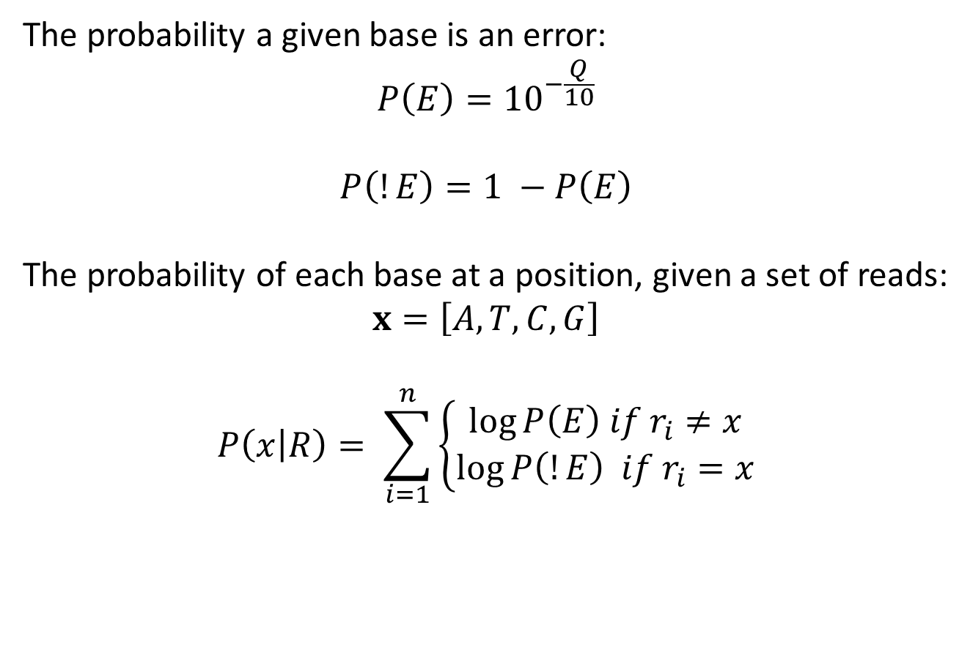
Capturing uncertainty from ngs data
The probability a given base is an error:
$$P\left(E\right)={10}^{−\frac{Q}{10}}$$
$$P\left(!E\right)=1 −P\left(E\right)$$
The probability of each base at a position, given a set of reads:
$$x=\left[A,T,C,G\right]$$
$$P\left(x | R\right)= \sum_{i=1}^{n}{\left\{\begin{aligned}\log{P\left(E\right) if r_{i}≠x} \\ \log{P\left(!E\right) if r_{i}=x}\end{aligned}\right.}$$

Slide 19
Conclusions
Currently benchmarking on simulated data
Will add quality metric to all NGS assemblies
Focus on phylogenetic reconstructions

Slide 20

Acknowledgements
Advisor:
Matt Hahn
Committee:
Haixu Tang
Elizabeth Housworth
Colleagues:
James Pease
Simo Zhang
Fabio Mendes
Rafael Guerrero
Jeff Adrion
Ben Rosenzweig
GCMS Training Grant
Notes:
Acknowledgments

