Slide 1
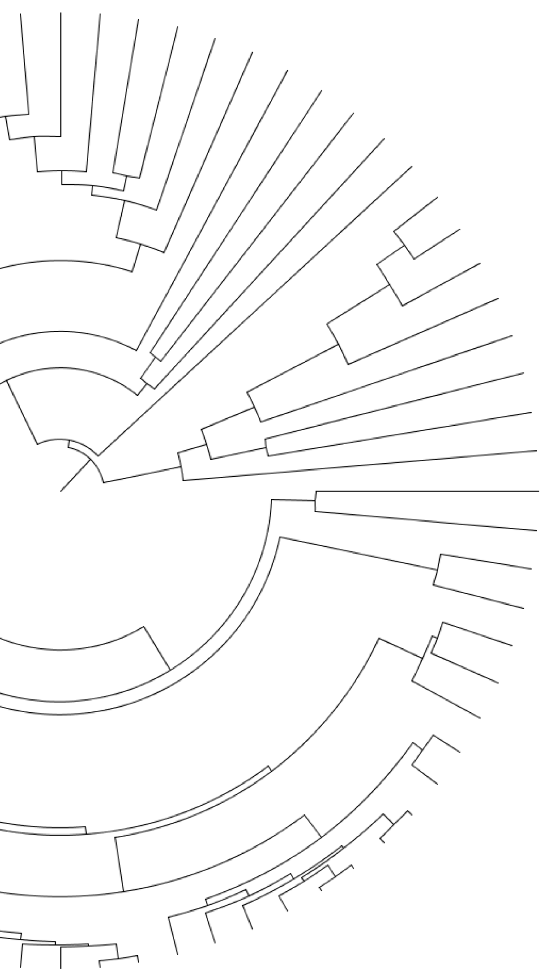
Gene-tree reconciliation with MUL-trees for polyploid analysis
Gregg Thomas, S. Hussain Ather,
and Matthew Hahn
Indiana University

Slide 2
Background: Polyploidy
The presence of additional sets of chromosomes in an organism due to whole genome duplication (WGD).

Slide 3
Background: Polyploidy
The presence of additional sets of chromosomes in an organism due to whole genome duplication (WGD).
Gene trees look like:
Autopolyploidy
A
B
B
C
D

Slide 4
Background: Polyploidy
The presence of additional sets of chromosomes in an organism due to whole genome duplication (WGD).
Gene trees look like:
Autopolyploidy
A
B
B
C
D
Allopolyploidy
A
B
C
B
D

Slide 5
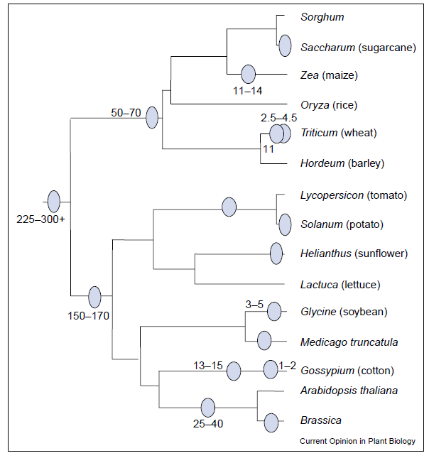
Background: Polyploidy
The presence of additional sets of chromosomes in an organism due to whole genome duplication (WGD).
Adams and Wendel, 2005

Slide 6
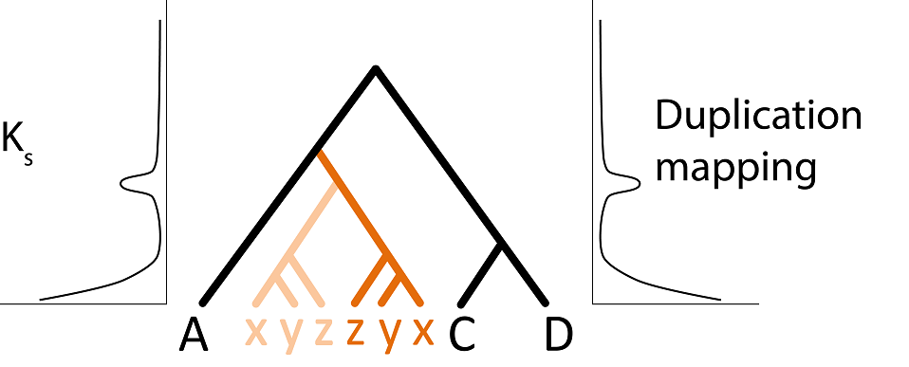
Methods to date polyploidy
Counts:
1
2
2
2
1
1

Slide 7
Methods to date polyploidy
Phylogeny-based duplication mapping
Counts:
1
2
2
2
1
1

Slide 8
Methods to date polyploidy
Phylogeny-based duplication mapping
Counts:
1
2
2
2
1
1

Slide 9
Methods to date polyploidy*
Phylogeny-based duplication mapping
Counts:
1
2
2
2
1
1
*Autopolyploidy

Slide 10
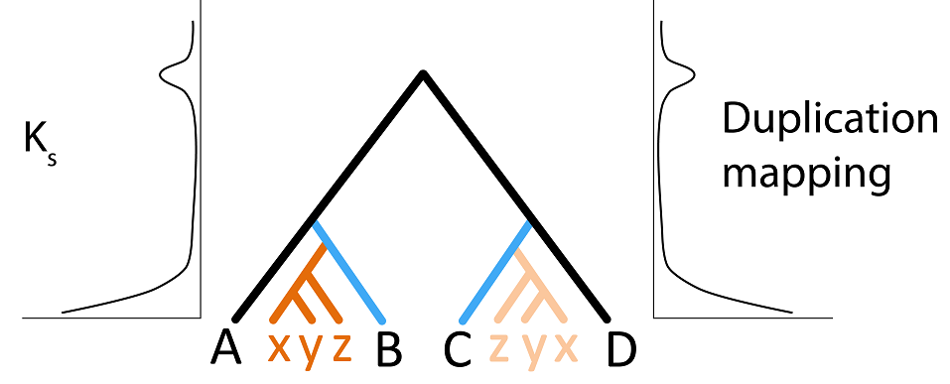
Methods to date polyploidy fail in cases of allopolyploidy
Counts:
1
2
2
2
1
1
1

Slide 11
Methods to date polyploidy fail in cases of allopolyploidy
Phylogeny-based duplication mapping
Counts:
1
2
2
2
1
1
1

Slide 12
Methods to date polyploidy fail in cases of allopolyploidy
Phylogeny-based duplication mapping
Counts:
1
2
2
2
1
1
1

Slide 13
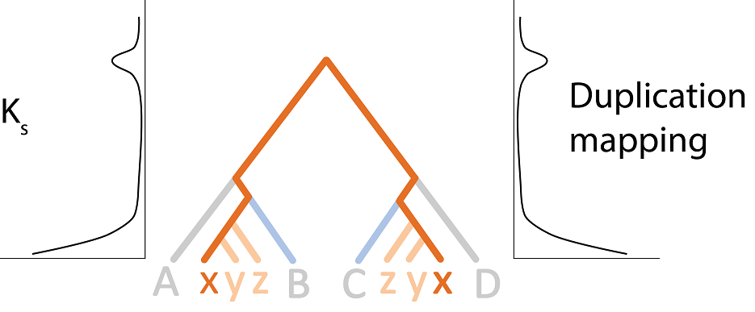
Methods to date polyploidy fail in cases of allopolyploidy…
Phylogeny-based duplication mapping
Counts:
1
2
2
2
1
1
1
…because they are actually measuring distance from the most recent common ancestor of the parental lineages

Slide 14

Species representations of polyploidy
Standard species trees

Slide 15
Species representations of polyploidy
Standard species trees
Species Networks

Slide 16
Species representations of polyploidy
Standard species trees
Species Networks
Multi-labeled species trees (MUL-trees)

Slide 17
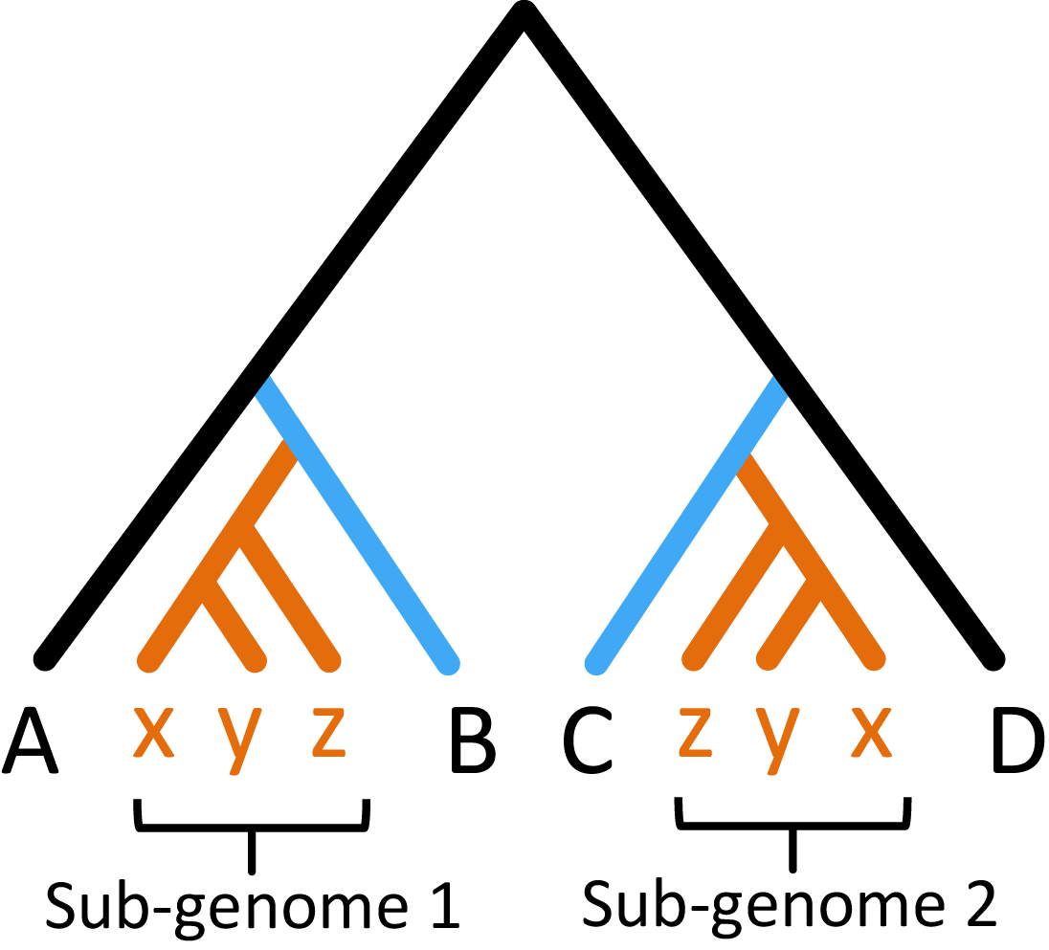
MUL-trees are a natural representation of polyploids
= polyploid lineage
MUL-trees are defined by having duplicate labels
Notes:
Fix ordering of clade

Slide 18
We have modified the popular Least Common Ancestor (LCA) reconciliation algorithm to work with MUL-trees
This allows us to:
Identify the parental lineages of polyploidy events
Differentiate between autopolyploidy and allopolyploidy
Correctly count the # of duplications and losses in the presence of polyploidy
Notes:
The LCA reconciliation algorithm is widely used to count duplications and losses on a gene tree given a species tree.
Parsimony method
Can also be used for species tree inference

Slide 19
LCA mapping: an example
Gene tree
Species tree
A
A1
B1
B
B2
C1
C

Slide 20
LCA mapping: an example
Gene tree
Species tree
A
A1
B1
B
B2
C1
C

Slide 21
LCA mapping: an example
Gene tree
Species tree
A
A1
B1
B
B2
C1
C

Slide 22
LCA mapping: an example
Gene tree
Species tree
A
A1
B1
Duplication node
B
B2
C1
C

Slide 23
LCA mapping: an example
Gene tree
Species tree
But in cases of allopolyploidy, no duplication has occurred here!
A
A1
B1
B
B2
C1
C

Slide 24
Gene-tree Reconciliation Algorithm using MUL-trees for Polyploid Analysis
Gene tree
Species MUL- tree
A1
A
B1
B
B2
B
C1
C

Slide 25
Gene-tree Reconciliation Algorithm using MUL-trees for Polyploid Analysis
Gene tree
Species MUL- tree
A1
A
B1
B
B2
B
C1
C
GRAMPA

Slide 26
Problem: Some nodes now have two possible maps
Gene tree
Species MUL- tree
A1
A
B1
B
B2
B
C1
C

Slide 27
Solution: Run the LCA algorithm on all possible combinations of leaf maps
Gene tree
Species MUL- tree
A1
A
B1
B
B2
B
C1
C
Score = 3

Slide 28
Solution: Run the LCA algorithm on all possible combinations of leaf maps
Gene tree
Species MUL- tree
A1
A
B1
B
B2
B
C1
C
Score = 3

Slide 29
Solution: Run the LCA algorithm on all possible combinations of leaf maps
Gene tree
Species MUL- tree
A1
A
B1
B
B2
B
C1
C
Score = 3

Slide 30
Solution: Run the LCA algorithm on all possible combinations of leaf maps
Gene tree
Species MUL- tree
A1
A
B1
B
B2
B
C1
C
Score = 0

Slide 31
Given a set of gene trees, we can generate a reconciliation score for a single MUL-tree

Slide 32
How can we use this?
Given a set of gene trees, we can generate a reconciliation score for a single MUL-tree

Slide 33
How can we use this?
Given a set of gene trees, we can generate a reconciliation score for a single MUL-tree
From a standard species tree, we can generate all possible MUL-trees and find the one with the lowest reconciliation score.
Notes:
This would tell us the exact location of a polyploid event!

Slide 34
GRAMPA’s Search
A
x
y
z
B
C
D
Standard species tree as input

Slide 35
GRAMPA’s Search
GRAMPA builds the MUL-tree
A
x
y
z
B
x
y
z
D
C
A
x
y
z
B
C
D
Standard species tree as input

Slide 36
GRAMPA’s Search
GRAMPA builds the MUL-tree
Reconciliation score = 100
A
x
y
z
B
x
y
z
D
C
A
x
y
z
B
C
D
Standard species tree as input

Slide 37
GRAMPA’s Search
GRAMPA builds the MUL-tree
Reconciliation score = 100
A
x
y
z
B
x
y
z
D
C
Reconciliation score = 55
A
x
y
z
B
C
D
A
x
y
z
B
C
z
y
x
D
Standard species tree as input

Slide 38
GRAMPA’s Search
GRAMPA builds the MUL-tree
Reconciliation score = 100
A
x
y
z
B
x
y
z
D
C
Reconciliation score = 55
A
x
y
z
B
C
D
A
x
y
z
B
C
z
y
x
D
Standard species tree as input
Reconciliation score = 76
A
z
y
x
x
y
z
B
C
D

Slide 39
GRAMPA’s Search
GRAMPA builds the MUL-tree
Reconciliation score = 100
A
x
y
z
B
x
y
z
D
C
Reconciliation score = 55
A
x
y
z
B
C
D
A
x
y
z
B
C
z
y
x
D
Standard species tree as input
Reconciliation score = 76
A
z
y
x
x
y
z
B
C
D

Slide 40
In other words, we can identify IF an allopolyploidy has occurred and WHERE it has occurred on a tree
A
x
y
z
B
C
z
y
x
D

Slide 41
Does GRAMPA work?
JPrIME
Simulated gene trees
A
x
y
z
B
C
z
y
x
D

Slide 42
Does GRAMPA work?
JPrIME
Simulated gene trees
A
x
y
z
B
C
z
y
x
D
GRAMPA
A
x
y
z
B
C
D
+
Simulated gene trees

Slide 43

Does GRAMPA work?
JPrIME
Simulated gene trees
A
x
y
z
B
C
z
y
x
D
GRAMPA
A
x
y
z
B
C
D
A
x
y
z
B
C
z
y
x
D
+
Simulated gene trees

Slide 44
Caveats
Must have accurate gene trees
If the parental lineages of an allopolyploid were sisters and both have gone extinct, GRAMPA would infer autopolyploidy
GRAMPA always returns a MUL-tree – must use autopolyploidy as a null hypothesis
Notes:
Reconstruction or ILS

Slide 45
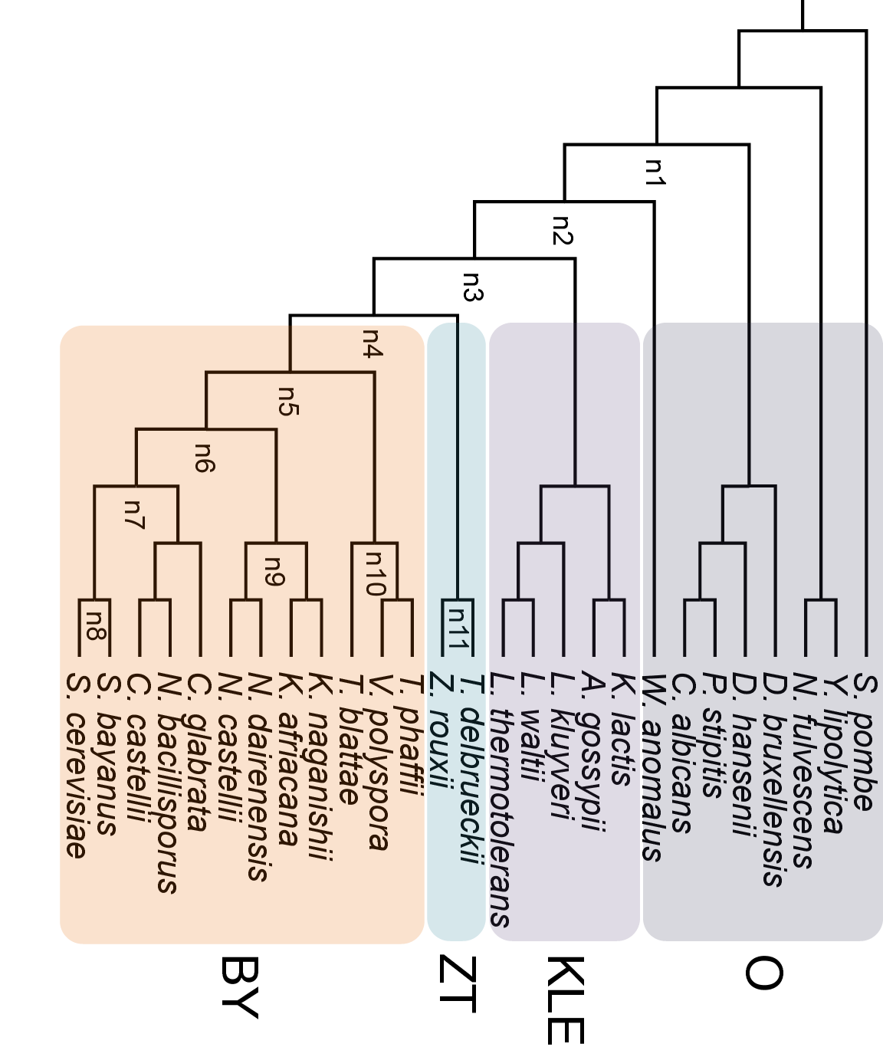
Baker’s Yeast WGD
Beyond the whole genome duplication: Phylogenetic evidence for an ancient interspecies hybridization in the Baker's yeast lineage
Marina Marcet-Houben and Toni Gabaldón, 2015
BY
ZT
KLE
O

Slide 46
They notice a discrepancy between count data and duplication mapping
Peak of Duplication Density
BY
ZT
KLE
O
Counts:
2
1
1
1

Slide 47
Recall: This is what we would expect with allopolyploidy
Peak of Duplication Density
Counts:
1
2
2
2
1
1
1

Slide 48
What does GRAMPA tell us?
I downloaded their sets of gene trees
4004 trees after filtering
I gave this set of trees to GRAMPA along with their species tree
BY
ZT
KLE
O
Notes:
5402 trees
Used Notung for rooting and bootstrap rearrangement
Nodes 3, 4, 5, 6, 7, 8, 9, 10 were given as possible H1
For each H1, every other node was tried as H2

Slide 49
GRAMPA’s results vs. other hypotheses
Optimal MUL-tree
153,368

Slide 50
GRAMPA’s results vs. other hypotheses
Optimal MUL-tree
153,368
Lowest scoring autopolyploid-like MUL-tree

Slide 51
GRAMPA’s results vs. other hypotheses
Optimal MUL-tree
153,368
Lowest scoring autopolyploid-like MUL-tree
159,937

Slide 52
Simplified Yeast tree
Peak of Duplication Density
BY
ZT
KLE
O

Slide 53
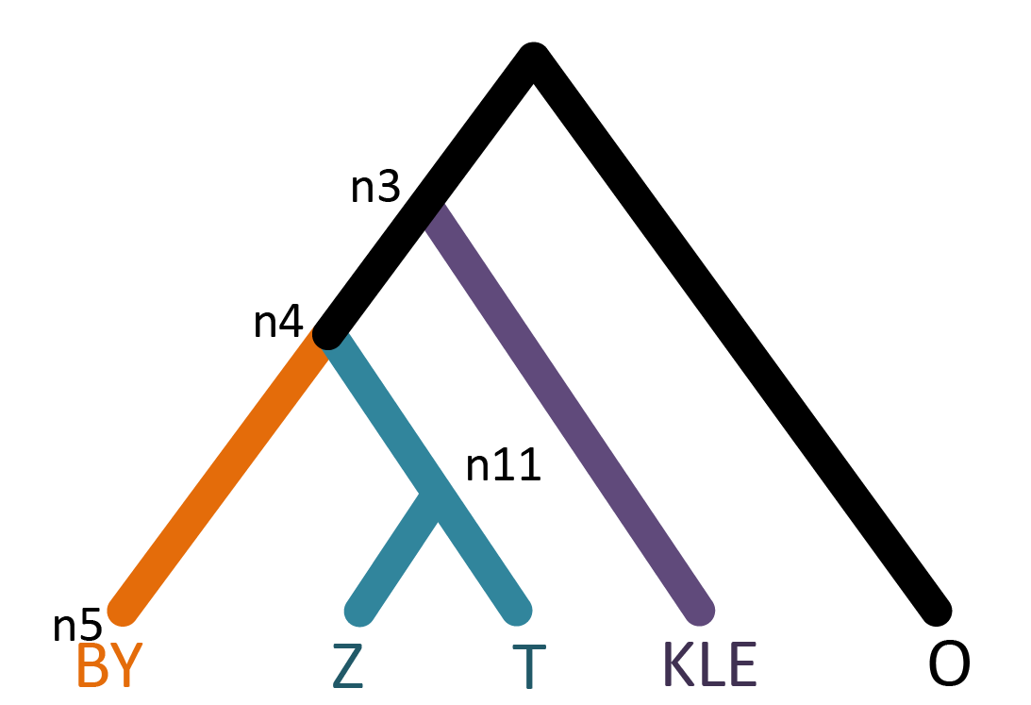
Simplified Yeast tree
Peak of Duplication Density
BY
ZT
KLE
O

Slide 54
Proposed evolutionary scenario as a network
Peak of Duplication Density
n3
n4
n11
n5
KLE
Z
T
BY
Extinct lineage sister to KLE
O

Slide 55
GRAMPA’s results vs. other hypotheses
Optimal MUL-tree
153,368
Lowest scoring autopolyploid-like MUL-tree
Marcet-Houben and Gabaldón (2015) scenario
159,937

Slide 56
GRAMPA’s results vs. other hypotheses
Optimal MUL-tree
153,368
Lowest scoring autopolyploid-like MUL-tree
Marcet-Houben and Gabaldón (2015) scenario
159,937
166,898

Slide 57
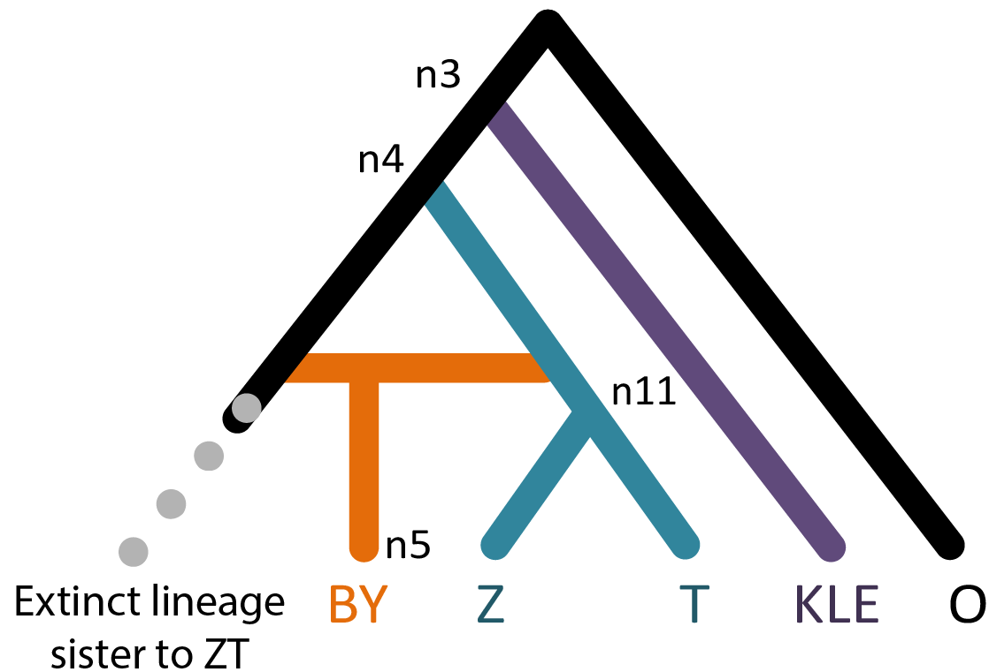
Results
n4

Slide 58
Conclusions
We have developed a Gene-tree Reconciliation Algorithim with MUL-trees for Polyploid Analysis – GRAMPA
GRAMPA can identify and differentiate between auto- and allopolyploidy events
Software availability:
https://github.com/gwct/grampa
Notes:
Conclusion

Slide 59
Acknowledgements
Co-Authors:
Hussain Ather and Matthew Hahn
Hahn lab
Software availability:
https://github.com/gwct/grampa
Thanks!!
Notes:
Co-authors

Slide 60
Supplemental slides

Slide 61
Background: Polyploidy
The presence of additional sets of chromosomes in an organism due to whole genome duplication (WGD).
Gene trees look like:
Autopolyploidy
A
B
B
C
D
Allopolyploidy
A
B
C
B
D

Slide 62
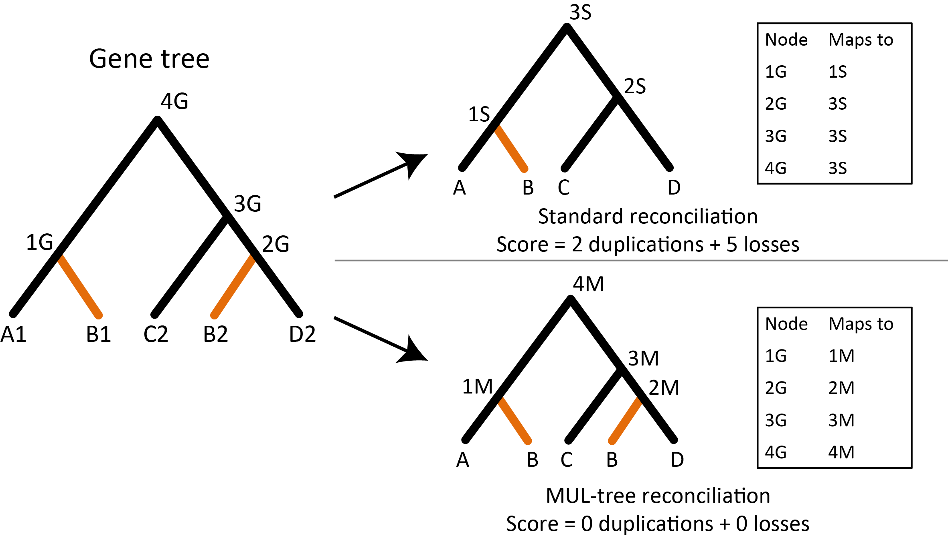
Standard reconciliation vs. MUL-tree reconciliation

Slide 63
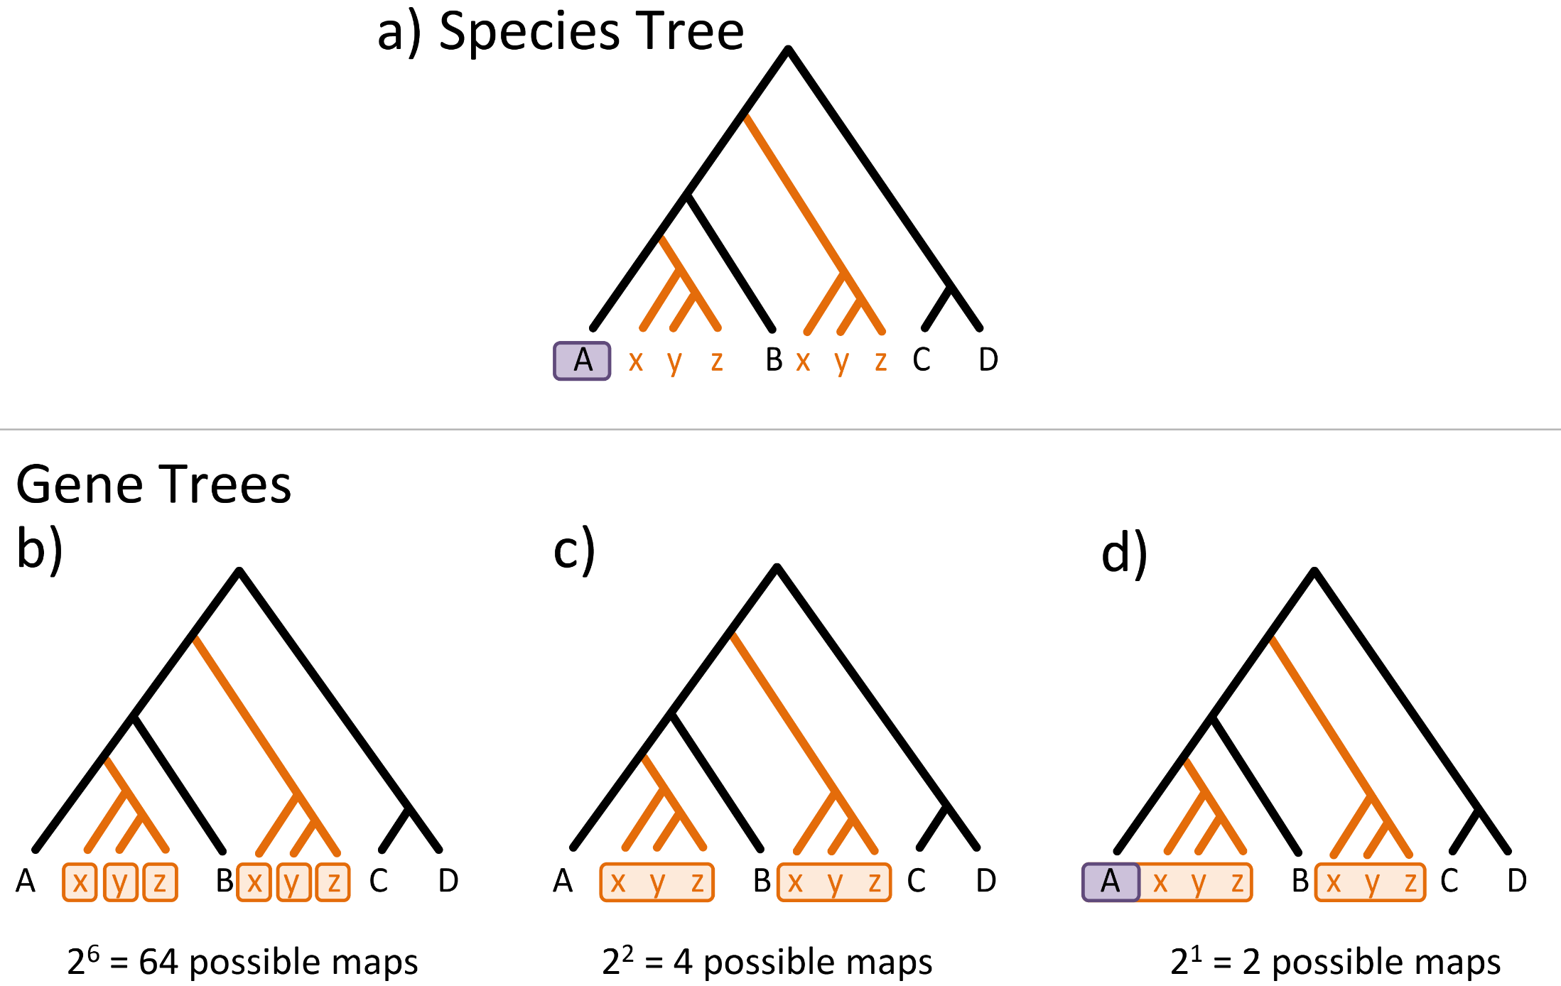
Heuristic speed-ups of GRAMPA

Slide 64
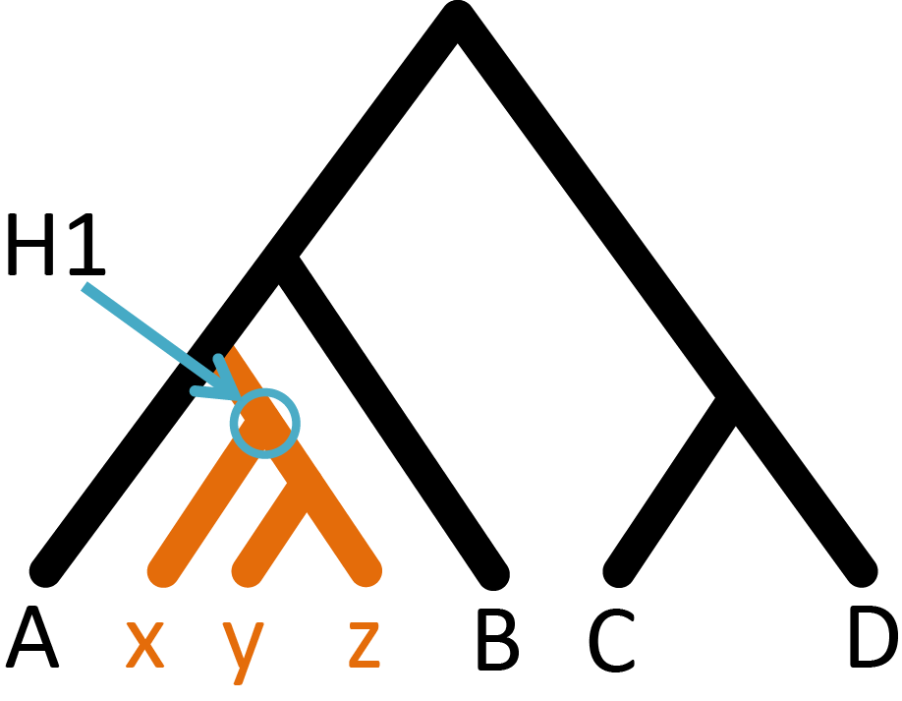
Starting topology for simulations

Slide 65
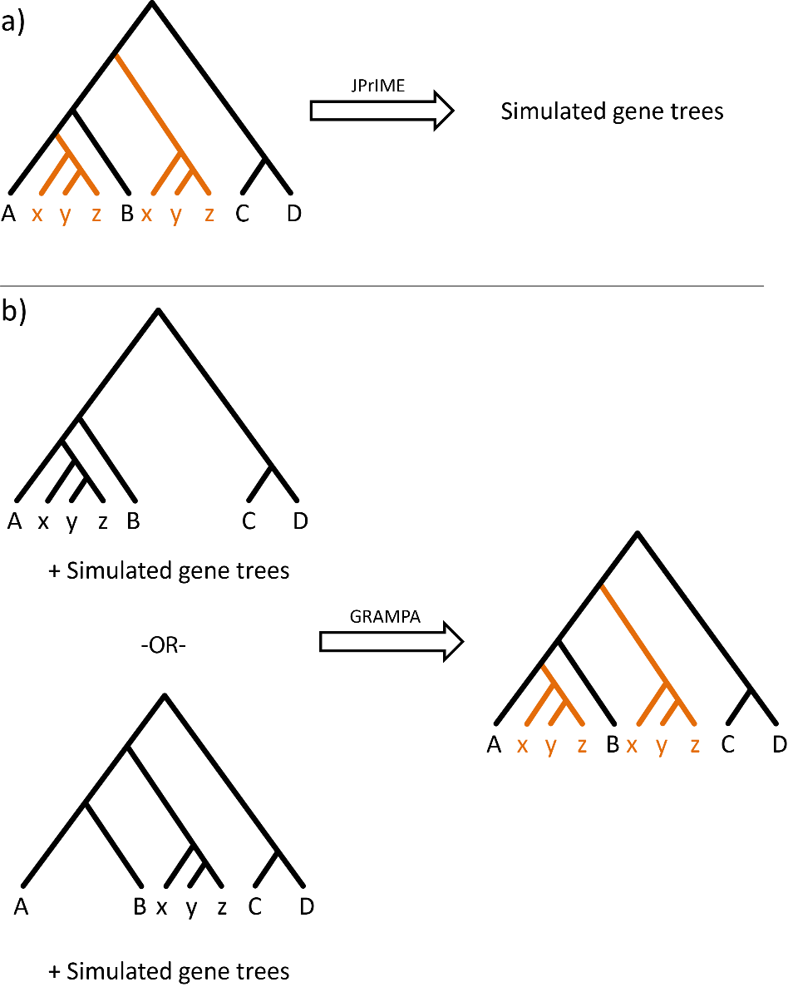
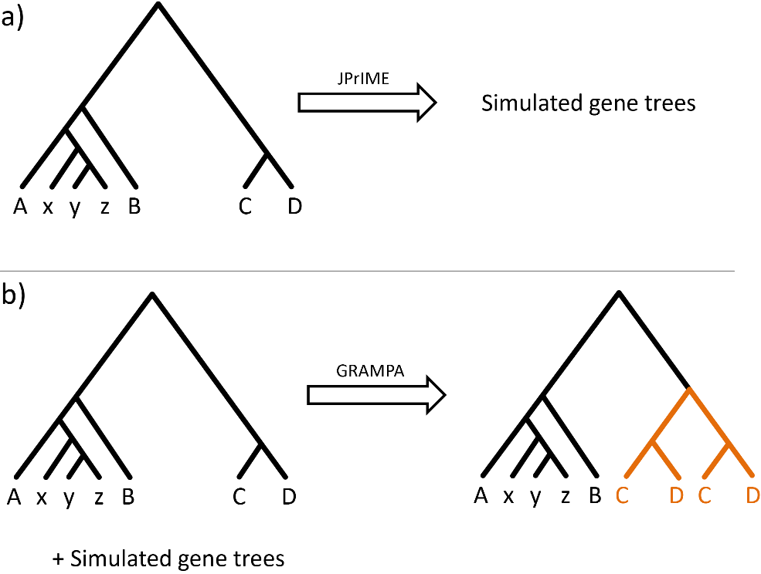
Simulation scenarios

Slide 66
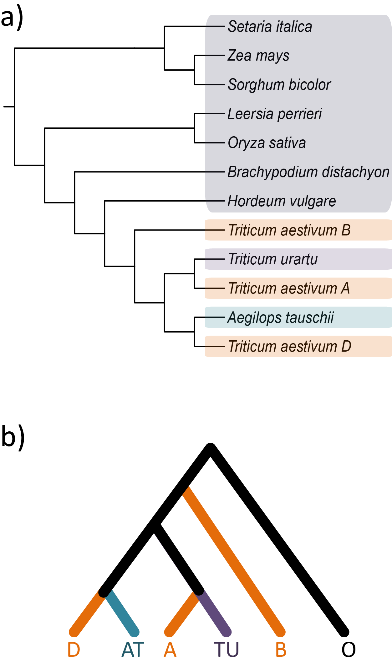
Wheat species tree

Slide 67
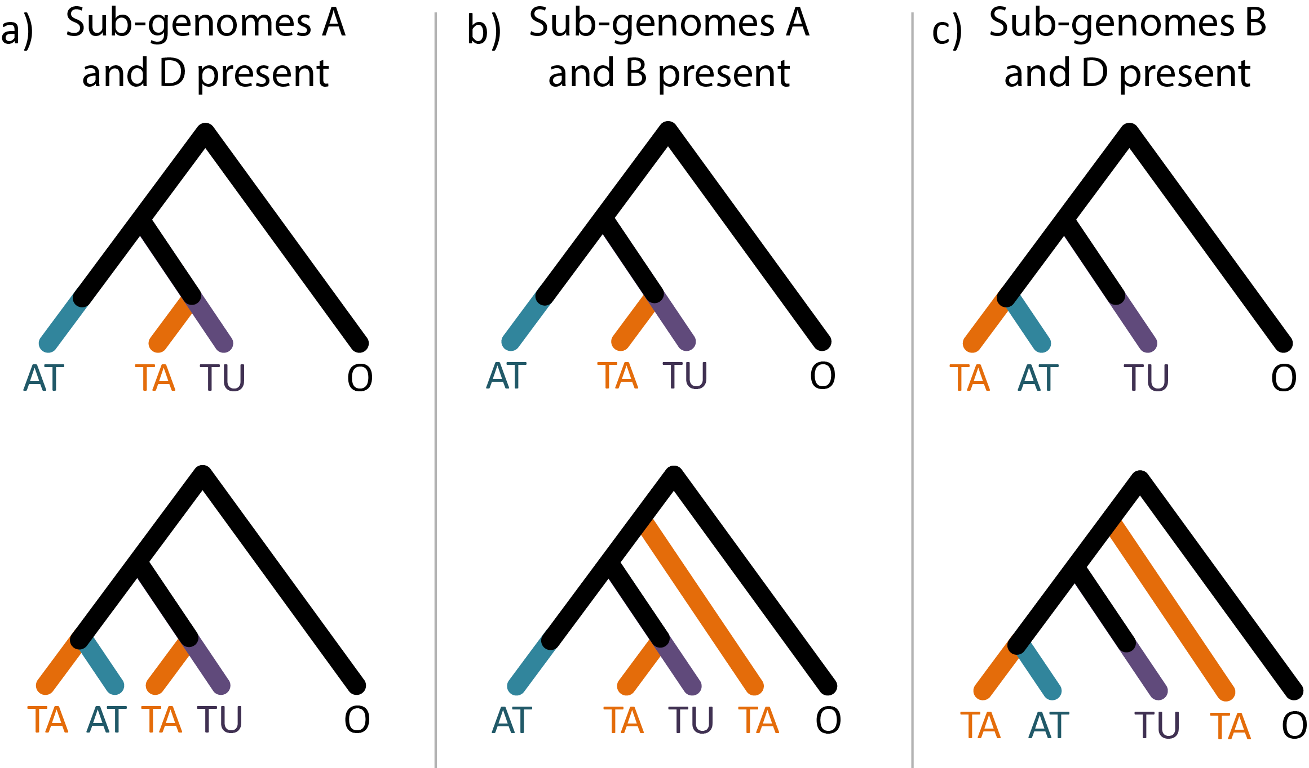
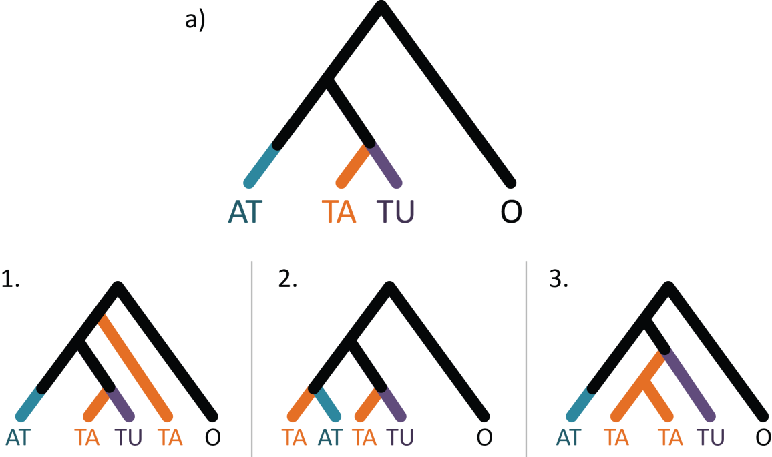
Wheat Results

Slide 68
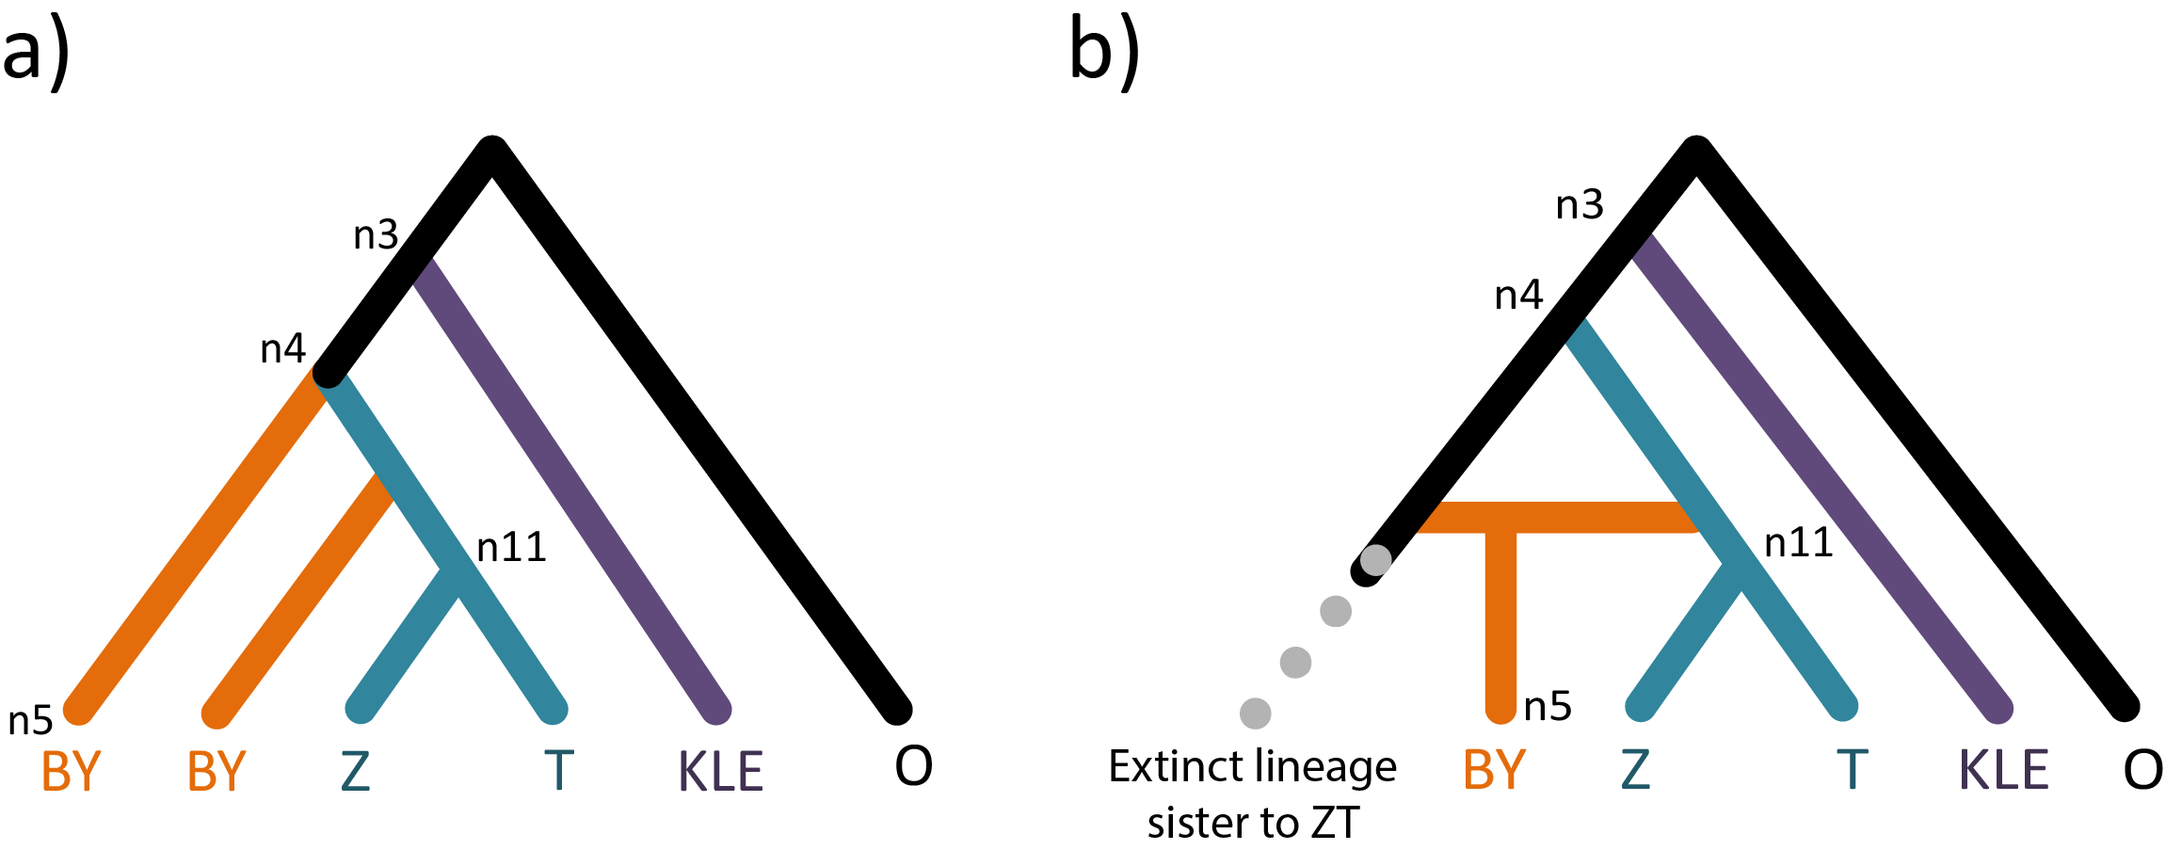
Inferred scenario for yeast with MUL-tree

Slide 69
Comparison of networks
n3
n4
n3
n4
n5
n5
KLE
Z
T
BY
Extinct lineage sister to KLE
O
Extinct lineage sister to ZT
BY
Z
T
KLE
O
Their network
Our network
Notes:
We agree that this is an allopolyploid event
We propose an ancestor of Z. rouxii as the second parental lineage

