Slide 1
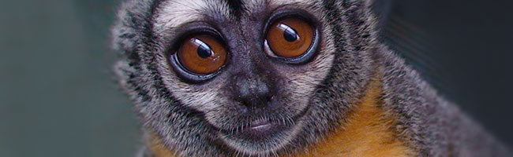


Reproductive longevity predicts mutation rates in primates
Gregg Thomas
@greggwcthomas
Indiana University
May 15, 2018

Slide 2
Mutation rates
Short term
Long term

Slide 3
Mutation rates
Short term
Long term
Disease risk

Slide 4
Mutation rates
Short term
Long term
Disease risk
Differences between species

Slide 5
Mutation rates
Short term
Long term
Disease risk
Differences between species
The mutation rate is a trait that can evolve

Slide 6
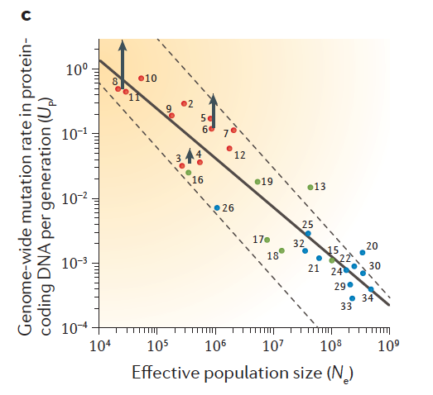
Mutation rates vary between species
This variation is broadly correlated with population size across domains of life
Most hypotheses posit changes in selection pressure on mutational machinery
Lynch 2016

Slide 7
Mutation rates vary between species
This variation is broadly correlated with population size across domains of life
Most hypotheses posit changes in selection pressure on mutational machinery
Lynch 2016

Slide 8
Mutation rates vary between species
This variation is broadly correlated with population size across domains of life
Most hypotheses posit changes in selection pressure on mutational machinery
Multicellular eukaryotes
Lynch 2016

Slide 9
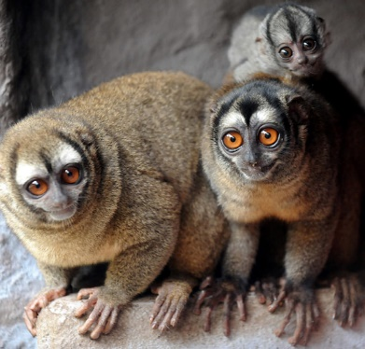
Owl monkey (Aotus nancymaae) pedigree sequencing
Small New World monkey
Nocturnal
Monogamous

Slide 10
Owl monkey (Aotus nancymaae) pedigree sequencing
Small New World monkey
Nocturnal
Monogamous
Age of puberty ~1 year
Avg. generation time ~6 years

Slide 11
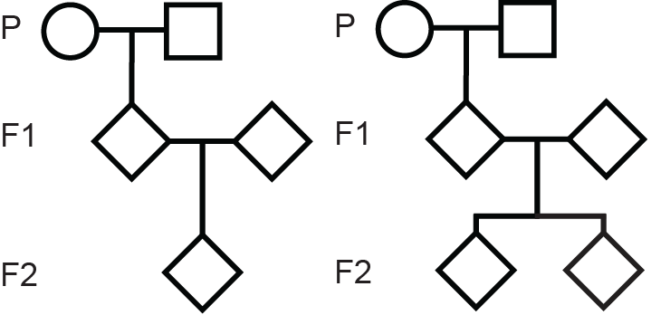
Owl monkey (Aotus nancymaae) pedigree sequencing
Small New World monkey
Nocturnal
Monogamous
Age of puberty ~1 year
Avg. generation time ~6 years
30 individuals in 6 three generation pedigrees (14 trios)
Each sequenced to ~30X coverage
4x
2x

Slide 12
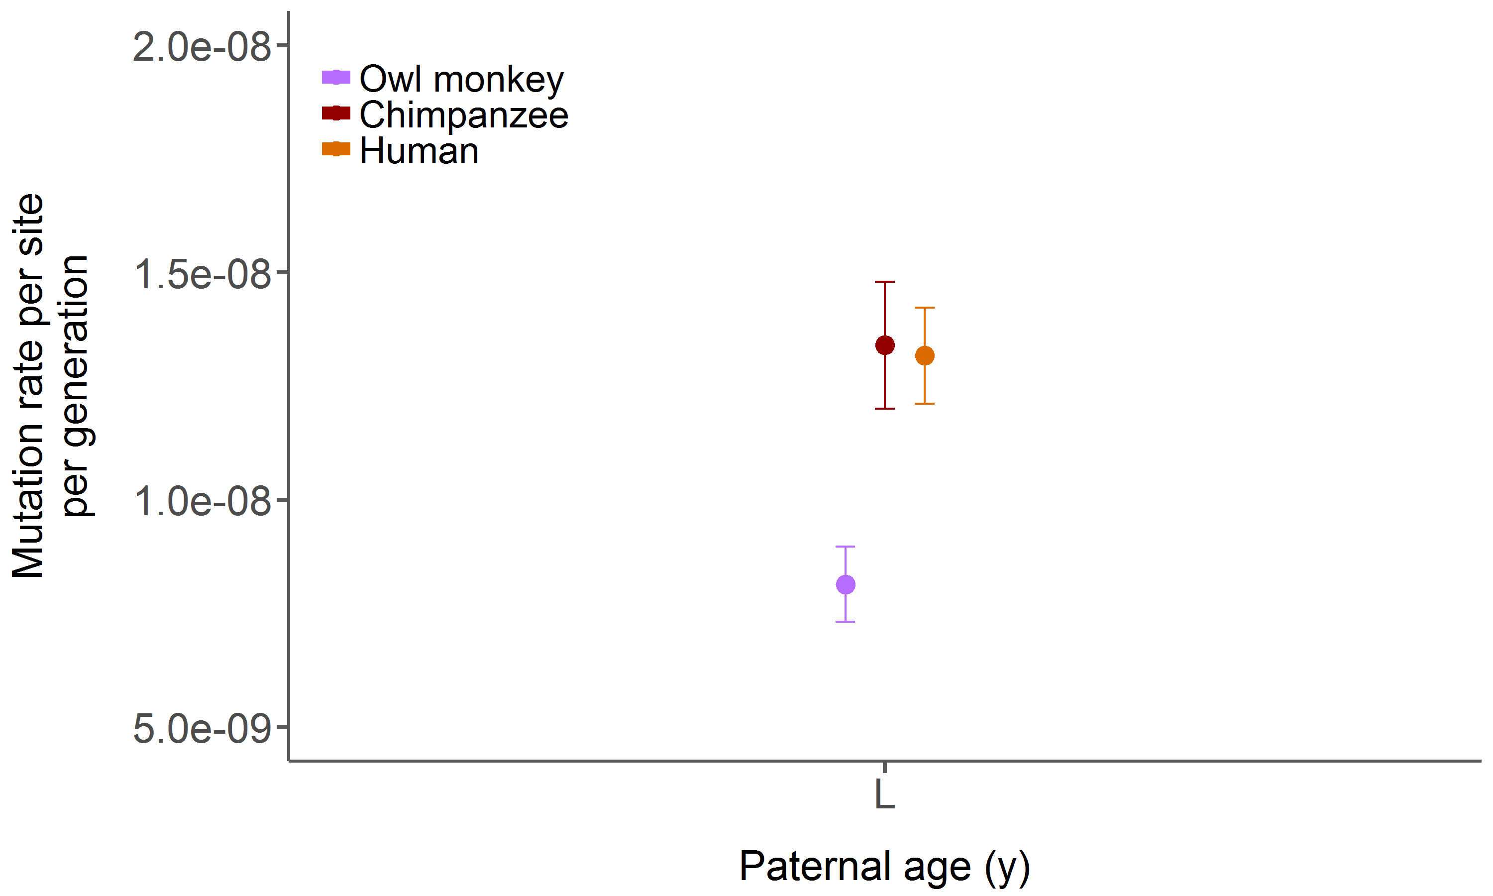
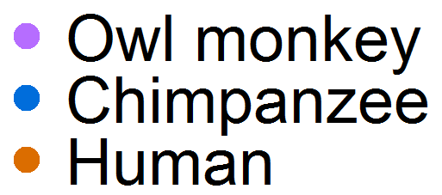
The average owl monkey mutation rate is 0.81 x 10⁻⁸ per site per generation
Owl monkey:
0.81 x 10⁻⁸ average across 14 trios

Slide 13
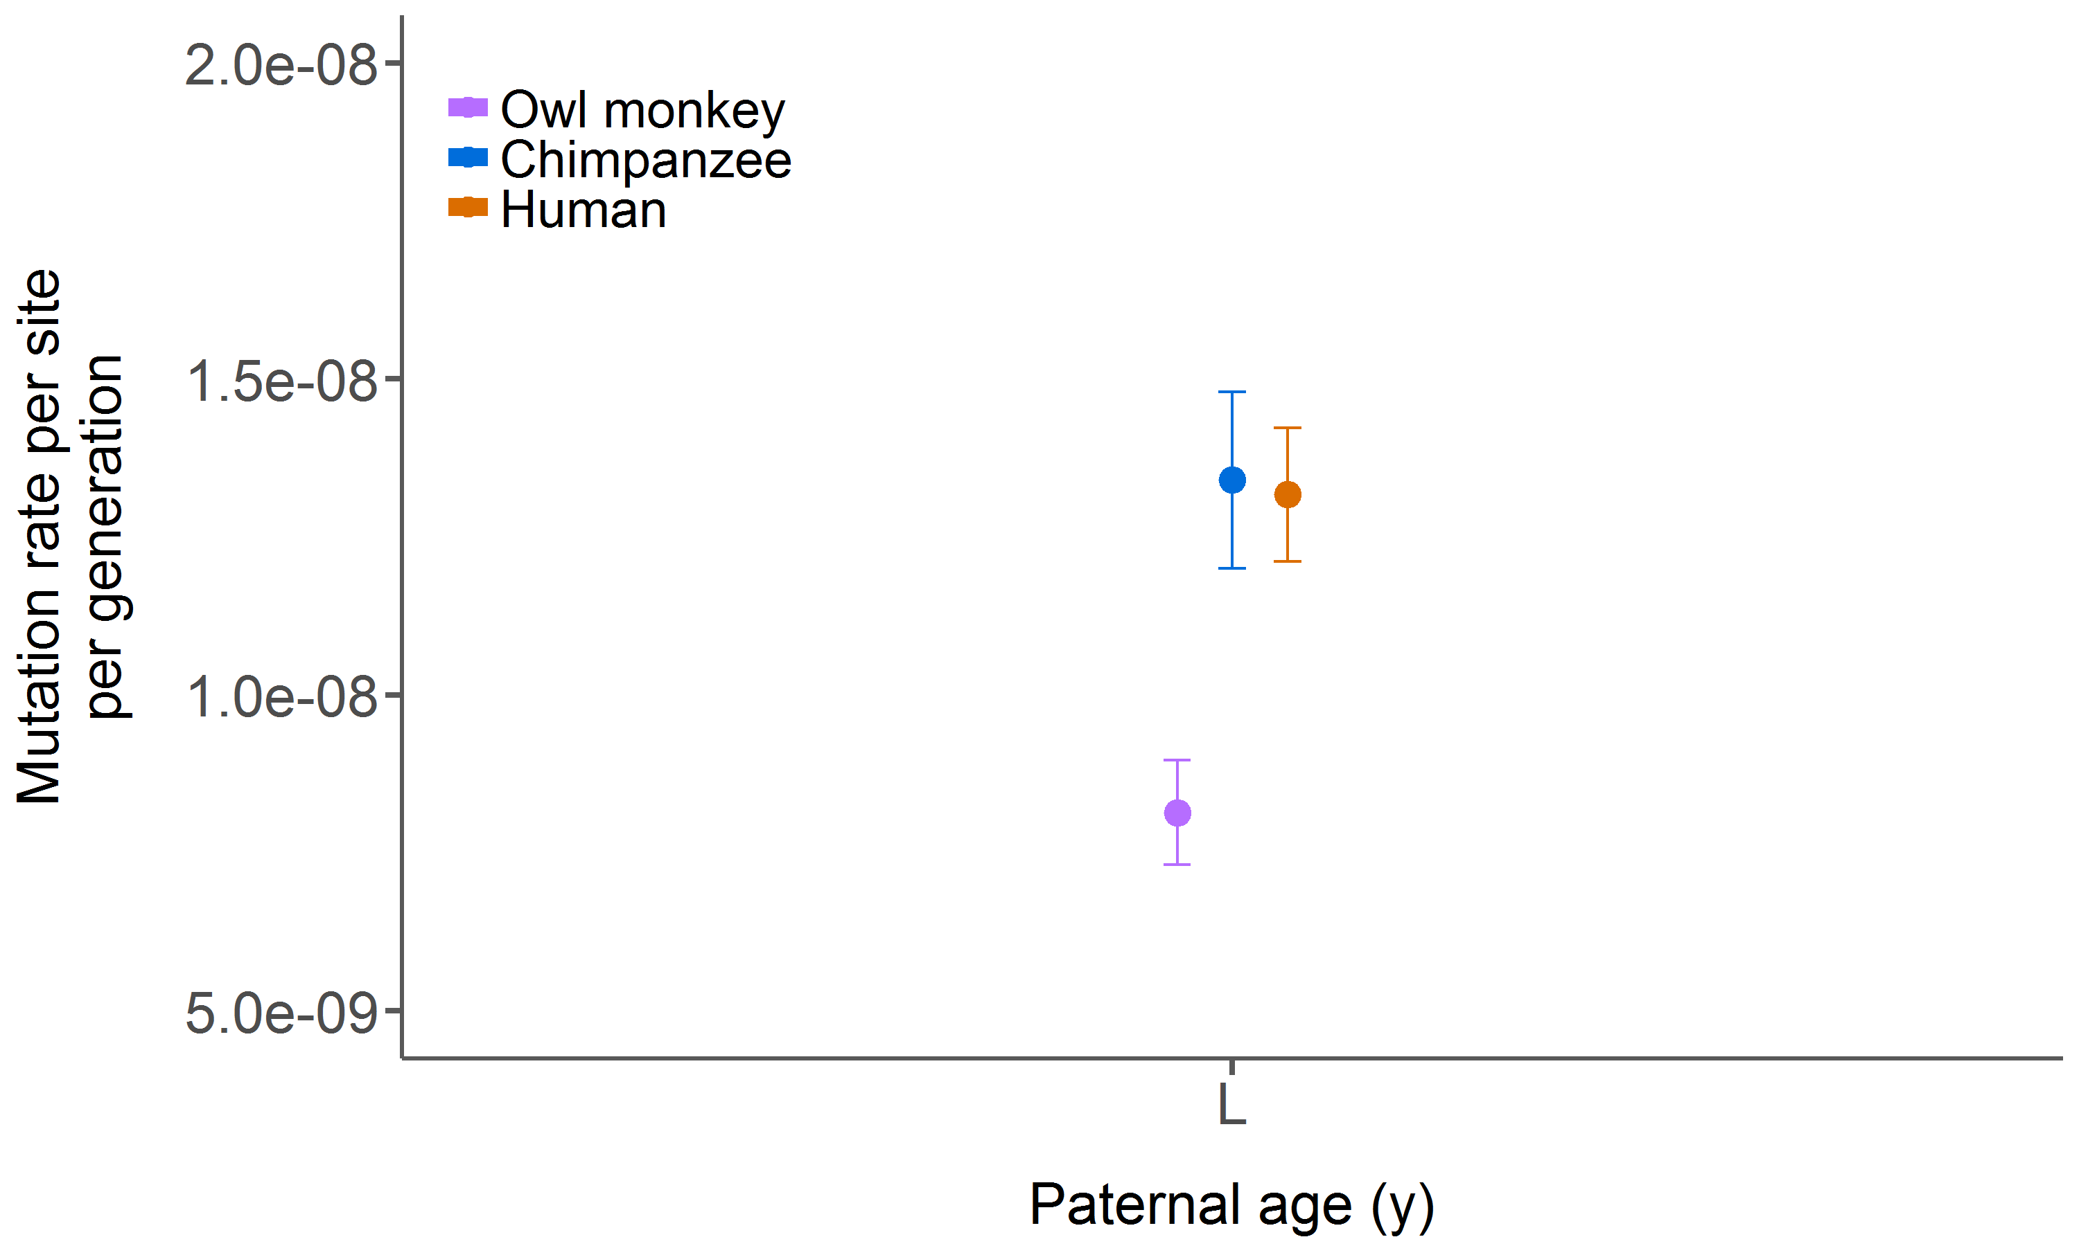
The owl monkey rate is roughly 30% lower than great apes
Chimpanzee:
1.34 x 10⁻⁸ average across 2 studies
Human:
1.32 x 10⁻⁸ average across 9 studies
Owl monkey:
0.81 x 10⁻⁸ average across 14 trios

Slide 14
The owl monkey rate is roughly 30% lower than great apes
Chimpanzee:
1.34 x 10⁻⁸ average across 2 studies
Human:
1.32 x 10⁻⁸ average across 9 studies
Owl monkey:
0.81 x 10⁻⁸ average across 14 trios
Consistent with population size correlation

Slide 15
The owl monkey rate is roughly 30% lower than great apes
Chimpanzee: 24 yrs
Human: 31 yrs
Owl monkey: 6.6 yrs

Slide 16
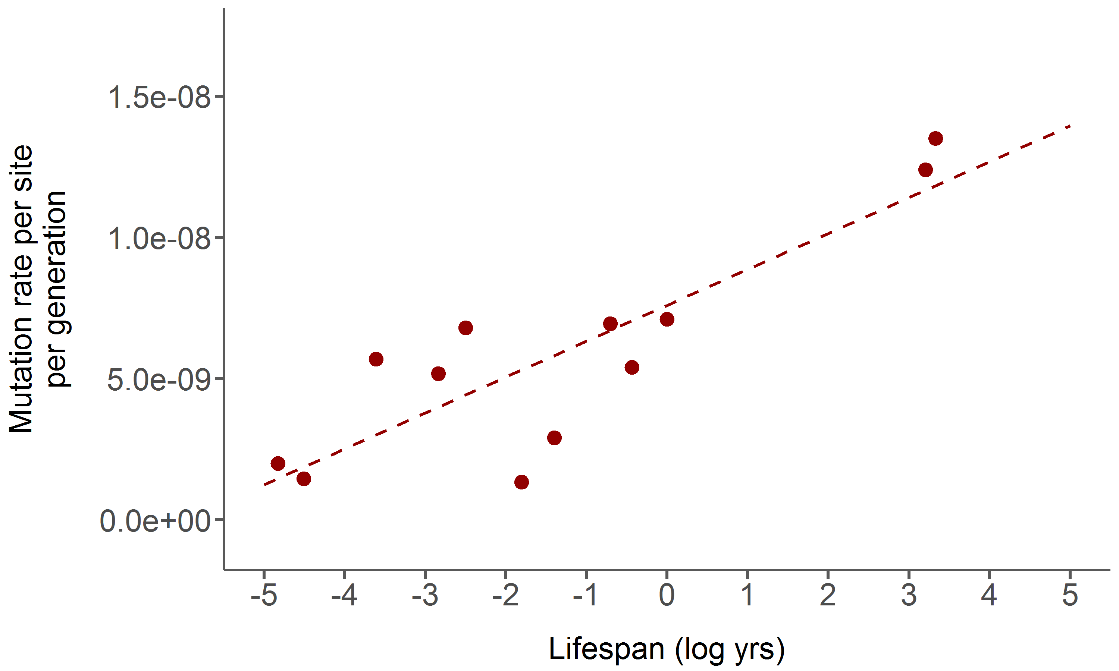
Mutation rates in multicellular eukaryotes are also correlated with lifespan
Human
Chimp
Arabidopsis
Rice
Daphnia
Honeybee
Mouse
Drosophila
Pristionchus
Heliconius
C. elegans
C. briggsae

Slide 17
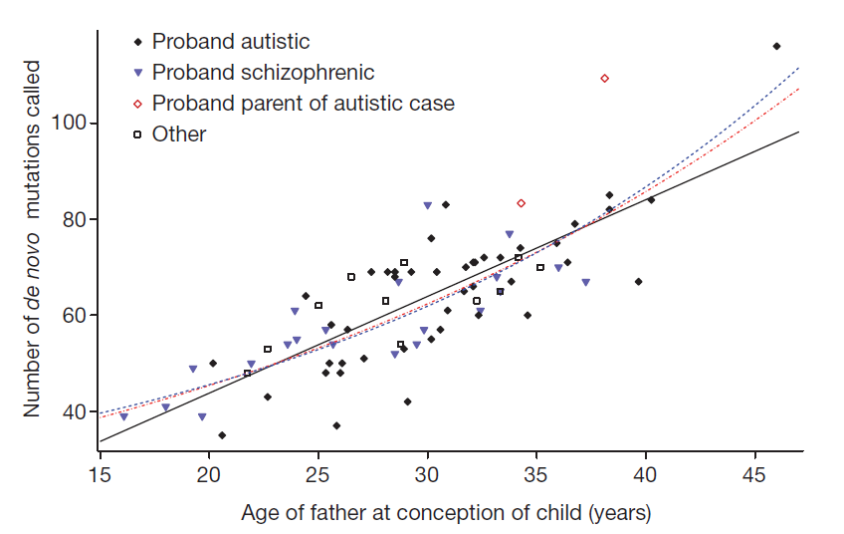
Human pedigree studies show more mutations are passed on from older fathers
Human trios
# mutations
Father's age
Kong et al. 2012
This is known as the paternal age effect

Slide 18
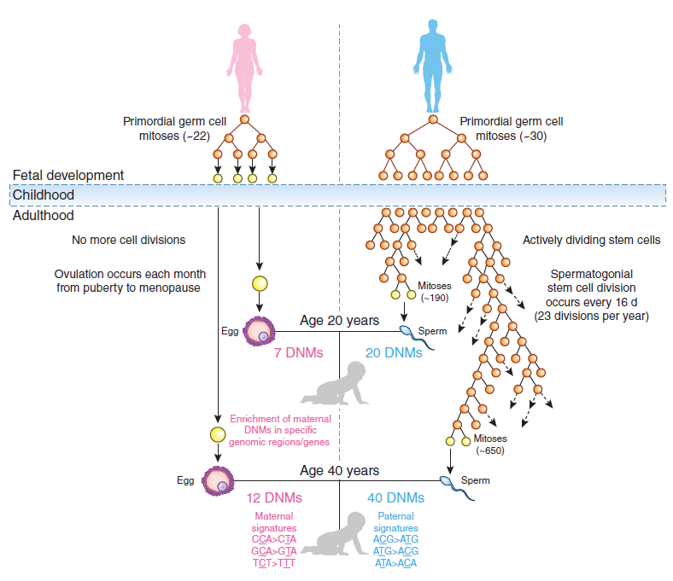
The mammalian germline exists in three distinct life stages
Human trios
# mutations
Father's age
Kong et al. 2012
This is known as the paternal age effect
Goriely 2016

Slide 19
Females and males before puberty have a constant number of germline cell divisions
Human trios
Pre-puberty males
# mutations
Females
Father's age
Kong et al. 2012
Goriely 2016

Slide 20
The germline continuously replicates in males after puberty
Human trios
# mutations
Post-puberty males
Father's age
Kong et al. 2012
Goriely 2016

Slide 21
The germline continuously replicates in males after puberty
Human trios
# mutations
Father's age
Kong et al. 2012
Goriely 2016

Slide 22
The germline continuously replicates in males after puberty
Human trios
# mutations
Father's age
Kong et al. 2012
Goriely 2016

Slide 23
The germline continuously replicates in males after puberty
Human trios
# mutations
Father's age
Kong et al. 2012
We would not say the mutation rate has evolved between ages 20 and 40
Goriely 2016

Slide 24
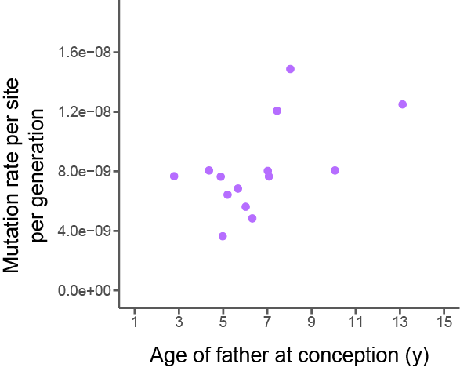
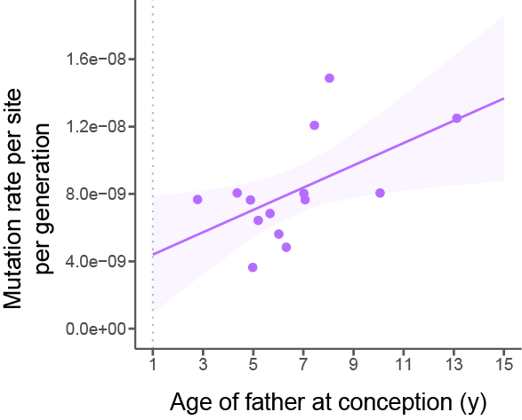
We observe a paternal age effect in owl monkeys
Owl monkey trios
2.92 mutations per year of the father
Ratio of M:F mutations: 2.09
No maternal age effect

Slide 25
We observe a paternal age effect in owl monkeys
Owl monkey trios
2.92 mutations per year of the father
Ratio of Male:Female mutations: 2.09
No maternal age effect

Slide 26
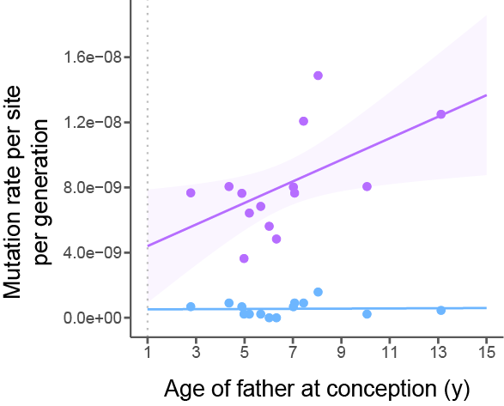
No age effect on non-replicative mutations
Owl monkey trios
2.92 mutations per year of the father
Ratio of Male:Female mutations: 2.09
No maternal age effect
Purple = All mutations
Blue = Mutations at CpG sites

Slide 27
How can we compare rates between species while accounting for paternal age effects?
Chimpanzee: 24 yrs
Human: 31 yrs
Owl monkey: 6.6 yrs

Slide 28
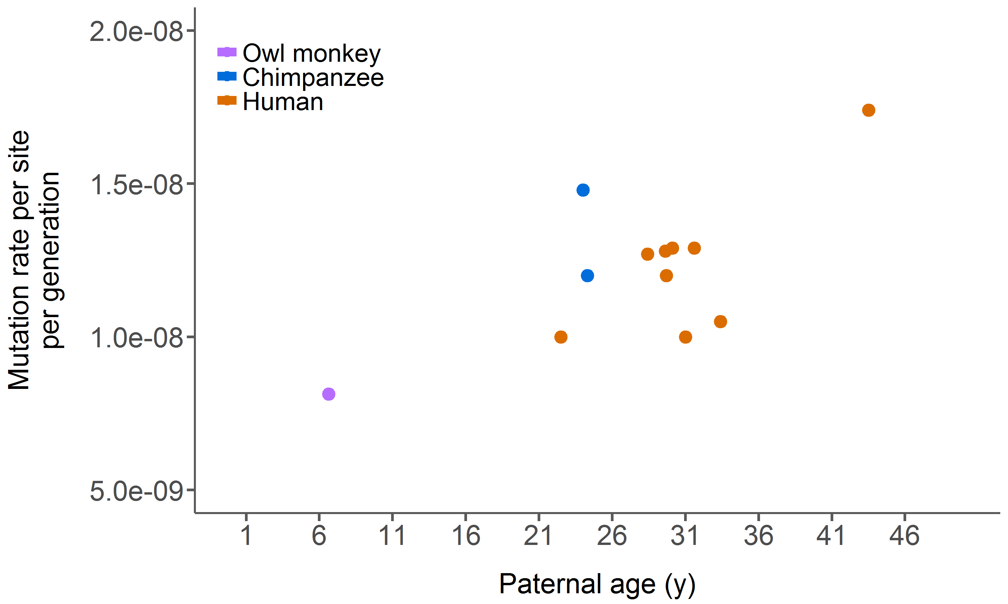
Age of reproduction is crucial in determining mutation rates per generation
Each point = 1 study

Slide 29
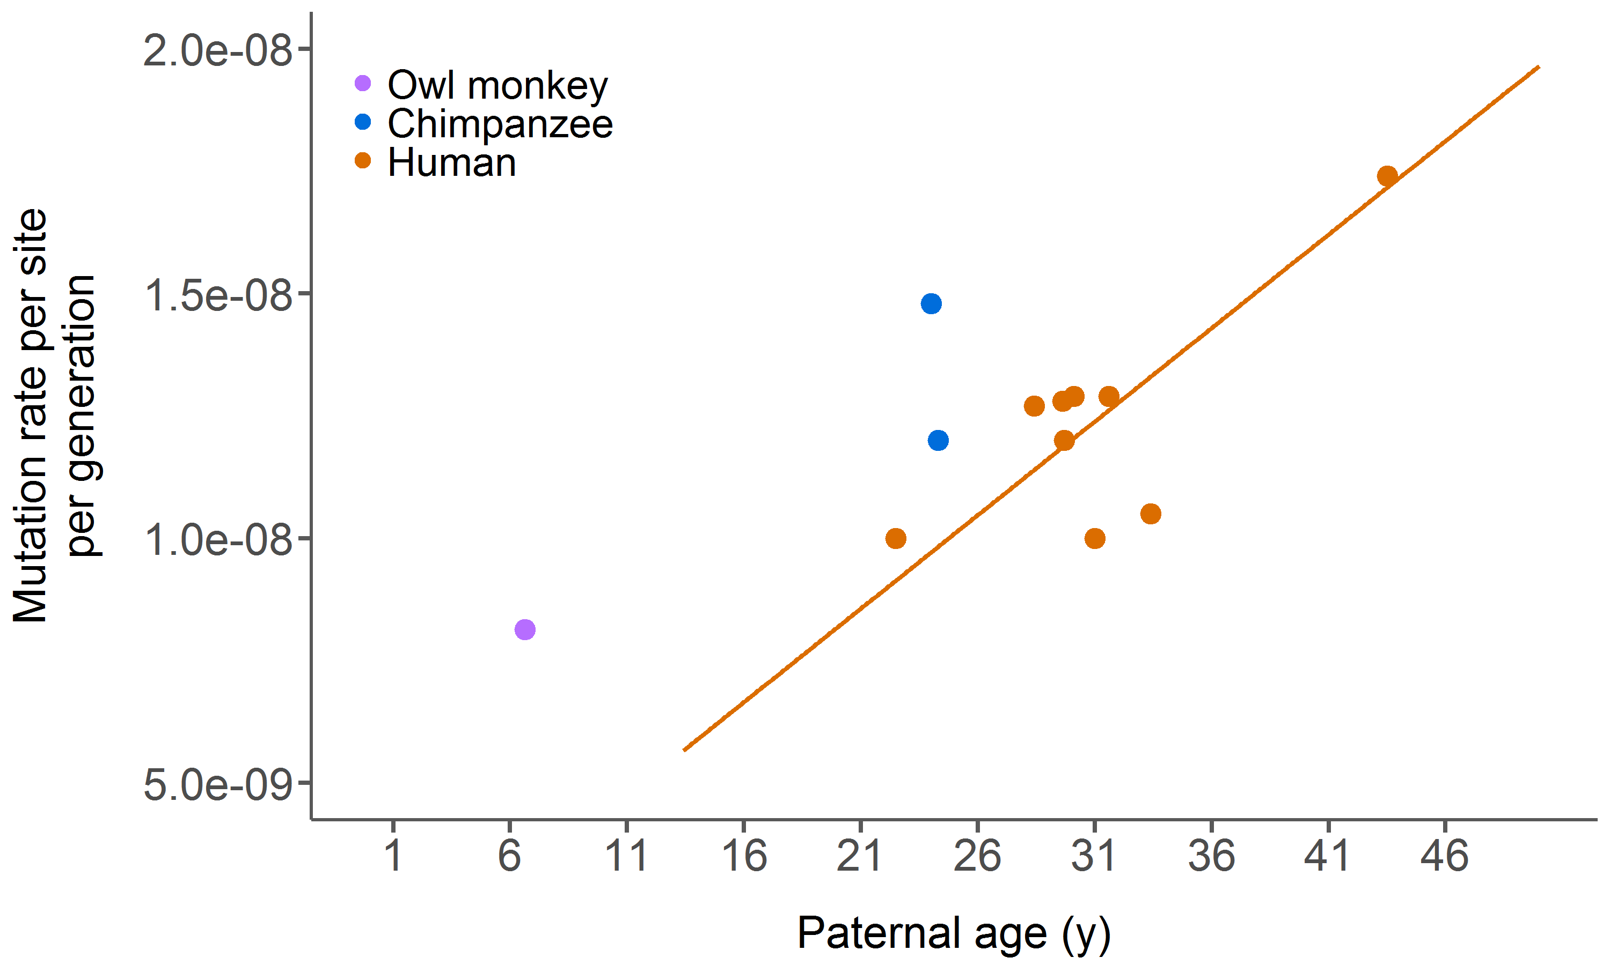
Paternal age effect explains variation among human studies
Each point = 1 study
Notes:
No puberty line

Slide 30
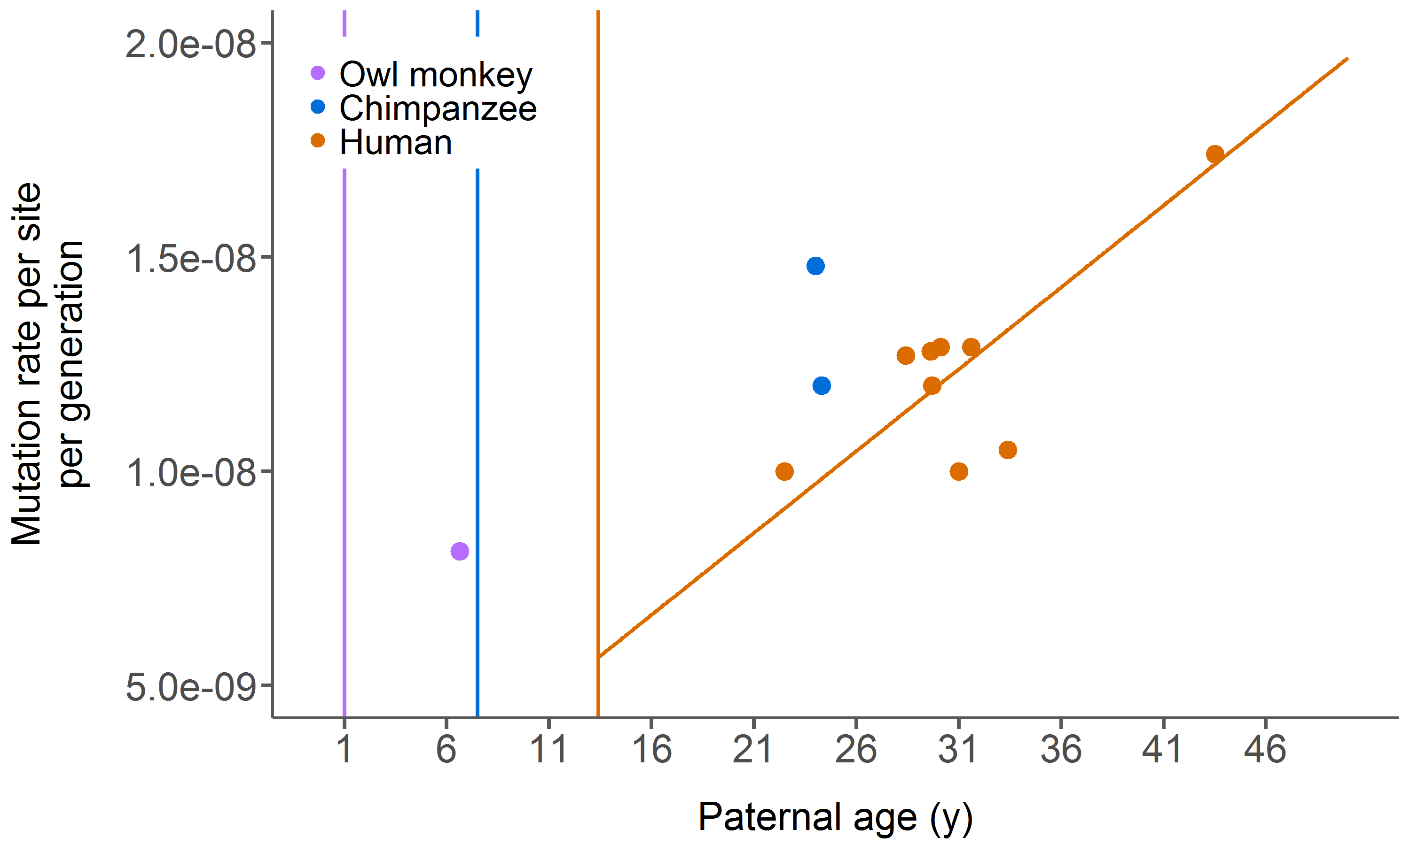
Age of puberty and age of reproduction are both crucial in determining mutation rates
Each point = 1 study
Vertical lines = puberty age
Owl monkey
Chimp
Human
Notes:
Keep line

Slide 31
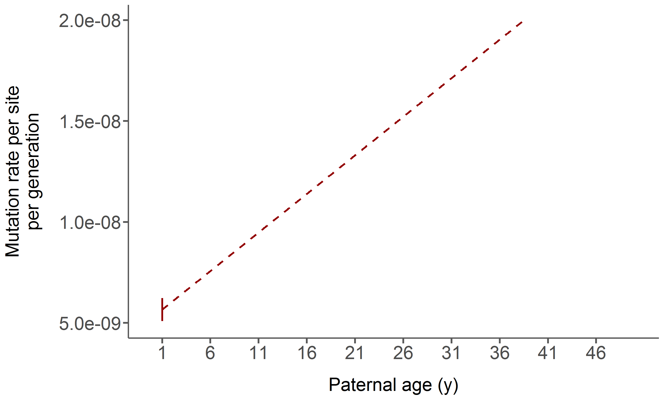
How can we model mutation rates between species?

Slide 32
How can we model mutation rates between species?
Mutations per year of the father

Slide 33
How can we model mutation rates between species?
Mutations per year of the father
Age of puberty

Slide 34
How can we model mutation rates between species?
Mutations per year of the father
Age of puberty
# of mutations pre-puberty

Slide 35
How can we model mutation rates between species?
What happens when age of puberty changes with or without changing the underlying mechanisms?
Mutations per year of the father
Age of puberty
# of mutations pre-puberty

Slide 36
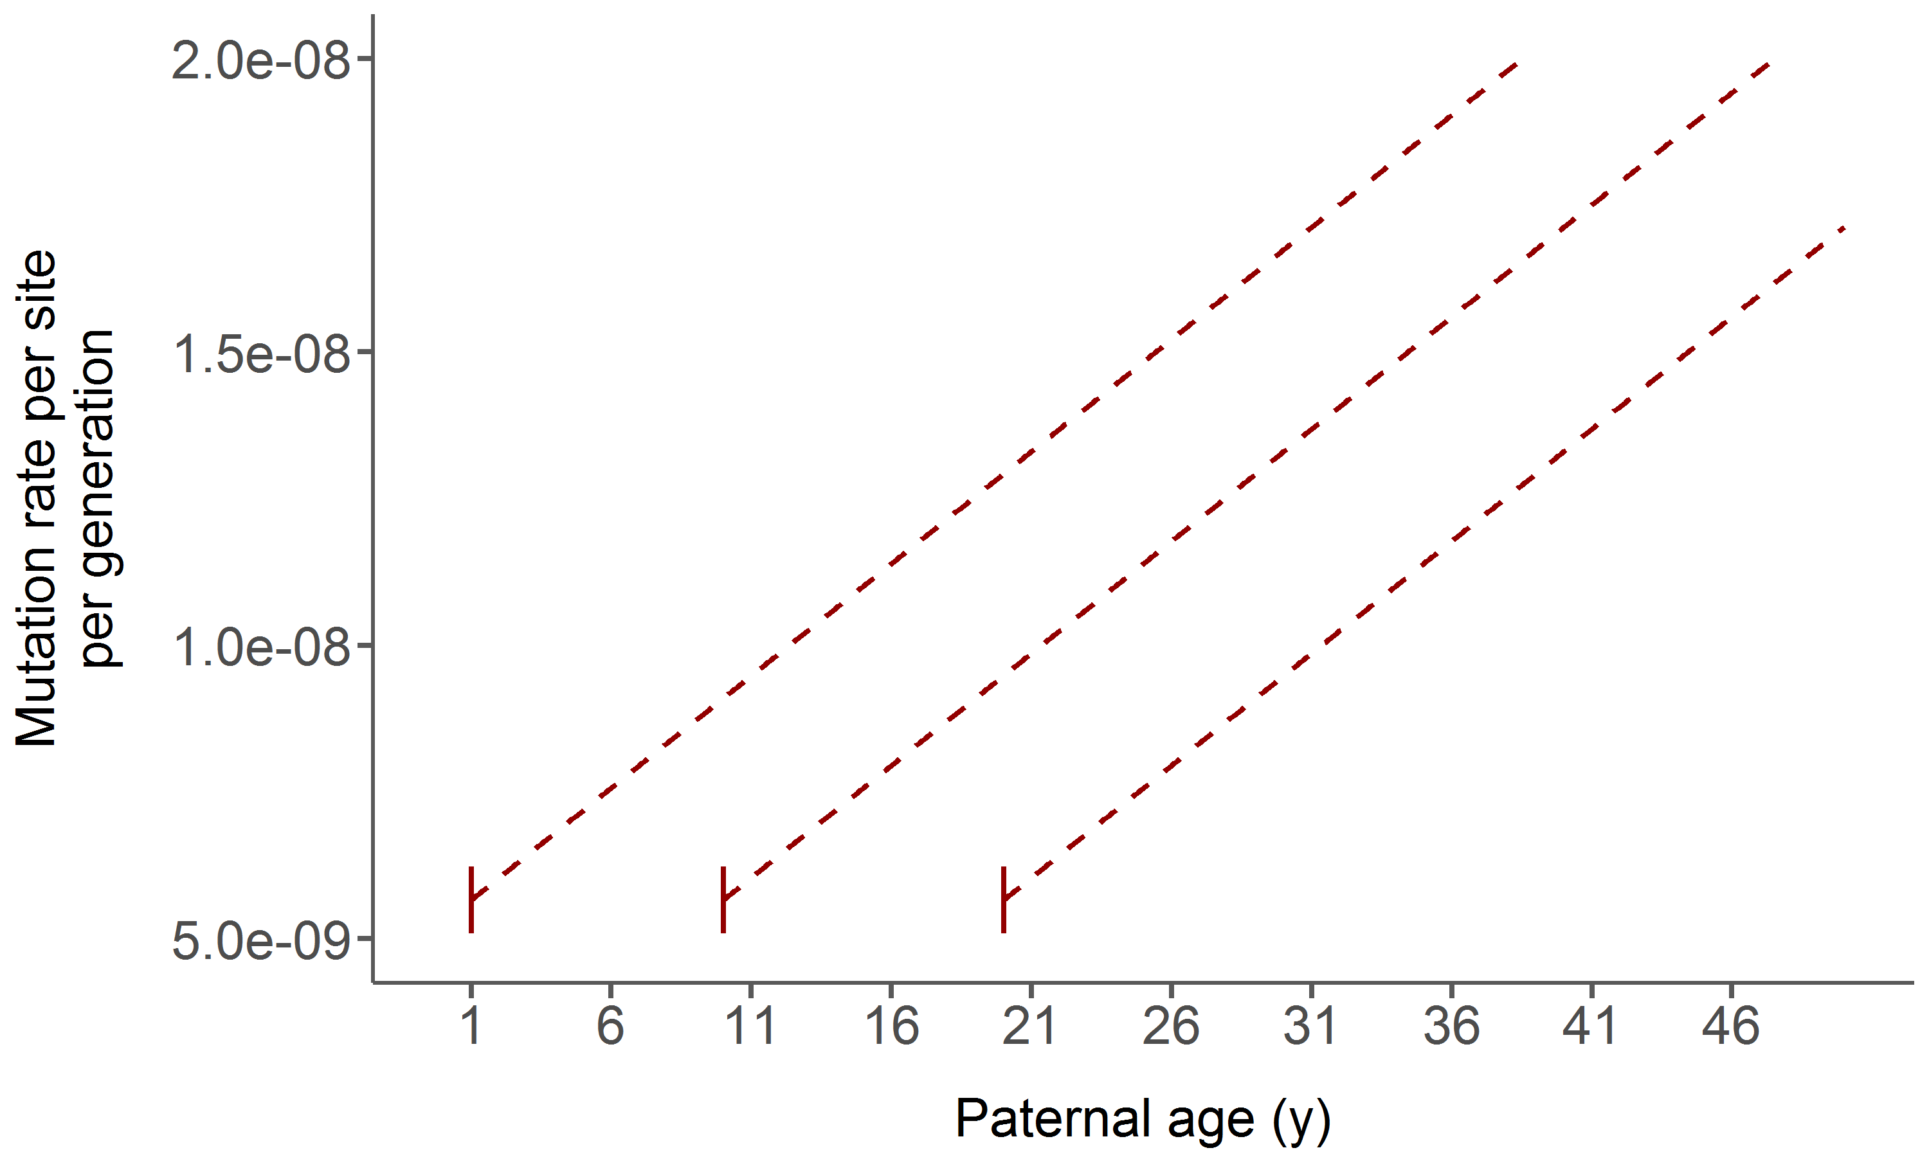
Expectations when age of puberty varies
When only puberty changes, the lines shift along the x-axis

Slide 37
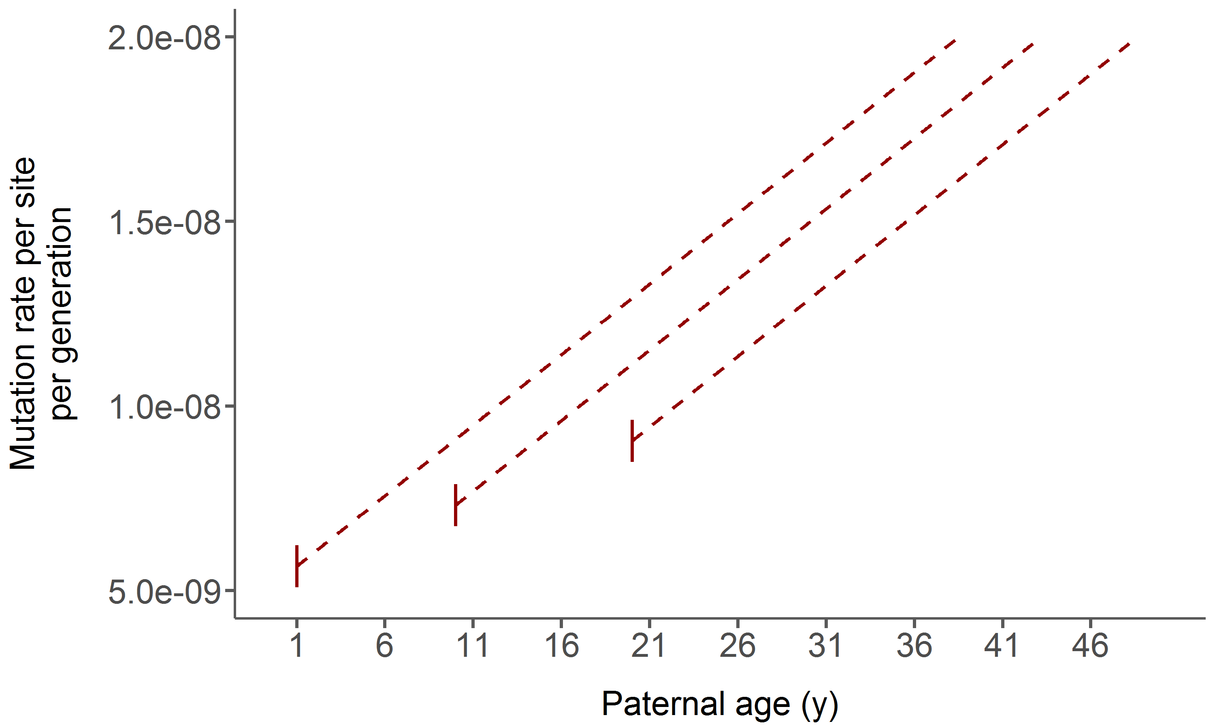
Expectations when age of puberty varies
Simultaneously changing mutation rate in females or pre-puberty males

Slide 38
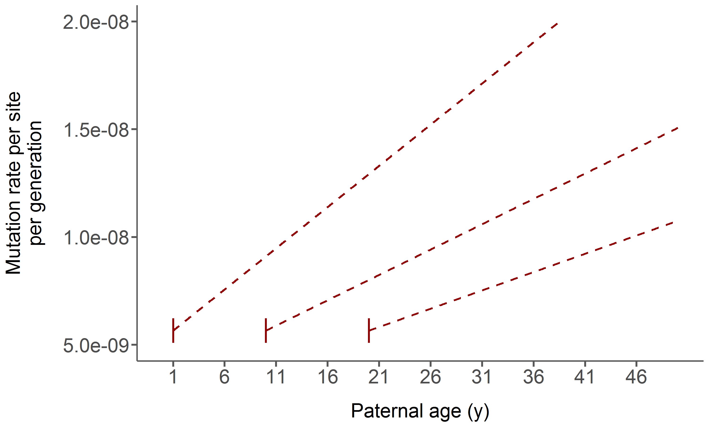
Expectations when age of puberty varies
Simultaneously changing the mutation rate in males AFTER puberty

Slide 39
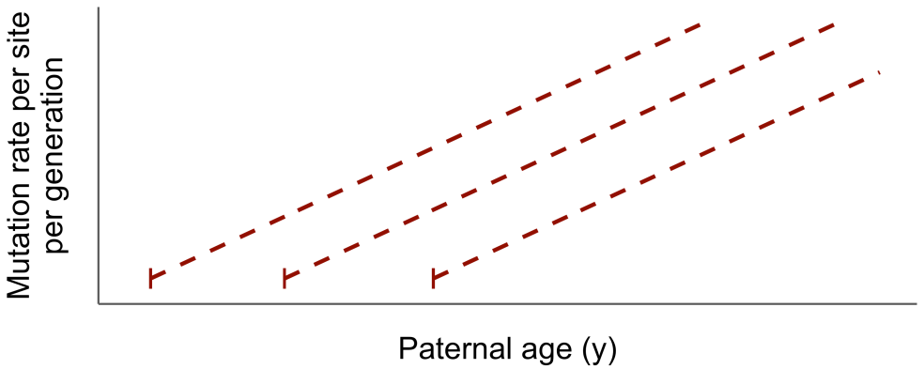
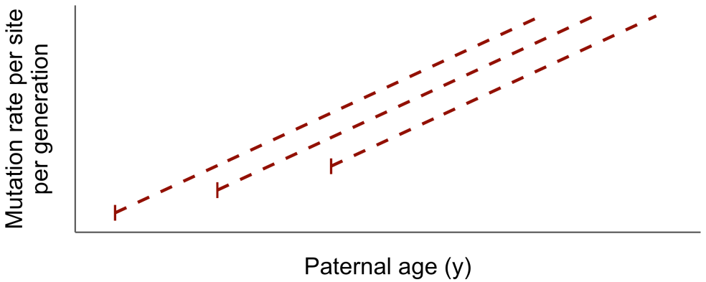
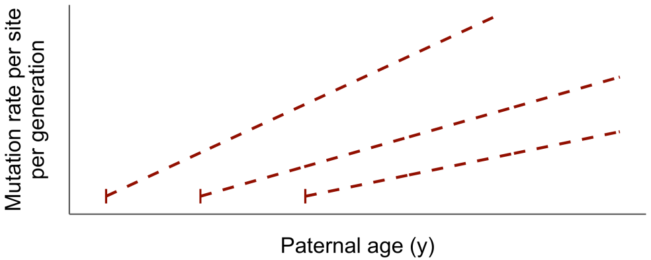
Changing age of puberty only
Also changing mutation rate in females or pre-puberty males
Also changing mutation rate in males after puberty

Slide 40
Changing age of puberty only
Change to molecular machinery
Also changing mutation rate in females or pre-puberty males
Also changing mutation rate in males after puberty

Slide 41
NO change to molecular machinery
Changing age of puberty only
Change to molecular machinery
Also changing mutation rate in females or pre-puberty males
Also changing mutation rate in males after puberty

Slide 42

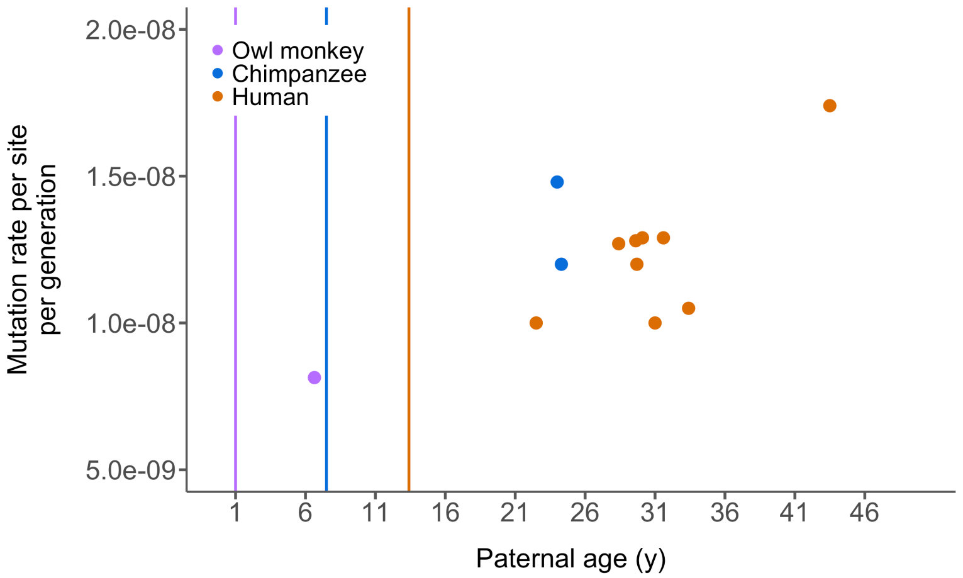

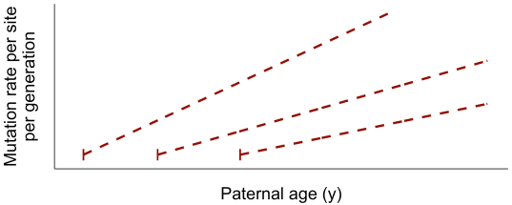
How can we predict mutation functions?
Each point = 1 study
Vertical lines = puberty age
Owl monkey
Chimp
Human
Notes:
NO human line

Slide 43

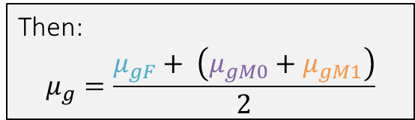
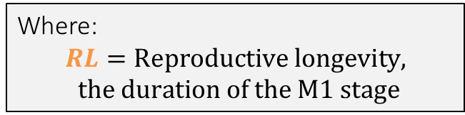


We model mutation rate as the average of the contribution of mutations from three life-stages
$$μ_{gM0}= μ_{c}∗d_{M0}$$
Then:
$$μ_{g}=\frac{μ_{gF}+ \left(μ_{gM0}+μ_{gM1}\right)}{2}$$
Age of puberty
$$μ_{gF}=μ_{c}∗d_{F}$$
$$μ_{gM1}= μ_{c}∗d_{yM1}∗RL$$
Where:
$$RL=Reproductive longevity,$$
$$the duration of the M1 stage$$
Goriely 2016

Slide 44
We model mutation rate as the average of the contribution of mutations from three life-stages
$$μ_{gM0}= μ_{c}∗d_{M0}$$
Then:
$$μ_{g}=\frac{μ_{gF}+ \left(μ_{gM0}+μ_{gM1}\right)}{2}$$
Age of puberty
$$μ_{gF}=μ_{c}∗d_{F}$$
$$μ_{gM1}= μ_{c}∗d_{yM1}∗RL$$
Where:
$$RL=Reproductive longevity,$$
$$the duration of the M1 stage$$
Goriely 2016

Slide 45
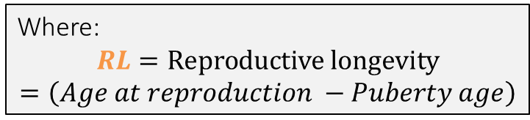



We model mutation rate as the average of the contribution of mutations from three life-stages
$$μ_{gM0}= μ_{c}∗d_{M0}$$
Then:
$$μ_{g}=\frac{μ_{gF}+ \left(μ_{gM0}+μ_{gM1}\right)}{2}$$
Age of puberty
$$μ_{gF}=μ_{c}∗d_{F}$$
$$μ_{gM1}= μ_{c}∗d_{yM1}∗RL$$
Where:
$$RL=Reproductive longevity=\left(Age at reproduction −Puberty age\right)$$
Goriely 2016

Slide 46
We model mutation rate as the average of the contribution of mutations from three life-stages
$$μ_{gM0}= μ_{c}∗d_{M0}$$
Then:
$$μ_{g}=\frac{μ_{gF}+ \left(μ_{gM0}+μ_{gM1}\right)}{2}$$
Age of puberty
$$μ_{gF}=μ_{c}∗d_{F}$$
$$μ_{gM1}= μ_{c}∗d_{yM1}∗RL$$
Where:
$$RL=Reproductive longevity=\left(Age at reproduction −Puberty age\right)$$
Goriely 2016

Slide 47
Reproductive longevity determines mutation rates
$$μ_{gM0}= μ_{c}∗d_{M0}$$
Then:
$$μ_{g}=\frac{μ_{gF}+ \left(μ_{gM0}+μ_{gM1}\right)}{2}$$
Age of puberty
$$μ_{gF}=μ_{c}∗d_{F}$$
$$μ_{gM1}= μ_{c}∗d_{yM1}∗RL$$
Where:
$$RL=Reproductive longevity=\left(Age at reproduction −Puberty age\right)$$
Goriely 2016

Slide 48
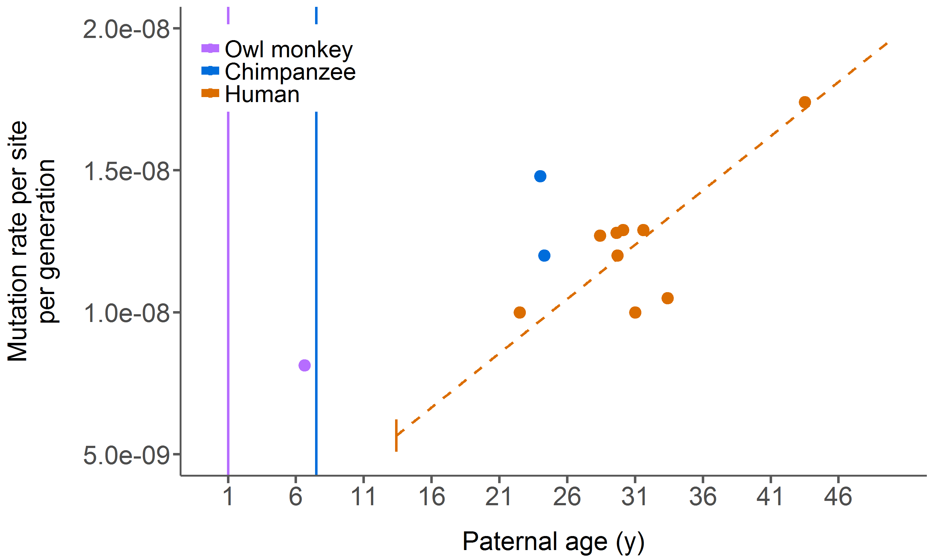
Human studies give us a mutation rate function for a given age of puberty
Each point = 1 study
Vertical lines = puberty age
Dashed line = model predictions
Owl monkey
Chimp

Slide 49
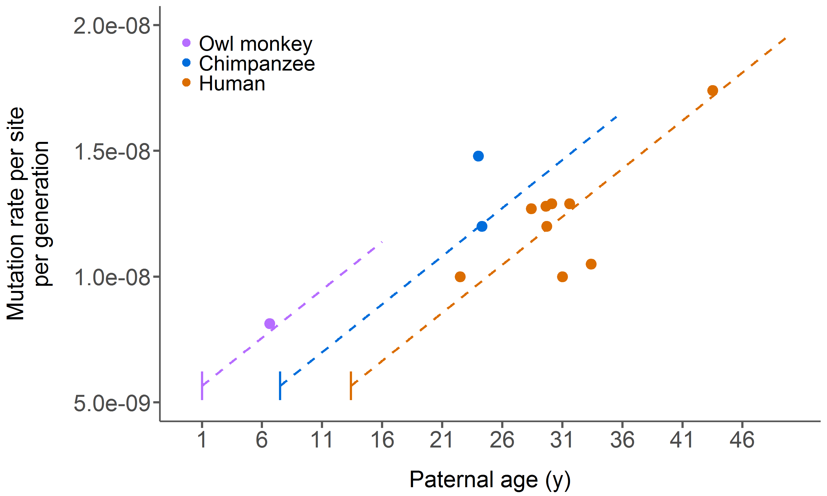
Altering reproductive longevity predicts mutation rates for chimpanzee and owl monkey
Each point = 1 study
Vertical lines = puberty age
Dashed lines = model predictions

Slide 50

Altering reproductive longevity predicts mutation rates for chimpanzee and owl monkey
Only age of puberty varies!
Each point = 1 study
Vertical lines = puberty age
Dashed lines = model predictions

Slide 51
A human at age 25 passes on the same number of mutations as an owl monkey at age 12
Each point = 1 study
Vertical lines = puberty age
Dashed lines = model predictions

Slide 52
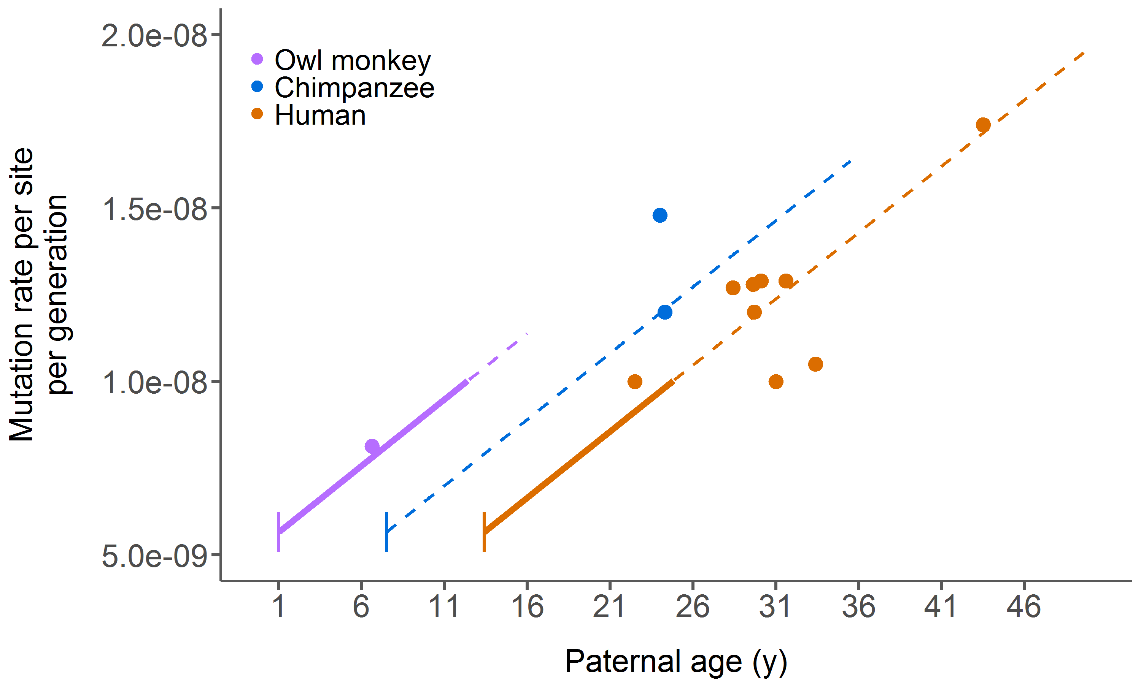
A human at age 25 passes on the same number of mutations as an owl monkey at age 12
Each point = 1 study
Vertical lines = puberty age
Dashed lines = model predictions

Slide 53
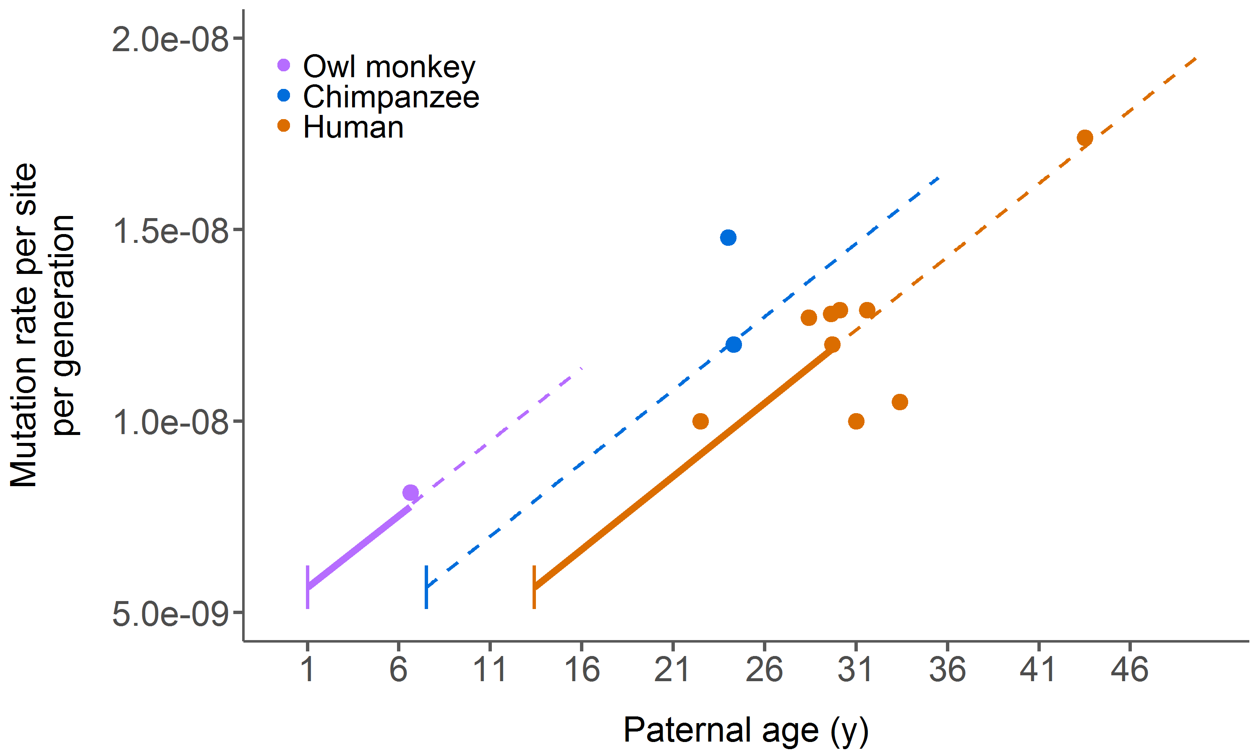
Measuring samples with different reproductive longevities leads to differences in rate estimates
Each point = 1 study
Vertical lines = puberty age
Dashed lines = model predictions

Slide 54
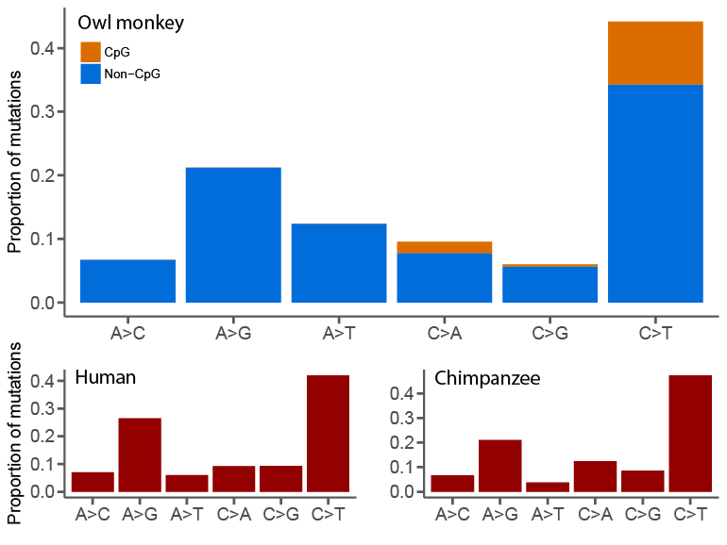
Mutational spectra show no evidence of evolution of the mutational machinery

Slide 55
Take home points
Owl monkeys have a lower average mutation rate than apes and a similar paternal age effect as humans
This lower rate can be explained entirely by its earlier puberty age and age at reproduction
Mutation rates are a function of reproductive longevity

Slide 56
Take home points
Owl monkeys have a lower average mutation rate than apes and a similar paternal age effect as humans
This lower rate can be explained entirely by its earlier puberty age and age at reproduction
Mutation rates are a function of reproductive longevity

Slide 57
Take home points
Owl monkeys have a lower average mutation rate than apes and a similar paternal age effect as humans
This lower rate can be explained entirely by its earlier puberty age and age at reproduction
Mutation rates are a function of reproductive longevity

Slide 58
Reproductive longevity may be important across larger scales
Human
Chimp
Arabidopsis
Rice
Daphnia
Honeybee
Mouse
Drosophila
Pristionchus
Heliconius
C. elegans
C. briggsae

Slide 59

Acknowledgements
Indiana University
Matt Hahn
Richard Wang
Arthi Puri
Predrag Radijovac
Baylor College of Medicine
Jeff Rogers
Muthuswamy Raveendran
R. Alan Harris
University of Texas
(Bastrop colony)
Christian Abee
Lawrence Williams
The owl monkeys!
The Precision Health Initiative

Slide 61
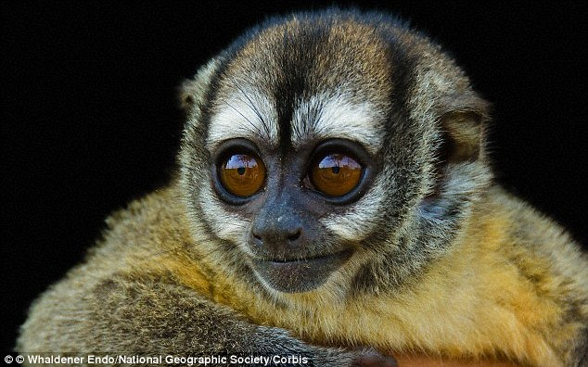
Thanks

Slide 62
Inheritance of mutations to F2 generation gives confidence for mutation calls
Owl monkey trios
2.92 mutations per year of the father
Ratio of Male:Female mutations: 2.09
No maternal age effect
Average transmission frequency to F2: 0.502

Slide 63
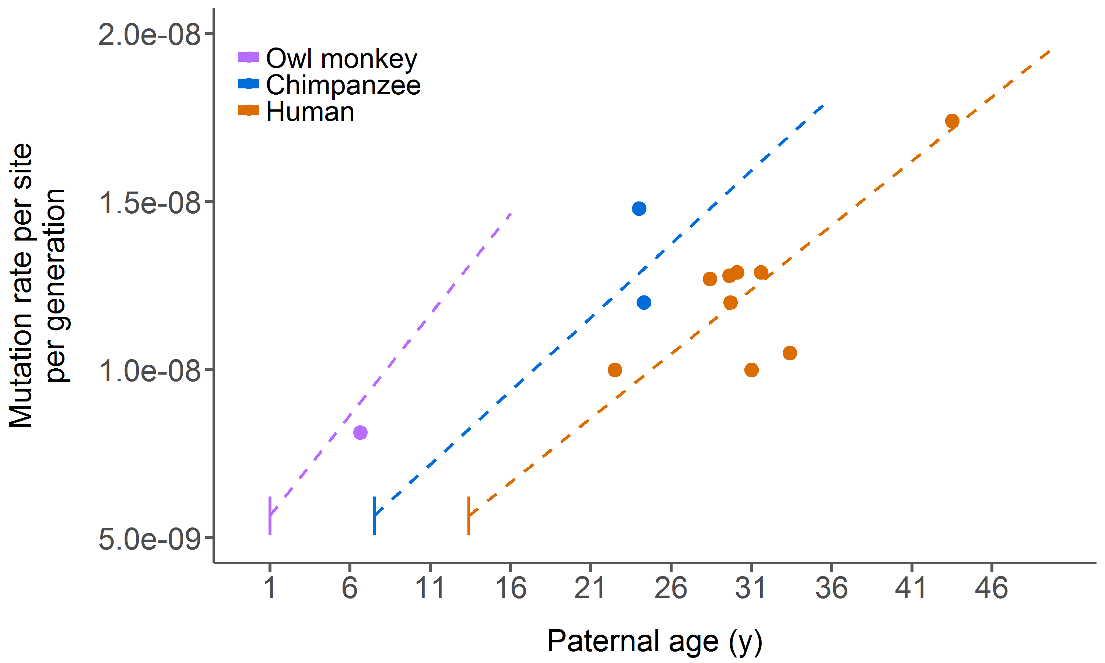
Using species specific spermatogenesis rates does not affect our conclusions
Each point = 1 study
Dashed lines = model predictions

Slide 64
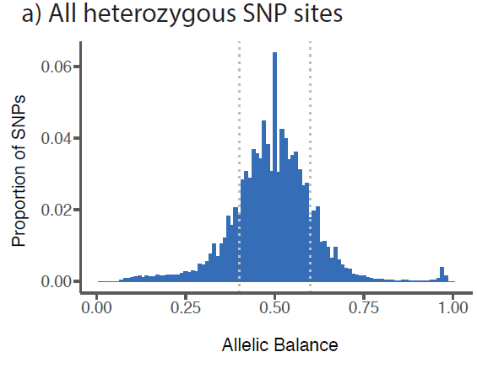
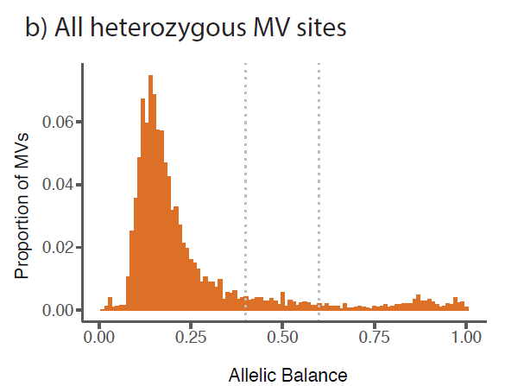
We applied stringent filters to initial MV calls to minimize false positives
Allelic balance in F1
Read depth in all individuals
Not homozygous parents
Allele present in other individuals in sample

Slide 65
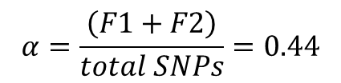
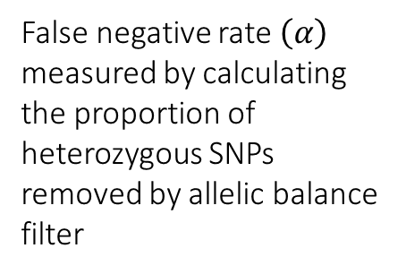
False negative rate estimation
False negative rate $\left(α\right)$ measured by calculating the proportion of heterozygous SNPs removed by allelic balance filter
F1
F2
$$α=\frac{\left(F1+F2\right)}{total SNPs}=0.44$$

Slide 66
Read depth distributions of SNPs and MVs

Slide 67
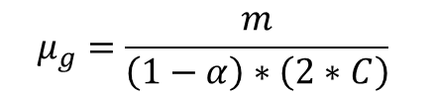
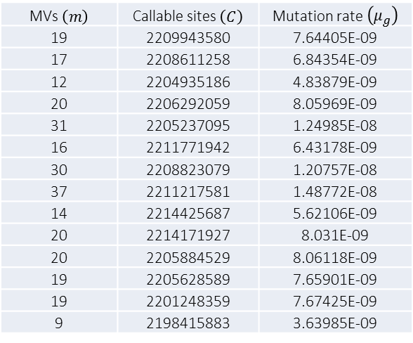
Mutation rate per site estimates for 14 owl monkey trios
MVs $\left(m\right)$ | Callable sites $\left(C\right)$ | Mutation rate $\left(μ_{g}\right)$
19 | 2209943580 | 7.64405E-09
17 | 2208611258 | 6.84354E-09
12 | 2204935186 | 4.83879E-09
20 | 2206292059 | 8.05969E-09
31 | 2205237095 | 1.24985E-08
16 | 2211771942 | 6.43178E-09
30 | 2208823079 | 1.20757E-08
37 | 2211217581 | 1.48772E-08
14 | 2214425687 | 5.62106E-09
20 | 2214171927 | 8.031E-09
20 | 2205884529 | 8.06118E-09
19 | 2205628589 | 7.65901E-09
19 | 2201248359 | 7.67425E-09
9 | 2198415883 | 3.63985E-09
$$μ_{g}=\frac{m}{\left(1−α\right)∗\left(2∗C\right)}$$

Slide 68
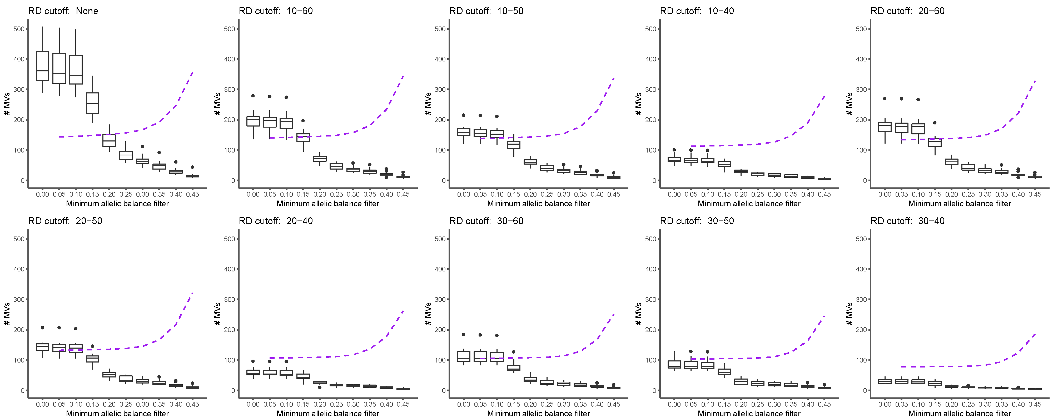
Effect of different filtering levels on estimated number of mutations

Slide 69
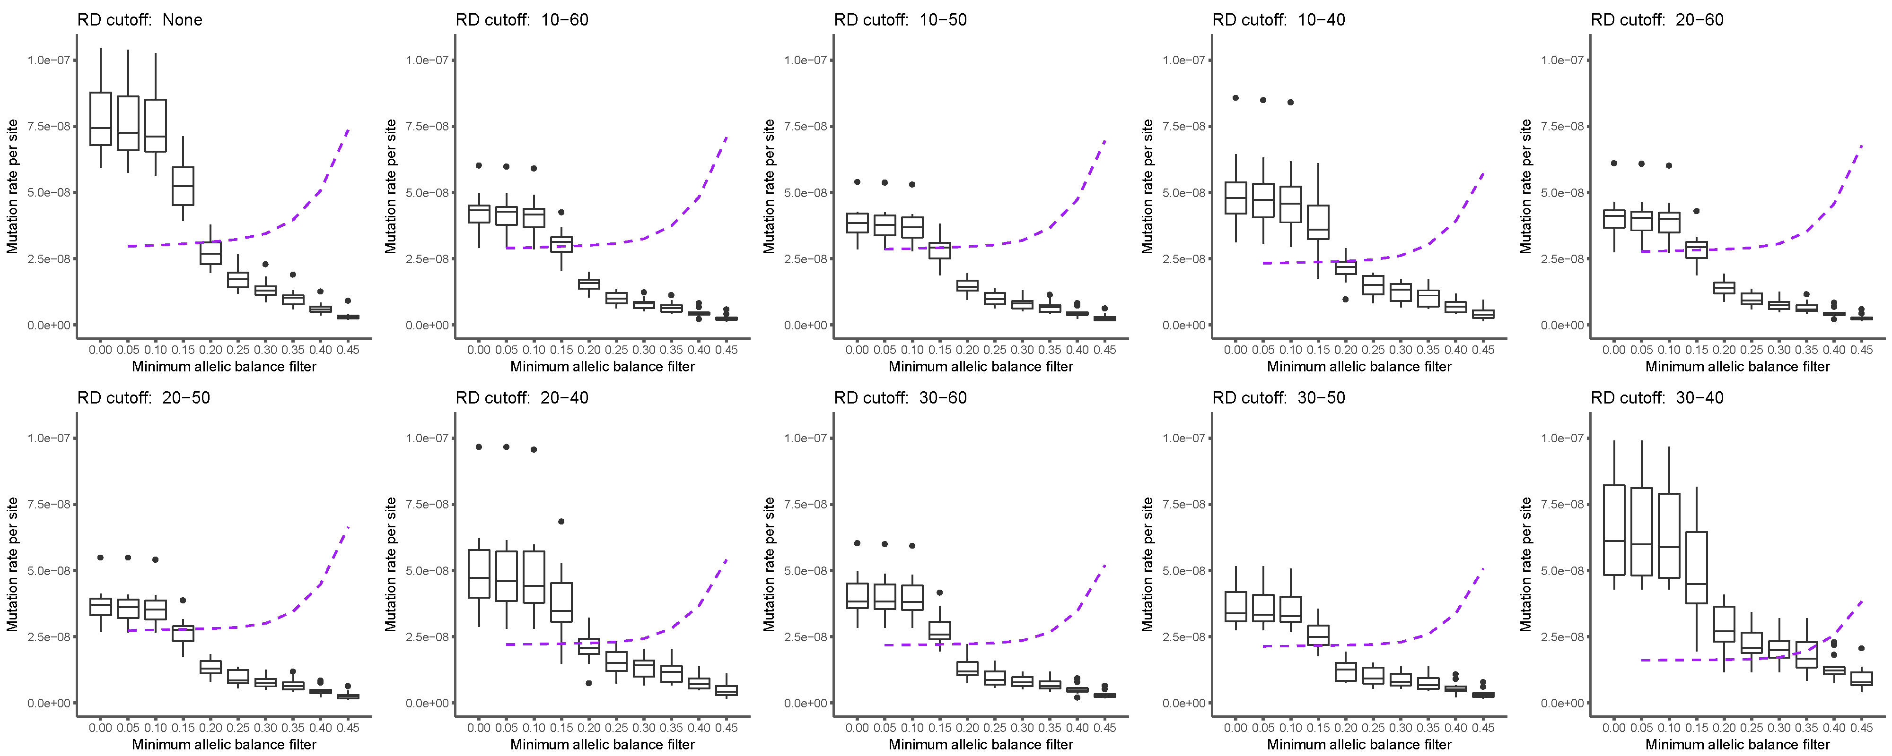
Effect of different filtering levels on mutation rates

Slide 70
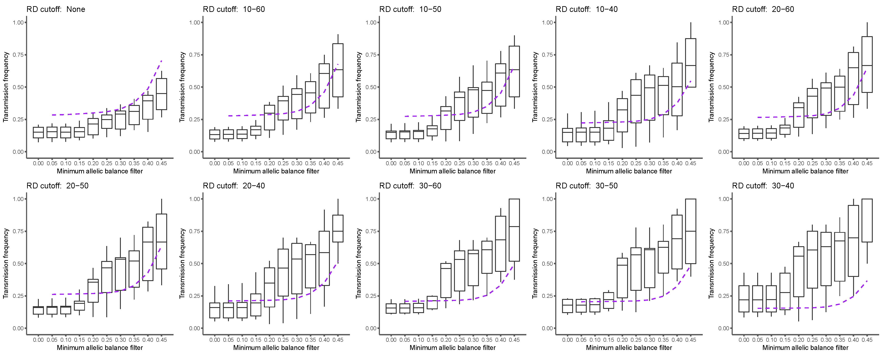
Effect of different filtering levels on transmission frequency

Slide 71
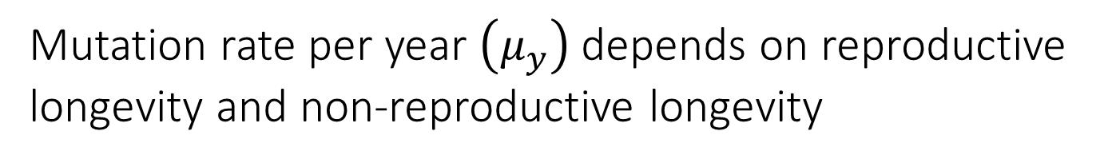



Mutation rate per year $\left(μ_{y}\right)$depends on reproductive longevity and non-reproductive longevity
$$RL=A_{M}−P_{M}$$
$$NRL=A_{F}+P_{M}$$
$$μ_{y}=\frac{\left(μ_{gM0}+μ_{gM1}\right)+ μ_{gF}}{RL+NRL}=\frac{μ_{g}}{\left(\frac{RL+NRL}{2}\right)}$$

Slide 72
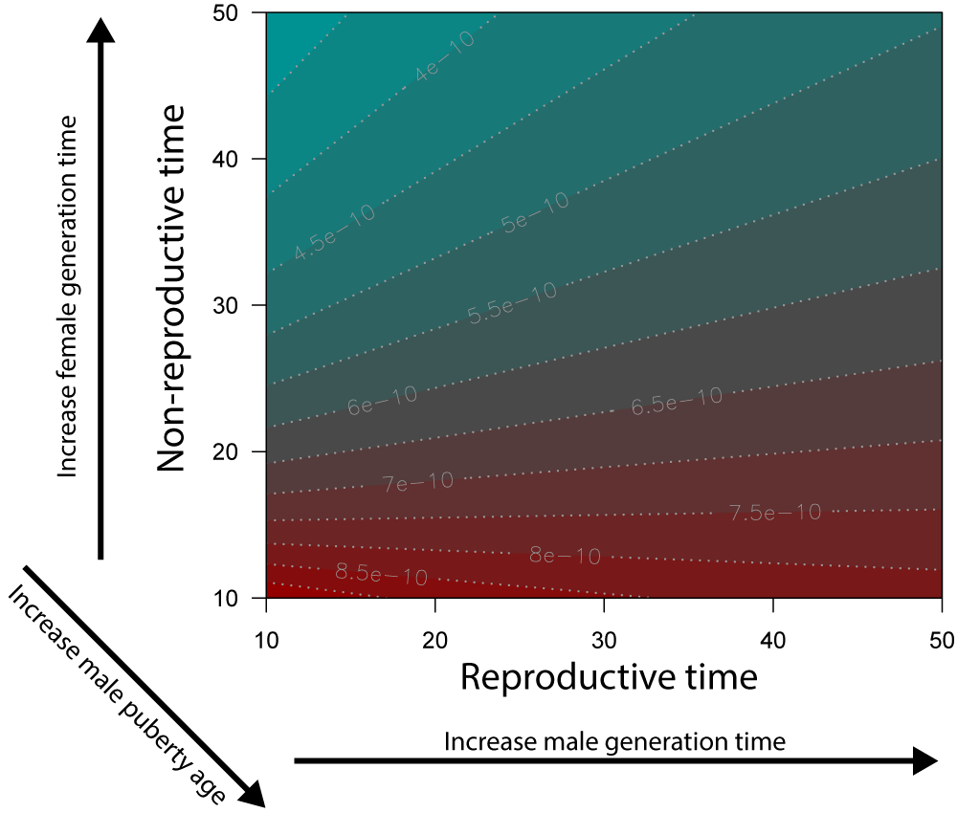
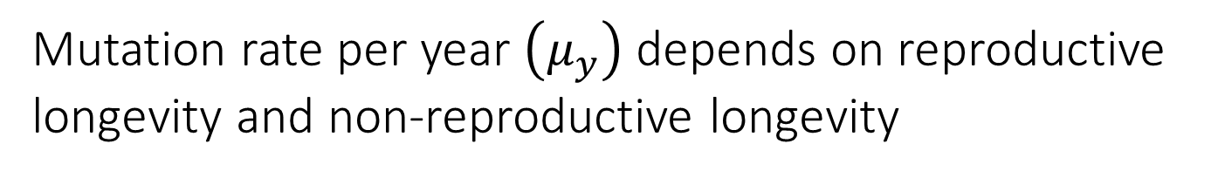
Mutation rate per year $\left(μ_{y}\right)$ depends on reproductive longevity and non-reproductive longevity

Slide 73
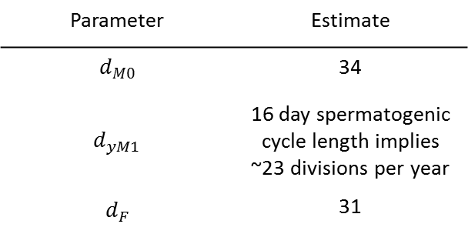
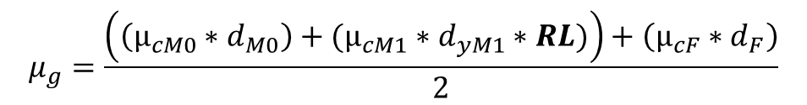
Estimating model parameters from human data
$$μ_{g}=\frac{\left(\left(μ_{cM0}∗d_{M0}\right)+(μ_{cM1}∗d_{yM1}∗RL)\right)+\left(μ_{cF}∗d_{F}\right)}{2}$$
Parameter | Estimate
$$d_{M0}$$ | 34
$$d_{yM1}$$ | 16 day spermatogenic cycle length implies ~23 divisions per year
$$d_{F}$$ | 31

Slide 74
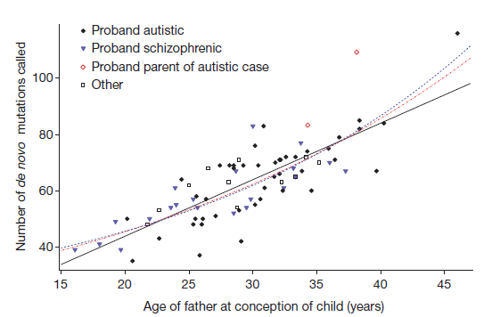


Estimating $μ_{c}$ with the observed female $μ_{g}$
$$μ_{gF}= μ_{cF} ∗d_{F}$$
$$μ_{gF}=14.2$$
$$μ_{cF}=\frac{14.2}{31}=0.458$$
Or, given a genome size of 2.63 billion base pairs:
$μ_{cF}=\frac{0.458}{\left(2.63e^{9}\right)}=1.74e^{−10}$
Kong et al. 2011

Slide 75

Estimating the parameters in males after puberty
$$μ_{gM1}= μ_{cM1} ∗d_{yM1} ∗RL$$
The paternal age effect = 2.01 mutations per year in the father after puberty:
$$μ_{cM1} ∗d_{yM1}=2.01$$
Given a spermatogenic cycle length of 16 days:
$d_{yM1}=22.8125$
Kong et al. 2011

Slide 76


Estimating the parameters in males after puberty
$$μ_{gM1}= μ_{cM1} ∗d_{yM1} ∗RL$$
The paternal age effect = 2.01 mutations per year in the father after puberty:
$$μ_{cM1} ∗d_{yM1}=2.01$$
Given a spermatogenic cycle length of 16 days:
$d_{yM1}=22.8125$
This means that $μ_{cM1}$ must be an order of magnitude lower than $μ_{cM0}$ and $μ_{cF}$:
$$μ_{cM1}=\frac{7.64e^{−10}}{22.8125}=3.3e^{−11}$$
or…

Slide 77

Estimating the parameters in males after puberty
$$μ_{gM1}= μ_{cM1} ∗d_{yM1} ∗RL$$
The paternal age effect = 2.01 mutations per year in the father after puberty:
$$μ_{cM1} ∗d_{yM1}=2.01$$
Given a spermatogenic cycle length of 16 days:
$d_{yM1}=22.8125$
OR There are fewer than the expected number of divisions per year in this life-stage.
Scally 2016

Slide 78

Estimating the parameters in males after puberty
$$μ_{gM1}= μ_{cM1} ∗d_{yM1} ∗RL$$
The paternal age effect = 2.01 mutations per year in the father after puberty:
$$μ_{cM1} ∗d_{yM1}=2.01$$
Given a spermatogenic cycle length of 16 days:
$d_{yM1}=22.8125$
Assuming constant $μ_{c}$ between all life stages, we can estimate:
$$d_{yM1}=\frac{7.64e^{−10}}{1.74e^{−10}}=4.39$$

Slide 79

Varying only age of puberty can explain mutation rate variation in primates
$$μ_{g}=\frac{\left(\left(1.74e^{−10}∗31\right)+(1.74e^{−10}∗4.39∗RL)\right)+\left(1.74e^{−10}∗31\right)}{2}$$

