Slide 1
Spark Streaming

Slide 2
目录
Spark Streaming架构
Streaming时间和窗口
Streaming编程模型
DStream源码分析
StreamingContext源码分析
JobScheduler源码分析
DStreamGraph源码分析

Slide 3
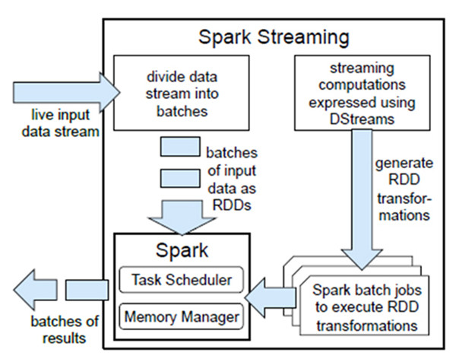
Spark Streaming架构

Slide 4
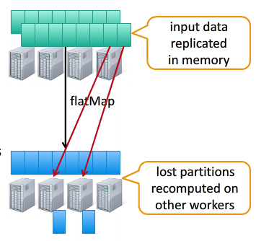
Spark Streaming架构
计算流程： 将流式计算分解成一系列短小的批处理作业，也就是把Spark Streaming的输入数据按照batch size（如1秒）分成一段一段的数据（Discretized Stream），每一段数据都转换成Spark中的RDD，然后将对DStream的操作变为对RDD的操作。 容错特性： 输入数据可以来自于HDFS（多份拷贝）或是来自于网络的数据流（Spark Streaming会将网络输入数据的每一个数据流拷贝两份到其他的机器）都能保证容错性。所以RDD中任意的Partition出错，都可以并行地在其他机器上将缺失的Partition计算出来。

Slide 5
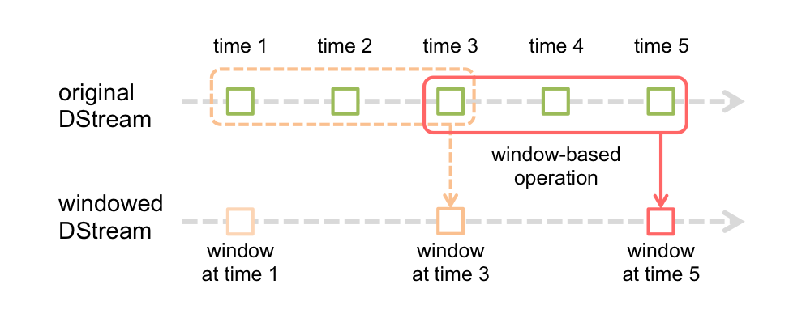
Streaming时间和窗口
三个重要参数： 批处理间隔：spark streaming提交作业的频率 窗口间隔：必须为批处理间隔的整数倍。落在同一个窗口里面的RDD作为一个整体计算，例如计算最近30秒的词频 滑动间隔：必须为批处理间隔的整数倍。默认跟批处理间隔一样，是窗口推进的步长。例如计算最近30秒的词频，每10更新一次，这个10秒就是窗口滑动间隔 // Reduce last 30 seconds of data, every 10 seconds val windowedWordCounts = pairs.reduceByKeyAndWindow((a:Int,b:Int) => (a + b), Seconds(30), Seconds(10))

Slide 6
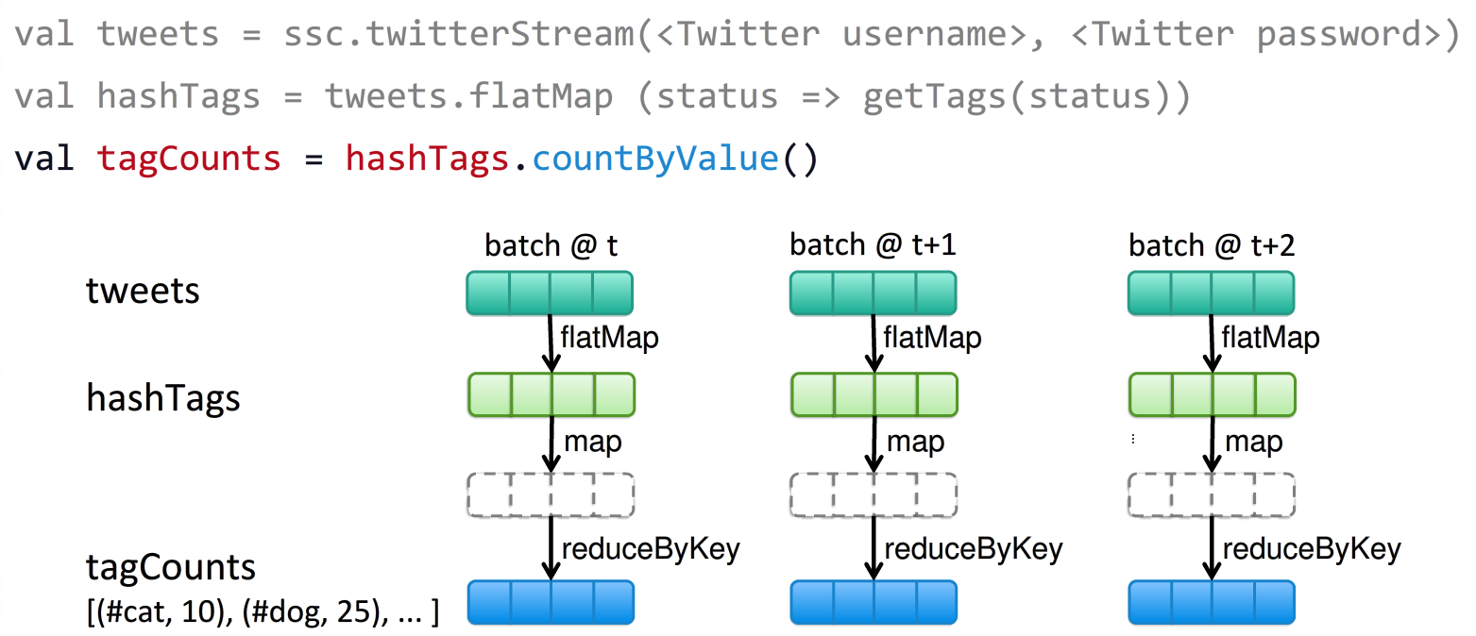
Streaming编程模型

Slide 7
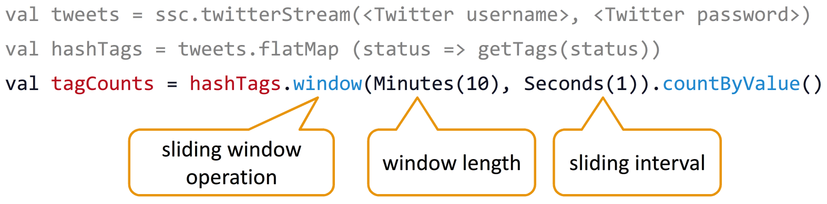
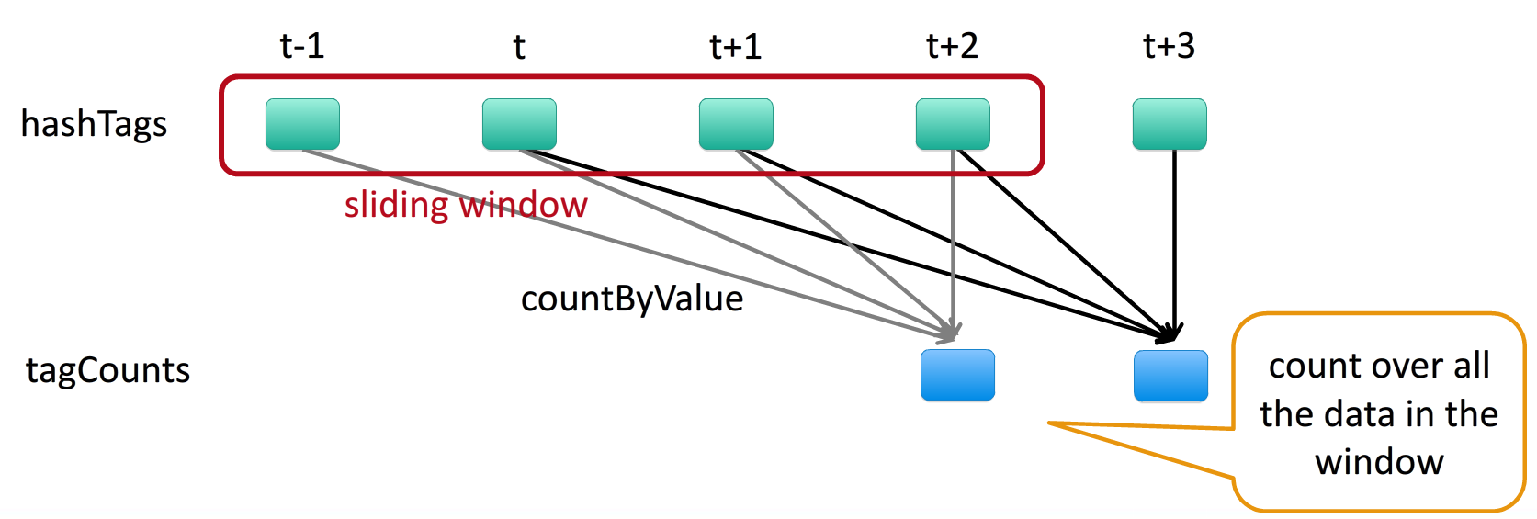
Streaming编程模型

Slide 8
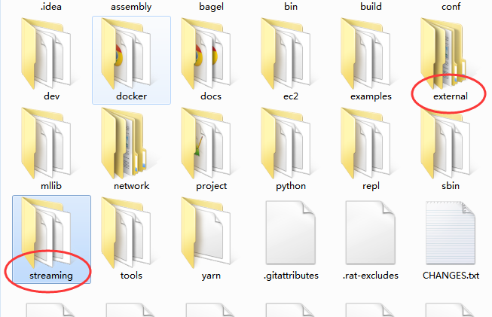
Streaming源码目录
Streaming的代码主要分布在下面两个目录：

Slide 9
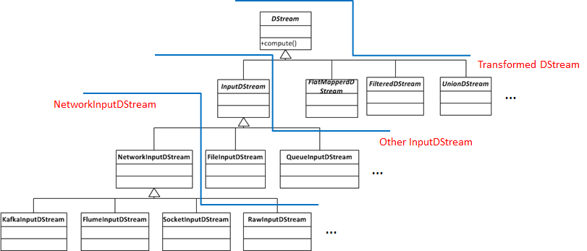
DStream源码分析
abstract class DStream[T: ClassTag] (…) { …… def slideDuration: Duration def dependencies: List[DStream[_]] def compute (validTime: Time): Option[RDD[T]] …… }

Slide 10
DStream源码分析
看看kafka的DStream： class DirectKafkaInputDStream ( val fromOffsets: Map[TopicAndPartition, Long], messageHandler: MessageAndMetadata[K, V] => R ) { …… override def compute (validTime: Time): Option[KafkaRDD[K, V, U, T, R]] = { val untilOffsets = clamp ( latestLeaderOffsets (maxRetries) ) val rdd = KafkaRDD[K, V, U, T, R]( context.sparkContext, kafkaParams, currentOffsets, untilOffsets, messageHandler) // Report the record number of this batch interval to InputInfoTracker. val numRecords = rdd.offsetRanges.map(r => r.untilOffset - r.fromOffset).sum val inputInfo = InputInfo(id, numRecords) ssc.scheduler.inputInfoTracker.reportInfo(validTime, inputInfo) currentOffsets = untilOffsets.map(kv => kv._1 -> kv._2.offset) Some(rdd) } …… }

Slide 11
DStream源码分析
DStream与RDD： DStream在内部维护了一组时间序列的RDD，对于DStream的transformation和output在内部都转化为对于RDD的transformation和output。 下面来看一下对于DStream的计算是如何映射到对于RDD的计算上去的 // class DStream private[streaming] final def getOrCompute (time: Time): Option[RDD[T]] = { generatedRDDs.get(time).orElse { if (isTimeValid(time)) { val rddOption = createRDDWithLocalProperties(time) { // compute() might cause Spark jobs to be launched. PairRDDFunctions.disableOutputSpecValidation.withValue(true) { compute(time) } } rddOption.foreach { case newRDD => generatedRDDs.put(time, newRDD) } ……

Slide 12
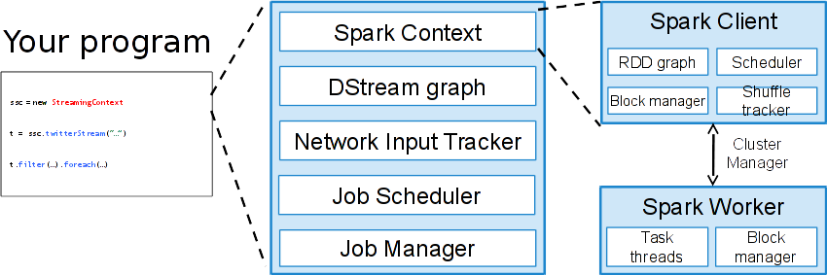
StreamingContext源码分析
class StreamingContext private[streaming] (…) { …… private[streaming] val sc: SparkContext private[streaming] val scheduler = new JobScheduler(this) private[streaming] val graph: DStreamGraph …… }

Slide 13
StreamingContext源码分析
Context启动： streaming程序是从StreamingContext.start()开始的，做一个必要的参数检查然后启动 jobscheduler def start(): Unit = synchronized { state match { case INITIALIZED => StreamingContext.ACTIVATION_LOCK.synchronized { StreamingContext.assertNoOtherContextIsActive() try { validate() scheduler.start() state = StreamingContextState.ACTIVE } catch { case NonFatal(e) => logError("Error starting the context, marking it as stopped", e) scheduler.stop(false) state = StreamingContextState.STOPPED throw e } ……

Slide 14
JobScheduler源码分析
JobScheduler启动： 启动listener、actor、receiver,调用JobGenerator生成任务执行的Job对象 def start(): Unit = synchronized { if (eventActor != null) return // scheduler has already been started logDebug("Starting JobScheduler") eventActor = ssc.env.actorSystem.actorOf(Props(new Actor { def receive = { case event: JobSchedulerEvent => processEvent(event) } }), "JobScheduler") listenerBus.start() receiverTracker = new ReceiverTracker(ssc) receiverTracker.start() jobGenerator.start() logInfo("Started JobScheduler") }

Slide 15
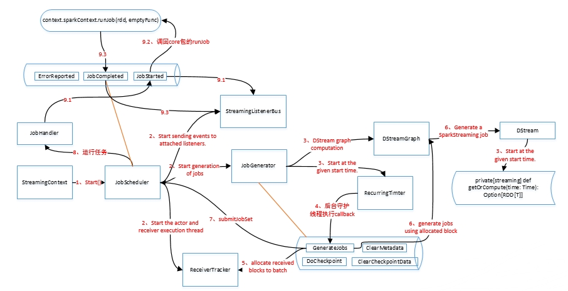
JobScheduler源码分析

Slide 16
DStreamGraph源码分析
作用： 维护inputStream和outputStream class DStreamGraph extends Serializable with Logging { private val inputStreams = new ArrayBuffer[InputDStream[_]]() private val outputStreams = new ArrayBuffer[DStream[_]]() def getInputStreamName (streamId: Int): Option[String] = synchronized { inputStreams.find(_.id == streamId).map(_.name) } def generateJobs (time: Time): Seq[Job] = { logDebug("Generating jobs for time " + time) val jobs = this.synchronized { outputStreams.flatMap(outputStream => outputStream.generateJob(time)) } jobs }

Slide 17
DStreamGraph源码分析
生成定时任务 // JobGenerator /** Generate jobs and perform checkpoint for the given `time`. */ private def generateJobs (time: Time) { Try { jobScheduler.receiverTracker.allocateBlocksToBatch(time) // allocate received blocks to batch graph.generateJobs(time) // generate jobs using allocated block } match { case Success(jobs) => val receivedBlockInfos = jobScheduler.receiverTracker.getBlocksOfBatch(time).mapValues { _.toArray } jobScheduler.submitJobSet (JobSet(time, jobs, receivedBlockInfos))

Slide 18
DStreamGraph源码分析
生成定时任务 // DStream private[streaming] def generateJob(time: Time): Option[Job] = { getOrCompute(time) match { case Some(rdd) => { val jobFunc = () => { val emptyFunc = { (iterator: Iterator[T]) => {} } context.sparkContext.runJob(rdd, emptyFunc) } Some(new Job(time, jobFunc)) } case None => None } } 后面就是sparkContext的DAG Scheduler和Task Scheduler的事情了

Slide 19
Thanks

