Slide 1
Spark Streaming（续）

Slide 2
目录
Receiver的启动过程
ReceiverTracker源码分析
ReceiverLauncher源码分析
Receiver接收保存数据流程
InputInfoTracker源码分析

Slide 3
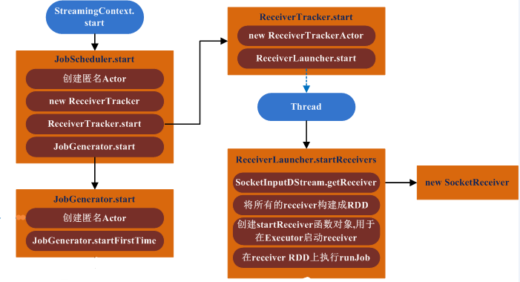
Receiver的启动过程
Receiver启动分为两个部分 Driver端初始化ReceiverTracker 将Receiver封装成RDD，并发送Executor执行

Slide 4
ReceiverTracker源码分析
从DStreamGraph中读取所有的ReceiverInputDStream 创建ReceiverLauncher对象，用于启动Receiver； 创建ReceivedBlockTracker对象，用于存储Receiver创建好的Block数据描述信息，具体的Block数据存储在Executor的BlockManager中 class ReceiverTracker( … ) extends Logging { private val receiverInputStreams = ssc.graph.getReceiverInputStreams() private val receiverInputStreamIds = receiverInputStreams.map { _.id } private val receiverExecutor = new ReceiverLauncher() private val receiverInfo = new HashMap[Int, ReceiverInfo] with SynchronizedMap[Int, ReceiverInfo] private val receivedBlockTracker = new ReceivedBlockTracker( ……

Slide 5
ReceiverTracker源码分析
ReceiverTracker的启动 （1）创建ReceiverTrackerEndpoint对象，处理Receiver的注册及Receiver创建的Block信息； （2）启动ReceiverLauncher，负责启动所有的Receiver。 /** Start the endpoint and receiver execution thread. */ def start(): Unit = synchronized { if (endpoint != null) { throw new SparkException(“ReceiverTracker already started”) } if (!receiverInputStreams.isEmpty) { endpoint = ssc.env.rpcEnv.setupEndpoint( “ReceiverTracker”, new ReceiverTrackerEndpoint(ssc.env.rpcEnv)) if (!skipReceiverLaunch) receiverExecutor.start() // 启动Receiver logInfo("ReceiverTracker started") } } ……

Slide 6
ReceiverTracker源码分析
处理Receiver的消息 包括Receiver的注册、注销，以及接受数据流的存储AddBlock // class ReceiverTrackerEndpoint override def receiveAndReply(context: RpcCallContext): PartialFunction[Any, Unit] = { case RegisterReceiver(streamId, typ, host, receiverEndpoint) => registerReceiver(streamId, typ, host, receiverEndpoint, context.sender.address) context.reply(true) case AddBlock(receivedBlockInfo) => context.reply(addBlock(receivedBlockInfo)) case DeregisterReceiver(streamId, message, error) => deregisterReceiver(streamId, message, error) context.reply(true) } } ……

Slide 7
ReceiverLauncher源码分析
遍历receiverInputStreams，创建对应的Receiver，SocketInputDStream对应为SocketReceiver； 通过makeRDD方法将所有的Receiver封装成RDD，分区数等于Receiver数量，每个Receiver将会占用一个Task，即一个core； 创建startReceiver函数对象，将在Executor端执行； 基于Receiver的RDD提交Job，每个Receiver将作为一个Task在Executor上执行。 // private def startReceivers() { val receivers = receiverInputStreams.map(nis => { val rcvr = nis.getReceiver() rcvr.setReceiverId(nis.id) rcvr }) val tempRDD = { …… ssc.sc.makeRDD(receivers, receivers.size) }

Slide 8
ReceiverLauncher源码分析
// private def startReceivers() { …… // Function to start the receiver on the worker node val startReceiver = (iterator: Iterator[Receiver[_]]) => { if (!iterator.hasNext) { throw new SparkException( "Could not start receiver as object not found.") } val receiver = iterator.next() val supervisor = new ReceiverSupervisorImpl( receiver, SparkEnv.get, serializableHadoopConf.value, checkpointDirOption) supervisor.start() …… // 跟普通的RDD计算一样提交任务 ssc.sparkContext.runJob(tempRDD, ssc.sparkContext.clean(startReceiver)) }

Slide 9
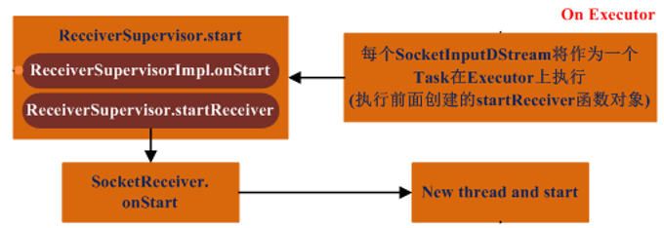
ReceiverLauncher源码分析
每个Receiver都会作为一个Task在Executor端执行，执行的具体函数就是上面创建的startReceiver函数对象，流程图如下： （1）onStart方法（ReceiverSupervisorImpl）用于启动BlockGenerator； （2）startReceiver则启动对应的Receiver（例如SocketReceiver），创建线程并启动，在线程中执行receive方法。

Slide 10
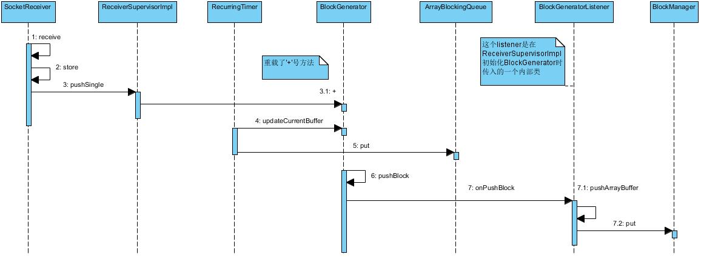
Receiver接收保存数据流程

Slide 11
InputInfoTracker源码分析
记录DStream里面每个RDD的信息（时间点，数据的数量） private[streaming] class InputInfoTracker(ssc: StreamingContext) extends Logging { private val batchTimeToInputInfos = new mutable.HashMap[Time, mutable.HashMap[Int, InputInfo]] def reportInfo (batchTime: Time, inputInfo: InputInfo): Unit = synchronized { val inputInfos = batchTimeToInputInfos.getOrElseUpdate(batchTime inputInfos += ((inputInfo.inputStreamId, inputInfo)) } def getInfo (batchTime: Time): Map[Int, InputInfo] = synchronized { val inputInfos = batchTimeToInputInfos.get(batchTime) } ……

Slide 12
InputInfoTracker源码分析
记录DStream里面每个RDD的信息（时间点，数据的数量） private[streaming] class InputInfoTracker(ssc: StreamingContext) extends Logging { private val batchTimeToInputInfos = new mutable.HashMap[Time, mutable.HashMap[Int, InputInfo]] def reportInfo (batchTime: Time, inputInfo: InputInfo): Unit = synchronized { val inputInfos = batchTimeToInputInfos.getOrElseUpdate(batchTime inputInfos += ((inputInfo.inputStreamId, inputInfo)) } def getInfo (batchTime: Time): Map[Int, InputInfo] = synchronized { val inputInfos = batchTimeToInputInfos.get(batchTime) } ……

Slide 13
InputInfoTracker源码分析
在产生RDD时会写入这个信息 // class ReceiverInputDStream override def compute(validTime: Time): Option[RDD[T]] = { // for this batch val receiverTracker = ssc.scheduler.receiverTracker val blockInfos = receiverTracker.getBlocksOfBatch(validTime).getOrElse(id, Seq.empty) val blockIds = blockInfos.map { _.blockId.asInstanceOf[BlockId] }.toArray // Register the input blocks information into InputInfoTracker val inputInfo = InputInfo(id, blockInfos.map(_.numRecords).sum) ssc.scheduler.inputInfoTracker.reportInfo(validTime, inputInfo) ……

Slide 14
InputInfoTracker源码分析
在JobGenerator提交任务时会读取 // class JobGenerator /** Generate jobs and perform checkpoint for the given `time`. */ private def generateJobs(time: Time) { // 这里先调DStreamGraph产生Job …… case Success(jobs) => val streamIdToInputInfos = jobScheduler.inputInfoTracker.getInfo(time) val streamIdToNumRecords = streamIdToInputInfos.mapValues(_.numRecords) jobScheduler.submitJobSet(JobSet(time, jobs, streamIdToNumRecords)) eventLoop.post(DoCheckpoint(time, clearCheckpointDataLater = false)) } ……

Slide 15
Thanks

