Slide 1
ADO Test Generator
AI-Powered Test Case Generation for Azure DevOps
Connects to Azure DevOps, retrieves Features & User Stories, uses Azure OpenAI
to generate test cases, and exports to Excel for import into Azure Test Plans.
React
Express
TypeScript
Azure OpenAI
Azure DevOps
ExcelJS

Slide 2
Creating an Azure DevOps PAT
Personal Access Token — required for reading work items from Azure DevOps
1
2
3
4
5
Sign in to your Azure DevOps organization
(dev.azure.com/{your-org})
Click the User settings icon (top-right)
and select Personal access tokens
Click + New Token, give it a name
and set an expiration date
Under Scopes select Custom defined,
then grant Work Items → Read
and Project and Team → Read
Click Create and copy the token
immediately — it won't be shown again

Slide 3
Creating an Azure OpenAI Instance
Deploy an OpenAI model on Azure to power test case generation
Create the Resource
Deploy a Model
1. Sign in to the Azure Portal (portal.azure.com)
1. Open Azure AI Foundry from the resource overview
2. Click + Create a resource, search for Azure OpenAI
2. Navigate to Deployments
3. Select your Subscription and Resource Group
3. Click + Deploy model → Deploy base model
4. Choose a Region where Azure OpenAI is available
(e.g., Sweden Central, East US)
4. Select a model (e.g., gpt-4o, gpt-4o-mini)
5. Enter a unique Name for the resource
5. Set a Deployment name — this is what
you enter in the app's config
6. Select Standard S0 pricing tier
6. Click Deploy and wait for completion
7. Click Review + create, then Create

Slide 4
Retrieving the Endpoint & API Key
Get the credentials needed to connect the app to your Azure OpenAI instance
Steps
Enter in the App
1. In the Azure Portal, navigate to your Azure OpenAI resource
Endpoint URL
Keys and Endpoint → Endpoint
2. In the left menu, click Keys and Endpoint
(under Resource Management)
API Key
Keys and Endpoint → KEY 1
3. Copy the Endpoint URL
(e.g., https://my-instance.openai.azure.com/)
Deployment Name
4. Click Show next to KEY 1 or KEY 2 and copy the value
Deployments → Model name

Slide 5
Why This Tool?
The Problem
The Solution
✖ Writing test cases manually is time-consuming
✔ AI generates test cases in seconds from acceptance criteria
✖ Acceptance criteria often get lost between features and test plans
✔ Directly reads Features & Stories from Azure DevOps
✖ Inconsistent test coverage across user stories
✔ 3-agent AI pipeline ensures thorough, reviewed test coverage
✖ Manual Excel formatting for Azure Test Plans import is error-prone
✔ One-click Excel export formatted for Azure Test Plans

Slide 6
Architecture Overview
Frontend
Backend
External Services
React + Vite
Express + TypeScript
APIs
• 5-step wizard UI
• REST API endpoints
• Azure DevOps REST API v7.1
• Real-time SSE progress
• 3-agent AI pipeline
• Azure OpenAI Chat API
➡
➡
• Deployment selector
• DevOps API client
• PAT authentication
• Test case preview
• Excel export service
• SSE streaming

Slide 7
Data Flow: What Goes Where
Exactly which data crosses each boundary — all processing runs locally on your machine
Browser → Backend
Backend → Azure DevOps
Backend → Azure OpenAI
Local Export
Sends:
• Organization name
• PAT token
• Project & iteration selections
• OpenAI endpoint, key, deployment
• Selected feature IDs
Sends (HTTPS):
• PAT in Authorization header
• WIQL queries (iteration filter)
• Work item ID batches (max 200)
Returns:
• Projects, iterations, features
• User story descriptions & criteria
Sends (HTTPS):
• API key in header
• Feature titles & descriptions
• User story acceptance criteria
• Agent system prompts
Returns:
• Structured JSON test cases
Processed locally:
• Test cases → Excel (.xlsx)
• Azure Test Plans format
• No external API call
Downloaded to:
• User's browser (file download)
→
→
→
What is sent to Azure OpenAI
What is NOT sent to Azure OpenAI
✔ Feature titles and plain-text descriptions
✔ User story titles, descriptions, and acceptance criteria (HTML stripped)
✔ Agent instructions (system prompts defining analyze/generate/review tasks)
✖ PAT tokens or API keys (used only for auth headers)
✖ Organization name, project name, iteration paths
✖ Work item IDs, area paths, or any DevOps metadata
All communication with Azure services uses HTTPS. The backend runs on localhost:3001 — no data is routed through third-party servers.

Slide 8
Security Controls
How credentials are handled, what stays local, and network boundaries
Credential Handling
Network Boundaries
Data Protection
Azure DevOps PAT
• Scoped: Work Items (Read),
Project and Team (Read)
• Base64 in Authorization header
• In-memory only (React state)
Azure OpenAI API Key
• Passed to Azure OpenAI SDK
• Sent as api-key header (HTTPS)
• In-memory only (React state)
No credentials are persisted
to disk, localStorage, or cookies
Runs locally on user's machine
• Frontend: localhost:5173
• Backend: localhost:3001
Only 2 external HTTPS calls:
1. Azure DevOps (dev.azure.com)
Read-only: projects, iterations,
features, user stories
2. Azure OpenAI (*.openai.azure.com)
Send: feature text + criteria
Receive: test cases (JSON)
What stays local:
• All credentials (PAT, API key)
• Work item IDs & metadata
• Generated test cases
• Excel exports
• HTML → text conversion
Backend safeguards:
• JSON payload limit: 10 MB
• CORS enabled
• Retry: 3x exponential backoff
• Max tokens: 16,384 per call
Recommendations for production deployment
• Use env variables or a secrets manager instead of UI-entered credentials • Restrict CORS to frontend origin only • Add backend API authentication • Deploy behind a reverse proxy with TLS • Consider Azure Managed Identity for OpenAI access

Slide 9
5-Step Wizard Flow
1
2
3
4
5
Connect
Select PI
Review
Generate
Export
Enter Azure DevOps org, PAT,
select project, provide
Azure OpenAI endpoint & key
▶
Choose a Program Increment
(iteration path) to scope
work items
▶
Browse Features & linked
User Stories, select items
to generate tests for
▶
AI generates test cases
with real-time streaming
progress via SSE
▶
Preview test cases and
export as .xlsx for
Azure Test Plans

Slide 10
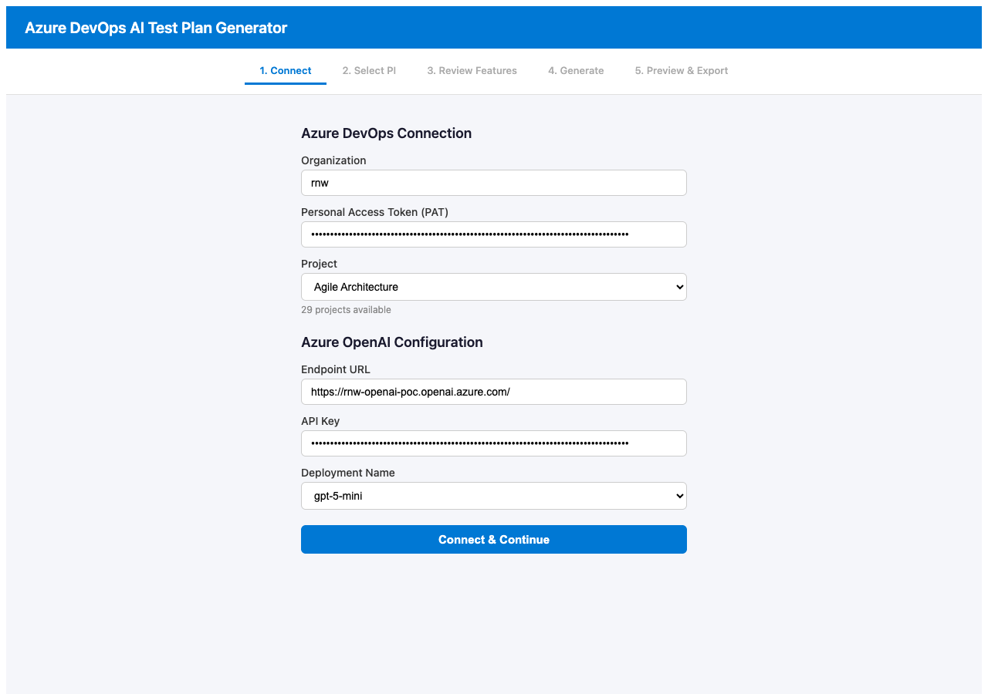
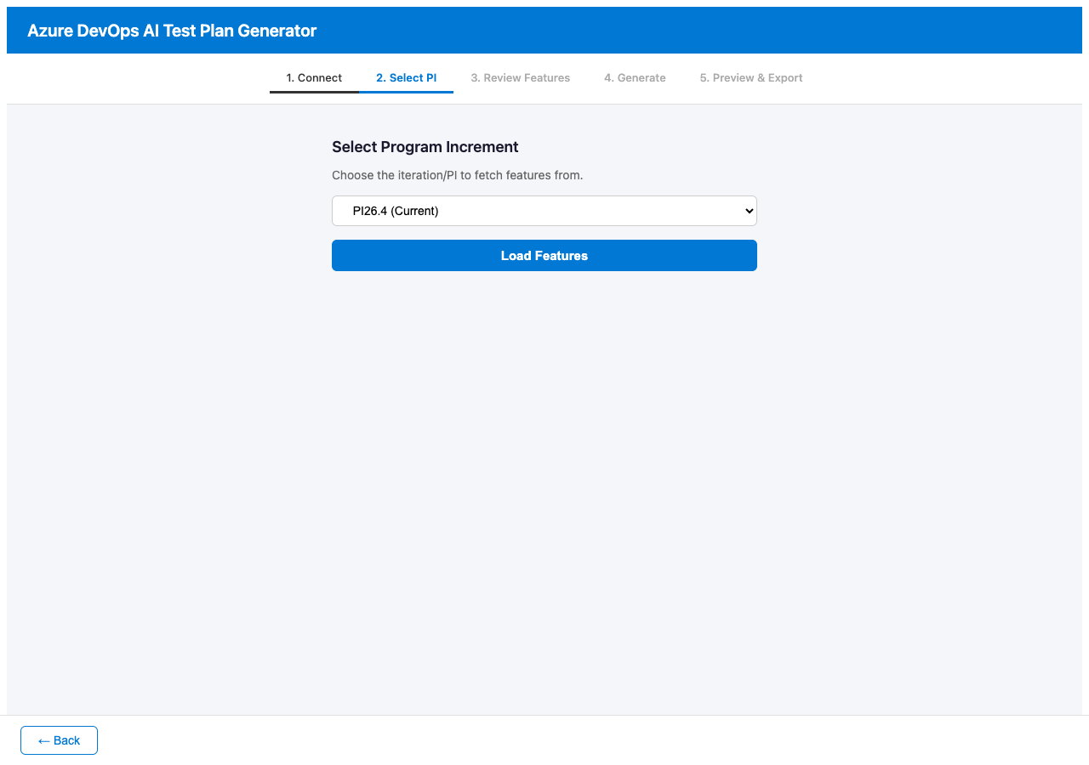
Demo: Connect & Configure
Step 1: Enter Azure DevOps credentials and Azure OpenAI config · Step 2: Select a Program Increment
Step 1: Connect
Step 2: Select PI

Slide 11
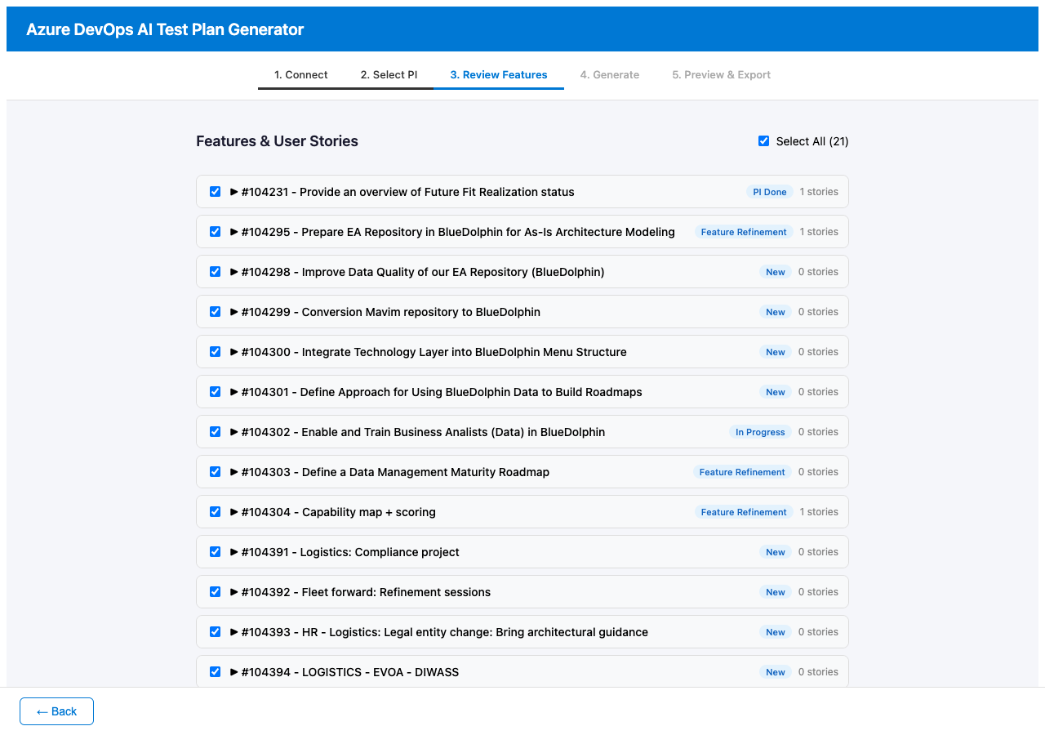
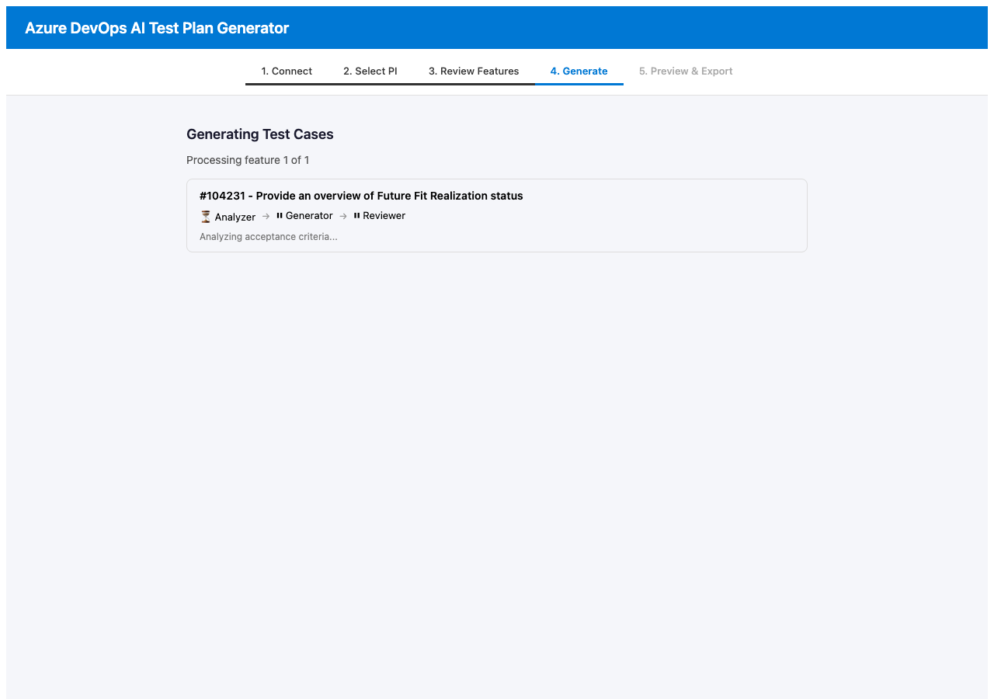
Demo: Review & Generate
Step 3: Select features to generate tests for · Step 4: AI pipeline processes each feature
Step 3: Review Features
Step 4: Generate

Slide 12
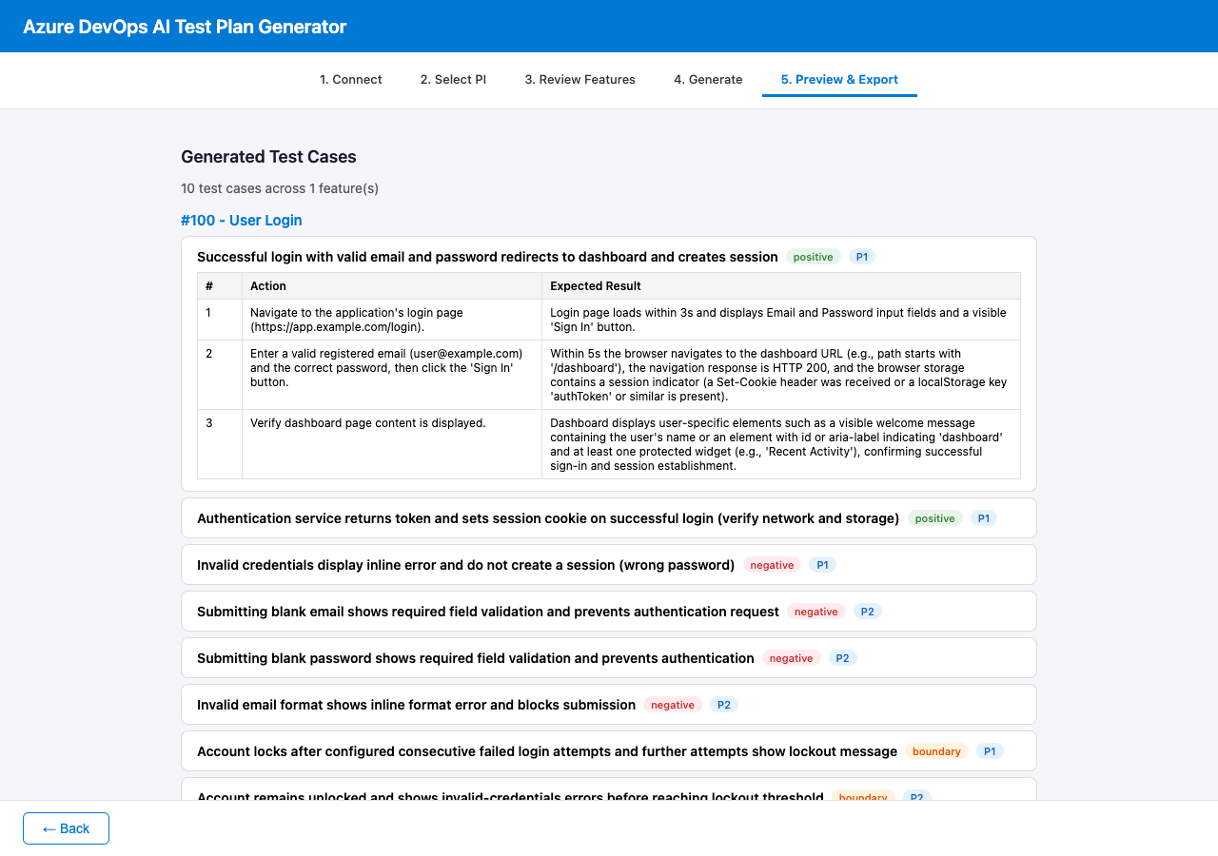
Demo: Preview & Export
Step 5: Review generated test cases with steps, priorities, and type badges — then export to Excel
Step 5: Preview & Export

Slide 13
3-Agent AI Pipeline
Each feature's test cases pass through three specialized AI agents sequentially
Agent 1
Agent 2
Agent 3
Analyzer
Generator
Reviewer
Examines the feature description and its linked user stories to extract and categorize all testable acceptance criteria.
Creates detailed test cases with numbered steps, actions, and expected results for each identified criterion.
Validates test cases for completeness and coverage. Removes redundancy, refines wording, and adds missing edge cases.
➡
➡
Input: Feature + User Stories
Input: Structured criteria
Input: Draft test cases
Output: Structured criteria
Output: Draft test cases
Output: Final test cases

Slide 14
Tech Stack
Frontend
Backend
AI
• React 18
• Express 4
• Azure OpenAI API
• Vite 5
• TypeScript
• GPT-5-mini deployment
• TypeScript
• tsx (dev runner)
• 3-agent pipeline
Integration
Export
Project
• Azure DevOps REST API v7.1
• ExcelJS
• npm workspaces monorepo
• PAT authentication
• .xlsx format
• Shared types package
• SSE streaming
• Azure Test Plans compatible
• Concurrently for dev

Slide 15
End-to-End Data Flow
Azure DevOps
Backend API
AI Pipeline
Frontend
Features &
User Stories
▼
Fetch & parse
work items
▼
Analyze → Generate
→ Review
▼
Preview &
edit test cases
Excel Export Output
✔ Test Case Title
✔ Test Steps (action + expected result)
✔ Priority (1–4)
✔ Test Type (positive / negative / boundary)
✔ Assigned To
✔ Automation Status
✔ Area Path
✔ Ready for Azure Test Plans import

Slide 16
Azure OpenAI Integration
The tool connects to your Azure OpenAI instance with configurable endpoint, API key, and deployment name
Configuration
Reasoning Model Handling
Endpoint URL
Your Azure OpenAI resource endpoint
Reasoning models (o1, o3, o4) are handled specially:
API Key
Authentication key for the resource
• No system message — instructions passed as user message
• No response_format parameter
Deployment Name
Currently: gpt-5-mini
• No temperature or max_tokens overrides
API Version
Set to 2024-10-21 (stable)
• JSON response parsed with markdown fence stripping

Slide 17
Getting Started
1
2
3
4
Prerequisites
Install
Run
Open
Node.js v18+, Azure DevOps PAT,
Azure OpenAI instance with a deployment
npm install
npm run dev
http://localhost:5173
Monorepo with npm workspaces • backend/ (port 3001) • frontend/ (port 5173) • shared/ (types)

