Slide 1
Demand Driven Deployment Capabilities in Cyclus
TwoFCS Workshop 2019
Gwendolyn J. Chee¹, Robert R. Flanagan², Kathryn D. Huff¹
¹University of Illinois at Urbana-Champaign
²University of South Carolina
June 26, 2019

Slide 2
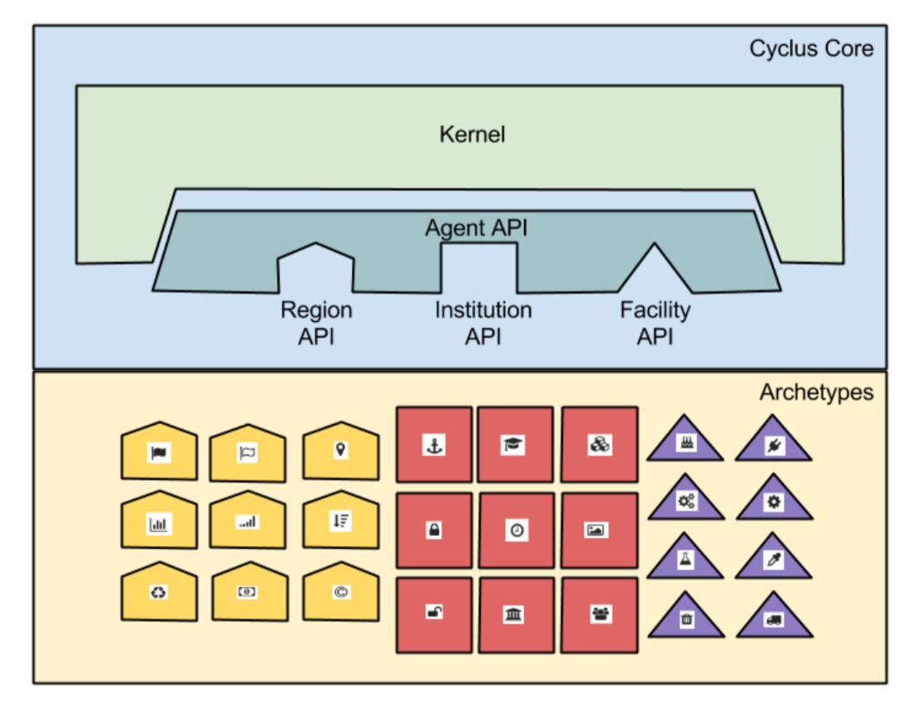
CYCLUS
Background
Agent-based framework [1]
Agent types: facilities, institutions, and regions
Compatible with plug-in libraries
Gives users ability to customize agents
Figure 1: Cyclus has a modular architecture [1]
Notes:
A little bit about Cyclus for the people in the audience who are not too familiar. Cyclus is an agent based nuclear fuel cycle simulator
It is different from fleet based NFC simulators because every facility and isotope is individually tracked and not lumped.
As an agent based model, Cyclus has a modular architecture, and has plug-in libraries that are compatible with it. These plug in libraries give users the ability to give the simulator custom functionality. There is ease of creating independent agents for specific use without modifying core simulation. For example, a unique reactor archetype can be constructed and added into a fuel cycle simulation.
There are three kinds of agents: regions, institutions and facilities. Facilities are agents that manipulates materials EXAMPLES. An example is an enrichment facility, natural uranium enters and fresh uox fuel leaves the facility. Whereas Institutions control the deployment and decommissioning of facilities. And Regions represent countries or any geopolitical entities that the facilities and institutions are functioning in.
In this project, d3ploy is considered an institution agent since it controls the deployment of facilities in the simulation.
COMMUNICATION GOAL:
What is Cyclus

Slide 3
CYCLUS
Background
Gap in capability: User must define when support facilities are deployed
x kg
fuel
?
Source
?
Enrichment
1
Reactor
?
Waste Storage
Figure 1: User defined Deployment Scheme
Bridging the gap: Developed demand-driven deployment capability in Cyclus, d3ploy.
Energy demand growth: 1% / year
w
Source
x
Enrichment
y
Reactor
z
Waste Storage
Figure 2: Demand Driven Deployment Scheme
Notes:
Presently, Cyclus has the capability to deploy reactors to meet a power demand. However, the user must determine when each supporting facility is deployed to meet the demand for supporting commodities.
This means that if you have one reactor in your simulation and you know it is demanding x amount of fuel, it is up to user to determine how many source, enrichment and waste storage facilities have to be deployed to meet this demand.
However, having to do this is tedious and not optimal. It is simple for a scenario with only 1 reactor, however, it gets more complex if the demand changes over time, when there are many facilities are in play and during dynamic transition scenarios.
To overcome this, in this presentation we introduce the demand driven deployment capability in Cyclus, known as d3ploy.
D3ploy automatically deploys supporting fuel cycle facilities to meet demands of the fuel cycle.
And so for example if a user defines an energy demand growth of 1% per year, Cyclus will predict when to deploy reactor, enrichment ,source and waste storage facilities to automatically to meet this demand.
COMMUNICATION GOAL:
Fuel cycle simulators are not demand driven but require user defining the deployment.

Slide 4
Goal
Motivation
Automatic deployment of supporting fuel cycle facilities in Cyclus
Demonstrate transition scenarios with no power undersupply
Acknowledgements
This work is supported by U.S. Department of Energy, Nuclear Energy University Program, under contract # NEUP- FY16-10512.

Slide 5
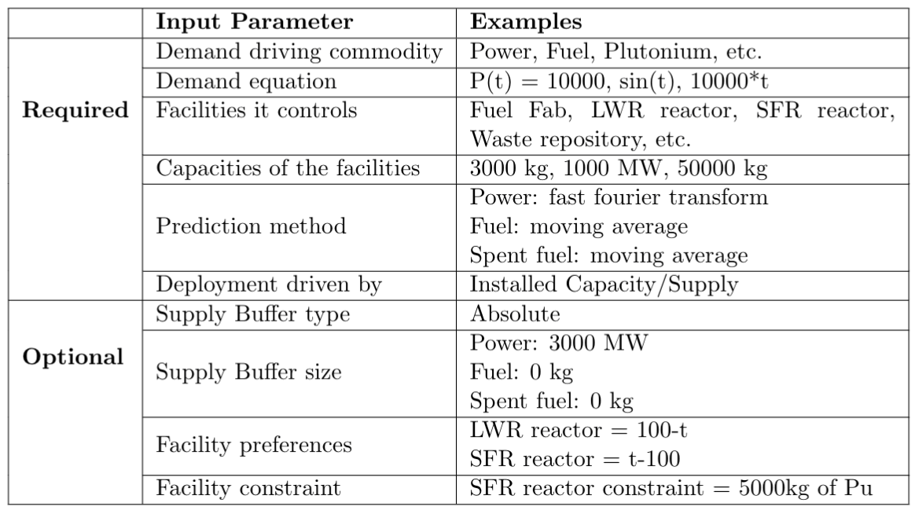
D3ploy – Input Parameters
D3ploy
Table 1: D3ploy Input Parameters
Notes:
This is the input parameters for d3ploy. Go through each input option.
I will give an example scenario and the resulting plots are on the next slide.
Supply buffer

Slide 6
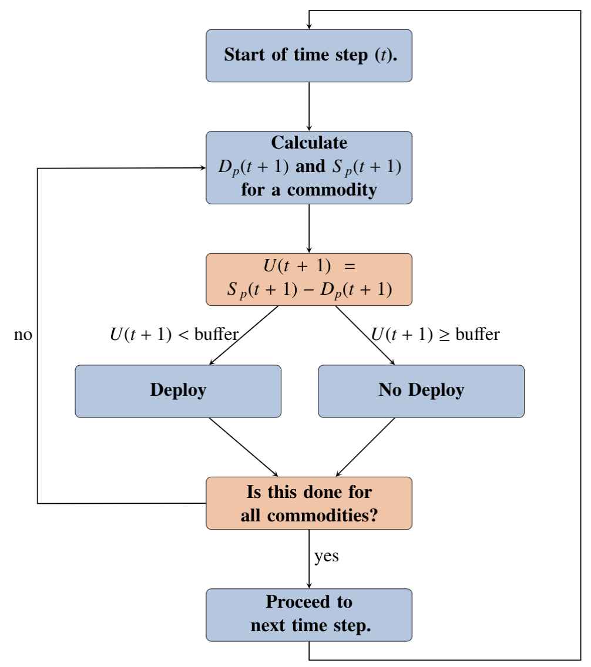
D3ploy – Logic Flow
D3ploy
D_{p} : Predicted demand
S_{p} : Predicted supply
U = S_{p} - D_{p}
Figure 3: D3ploy logic flow
Notes:
D3ploy’s primary objective is minimizing the number of time steps in which there is an undersupply of any commodity.
At each time step, d3ploy will predict the demand and supply of a commodity for the next time step.
If it predicts an undersupply, it responds by deploying the fewest number of available facilities to meet demand with minimal oversupply. This will be repeated for all commodities that are controlled by that d3ploy institution. After all that is done, it will move on to the next time step.

Slide 7
Prediction Methods
Non-Optimizing Methods
Demand Response
Moving Average
Autoregressive Moving Average
Autoregressive Heteroskedasticity
Deterministic Methods
Fast Fourier Transform
Polynomial Fit
Exponential Smoothing and Holt-Winters
Matrix Solution
Uses supply and demand to create a system of equations in matrix form.
Solving the matrix returns the number of facilities required at a given time-step.

Slide 8
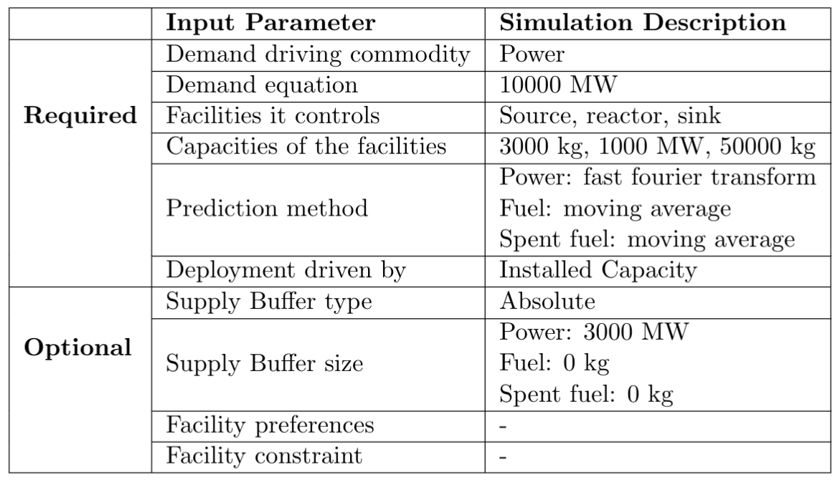
D3ploy – Simulation Description
D3ploy
Table 2: D3ploy Simulation Description
Notes:
This is the input parameters for d3ploy. Go through each input option.
I will give an example scenario and the resulting plots are on the next slide.

Slide 9
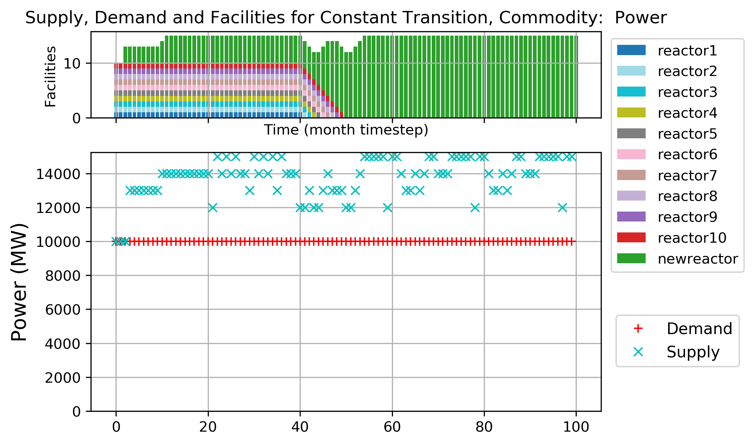
Constant Power Demand: Reactor Deployment
Demonstrations
Figure 4: Power commodity supply and demand for transition scenario of constant 10000MW power demand
Notes:
In this simple transition scenario, we initially have 10 reactors that meet the 10000MW power demand. At time step 40, they start to decommission. This is where d3ploy comes in to meet the power demand. D3ploy begins to deploy newreactor facilities to meet the gap in power supply to ensure that the power demand is met for all time steps. By using a combination of the fast fourier transform method for predicting demand and setting the supply buffer to 3000MW (the capacity of 3 reactors), the simulation does not under supply power. The red T’s refer to demand and the blue crosses supply.
Precisely meeting demand during a transition is difficult, that’s why you need a buffer to provide surplus capacity.

Slide 10
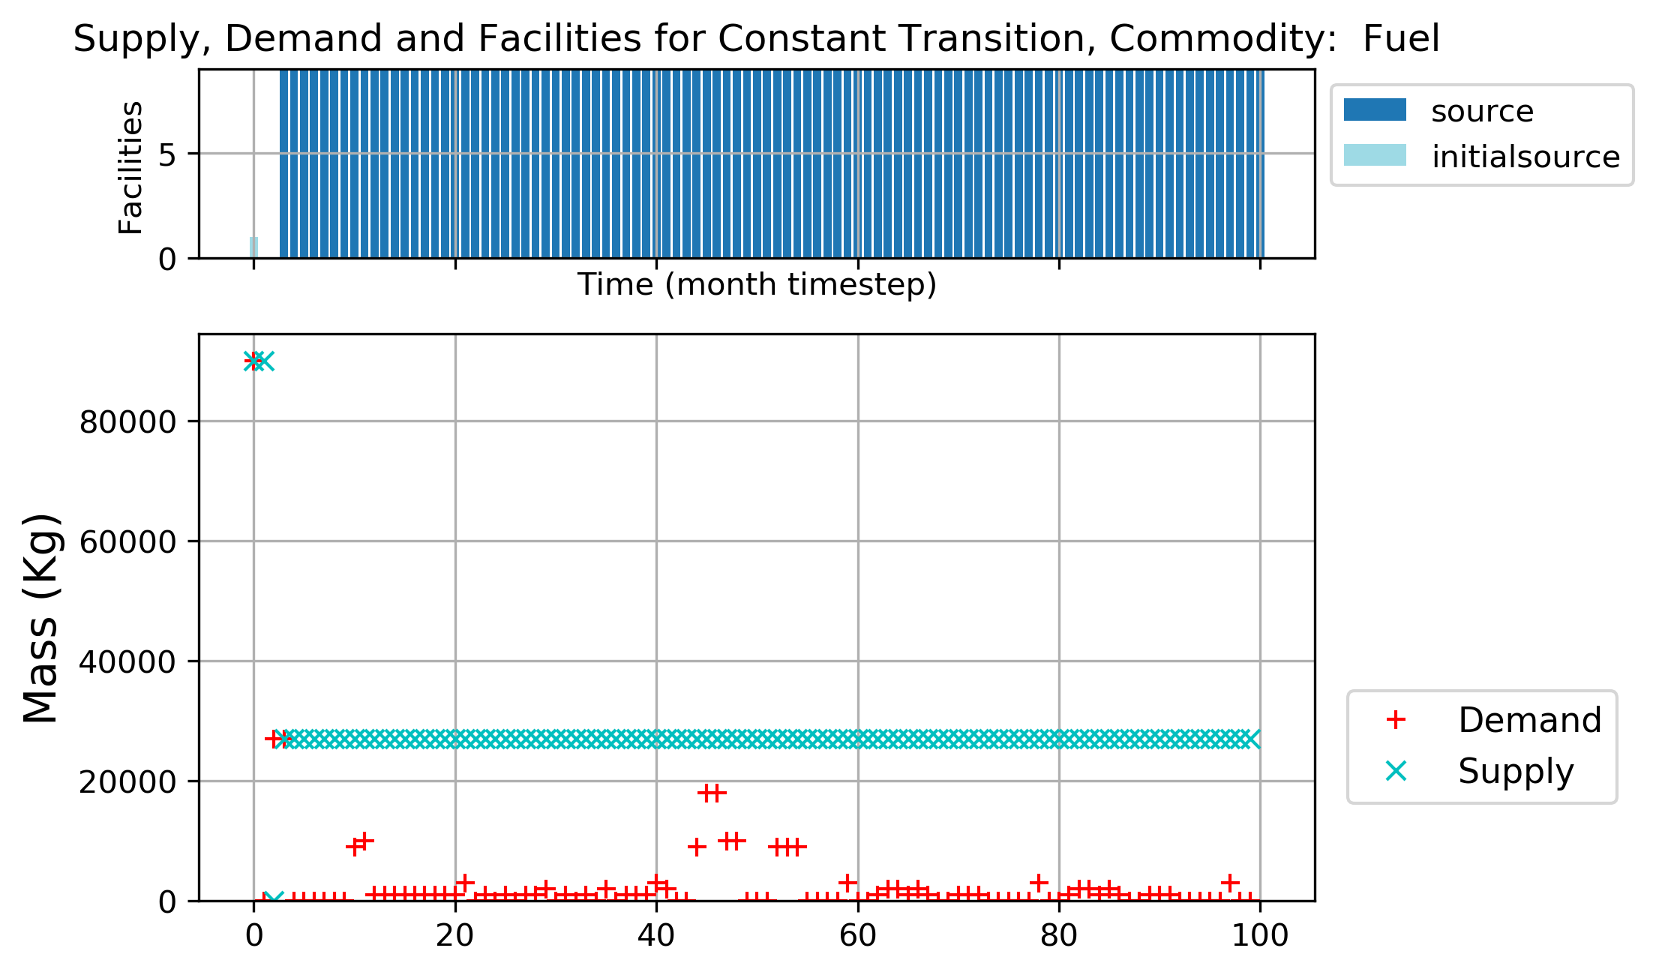
Constant Power Demand: Supporting Facility Deployment
Demonstrations
Figure 5: Fuel commodity supply and demand for transition scenario of constant 10000MW power demand
Notes:
These figures show the demand and supply for fuel and spent fuel.

Slide 11
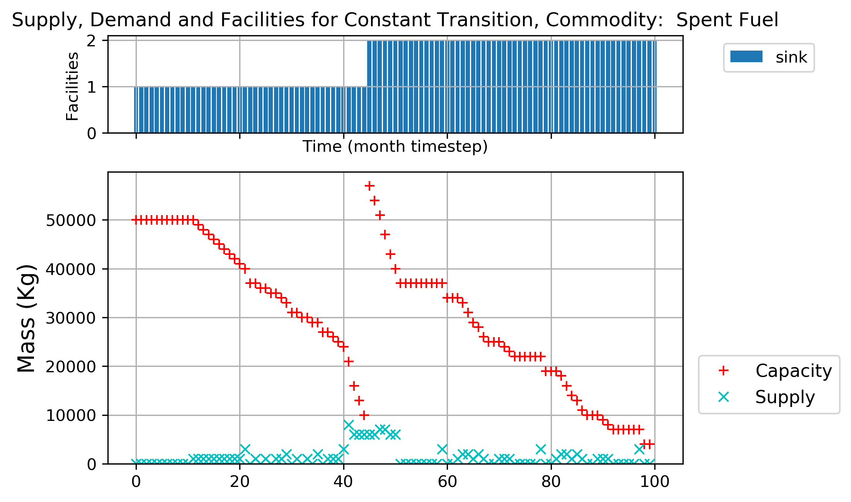
Constant Power Demand: Supporting Facility Deployment
Demonstrations
Figure 6: Spent Fuel commodity supply and demand for transition scenario of constant 10000MW power demand
Notes:
These figures show the demand and supply for fuel and spent fuel.

Slide 12
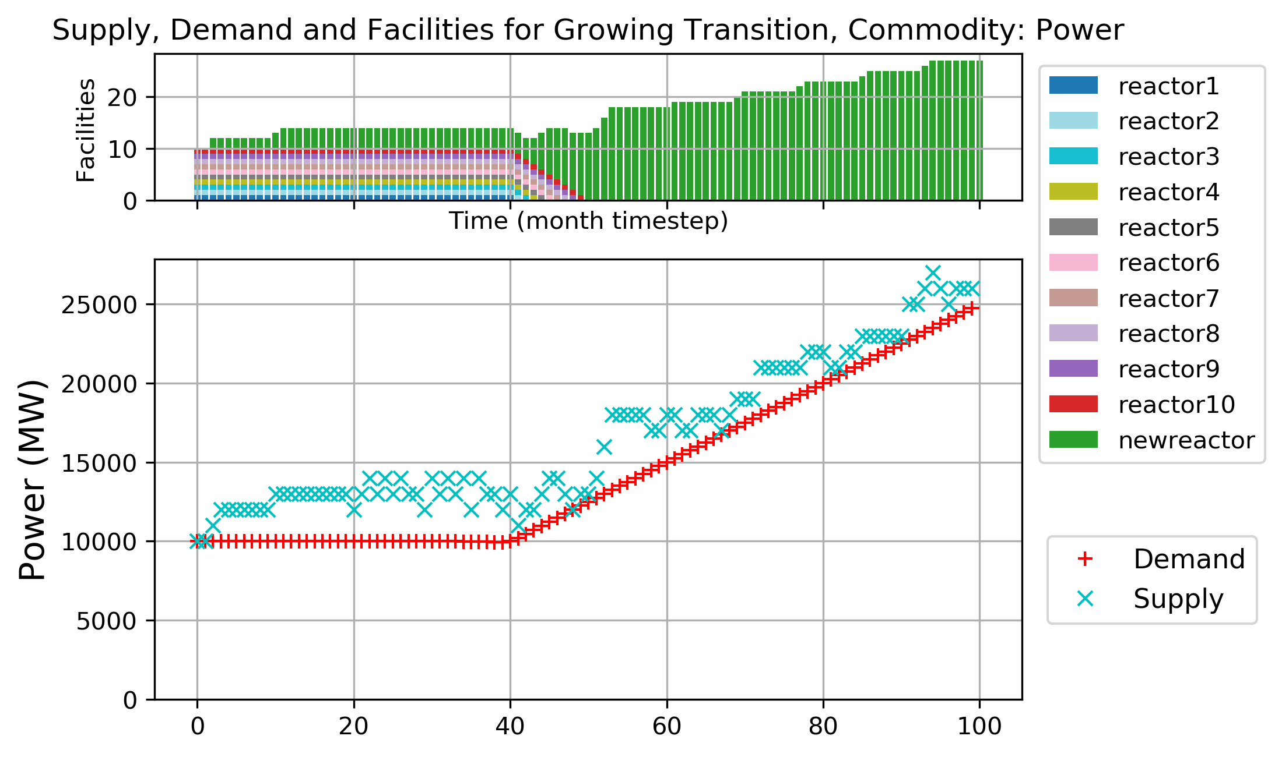
Linear Power Demand: Reactor Deployment
Demonstrations
Figure 7: Power commodity supply and demand for transition scenario of linearly increasing power demand

Slide 13
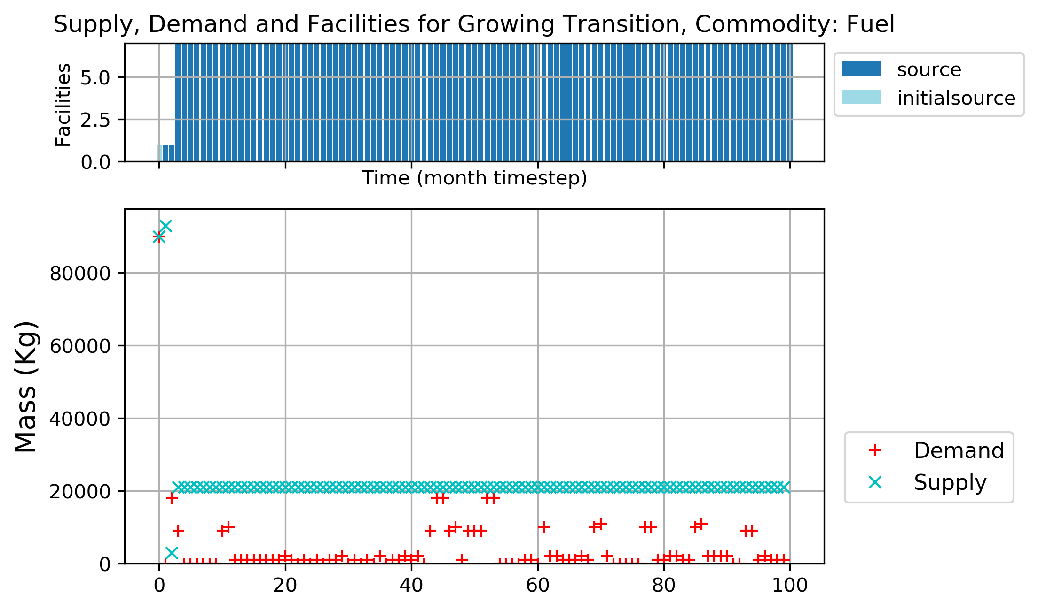
Linear Power Demand: Supporting Facility Deployment
Demonstrations
Figure 8: Fuel commodity supply and demand for transition scenario of linearly increasing power demand

Slide 14
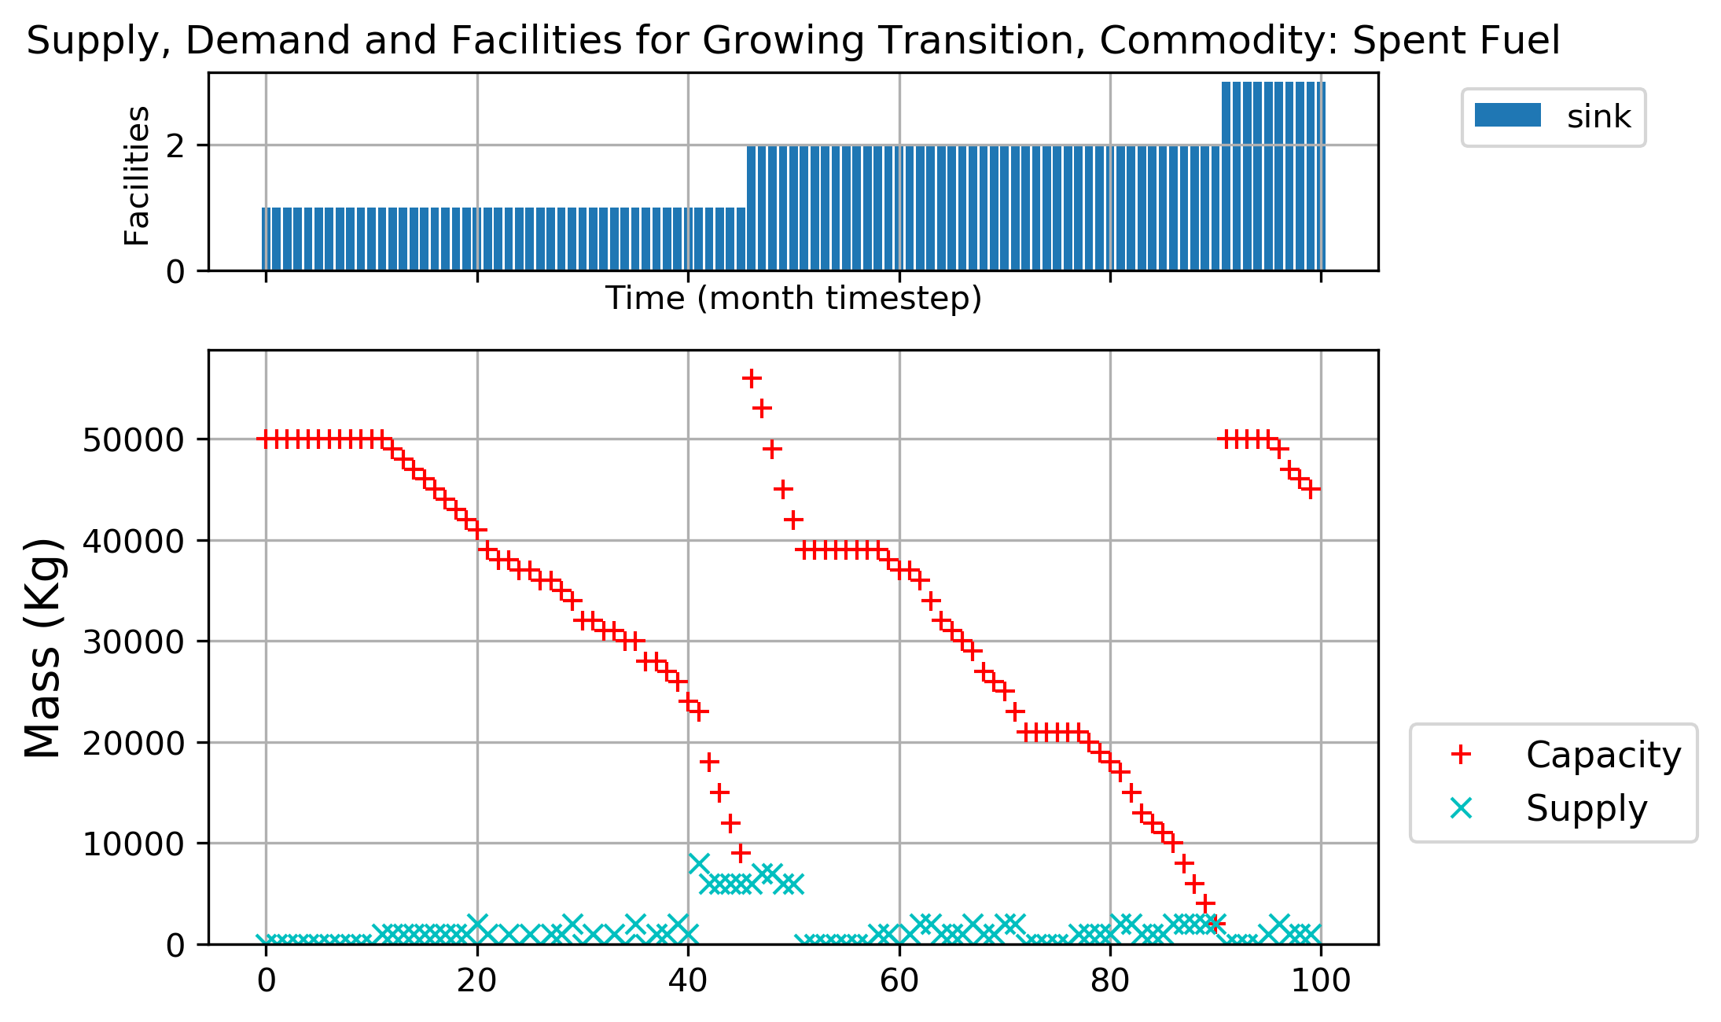
Linear Power Demand: Supporting Facility Deployment
Demonstrations
Figure 9: Spent fuel commodity supply and demand for transition scenario of linearly increasing power demand

Slide 15
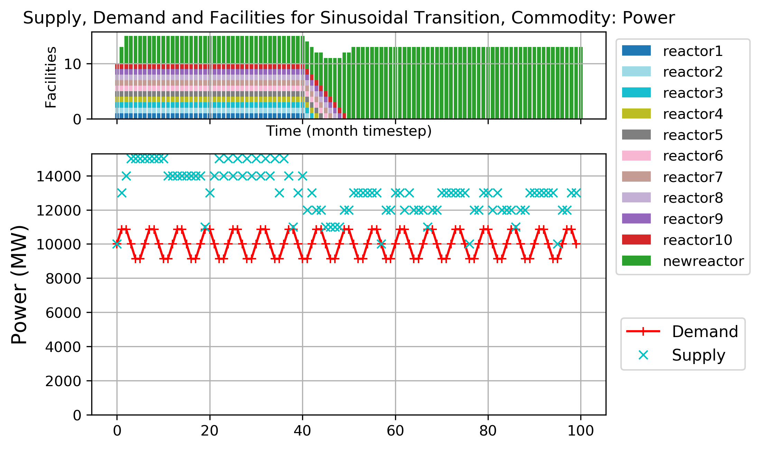
Sinusoidal Power Demand: Reactor Deployment
Demonstrations
Figure 10: Power commodity supply and demand for transition scenario of sinusoidal power demand

Slide 16
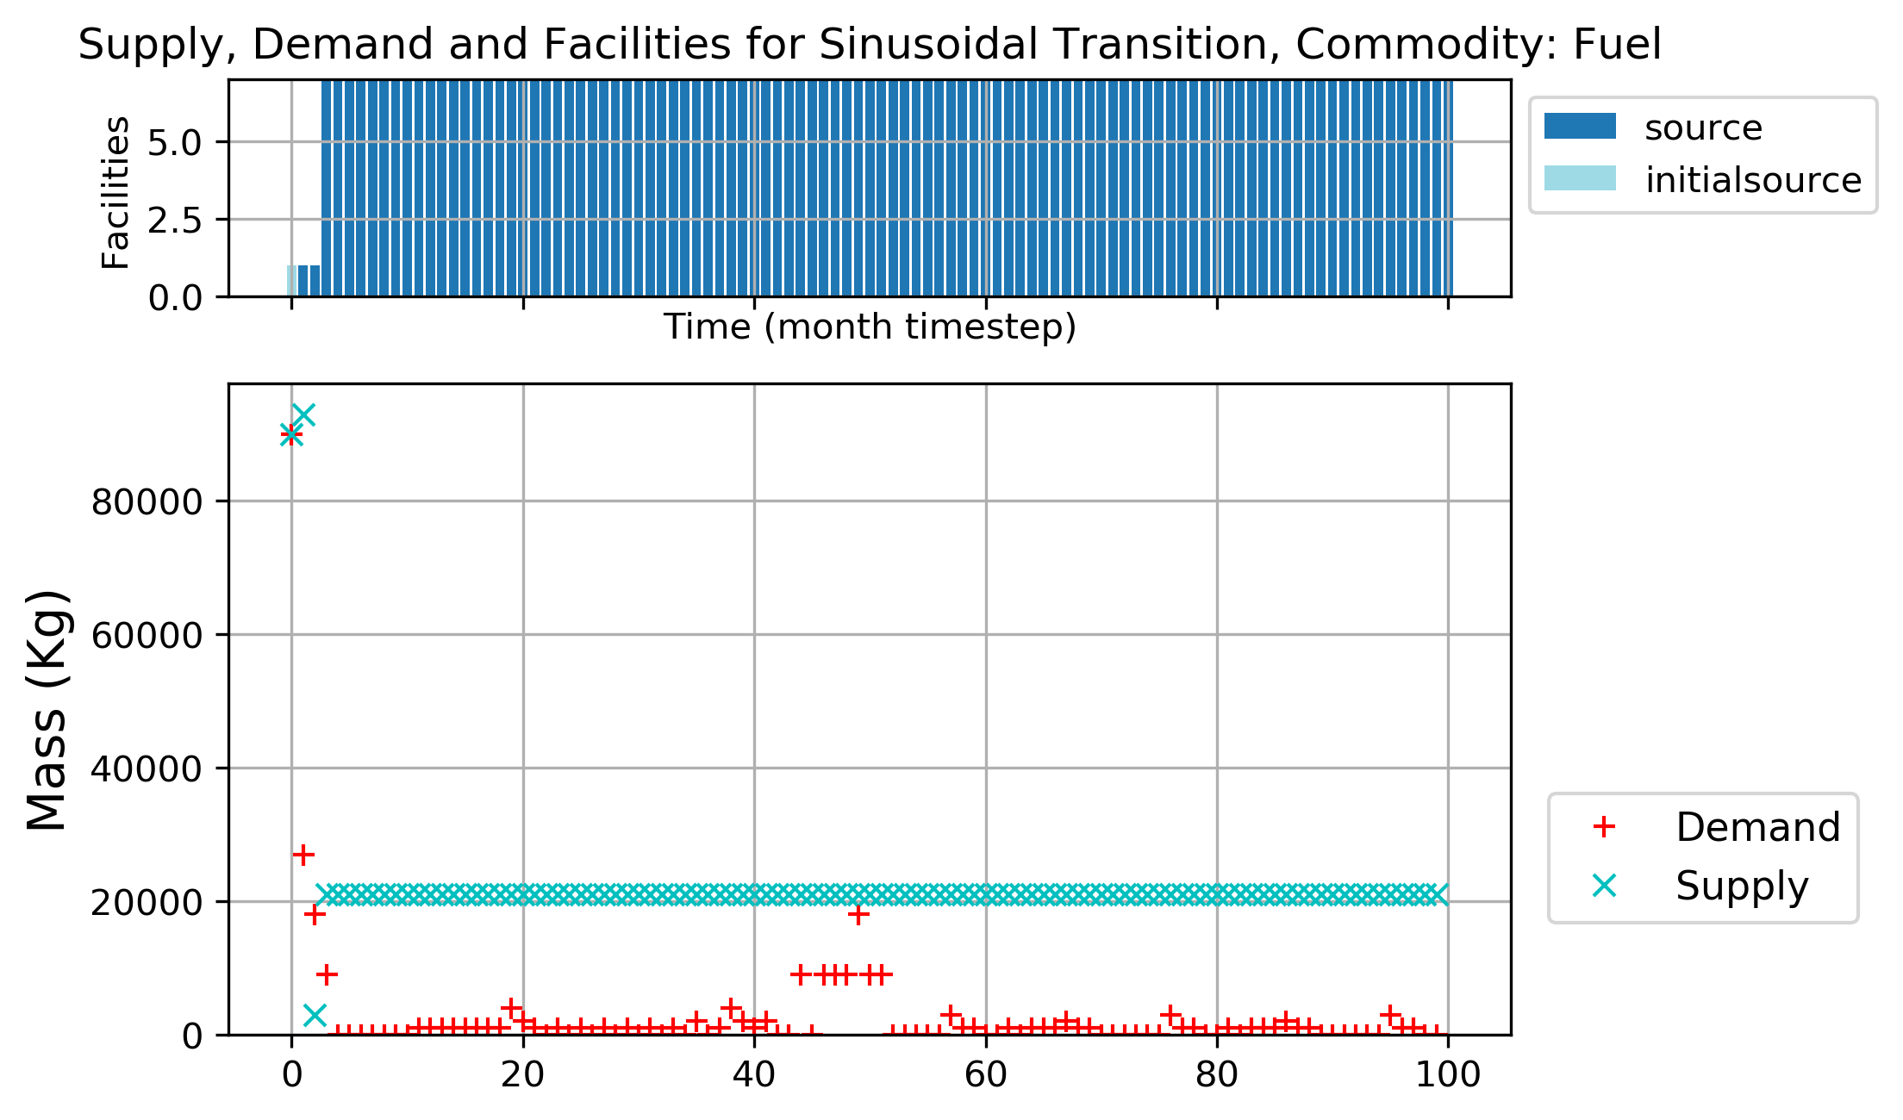
Sinusoidal Power Demand: Supporting Facility Deployment
Demonstrations
Figure 11: Fuel commodity supply and demand for transition scenario of sinusoidal power demand

Slide 17

Sinusoidal Power Demand: Supporting Facility Deployment
Demonstrations
Figure 12: Spent fuel commodity supply and demand for transition scenario of sinusoidal power demand

Slide 18
Conclusions
Conclusions
Demand driven deployment capabilities in Cyclus are important to automate setting up of transition scenarios.
Future Work: Similar power demand transition scenarios extended to include more nuclear fuel cycle facilities such as reprocessing facilities etc.

Slide 19
References
[1]: K. D. HUFF, M. J. GIDDEN, R. W. CARLSEN, R. R. FLANAGAN, M. B.
MCGARRY, A. C. OPOTOWSKY, E. A. SCHNEIDER, A. M. SCOPATZ, and
P. P. H. WILSON, “Fundamental concepts in the Cyclus nuclear fuel cycle
simulation framework,” Advances in Engineering Software, 94, 46–59 (Apr.
2016).
Notes:
1919

Slide 20
Thank You Any Questions?

