Slide 1
Posterior Sampling and Posterior Predictive Checking
June 11, 2025
UTSSRP
Prof. Gwendolyn Eadie

Slide 2
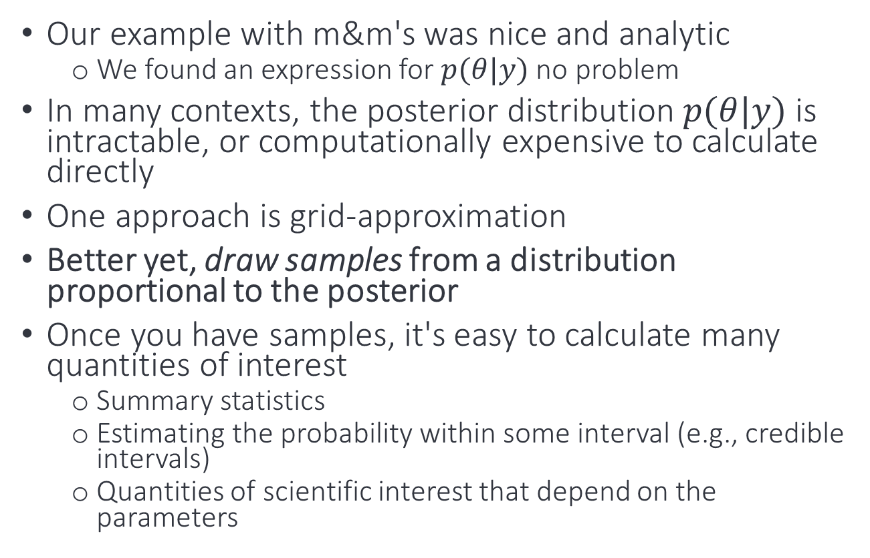
Sampling from the posterior distribution (Ch 3, McElreath)
Our example with m&m's was nice and analytic
We found an expression for $p(θ|y)$ no problem
In many contexts, the posterior distribution $p(θ|y)$ is intractable, or computationally expensive to calculate directly
One approach is grid-approximation
Better yet, draw samples from a distribution proportional to the posterior
Once you have samples, it's easy to calculate many quantities of interest
Summary statistics
Estimating the probability within some interval (e.g., credible intervals)
Quantities of scientific interest that depend on the parameters

Slide 3
Bayesian Computation: sampling from a distribution
Grid approximation
Computationally expensive as number of parameters increases
Markov Chain Monte Carlo (MCMC)
Metropolis algorithm
Invented by physicists
Assumes some symmetry in the sampling mechanism
Metropolis-Hastings
Generalizes to include asymmetry
Gibbs sampling
Uses conditional probabilities
Hamilton Monte Carlo
Uses physics ideas
Will cover this more after reading break

Slide 4
Why posterior samples are so useful
Model design
Draw samples from the prior distribution to get a sense of what the model expects before you use the data (helpful in multidimensional problems)
Model checking
Posterior predictive checks!
Software validation
Simulate data from known model
Fit data to model and make sure you get the expected result
Research design
With simulated observations, you ca test whether research design will be effective
Forecasting
Simulate new predictions
What modifications to model may be needed in the future
Scientific inference
Propagate uncertainty in future calculations

Slide 5
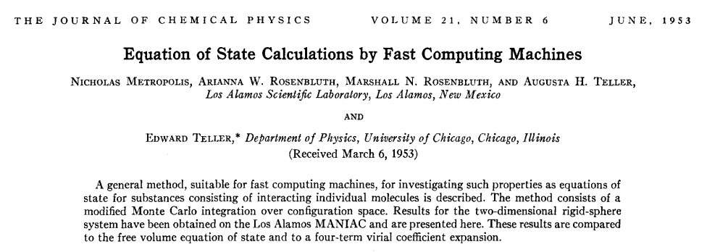
Metropolis algorithm
Invented by physicists!
Cited over 47,000 times

Slide 6
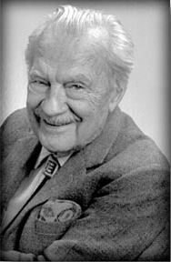

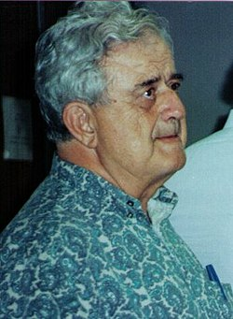
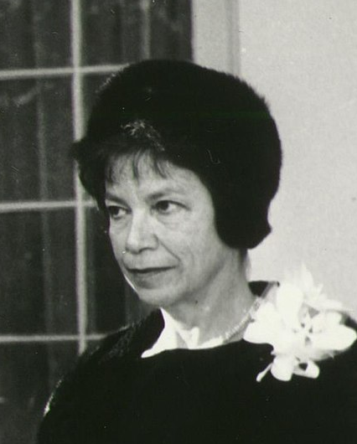
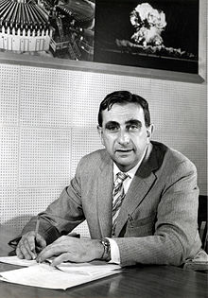

Slide 7

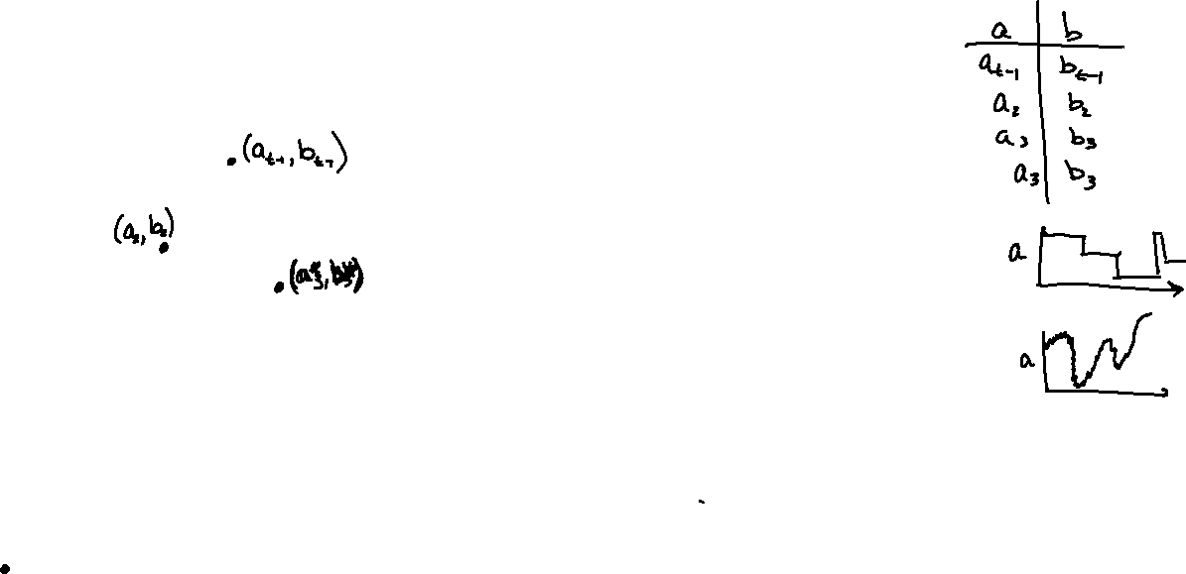
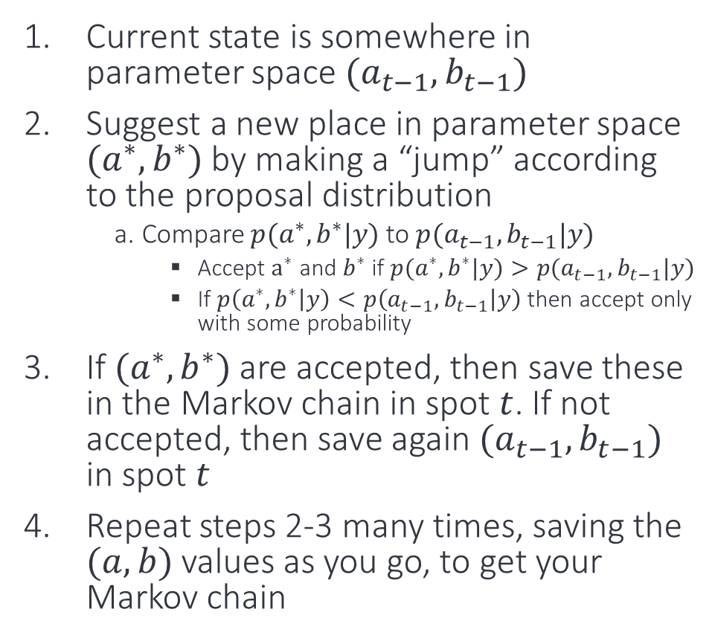


Sketch of how the Metropolis (Rosenbluth) algorithm works for a two-parameter posterior distribution p(a,b|y)
$$p(a,b|y)$$
Current state is somewhere in parameter space $(a_{t−1},b_{t−1})$
Suggest a new place in parameter space $(a^{∗},b^{∗})$ by making a “jump” according to the proposal distribution
Compare $p(a^{∗},b^{∗}|y)$ to $p(a_{t−1},b_{t−1}|y)$
Accept $a^{∗}$ and $b^{∗}$ if$p(a^{∗},b^{∗}|y)>p(a_{t−1},b_{t−1}|y)$
If $p\left(a^{∗},b^{∗} | y\right)<p\left(a_{t−1},b_{t−1} | y\right)$ then accept only with some probability
If $(a^{∗},b^{∗})$ are accepted, then save these in the Markov chain in spot $t$. If not accepted, then save again $(a_{t−1},b_{t−1})$ in spot $t$
Repeat steps 2-3 many times, saving the $(a,b)$ values as you go, to get your Markov chain
$$b$$
$$a$$

Slide 8
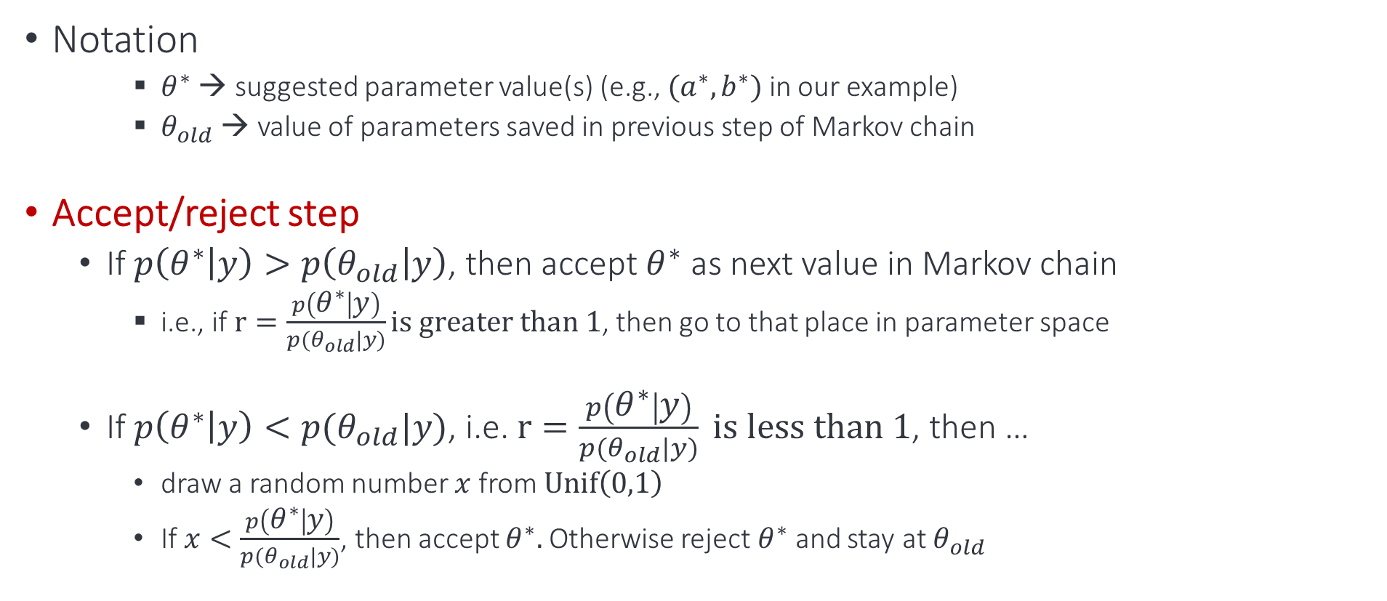
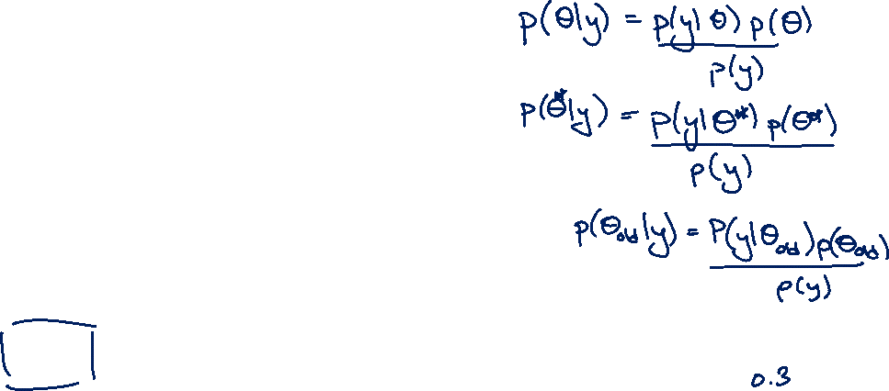
Markov Chain Monte Carlo (MCMC)
Notation
$θ^{∗}$ → suggested parameter value(s) (e.g., $(a^{∗}, b^{∗})$ in our example)
$θ_{old}$ → value of parameters saved in previous step of Markov chain
Accept/reject step
If $p\left(θ^{∗} | y\right)>p\left(θ_{old} | y\right)$, then accept $θ^{∗}$ as next value in Markov chain
i.e., if $r=\frac{p\left(θ^{∗} | y\right)}{p(θ_{old}|y)}\text{is} \text{greater} \text{than} 1$, then go to that place in parameter space
If $p\left(θ^{∗} | y\right)<p(θ_{old}|y)$, i.e. $r=\frac{p\left(θ^{∗} | y\right)}{p(θ_{old}|y)} \text{is} \text{less} \text{than} 1$, then …
draw a random number $x$ from $\text{Unif}\left(0,1\right)$
If $x<\frac{p\left(θ^{∗} | y\right)}{p(θ_{old}|y)}$, then accept $θ^{∗}.$ Otherwise reject $θ^{∗}$ and stay at $θ_{old}$

Slide 9
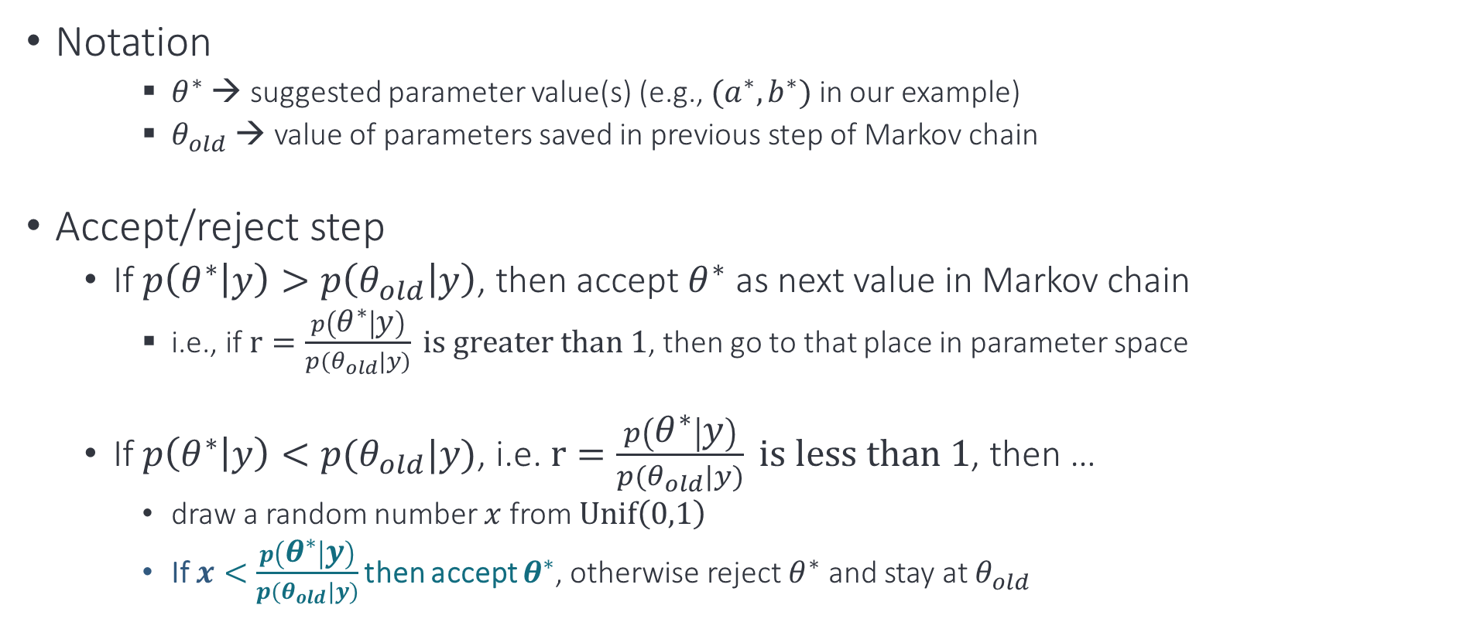
Metropolis (Rosenbluth) algorithm → the accept/reject step
Notation
$θ^{∗}$ → suggested parameter value(s) (e.g., $(a^{∗}, b^{∗})$ in our example)
$θ_{old}$ → value of parameters saved in previous step of Markov chain
Accept/reject step
If $p\left(θ^{∗} | y\right)>p\left(θ_{old} | y\right)$, then accept $θ^{∗}$ as next value in Markov chain
i.e., if $r=\frac{p\left(θ^{∗} | y\right)}{p(θ_{old}|y)} \text{is} \text{greater} \text{than} 1$, then go to that place in parameter space
If $p\left(θ^{∗} | y\right)<p(θ_{old}|y)$, i.e. $r=\frac{p\left(θ^{∗} | y\right)}{p(θ_{old}|y)} \text{is} \text{less} \text{than}\text{ 1}$, then …
draw a random number $x$ from $\text{Unif}\left(0,1\right)$
If $x<$ $\frac{p\left(θ^{∗} | y\right)}{p(θ_{old}|y)}$ then accept $θ^{∗}$, otherwise reject $θ^{∗}$ and stay at $θ_{old}$
Notes:
This ensures that theta^* are accepted with probability proportional to the posterior distribution

Slide 10
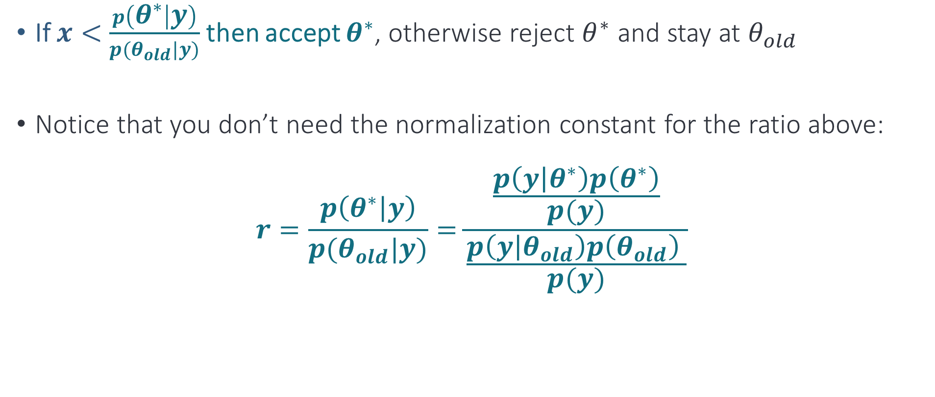

Metropolis (Rosenbluth) algorithm → the accept/reject step
If $x<$ $\frac{p\left(θ^{∗} | y\right)}{p(θ_{old}|y)}$ then accept $θ^{∗}$, otherwise reject $θ^{∗}$ and stay at $θ_{old}$
Notice that you don’t need the normalization constant for the ratio above:
$$r=\frac{p\left(θ^{∗} | y\right)}{p(θ_{old}|y)}=\frac{\frac{p\left(y | θ^{∗}\right)p\left(θ^{∗}\right)}{p(y)}}{\frac{p\left(y | θ_{old}\right)p\left(θ_{old}\right) }{p(y)}}$$
Notes:
This ensures that theta^* are accepted with probability proportional to the posterior distribution

Slide 11
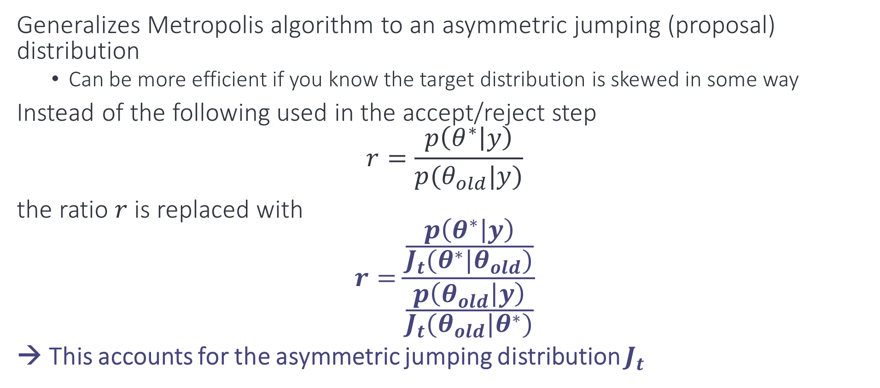
Metropolis-Hastings Algorithm
Generalizes Metropolis algorithm to an asymmetric jumping (proposal) distribution
Can be more efficient if you know the target distribution is skewed in some way
Instead of the following used in the accept/reject step
$$r=\frac{p\left(θ^{∗} | y\right)}{p(θ_{old}|y)}$$
the ratio $r$ is replaced with
$$r=\frac{\frac{p\left(θ^{∗} | y\right)}{J_{t}(θ^{∗}|θ_{old})}}{\frac{p\left(θ_{old} | y\right)}{J_{t}(θ_{old}|θ^{∗})}}$$
→ This accounts for the asymmetric jumping distribution $J_{t}$
Notes:
Ratio with J_t is always defined because a jump from theta_old to theta* can only happen if both p(theta_old|y) and J(theta*|theta_old) are nonzero. P(theta_old|y) will be non-zero because that’s where we were coming from, and the latter is nonzero because that’s the only way a jump will be suggested

Slide 12
A helpful visualization tool for different sampling algorithms
https://chi-feng.github.io/mcmc-demo/

Slide 13
Posterior Predictive Checking

Slide 14
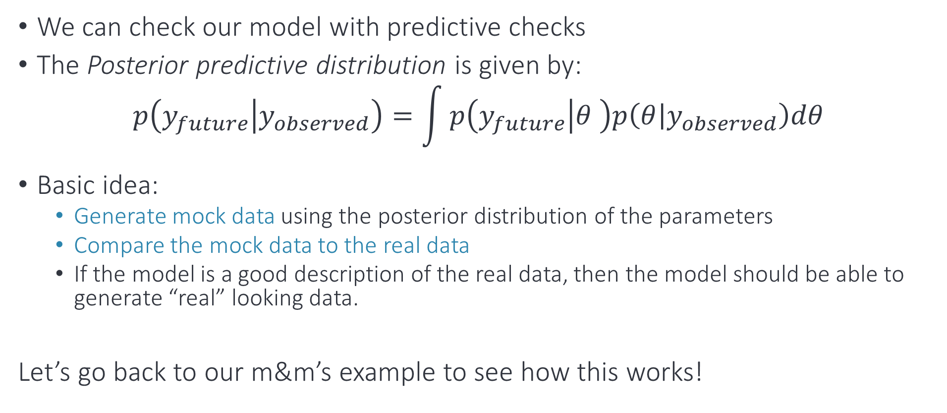
Posterior predictive distribution
We can check our model with predictive checks
The Posterior predictive distribution is given by:
$$p\left(y_{future} | y_{observed}\right)=\int{p\left(y_{future} | θ \right)p\left(θ | y_{observed}\right)dθ}$$
Basic idea:
Generate mock data using the posterior distribution of the parameters
Compare the mock data to the real data
If the model is a good description of the real data, then the model should be able to generate “real” looking data.
Let’s go back to our m&m’s example to see how this works!

Slide 15
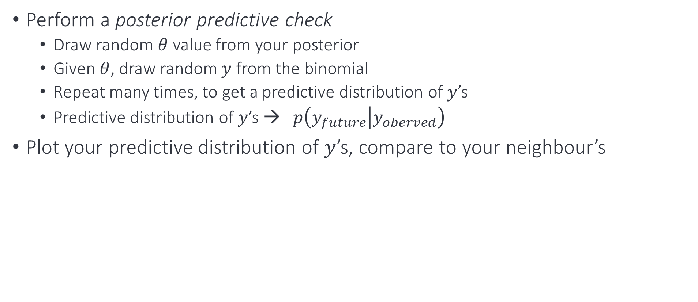
Exercise
Perform a posterior predictive check
Draw random $θ$ value from your posterior
Given $θ$, draw random $y$ from the binomial
Repeat many times, to get a predictive distribution of $y$’s
Predictive distribution of $y$’s → $p\left(y_{future} | y_{oberved}\right)$
Plot your predictive distribution of $y$’s, compare to your neighbour’s

