Slide 1
A Closer Look at NYC’s Doctors, As Told By RateMDs.Com
Gwen Fernandez

Slide 2
What is RateMds.com and how does it work?
One of a few websites that allow patients to post ratings and comments about doctors (others include ZocDoc, HealthGrades, Yelp, etc.)
Reviewers anonymously rate doctors based on their staff, punctuality, helpfulness and knowledgeability
While anyone can post a review on the site, comments are reviewed before being approved for posting
Doctors are able to flag comments for removal, but removal is not guaranteed
Site uses “automated algorithms and human moderators” to filter out fake reviews
Notes:
-

Slide 3
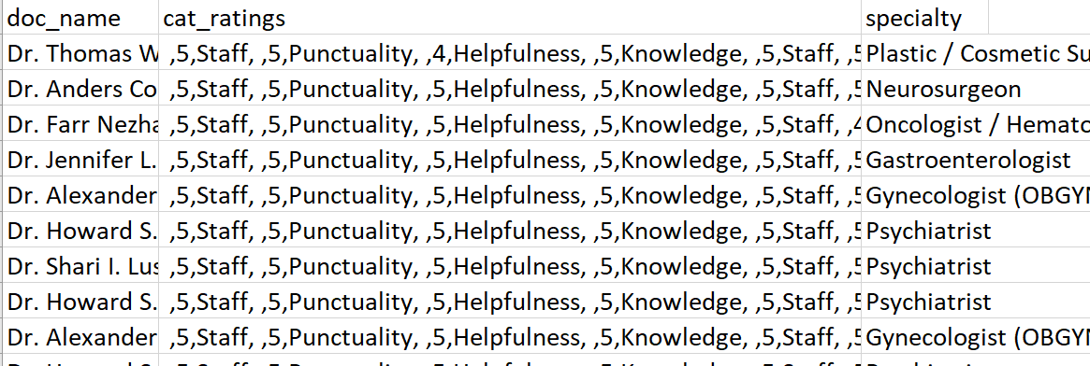
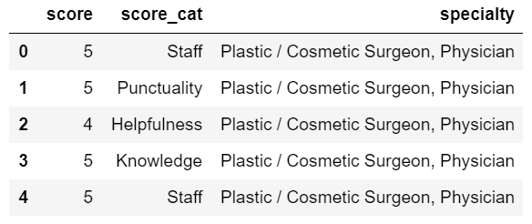
Scraping Ratemds
Two scrapy spiders to collect general information on all doctors within NYC area as well as a sample of their ratings
Variables include: name, gender, specialty, location (by borough), number of reviews, languages spoken, insurances accepted and ratings
Information for 1,388 MDs scraped
36,399 ratings scraped
Notes:
Avg number of reviews per doctor about 13
Unfortch wasn’t able to yield good information about location – got all location information for the 1,388 doctors but the majority (1,272) listed New York City as the borough

Slide 4
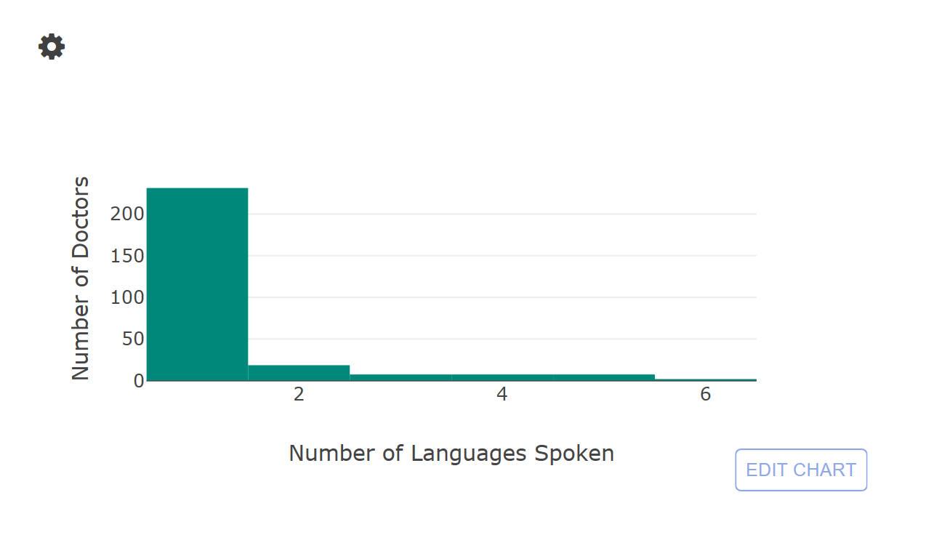
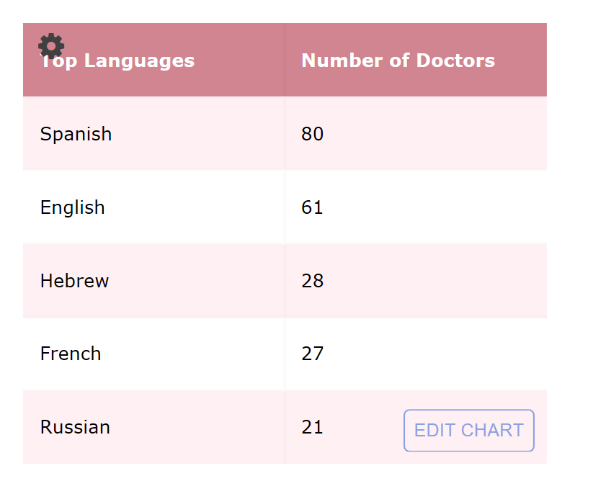
In a city as diverse as NYC, how many doctors accommodate multi-lingual populations by speaking more than one language?
What are the most commonly spoken languages by NYC MDs?
Notes:
(As of 2014) In NYC, 48.9% of the population (>5 years) speaks a language other than English
-of those 48.9%, 49.8% speak Spanish, followed by Chinese (12.3%) and Russian (4.8%) (INFO from NYC.gov)

Slide 5
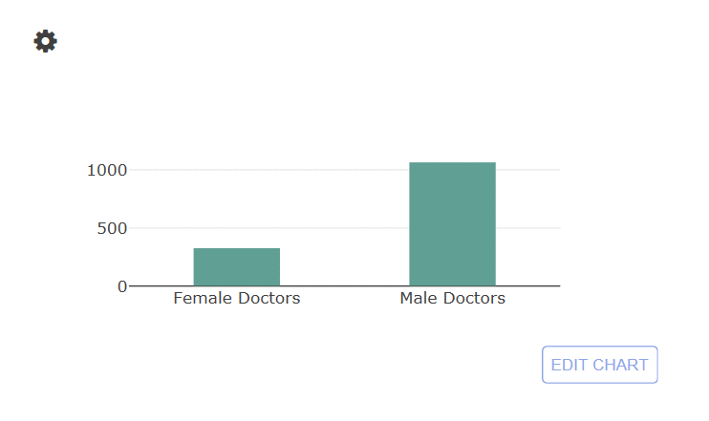
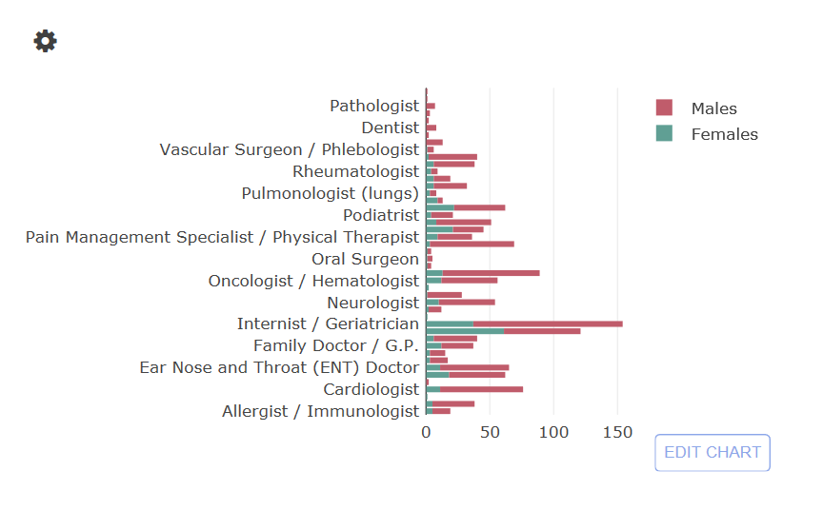
In New York state, 38% of Physicians are women and 62% are men. How did the RateMDs gender ratio compare?
Notes:
-As of April 2017, 34% of all Physicians in the USA were female and 66% were male - https://www.kff.org/other/state-indicator/physicians-by-gender/?dataView=1&currentTimeframe=0&selectedRows=%7B%22wrapups%22:%7B%22united-states%22:%7B%7D%7D%7D&sortModel=%7B%22colId%22:%22Location%22,%22sort%22:%22asc%22%7D
-77% male and 23% female in this dataset
-NY state has one of highest percentage of female doctors in the country – two highest states are Mass and RI (both with 40% female doctors)
-times article from july 2016 on the gender wage gap asserts that although half of all medical graduates are now women, male doctors earn on average 8% more
than female counterparts (about a $20,000 salary difference on average)
-article also asserts that similar discrepancies are observed between racial groups, for example white doctors can earn up to $60,000 more than black doctors
-would like to analyze this as well, but the information was not provided.
-http://time.com/4398888/doctors-gender-wage-gap/

Slide 6
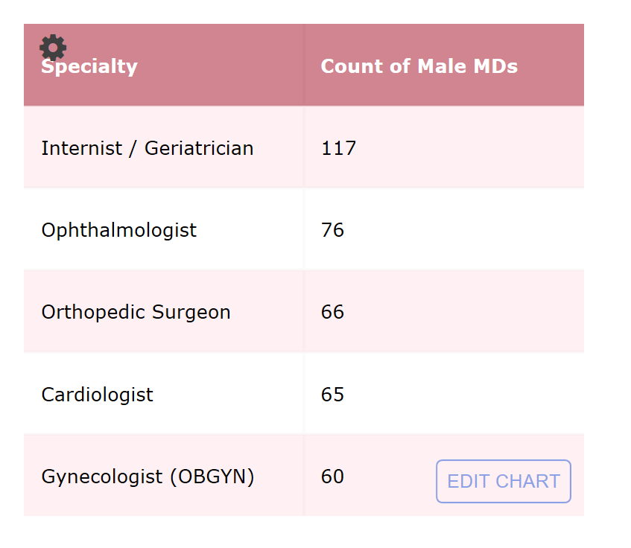
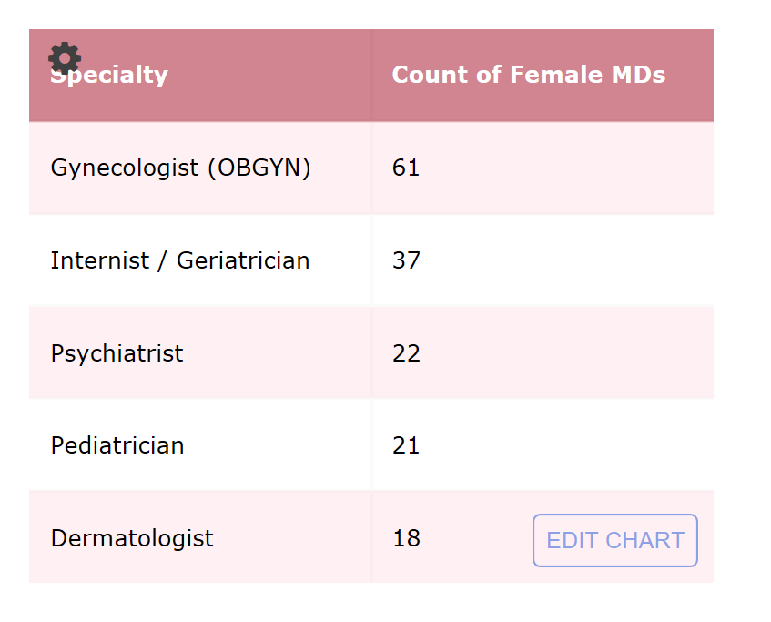
What are the top specialties for female and male MDs?
Notes:
According to Merrit Hawkins’ 2017 review of physician and advanced particitioner recruiting incentives,
The top 3 most requested searches by medical specialty were – Family Medicine, Psychiatry, Internal Medicine,
Nurse Practitioner and OBGYN

Slide 7
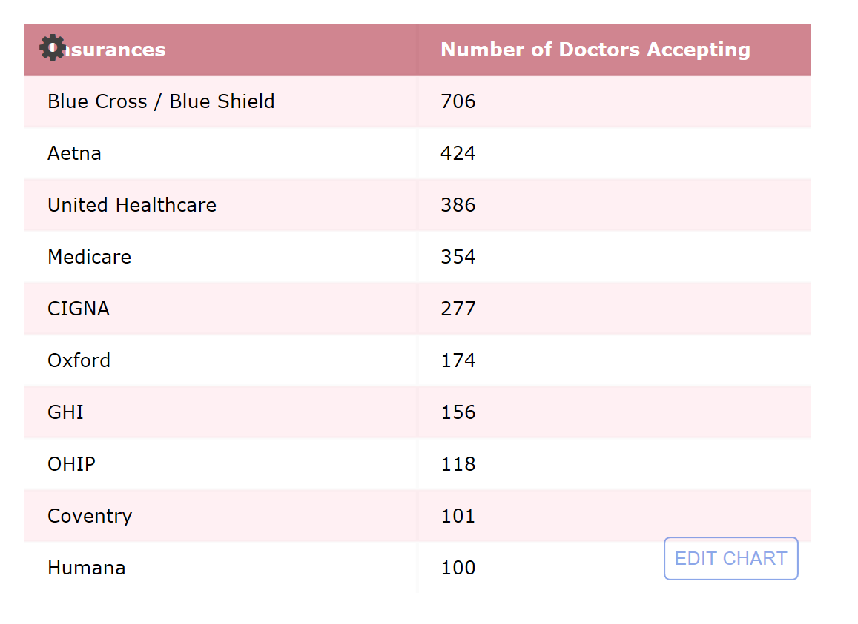
What are the most widely accepted insurances by NYC doctors?

Slide 8
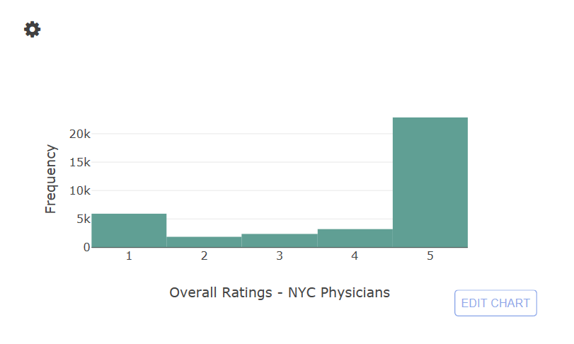
How well are NYC MDs performing according to their patients?

Slide 9
