Slide 1

Hourly Wage / Salary Report
Data: Employment - Earnings from main wage and salary job by occupation, sex, age groups, and ethnic groups 2009–2019 from Stats NZ

Slide 2
Overview
1. Brief Introduction: What data is being explored?
2. Findings: What does the data show?
3. Points of Interest: What from the data stood out?

Slide 3
1. What data is being explored?

Slide 4
Hourly Wage / Salary Data from Stats NZ
NZD only
Data is broken down by Gender, Occupation, Age, and Ethnicity
Focusing on trends over time (2009-2019)

Slide 5
2. What does the data show?

Slide 6
Average Wage Over Time
Median wage is lower than Mean. Why?
Wages have increased over time, but…

Slide 7
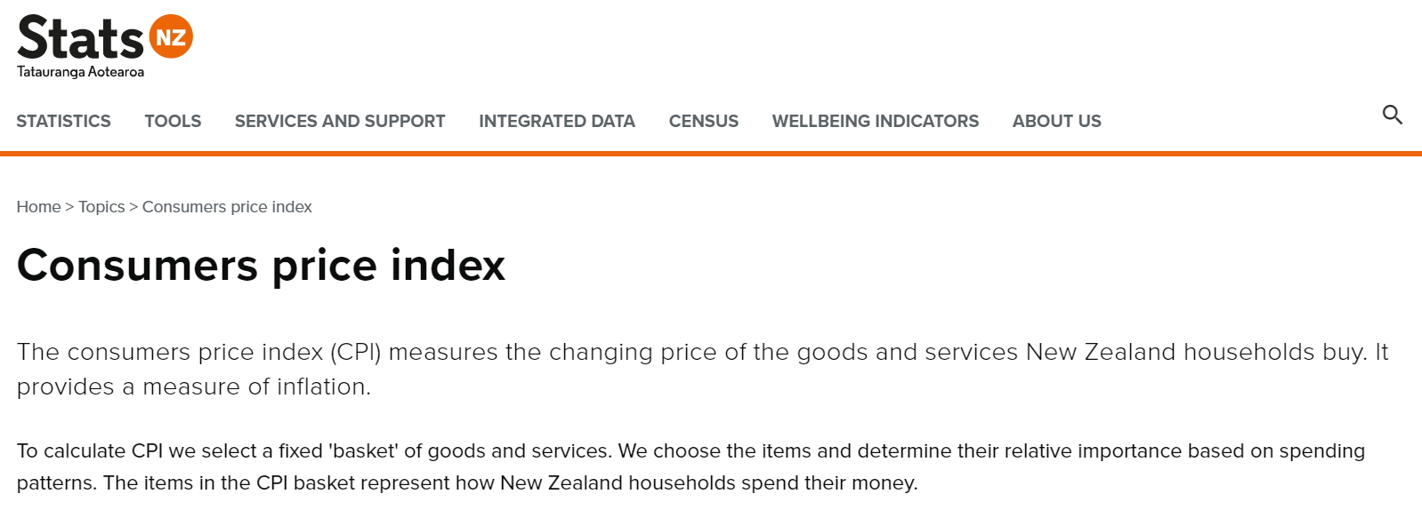
CPI (Inflation)
https://www.rbnz.govt.nz/statistics/key-graphs/key-graph-inflation
https://www.stats.govt.nz/topics/consumers-price-index

Slide 9

Gender
$$\frac{males−females}{males}∗100$$
0 difference would mean there is no median hourly pay gap between groups
But in reality, the states show that Males earn 13% on average more than Females for an hour of work in 2019

Slide 10
Occupation
‘Professionals’ and ‘Managers’ record the highest income
‘Labourers’ shows the lowest income
‘Other’ – Non-traditional jobs wages have been rising

Slide 12
Age
Age 15 – 24 presented as the lowest income group ($15.0 to $29.0 in 2019)
Age 65 or higher presented as the next lowest income group ($17.7 to $41.71 in 2019)
Age 35 – 59 presented as the highest income group ($17.7 to $55.79 in 2019)

Slide 13
2011 had the biggest variation in salary for the latest 10 years
Compared to 2011…
Age 50 to 59
Age 15 to 24

Slide 14
Ethnicity
‘Europeans’ earn a median of $26.41 per hour
‘Pacific Peoples’ earn a median of $23.00 per hour
European/Other/MELLA groups are the highest income groups
Pacific Peoples/Maori/Asian groups are the lowest income groups

Slide 15
Compared to last year,
Other(‘New Zealander’) showed 14% increase in their median income.
MELAA (‘Middle Eastern, Latin American, and African’) showed 1.02% decrease in their median income

Slide 16
3. What from the data stood out?

Slide 17
Missing values in Values – Especially in ‘MELLA’ & ‘Other’ Ethnicity and ’65 over’ Age groups
Gender pay gap has been fluctuating since 2013
‘Other’ Occupation has a increasing trend – Identify them
Hourly Wage/Salary gap between European/Other/ MELLA and Pacific Peoples/Maori/Asian became smaller, but is still large overall

Slide 18
END
Thank you ☺

