Slide 1
DOST REGION IV-A · VALIDATION MEETING
aiPHeed
A Geospatial Food Insecurity Forecasting System for CALABARZON,
built with NLP and Machine Learning
Presented to Engr. Francisco R. Barquilla III
Assistant Regional Director, Technical Operations — DOST Region IV-A
Presented by Princess Gwenn A. Destura · Christina M. Esico · Angel Vhea P. Melindo
BS Computer Science (Intelligence Systems) — De La Salle University–Dasmariñas
Adviser: Dr. Rolando B. Barrameda
Virtual meeting · 30 minutes
Notes:
DESTURA (leads intro): Magandang araw po, ARD Barquilla! Ako po si Princess Gwenn Destura, kasama sina Christina Esico at Angel Vhea Melindo, DLSU-Dasmariñas BS CS Intelligence Systems, sa ilalim ni Dr. Rolando Barrameda. Anim na bagay ang gusto naming ma-cover ngayon: ang problemang sinasagot namin, maikling teknikal na background, ang live demo, ang inyong papel bilang DOST Evaluator kasama ang draft ng post-testing questionnaire, ang aming datos, at panghuli, mga karagdagang tanong — kapwa galing sa amin at sa inyo. ESICO delivers the problem statistics next.

Slide 2

TODAY'S AGENDA
Six priorities for the next 30 minutes
01
Intro
2 min
02
Short Technical Background
3 min
6 things
matter today
03
Live System Demo
9 min
How it works, the demo, your role, the questionnaire, our data, and what you want — that's the whole call.
04
DOST's Role & the Post-Testing Questionnaire
7 min
05
Data Walkthrough — Validation & Annotation
4 min
Segment 03 pauses the slides for a live screen share.
06
More Questions
5 min
aiPHeed — DOST Region IV-A Meeting Kit
aiPHeed
Notes:
Quick agenda check. Note this is the v3 flow: a short technical background comes right after the intro, then the demo, then DOST's role/questionnaire, then data/annotation, then More Questions (pre-interview + DOST's own questions + close) — matching the updated script exactly.

Slide 3
01 · INTRO
Food insecurity monitoring is years behind the shocks it's meant to catch
44%
237,800
2–3 yrs
of Filipino households faced moderate-to-severe food insecurity in 2023
residents in Region IV-A still cannot meet basic food needs
the typical gap between official nutrition & poverty survey rounds
DOST-FNRI, 2024
PSA RSSO IV-A, 2025
DOST-FNRI / PSA
aiPHeed: a forward-looking, quarterly, LGU-level forecasting tool — built for and validated by a Philippine regional agency.
aiPHeed — DOST Region IV-A Meeting Kit
aiPHeed
Notes:
ESICO (delivers the problem stats): 44% ng households noong 2023 ang moderate-to-severe food insecure, 237,800 katao sa Region IV-A ang hindi pa rin naaabot ng sapat na pagkain. Every 2-3 years lang lumalabas ang opisyal na survey — malaking response lag.

Slide 4





02 · SHORT TECHNICAL BACKGROUND
From raw signals to an explained, quarterly forecast
News + Gov't Data
NLP + Feature Engineering
LightGBM + SHAP
Geospatial Dashboard
17,791 articles + 2,732 datasets
Food Stress Sentiment Index, CPI gaps, climate encodings
HIGH/LOW risk classification, fully explained
Province + 142-LGU forecasts, alerts
Runs automatically every quarter · every forecast is staged for mandatory human review before it reaches the public dashboard
Nothing today does this for the Philippines — WFP HungerMap excludes us; DOST-FNRI's Heat Map shows the past, not what's next.
aiPHeed — DOST Region IV-A Meeting Kit
aiPHeed
Notes:
MELINDO (leads this segment): Bago ang live demo, maikling technical background muna. Dalawang klase ng datos: news (17,791 articles) at government indicators (~2,732 datasets), dumadaan sa NLP feature engineering, kino-classify ng LightGBM + SHAP, at lumalabas sa geospatial dashboard. Tumatakbo automatic kada quarter, pero may mandatory human review bago mag-publish — dito papasok ang papel ng DOST Evaluator, ipapakita pagkatapos ng demo. Hands off to Destura for the demo.

Slide 5

03 · LIVE SYSTEM DEMO
Let's see it in action
⚠ Today's numbers are MOCK / PLACEHOLDER DATA — the trained model isn't integrated into this dashboard yet. This shows UI & workflow only, not real forecasts.
Map & quarterly forecasts
Municipal/city risk rankings
SHAP explanation panel
Early-warning alerts
What-if sandbox
Admin review workflow
We'll map these screens to the DOST Evaluator's use case diagram right after this demo.
aiPHeed — DOST Region IV-A Meeting Kit
aiPHeed
Notes:
DESTURA (leads demo, narrates throughout) says the mock-data disclaimer explicitly before Melindo touches anything: 'ang mga numero at forecast na makikita ninyo ay mock/placeholder data pa lang, hindi pa naka-integrate ang trained model sa live dashboard.' Then SWITCH TO SCREEN SHARE — MELINDO operates the screen share (non-verbal) while Destura narrates (~9 min): landing, login, map + quarter slider, municipal rankings, SHAP panel, alert banner, what-if sandbox, PDF export, data page, admin review workflow. Return to slides after — next is the use case diagram (Segment 04), led by Esico.

Slide 6
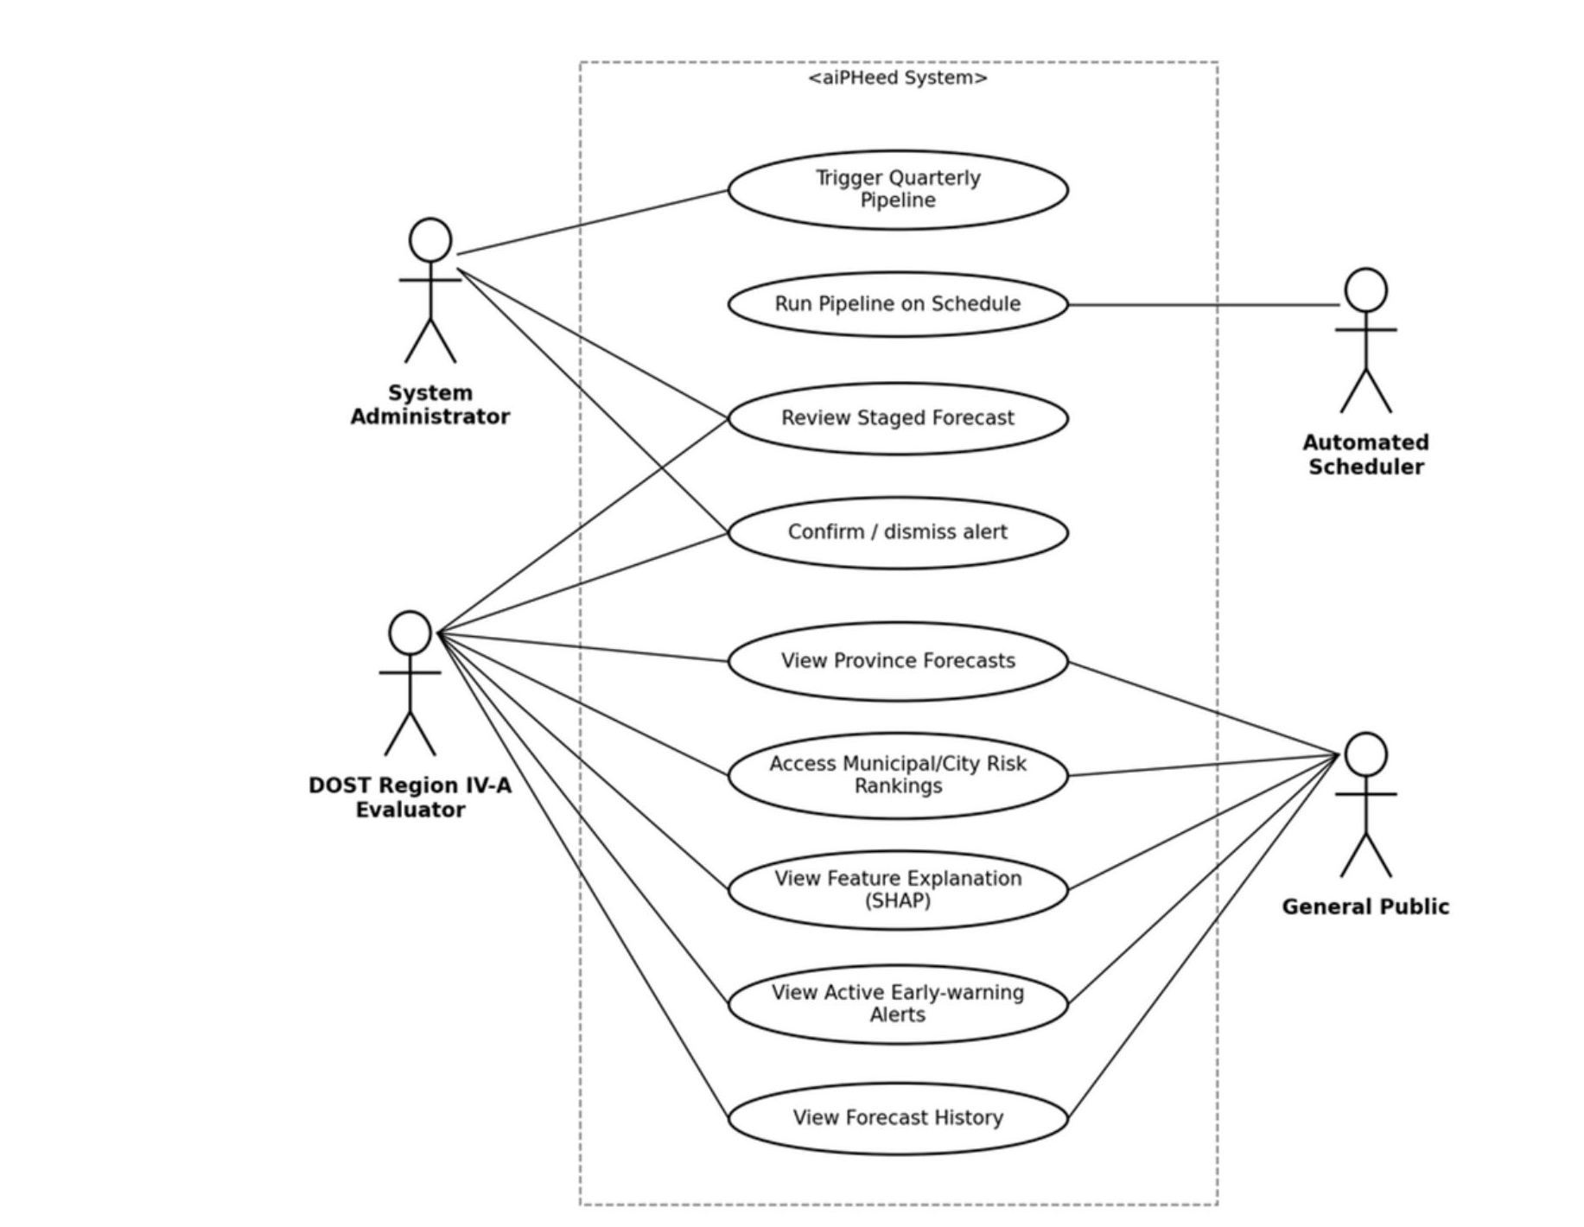
04 · DOST'S ROLE & THE QUESTIONNAIRE
What a DOST Region IV-A Evaluator can do
DOST Region IV-A Evaluator
"The main validating authority of the program"
View Province Forecasts
Access Municipal/City Risk Rankings
View Feature Explanation (SHAP)
View Active Early-Warning Alerts
View Forecast History
ASK #1
Validation Partnership
DOST's endorsement to formally hold this Evaluator role — reviewing staged forecasts before anything reaches the public.
aiPHeed — DOST Region IV-A Meeting Kit
aiPHeed
Notes:
ESICO (leads this segment): Ngayon na po nakita niyo kung paano gumagana ang system sa demo, ipapakita po namin kung paano ito nakaugnay sa inyong magiging tungkulin. Ito po ang use case diagram mula sa aming manuscript. Ang DOST Region IV-A Evaluator ang main validating authority — views province forecasts, municipal rankings, SHAP explanations, alerts, forecast history. Kaya ito ang una naming hihilingin — pormal na validation partnership, consistent sa DOST A.O. No. 002 s. 1989.

Slide 7
04 · DOST'S ROLE & THE QUESTIONNAIRE
The post-testing questionnaire — draft for your review
0
Consent
4
Usability (ISO/IEC 25010)
Purpose, RA 10173 confidentiality, voluntary participation
6 Likert items
1
Profile
5
Alignment with DOST Ops
Respondent group, division, experience
4 Likert items — DOST-focused
2
Forecast Accuracy & Relevance
6
Open-ended
5 Likert items
4 free-text items
3
Functionality
19 Likert items + 4 open-ended · ~10–15 min to answer
4 Likert items
ASK #2
No separate pre-questionnaire needed — this meeting/interview (Segment 06) already covers baseline needs & suggested features.
Post-Testing Evaluators
~30 DOST Region IV-A staff (Technical Operations, ICT/GIS, S&T project evaluation) to review this draft now, then answer the finalized form once real forecasts are live (not the mock data shown today).
aiPHeed — DOST Region IV-A Meeting Kit
aiPHeed
Notes:
ESICO (leads this segment): Ipinadala at ipapakita rin namin ang draft ng post-testing questionnaire — 7 sections, mula consent hanggang open-ended. Gusto namin markahan niyo kung may kulang o hindi malinaw. Kailangan namin ng ~30 DOST staff na sasagot pagkatapos ng demo/pilot. Walang atrasadong pre-survey — ang Segment 06 (More Questions) na po mismo ang aming pre-testing interview.

Slide 8

05 · DATA VALIDATION & ANNOTATION
Public data in, expert eyes on a sample out
Nothing requested from DOST
What “verify / label” looks like
real data, already collected
“Tumaas ang presyo ng bigas sa Batangas dahil sa pagkasira ng ani mula sa bagyong Kristine.”
17,791 news articles
(RSS / Google News / GDELT)
Rice prices rose in Batangas due to crop damage from Typhoon Kristine.
✓ Market issues
✓ Climate events
Employment
OFW remittances
~2,732 gov't datasets
(PSA, BSP, DOE, PAGASA, PhilRice, SWS)
Fish kill
No Listahanan, CBMS, or internal DOST records used or requested.
ASK #3
Expert Validator for the Dataset
One or more DOST staff to confirm/correct tags on a sample (not all 17,791) of articles — flexible format, light time commitment.
aiPHeed — DOST Region IV-A Meeting Kit
aiPHeed
Notes:
MELINDO (leads this segment): Dalawang klase ng datos — news at gov't indicators, publicly available lahat, at REAL na datos — ito po ang ginamit para sanayin ang model offline. Iba ito sa mock data na nakita sa demo, na display lang habang hindi pa naka-integrate ang model sa live dashboard. Halimbawa ng labeling task — ang artikulo tungkol sa presyo ng bigas sa Batangas, ita-tag bilang market issues at climate events. Hihingi kami ng expert validator na tutulong mag-verify ng sample ng training data.

Slide 9




06 · MORE QUESTIONS
This meeting IS the pre-questionnaire
No separate pre-survey was sent — these are the questions that survey would have asked, put to you directly. We'll open the floor for your questions right after.
Current Practice & Awareness
Desired Features
What do you currently use to monitor food insecurity? Where's the biggest blind spot today?
What would make aiPHeed genuinely useful? Which risk categories or groups should it prioritize?
Need & Usefulness
Capacity & Fit
Is there a real need for this, given what already exists? Is quarterly the right cadence?
Who would be the day-to-day user if adopted? What would DOST need to see to consider a wider pilot?
aiPHeed — DOST Region IV-A Meeting Kit
aiPHeed
Notes:
DESTURA (leads Ending, sole speaker for this segment): Dahil itong meeting na ito ang aming kapalit sa pre-survey, gusto naming marinig mula sa inyo: kasalukuyang tools/practices, gustong features, tunay na pangangailangan, at kung sino ang magiging araw-araw na user. Pause and take notes — this is the study's substitute for a pre-survey. Then open the floor for DOST's own questions before moving to closing.

Slide 10
06 · MORE QUESTIONS
What happens after this call
1
2
3
4
TODAY
+ A FEW DAYS
COORDINATED WITH DOST
BEFORE DEFENSE
Meeting, demo & open Q&A
Follow-up email
Expert validation
Post-testing round
Ask 1–3 confirmed, DOST's pre-interview answers and questions captured
Meeting summary, questionnaire draft, contact details
Assigned staff verify/label a sample of the training data
30 DOST + 20 public respondents complete the final form
Recap — the 3 asks:
① Validation partnership ② ~30 post-testing evaluators ③ Expert validator for the dataset
aiPHeed — DOST Region IV-A Meeting Kit
aiPHeed
Notes:
DESTURA: Susunod, ipapadala namin ang huling bersyon ng post-testing form matapos ang inyong review sa draft. Kokoordinate din kami tungkol sa expert validator. Follow-up email within 24 hours.

Slide 11

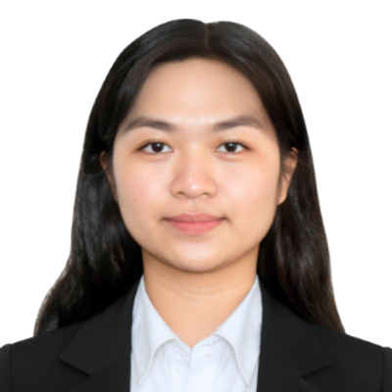
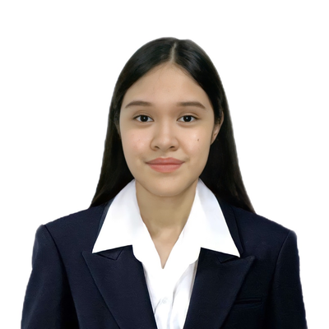

Salamat po! Maraming salamat sa oras.
Open forum — questions, feedback, and clarifications welcome
Princess Gwenn A. Destura
Christina M. Esico
Angel Vhea P. Melindo
BS Computer Science (Intelligence Systems) · De La Salle University–Dasmariñas · Adviser: Dr. Rolando B. Barrameda
Notes:
DESTURA: Maraming salamat po sa oras. Susunod, ipapadala namin ang post-testing form at questionnaire feedback loop. Follow-up email within 24 hours.

