Slide 1
What are you hiring for?
Looking beyond a 4 year degree to increase diversity in technology
Notes:
Slide on bootcamps, slide

Slide 2

First things First

Slide 3
4 year college costs
Avg cost of a 4 year in state school: $21,447
X4 = $85,788
Avg cost of a 4 year private school: $42,224
X4 = $168,896
This does not include room & board
Costs currently increase at least 5%/year
Source: https://bigfuture.collegeboard.org/pay-for-college/college-costs/college-costs-calculator
Notes:
Another slide?: technology changes faster than curriculum

Slide 4
2 year college and bootcamp costs
Avg cost of a 2 year in state school: $15,286
X2 = $30,572
Local Bootcamp costs:
We Can Code It: $12,900
Tech Elevator: $15,500
Others range from $5000-$2000
Source: https://bigfuture.collegeboard.org/pay-for-college/college-costs/college-costs-calculator
Source: https://www.coursereport.com/blog/coding-bootcamp-cost-comparison-full-stack-immersives
Notes:
Emphasis numbers

Slide 5
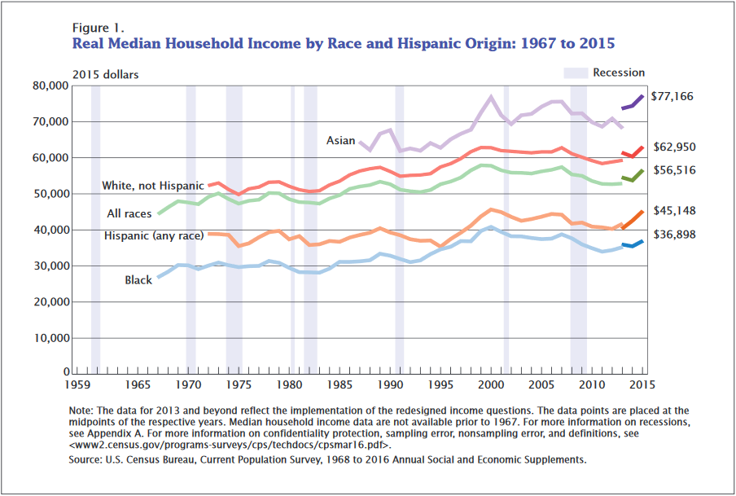
Median incomes

Slide 6
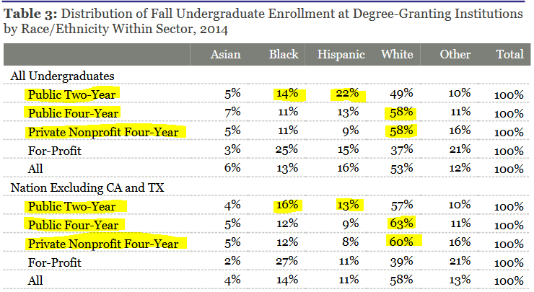
Demographic Breakdowns
Source: https://trends.collegeboard.org/sites/default/files/trends-in-community-colleges-research-brief.pdf

Slide 7
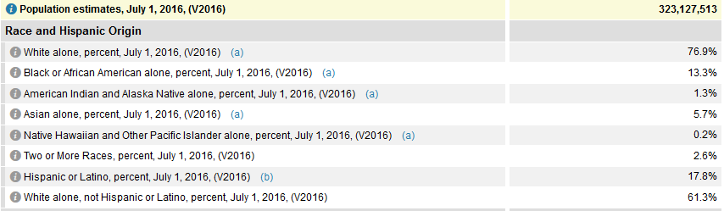
Demographic Breakdowns
Does your workforce match US demographics?
US Population
Source: https://www.census.gov/quickfacts/fact/table/US/PST045216

Slide 8
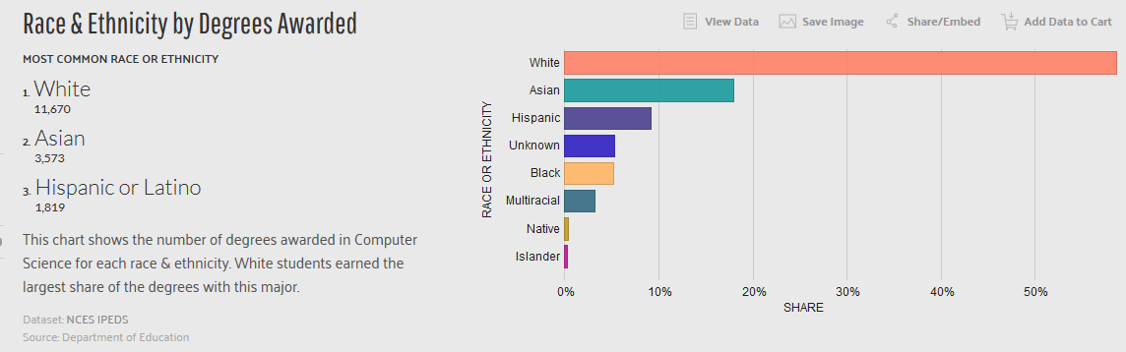
Demographic Breakdowns
Computer science degrees by race (US Residents)
Source: https://datausa.io/profile/cip/110701/#demographics
Notes:
New title

Slide 9
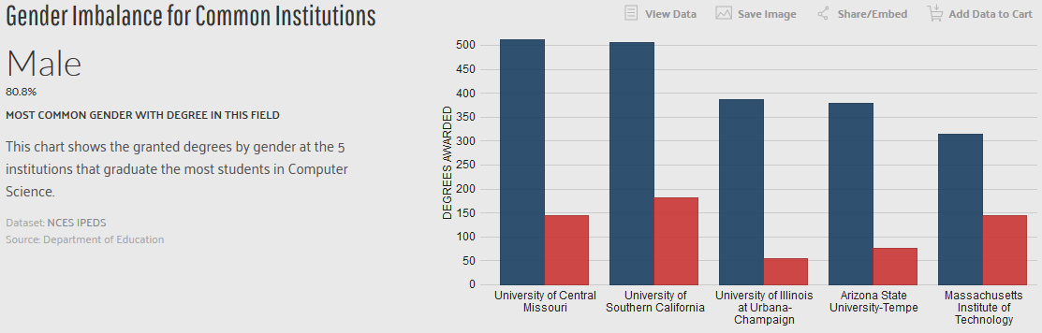
Demographic Breakdowns
Computer science degrees by gender
Source: https://datausa.io/profile/cip/110701/
Notes:
New title

Slide 10
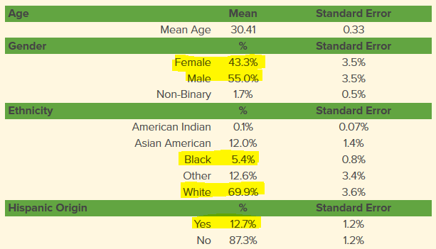

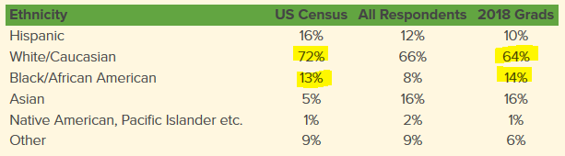
Demographic Breakdowns
Bootcamp demographics
2016
2018
Source: https://www.coursereport.com/reports/coding-bootcamp-job-placement-2018
Notes:
New title

Slide 11
Interview questions
Classic computer science interview questions
Merge Sort
Binary Search
Bubble Sort
Do you actually create these as part of any of your day to day development?
Notes:
Action words: step 1: hiring process : new slide, what should your hiring process be: 1ish. Define candidate or needs. Note add some images. Make prettier. Hiring question: start fresh, what percentage would you want your workforce to be of women and minorities

Slide 12
Trans Inclusion
Trans individuals come from all walks of life
Allow for non-gendered bathrooms
Allow people to work from home
Have an insurance policy that allows for gender reassignment surgery

Slide 13
Takeaways
Looking at alternative sources of talent won’t solve tech’s diversity problems, but it is an easily actionable item that can make a difference.
There isn’t just one lever to help solve the problem
Bootcamps and community colleges typically will be willing to work with you to ensure they are properly structuring their programs
Taylor your interview questions to be relevant to what work the position you’re hiring for will actually do
Notes:
Add personal/company examples. Talk about what has and hasn’t worked. Our limitations. Where we are at now.
Matchmaking in bootcamps
Ability to follow up on interview process, did the candidates know the skills that you were looking for.

Slide 14
Questions?/Thanks!
Follow me: @tterragnoj
Contact: gwesthov@gmail.co
Presentation: https://github.com/gwesthoven/DiversityPresentation

