Slide 1
DEI is not dead (yet)
Where to look and actions to take to try to keep diverse ideas in technology
Notes:
Slide on bootcamps, slide

Slide 3

First things First

Slide 4
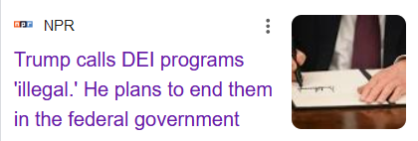
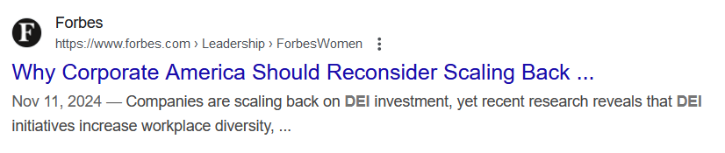
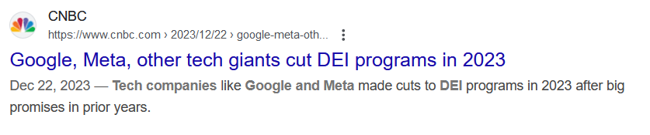
Current state of DEI

Slide 5
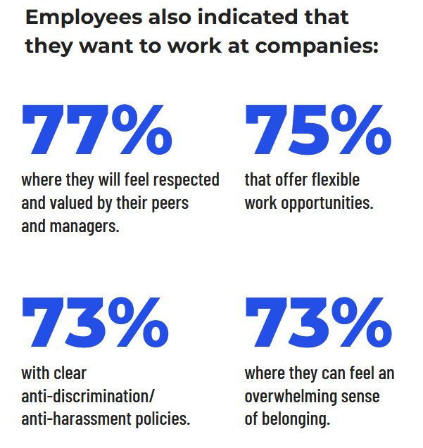
“Rank and File” people still care about DEI
Source: BuiltIn Employers

Slide 6

Let’s look at some data
Notes:
If you’re a hiring manager, where can you look for more diversity when you’re hiring?

Slide 7
4 year college costs
Avg cost of a 4 year in state school: $27,146
X4 = $108,584
Avg cost of a 4 year private school: $38,421
X4 = $153,684
This does not include room & board
Costs currently increase at least 3%/year
Source https://educationdata.org/average-cost-of-college, https://educationdata.org/college-tuition-inflation-rate
Notes:
Another slide?: technology changes faster than curriculum

Slide 8
2 year college and bootcamp costs
Avg cost (tuition) of a 2 year in state school: $6,730
X2 = $13460
Local Bootcamp costs:
We Can Code It: $14,900
Tech Elevator: $15,950
Others average: $13,584
Source: https://bigfuture.collegeboard.org/pay-for-college/college-costs/college-costs-calculator
Source: https://www.coursereport.com/blog/coding-bootcamp-cost-comparison-full-stack-immersives
Notes:
Emphasis numbers

Slide 9
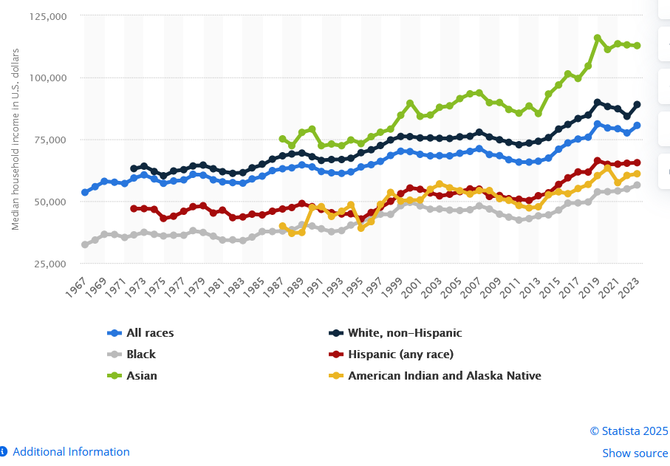
Median incomes

Slide 10
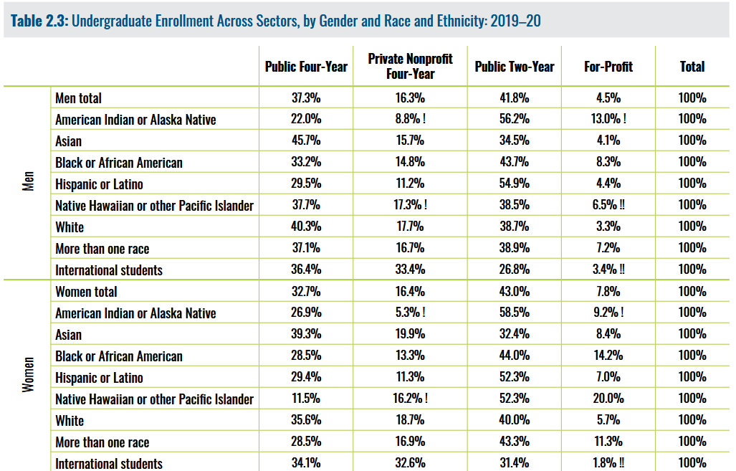
Demographic Breakdowns
Source: https://www.equityinhighered.org/wp-content/uploads/2024/05/REHE2024_Full_Report.pdf
Notes:
Notes: The breakdown of data seems to be about 4 years behind. Apologies for leaving gender non-conforming, but their stats are generally in line with men and women by race. Apologies for not including

Slide 11
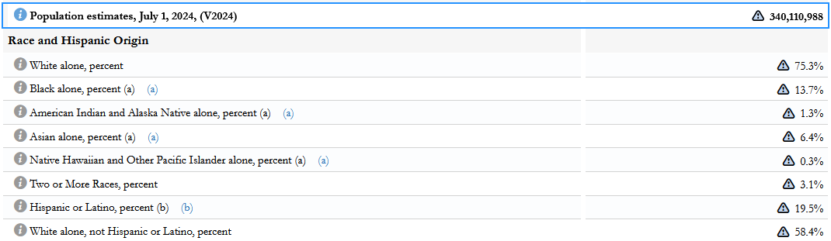
Demographic Breakdowns
Does your workforce match US demographics?
US Population
Source: https://www.census.gov/quickfacts/fact/table/US/PST045224

Slide 12
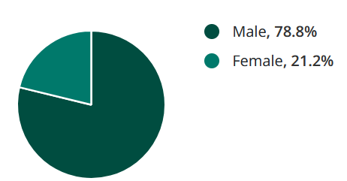
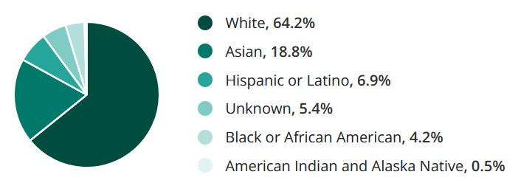
Demographic Breakdowns
Computer science degrees awarded: gender & race
Source: https://www.zippia.com/computer-scientist-jobs/demographics/
Notes:
New title

Slide 13
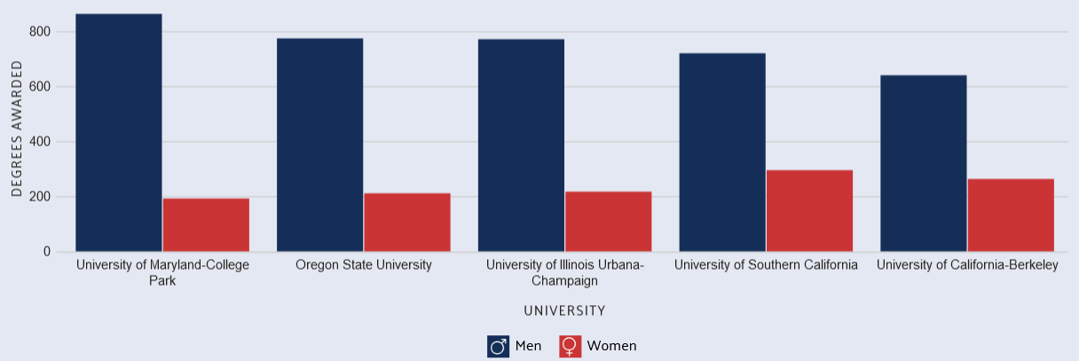
Demographic Breakdowns
Computer science degrees by gender
Source: https://datausa.io/profile/cip/computer-science-110701#enrolled_sex
Notes:
Picking the median school here (and the one closest to us), about 77% of CS students are male.

Slide 14
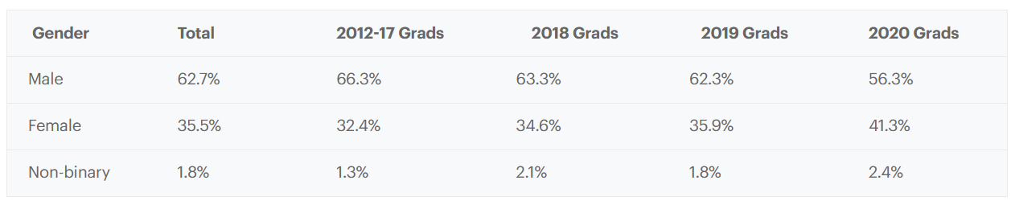
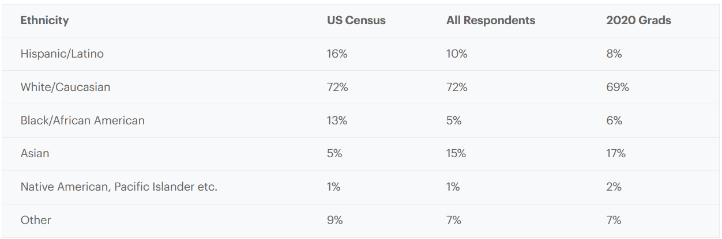
Demographic Breakdowns
Bootcamp demographics
Source: https://www.coursereport.com/reports/2020-coding-bootcamp-alumni-outcomes-demographics-report-during-covid-19
Notes:
New title

Slide 15
Takeaways
Looking at alternative sources of talent won’t solve tech’s diversity problems, but it is an easily actionable item that can make a difference.
There isn’t just one lever to help solve the problem
Bootcamps and community colleges typically will be willing to work with you to ensure they are properly structuring their programs
Notes:
Add personal/company examples. Talk about what has and hasn’t worked. Our limitations. Where we are at now.
Matchmaking in bootcamps
Ability to follow up on interview process, did the candidates know the skills that you were looking for.

Slide 16
Be realistic about the skills you need
Are looking for someone who is an algorithmic expert?
Are you looking for someone who can understand complex code bases and can communicate?
Make sure your interview questions match what you’re actually looking for.

Slide 17
Questions?/Thanks!
Follow me: @tterragnoj
Contact: gwesthov@gmail.com
Presentation: https://github.com/gwesthoven/DiversityPresentation

