Slide 1
The Athena Class of Ballot Polling Tabulation Audits
Filip Zagórski, Grant McClearn, Sarah Morin, Neal McBurnett, Poorvi L. Vora
https://arxiv.org/abs/2008.02315

Slide 2
Risk Limiting Tabulation Audit
Designed to check tabulation
Evidence-based elections require more:
Eligibility checks
Voter-verified paper trail
Compliance audits to ensure that the paper trail accurately represents all the properly cast ballots
Set desired risk limit for the RLTA up front

Slide 3
Ballot Polling RLTA
Draw a sample of ballots, identified at random from the ballot manifest
If the sample passes the audit
Stop and declare the RLTA successful
Else
Draw more ballots or go to a full hand count

Slide 4
Quick Note: Ballot Comparison RLTA
Far more efficient than any ballot polling RLTA
In Colorado, the sample size for a ballot-level comparison audit with a 5.37% margin (2016 Presidential) would be just 90, with a 100% stopping probability if there were (as usual) no discrepancies, vs 3,554 for BRAVO with 90% stopping probability
Can be used only if you can identify individual ballots to compare with the machine’s interpretation of the vote
When individual ballots cannot be identified
Ballot polling RLTAs are a choice
Other choices include batch comparison RLTAs

Slide 5
BRAVO: most popular ballot polling RLTA
Designed for use after each (single) ballot is drawn
Requires fewest ballots, on average, in this setting
When ballots are drawn in large numbers at a time:
End-of-round BRAVO: decision based on the tally of the sample
Selection-ordered BRAVO: decision based on order of the ballots drawn

Slide 6
The Athena Class of Audits: Minerva
Designed for use when ballots are drawn in large rounds.
Requires fewer ballots than BRAVO.
We considered first rounds with a 90% probability of stopping if the election tally is as announced, thus limiting the need for going to a next round.
Example results on statewide Presidential contest, 2016

Slide 7
Minerva and BRAVO: Distinct Ballots drawn stopping probability = 90%; risk limit =10% margin > 5%
State | Margin in percentage | Minerva | BRAVO |  | Minerva round size as a percentage of BRAVO round size
 |  |  | EoR | SB | EoR | SB
California | 32.26 | 79 | 148 | 99 | 53.38 | 79.80
Alabama | 28.75 | 94 | 181 | 122 | 51.93 | 77.05
New York | 23.54 | 140 | 272 | 186 | 51.47 | 75.27
Washington | 17.57 | 265 | 525 | 355 | 50.48 | 74.65
Rhode Island | 16.62 | 280 | 562 | 280 | 49.82 | 73.30
New Jersey | 14.57 | 350 | 703 | 478 | 49.79 | 73.22
Oregon | 12.31 | 535 | 1,068 | 724 | 50.09 | 73.90
Ohio | 8.54 | 1,018 | 2,077 | 1,403 | 49.01 | 72.56
Virginia | 5.65 | 2,329 | 4,788 | 3,228 | 48.64 | 72.13
Colorado | 5.37 | 2,675 | 5,470 | 3,685 | 48.90 | 72.59
Georgia | 5.32 | 2,567 | 5,263 | 3,554 | 48.77 | 72.23

Slide 8
Minerva and BRAVO: Distinct Ballots drawn stopping probability = 90%; risk limit =10% margin < 5%
State | Margin in percentage | Minerva | BRAVO |  | Minerva round size as a percentage of BRAVO round size
 |  |  | EoR | SB | EoR | SB
North Carolina | 3.81 | 4,998 | 10,319 | 6,956 | 48.43 | 71.85
Arizona | 3.78 | 5,199 | 10,710 | 7,217 | 48.54 | 72.04
Nevada | 2.59 | 11,056 | 22,711 | 15,357 | 48.68 | 71.99
Minnesota | 1.66 | 27,294 | 56,139 | 37,939 | 48.62 | 71.94
Florida | 1.24 | 46,449 | 96,115 | 64,827 | 48.33 | 71.65
Wisconsin | 0.82 | 108,592 | 220,878 |  | 49.16
Pennsylvania | 0.75 | 126,477 | 259,621 |  | 48.72
Michigan | 0.24 | 1,107,933 | 2,018,381 |  | 54.89

Slide 9
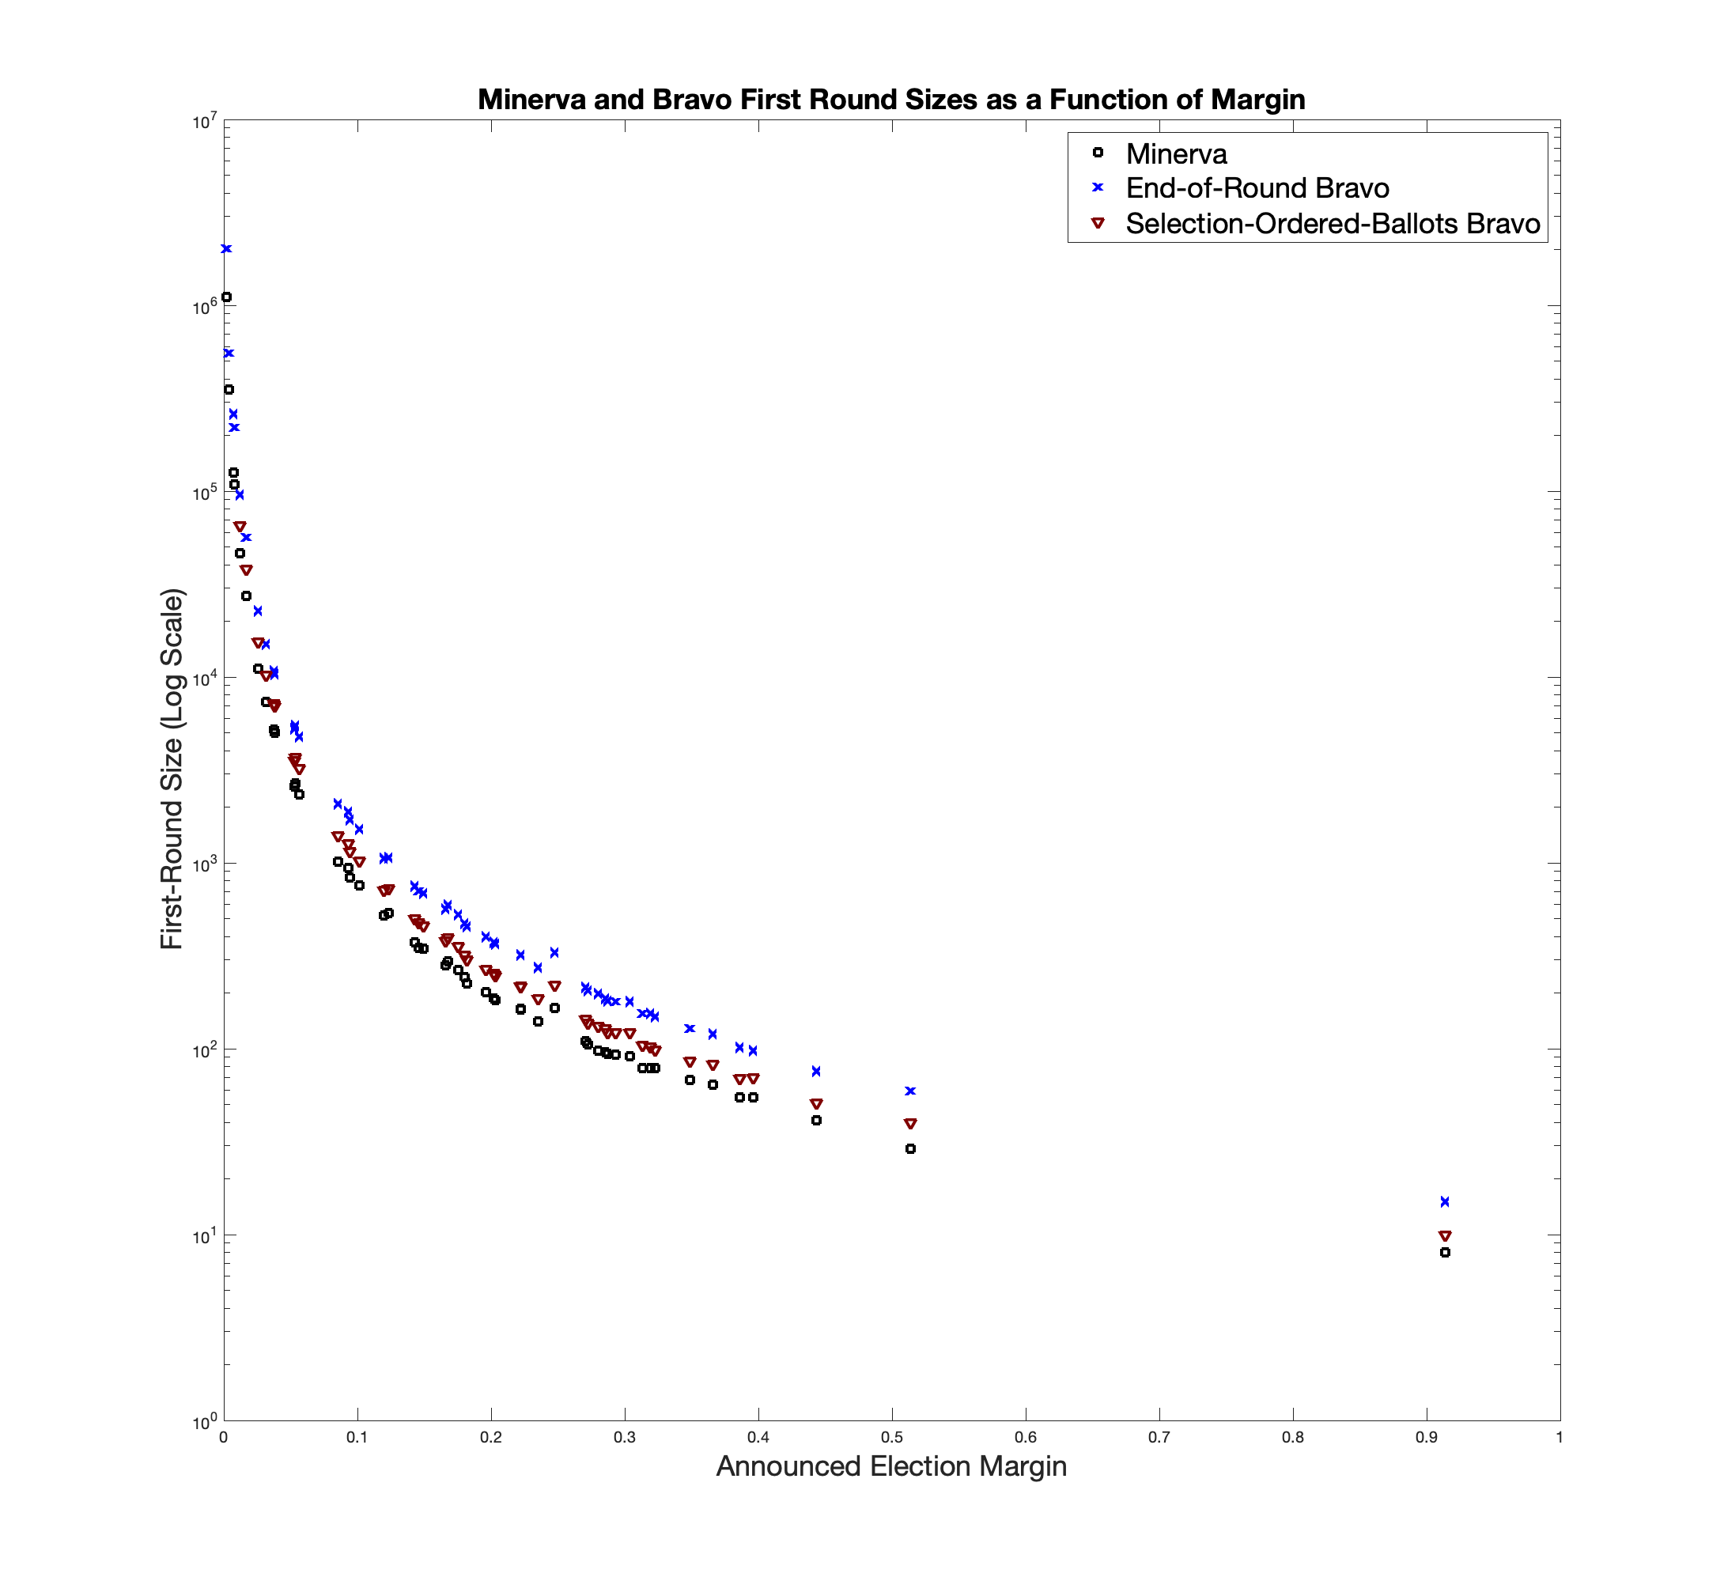
Minerva and BRAVO First-Round Sizes (log plot)

Slide 10
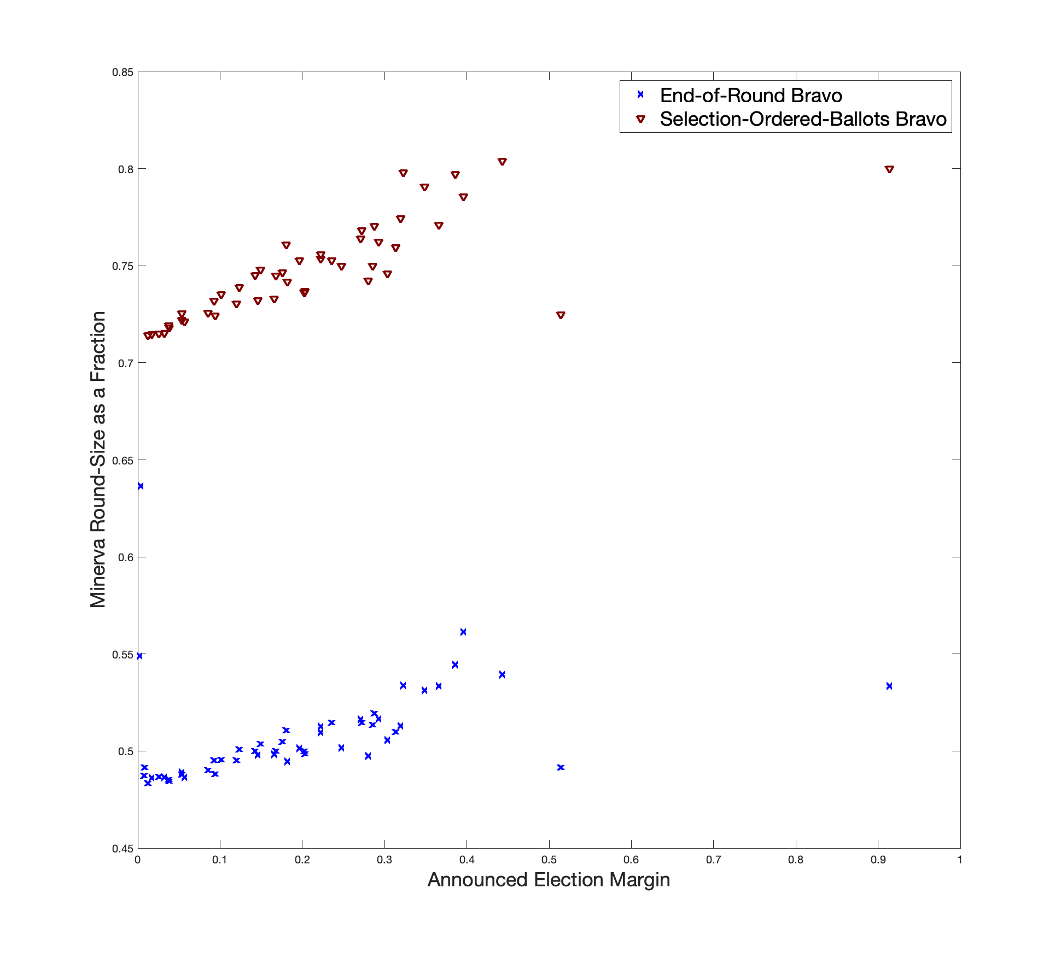
Minerva First-Round Sizes as a Fraction of BRAVO First-Round Sizes

Slide 11
Caveats
The improvement over BRAVO is expected to:
Be smaller for smaller stopping probabilities
Vary with risk limit
These are only first-round results.
Future rounds are trickier. E.g.: might need to commit to future round sizes in advance
When available, ballot comparison uses smaller samples

Slide 12
Where are we?
Open source code: https://github.com/gwexploratoryaudits/
Proofs appear reasonable to those who have reviewed them.
First round simulations.
Working on simulations to
Substantiate proven claims for further rounds
Examine audit behavior when election outcome is correct but announced tally is not
Paper in review.

