Slide 2
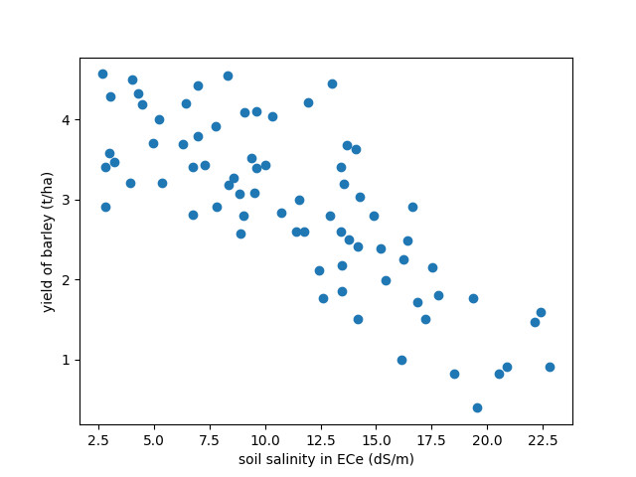

Slide 3
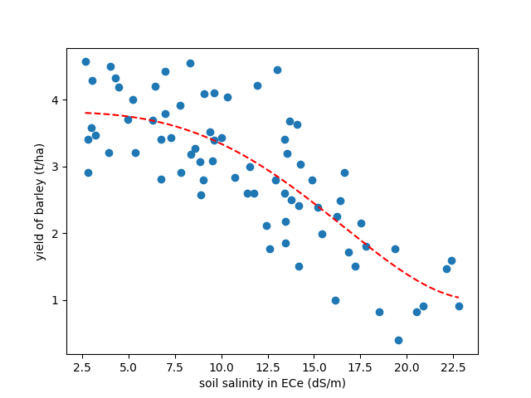
$$f\left(X\right)=\ln\left(0.0319X+0.0216\right)\left(2.926⋅{10}^{−5}X^{4}+0.000139X^{3}+8.12⋅{10}^{−5}X^{2}\right)+3.81$$

Slide 4

GENETIC PROGRAMMING

Slide 5
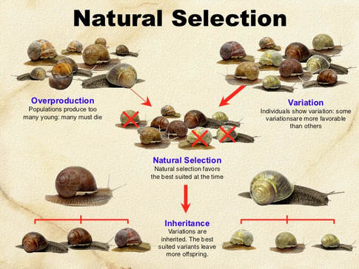

Slide 6
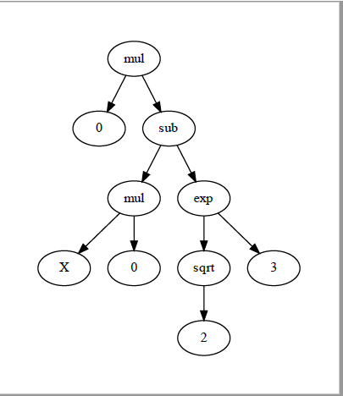
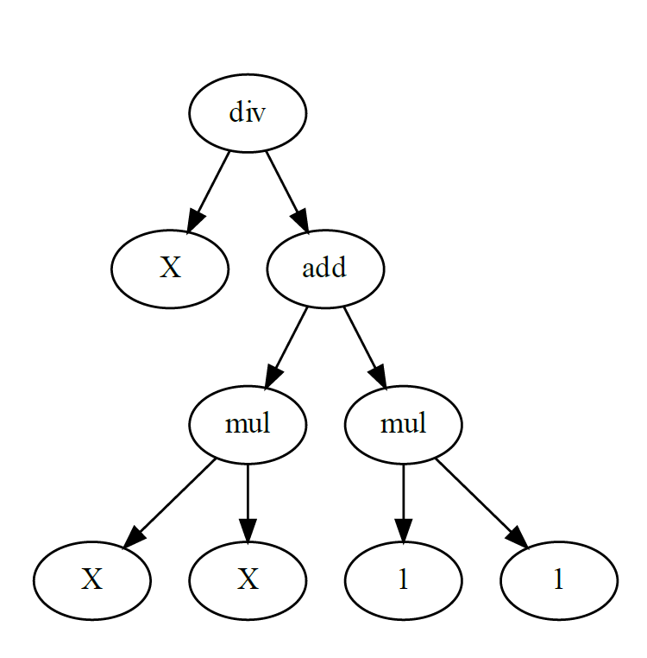
PROGRAM REPRESENTAION
X / ( (x*x) + (1*1) )
0 * ( (X*0) – (sqrt(2)^3))

Slide 7
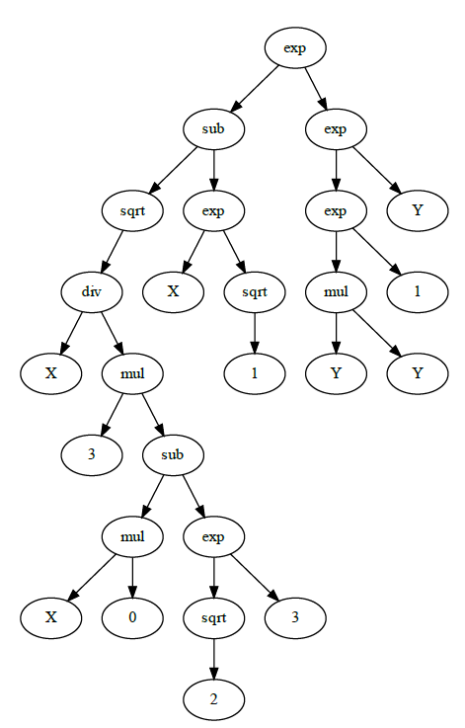
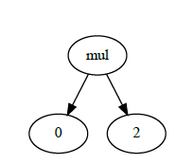
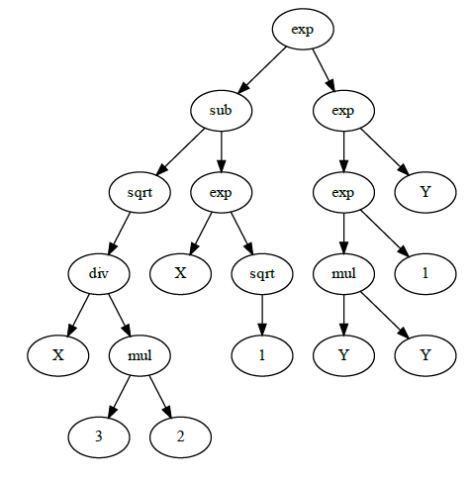
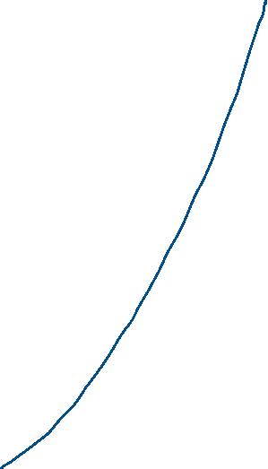


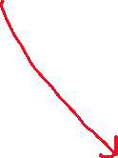

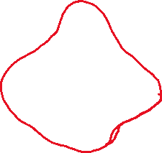
PARENT A
PARENT B
CHILD A
CHILD B

