Slide 1
Slapping Some Lipstick on the Big Data Pig: Visualize Voluminous Quantities of Data with Oracle R Enterprise
Gary Garrison

Slide 2
Goals
Learn a little about creating plots in R
Boring presentation slides
Demos
Questions
Finish in time for lunch

Slide 3
Agenda
Briefly describe Oracle R Enterprise (ORE)
Exploratory plots in R
Map based plots with R
Interactive pots with R (if we have time)

Slide 4
Oracle R Enterprise (ORE)
Oracle Advanced Analytics Option ($$)
Integrates R with Oracle
Overcomes memory limitation of R
Keep data in the database
Run R code on database server
Our focus will be on the R portion of ORE

Slide 5


Slide 6
What is R ?
Open Source environment for statistical computing
Inspired by S (Bell Labs)
Developed by Robert Gentleman and Ross Ihaka of the Statistics Department of the University of Auckland

Slide 7
Why use R?
Cheap
free
most popular development tool (RStudio) is free
Powerful
Over 6000 packages on Comprehensive R Archive Network (CRAN)
Popular

Slide 8
Help with R (demo)
Classes
Other sources
Application help
?<function>, <dataset>, etc.
??<search term>
example(<function>)
Notes:
References on Github contain a list of R classes. Most of the classes listed are free.

Slide 9
Using R with Oracle Database
Oracle R Enterprise (ORE)
ROracle
RODBC/RJDBC
Output table query to csv
Use R to access Oracle data
Notes:
https://blogs.oracle.com/R/entry/r_to_oracle_database_connectivity post describing these methods for using R with Oracle databases.

Slide 10
Why Do We Need Exploratory Plots?
Summary statistics can be misleading
Anscombe’s Quartet (demo)
Good for getting a quick look at large amounts of data
Combing through tables/data sets is tedious
We are good at processing visualizations

Slide 11
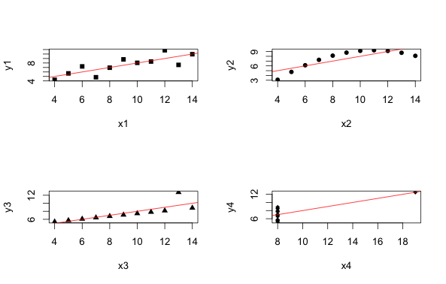
Anscombe’s Quartet (demo)

Slide 12
ggplot package
Developed by Hadley Wickham
Based on the “The Grammar of Graphics”, by Leland Wilkinson
Better than base R for creating plotting

Slide 13
Histogram
Often first exploratory plot
Shows the distribution of a continuous variable
Demo

Slide 14
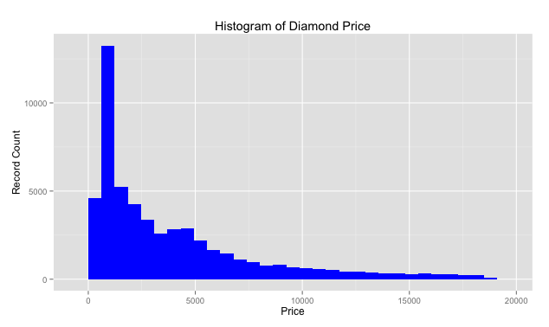
Histogram
Notes:
The good part of this information is that most diamonds fall into the lower priced category. The downside my wife likes the ones on the right side of this histogram.

Slide 15
Boxplot
Display the distribution of numerical/continuous variable grouped by a categorical variable
Show median and quantiles
Good for spotting outliers
Demo

Slide 16
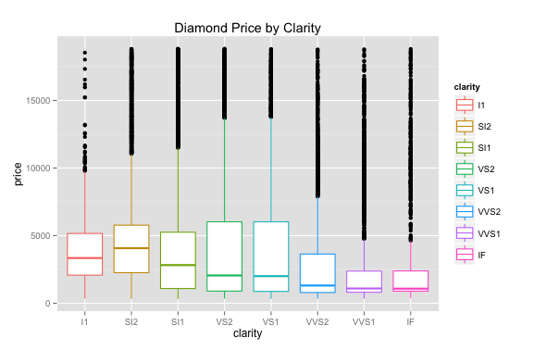
Boxplot

Slide 17
Scatterplot
Display relationship between two continuous variables
Often overplotting issue with a lot of data
Can show a third variable with color or shape

Slide 18
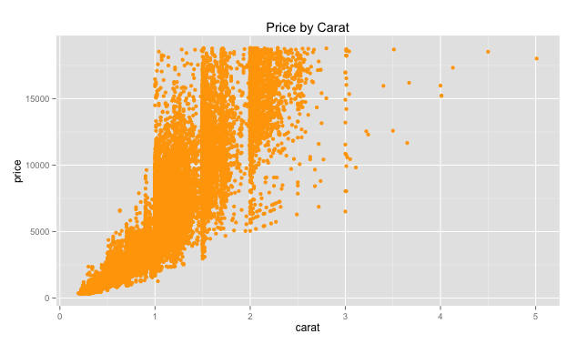
Scatterplots

Slide 19
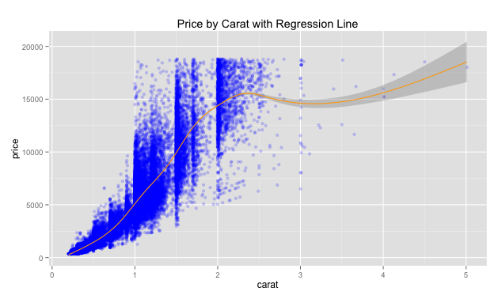
Scatter with smoother

Slide 20
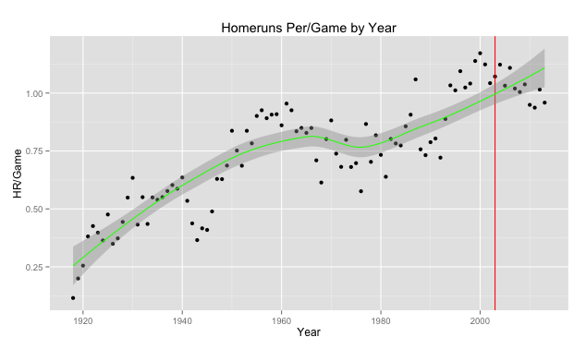
Interesting baseball plot with smoother

Slide 21
A diversion for data munging
Most of our time and effort manipulating data
Why
Fixing data
Aggregation
Discretization
dplyr package

Slide 22
Maps
Why put plots on maps?
They are fun
Quickly display data with geographic context
Demo

Slide 23
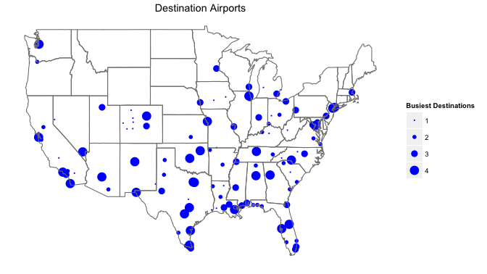
Simple Map
Notes:
Simple map showing the number of flights to various destinations from Houston.

Slide 24
“Real maps” with ggmap
Based on ggplot and Internet mapping APIs
Give context to your data
geocode() function for finding latitude/longitude

Slide 25
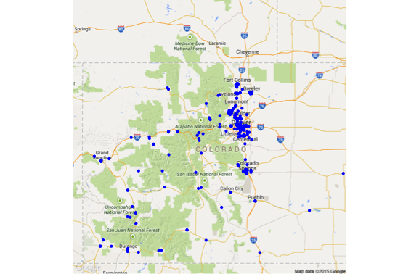
Location of Colorado Microbreweries
Notes:
Locations of Colorado microbreweries.

Slide 26
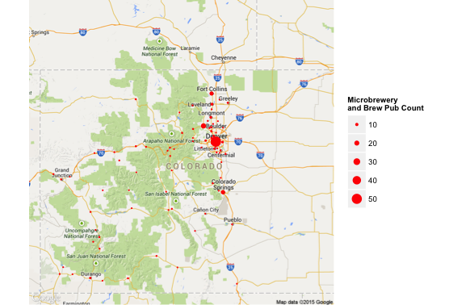
Colorado Microbrewery Count by City

Slide 27
Demo R Interactive Plots
ggvis
Demo (if we have time)

Slide 28


Slide 29
References
Chang, Winston. R Graphics Cookbook, 2013.
Rittman, Mark. Using Oracle R Enterprise to Analyze Large In-Database Datasets, 2014. URL http://www.rittmanmead.com/2014/03/using-oracle-r-enterprise-to-analyze-large-in-database-datasets/.
Wickham, Hadley. ggplot2: Elegant Graphics for Data Analysis (Use R!), 2009.

Slide 30
Important Information
Contact:
gary.garrison@arisant.com or garrisongw@gmail.com
Github Repository:
https://github.com/gwgarrison/rmoug_2015

