Slide 1
Slapping Some Lipstick on the Big Data Pig: Visualize Voluminous Quantities of Data with Oracle R Enterprise
Gary Garrison

Slide 2
More data than ever…
Exabytes get generated every day
Over half the data was created the last 1 year
Creation rate doubles every month
70% generated by individuals
BI usage increases exponentially as well
4300% increase yearly by 2020
35 ZB
2006
2020
Source: CSC
Notes:
1/15/2015
Oracle Confidential
2
The problem is the world’s ability to produce data has outstripped most organizations’ ability to use it.
One of the largest airlines in the world, employing dozens of operational research analysts, throws away most of its fleet operational data at the end of the day because it’s so big there’s nowhere to put it and analyze it. (Source: a presentation by Jim Diamond, Managing Director of Operations & Research at American Airlines. Given at the Evanta CIO event in Dallas, TX 6/7/13)
The same is true for many businesses: the information they need to improve products and services already exists, they’re just not quite sure how to use it.
According to a study we conducted with The Economist Intelligence Unit, only 12% of executives feel they understand the impact data will have on their organizations over the next three years.” (Source: http://www.oracle.com/webapps/dialogue/ns/dlgwelcome.jsp?p_ext=Y&p_dlg_id=13367869&src=7634271&Act=143 )
Business Intelligence has always held the promise of being able to provide timely information to the knowledge workers within an organization. The use of BI will continue to grow for the next several years as new technologies, such as mobile devices, enables BI to become more pervasive. This will open up BI to a whole new set of users. However, with this new pervasiveness comes a set of challenges…..

Slide 3
Goals
Learn a little about creating plots in R
Boring presentation slides
Demos
Questions
Finish in time for lunch

Slide 4
Agenda
Briefly describe Oracle R Enterprise (ORE)
Exploratory plots in R
Map based plots with R
Interactive pots with R (if we have time)

Slide 5
Oracle R Enterprise (ORE)
Oracle Advanced Analytics Option ($$)
Integrates R with Oracle
Overcomes memory limitation of R
Keep data in the database
Run R code on database server
Our focus will be on the R portion of ORE

Slide 6


Slide 7
What is R ?
Open Source environment for statistical computing
Inspired by S (Bell Labs)
Developed by Robert Gentleman and Ross Ihaka of the Statistics Department of the University of Auckland

Slide 8
Why use R?
Cheap
free
most popular development tool (RStudio) is free
Powerful
Over 6000 packages on Comprehensive R Archive Network (CRAN)
Popular

Slide 9
Help with R (demo)
Classes
Other sources
Application help
?<function>, <dataset>, etc.
??<search term>
example(<function>)
Notes:
References on Github contain a list of R classes. Most of the classes listed are free.

Slide 10
Using R with Oracle Database
Oracle R Enterprise (ORE)
ROracle
RODBC/RJDBC
Output table query to csv
Use R to access Oracle data
Notes:
https://blogs.oracle.com/R/entry/r_to_oracle_database_connectivity post describing these methods for using R with Oracle databases.

Slide 11
Why Do We Need Exploratory Plots?
Summary statistics can be misleading
Anscombe’s Quartet (demo)
Good for getting a quick look at large amounts of data
Combing through tables/data sets is tedious
We are good at processing visualizations

Slide 12
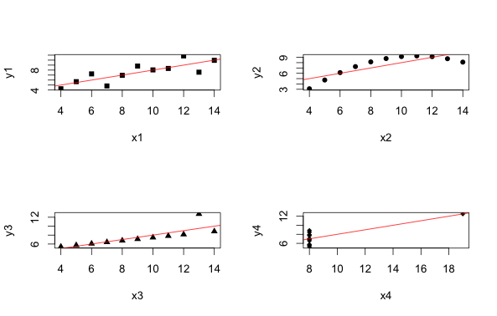
Anscombe’s Quartet (demo)

Slide 13
ggplot package
Developed by Hadley Wickham
Based on the “The Grammar of Graphics”, by Leland Wilkinson
Better than base R for creating plotting

Slide 14
Histogram
Often first exploratory plot
Shows the distribution of a continuous variable
Demo

Slide 15
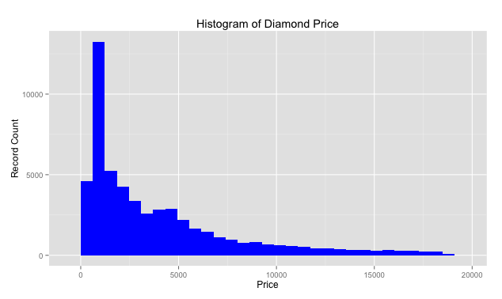
Histogram
Notes:
The good part of this information is that most diamonds fall into the lower priced category. The downside my wife likes the ones on the right side of this histogram.

Slide 16
Boxplot
Display the distribution of numerical/continuous variable grouped by a categorical variable
Show median and quantiles
Good for spotting outliers
Demo

Slide 17
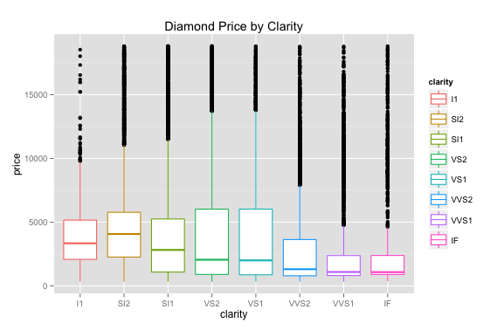
Boxplot

Slide 18
Scatterplot
Display relationship between two continuous variables
Often overplotting issue with a lot of data
Can show a third variable with color or shape

Slide 19
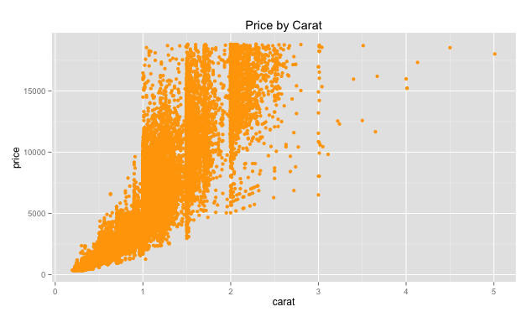
Scatterplots

Slide 20
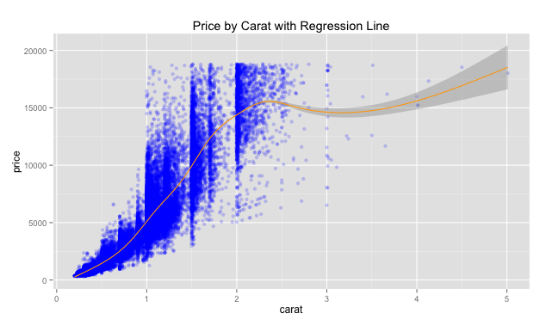
Scatter with smoother

Slide 21
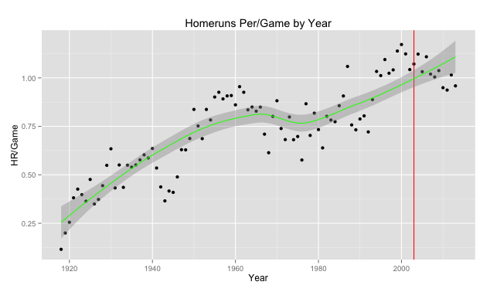
Interesting baseball plot with smoother

Slide 22
A diversion for data munging
Most of our time and effort manipulating data
Why
Fixing data
Aggregation
Discretization
dplyr package

Slide 23
Maps
Why put plots on maps?
They are fun
Quickly display data with geographic context
Demo

Slide 24
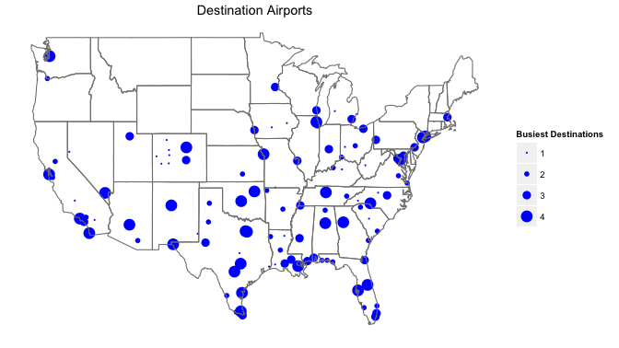
Simple Map
Notes:
Simple map showing the number of flights to various destinations from Houston.

Slide 25
“Real maps” with ggmap
Based on ggplot and Internet mapping APIs
Give context to your data
geocode() function for finding latitude/longitude

Slide 26
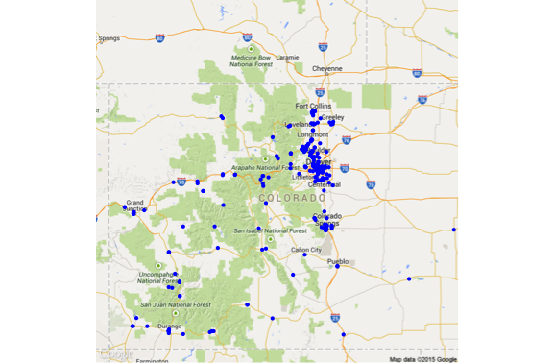
Location of Colorado Microbreweries
Notes:
Locations of Colorado microbreweries.

Slide 27
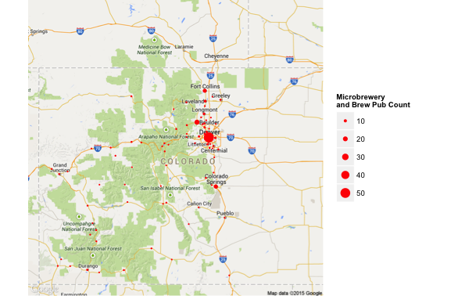
Colorado Microbrewery Count by City

Slide 28
Demo R Interactive Plots
ggvis
Demo (if we have time)

Slide 29


Slide 30
References
Chang, Winston. R Graphics Cookbook, 2013.
Rittman, Mark. Using Oracle R Enterprise to Analyze Large In-Database Datasets, 2014. URL http://www.rittmanmead.com/2014/03/using-oracle-r-enterprise-to-analyze-large-in-database-datasets/.
Wickham, Hadley. ggplot2: Elegant Graphics for Data Analysis (Use R!), 2009.

Slide 31
Important Information
Contact:
gary.garrison@arisant.com or garrisongw@gmail.com
Github Repository:
https://github.com/gwgarrison/rmoug_2015

