Slide 1
Pipeline Project Behavioral analysis of the program funnel
Graham Harris
NYU Entrepreneurial Institute
Notes:
Hi

Slide 2
Interim Presentation Goal
Feedback!
Notes:
The main goal of this interim presentation is feedback!
I have all the data and I’m discovering some insights that are really cool – this is a time for me to present that and for you to ask me any questions that’ll guide me to the final draft of the project. Please ask any and all questions you can think of!

Slide 3
Overview
Test the hypothesis of the “funnel” of events
Sub-objectives: data cleaning and diversity
Present a package of findings/insights for improved marketing, programs dev., etc
Cleaned data located in Google folder
Notes:
Are people actually travelling through the funnel in the way that we think they are?
Final draft will be a data resource for everyone to use going forward

Slide 4
Funnel
HTSAS, SS, FF (coaching)
Bootcamp
Sprints (Summer and J-Term)
Launchpad
Top:
Bottom:
Sub-funnel
Notes:
Funnel and sub-funnel structure

Slide 5
Assumptions/Notes
Data cleaning:
I stopped counting founders after the 4th person for bootcamps
I only used bootcamp application data, not attendees – the apps were more consistent. I do have some attendee data
Affinity data (all people and organizations) is from July 14th, 2021
Normal computing errors (extra spaces, misspelled names, etc)

Slide 6
Methodology
People vs. Teams:
People: funnel as a whole
Teams: efficacy of the sub-funnel
For both people and teams:
2018-2019, 2019-2020, 2020-2021
All the above
All the above, simplified (without dates)
10 total graphs

Slide 7
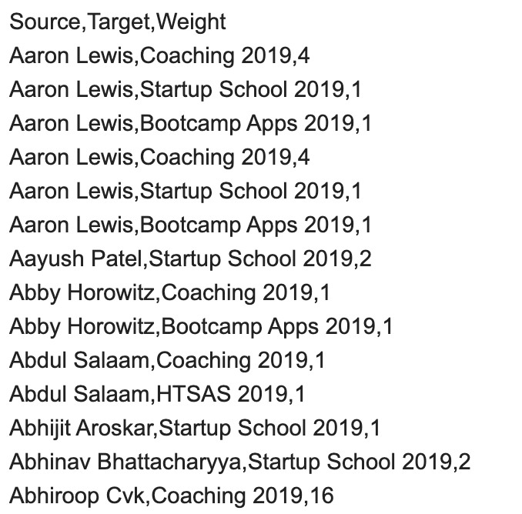
Adjacency
Header
Relationships
Notes:
So the way I analyzed the data is through adjacency lists like this one, here’s what the structure looks

Slide 8
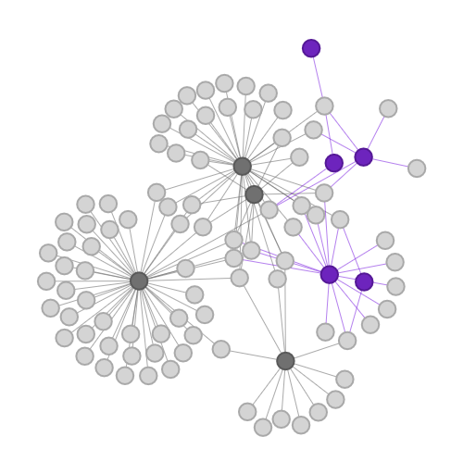
How to read the graph
Person/Team
Sub-funnel Event
Event
Notes:
Network graph - funnel and sub-funnel structure
Explain what a node and edge are

Slide 9
Graphs
Notes:
So without further ado….
(open HTML)

