Slide 1
Pipeline Project Behavioral analysis of the program funnel
Graham Harris
NYU Entrepreneurial Institute
Notes:
Hi

Slide 2
Interim Presentation Goal
Feedback!
Notes:
The main goal of this interim presentation is feedback!
I have all the data and I’m discovering some insights that are really cool – this is a time for me to present that and for you to ask me any questions that’ll guide me to the final draft of the project. Please ask any and all questions you can think of!

Slide 3
Overview
Test the hypothesis of the “funnel” of events
Sub-objectives: data cleaning and diversity
Spent first month cleaning 3 years worth of coaching, SS, FF, HTSAS, Bootcamps, Sprints, Launchpads
Clustered this data into network visuals
Present a package of findings/insights for improved marketing, programs dev., etc
Cleaned data located in Google folder
Notes:
Are people actually travelling through the funnel in the way that we think they are?
Final draft will be a data resource for everyone to use going forward

Slide 4
Funnel
HTSAS, SS, FF (coaching)
Bootcamp
Sprints (Summer and J-Term)
Launchpad
Top:
Bottom:
Sub-funnel
Notes:
Funnel and sub-funnel structure

Slide 5
Assumptions/Notes
Data cleaning:
I stopped counting founders after the 4th person for bootcamps
I only used bootcamp application data, not attendees – the apps were more consistent. I do have some attendee data
Affinity data (all people and organizations) is from July 14th, 2021
Normal computing errors (extra spaces, misspelled names, etc)

Slide 6
Methodology
People vs. Teams:
People: funnel as a whole
Teams: efficacy of the sub-funnel
For both people and teams:
2018-2019, 2019-2020, 2020-2021
All the above
All the above, simplified (without dates)
10 total graphs

Slide 7
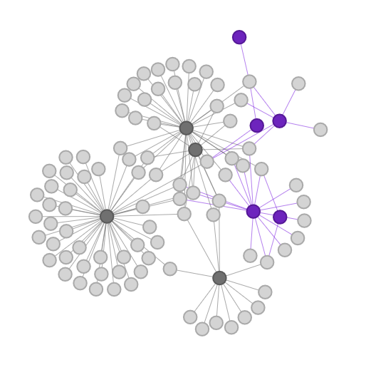
How to read the graphs
Person/Team
Sub-funnel Event
Event
Notes:
Network graph - funnel and sub-funnel structure
Explain what a node and edge are

Slide 8
Graphs
Notes:
So without further ado….
(open HTML)

Slide 9
Analysis
Notes:
Some analysis

Slide 10
Most Interesting Findings
HTSAS is really achieving the most immersion into other programs!
Coaching doesn’t interact as much as we thought – even though we coach sub-funnel teams, most coaching isn’t interacting
SS and FF engaged more and more each year – whatever we’re doing is working (keep pushing programs!)
Sub-funnel behaves the way hypothesized – by level of intensity

Slide 11
Additional Areas of Exploration
Diversity – very difficult to classify
Multiple pronouns / pronoun ambivalence (using multiple sets)
Compound ethnicities (bi-racial, multi-racial, international origin, etc)
Div. data isn’t available for all programs/years (no consistent picture) – could work on a rough picture of gender
Follow through rates between each program (full funnel or sub funnel)
Notes:
Compound ethnicity example – white Hispanic vs. Latinx vs. Black Hispanic. I’m sure everyone knows the relative ins and outs of diversity, but in terms of calculation, it just is very hard to pinpoint the perfect way to do this

Slide 12
Data Cleanup Recs
Dropdown menus are your best friend! Include an “other” category and an extra field for more detailed info.
Take this data in a consistent format:
Pronouns (include as many options as realistic)
Stick with ONE format (she/her vs. she/her/hers
Ethnicity (checkboxes with “other”)
Academics (single choice)
Avoid self-description where possible
Steal from a ”pick list” - use the same language on applications
Notes:
Cute anecdote for avoiding self description – someone listed themselves as “left-handed” on one of the applications for the summer programs, it’s things like that to avoid. Not only can I not analyze written text, people are just inclined to include wrong or irrelevant information.

Slide 13
Appendix
Notes:
If necessary

Slide 14
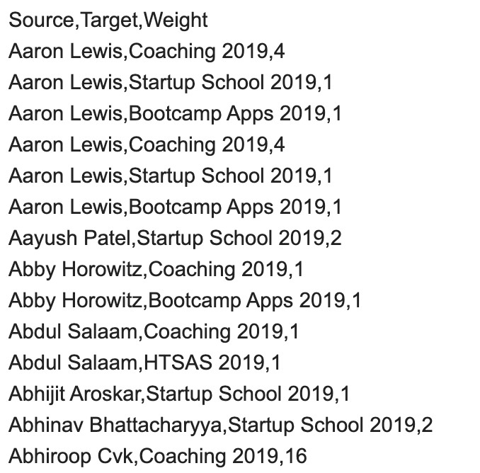
Adjacency
Header
Relationships
Notes:
So the way I analyzed the data is through adjacency lists like this one, here’s what the structure looks

