Slide 1
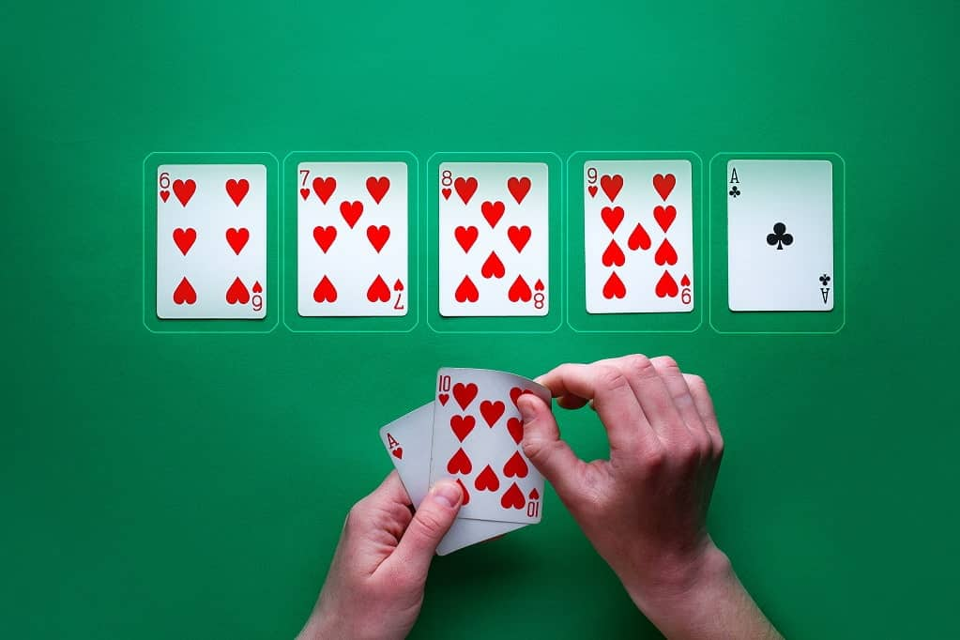
Poker(Simple Texas hold'em)
報告者:許峻瑋

Slide 2
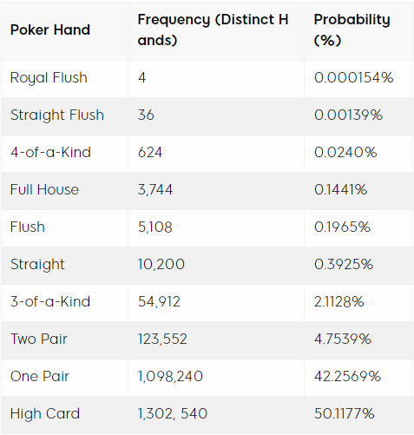
Game Flow
Texas Holdem Hands in Order ->
遊戲開始(洗牌)
發下5張公牌
3. 發下2張底牌
4. 下注
5. 判定兩位玩家牌效決定此回合勝負
Game Setting
兩位玩家(一位電腦/一位自己)
籌碼預設兩位都100
電腦一定會下注
一方籌碼歸零遊戲結束

Slide 3
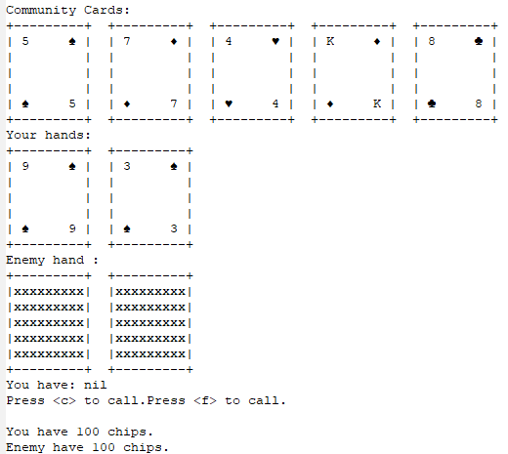
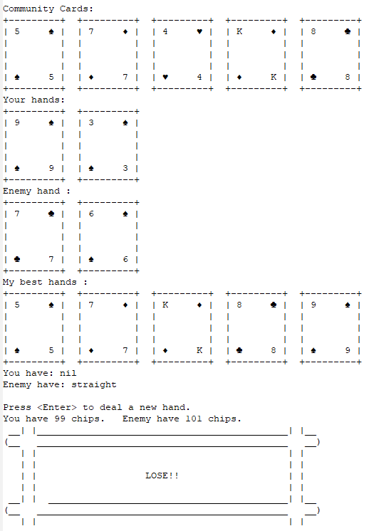
Game Flow
Game Start
Game State 1
Game State 2
Game
End
True
Press f(fold)
Press c(call)
Chip =0
False
Press
Enter

Slide 4
Game
State 1

Slide 5
Game
State 2

Slide 6
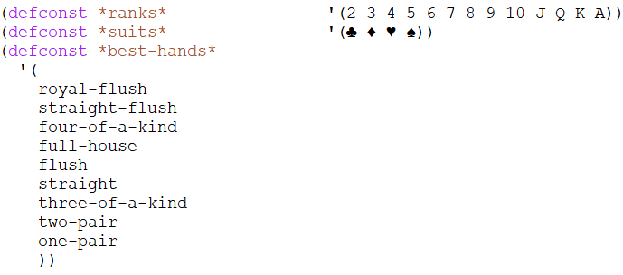
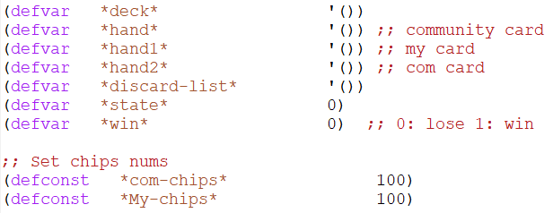
Code - Setting
Cards Setting
Game Setting

Slide 7
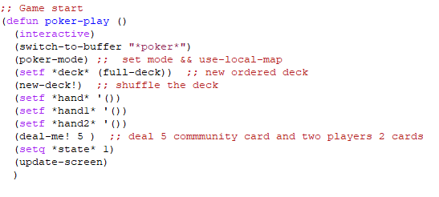
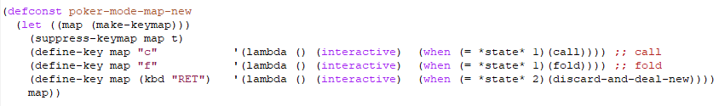
Code – Game Start && Keymap

Slide 8
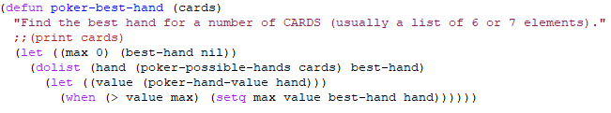
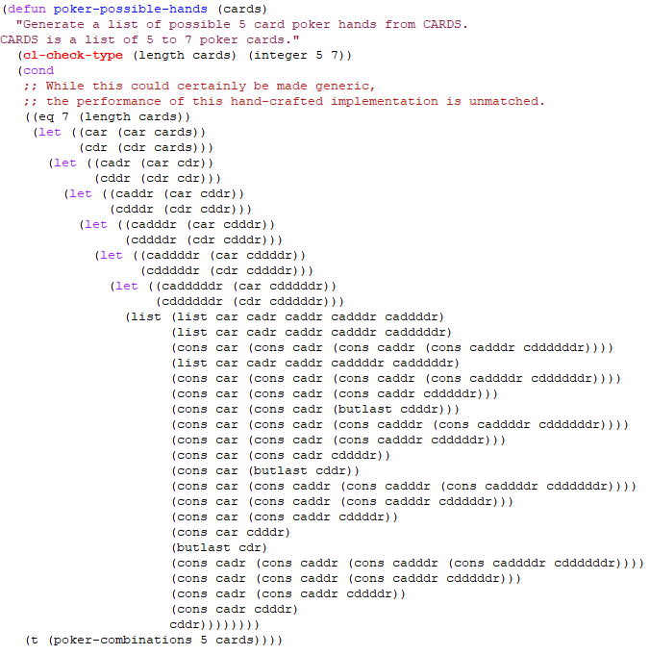
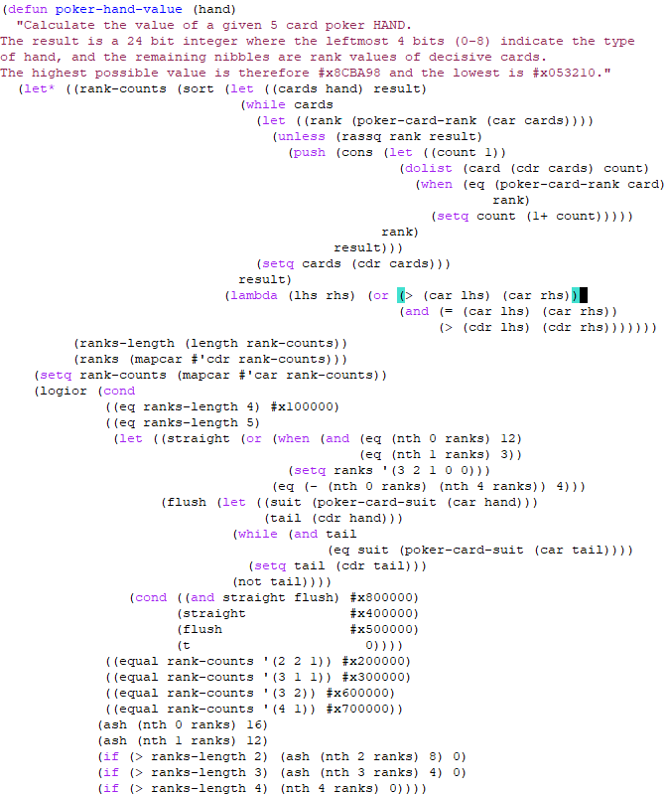
Code – Evaluate hands
List all possible hands
Calculate Max value of all possible hands

Slide 9
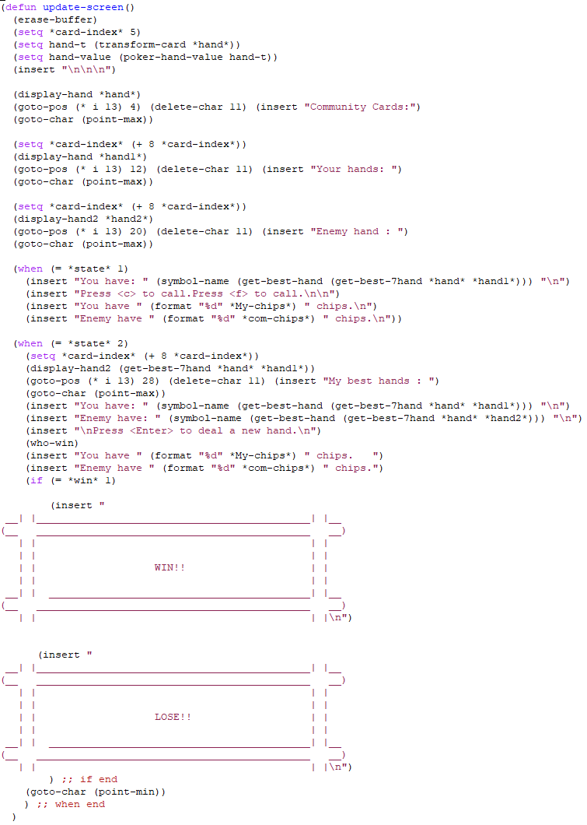
Code – Update screen
Insert cards
Insert wanted content acording to state

Slide 10
謝謝聆聽

