Slide 1



Mass Digitization on Demand
Automation and Terrible Metadata

Slide 2
We Digitize for Remote Requests
1-3 requests for scanning per week
Performed by student assistants
Simple Fact:
The most costly part of any traditional digitization project is metadata creation
We don’t have resources to add metadata sustainably

Slide 3
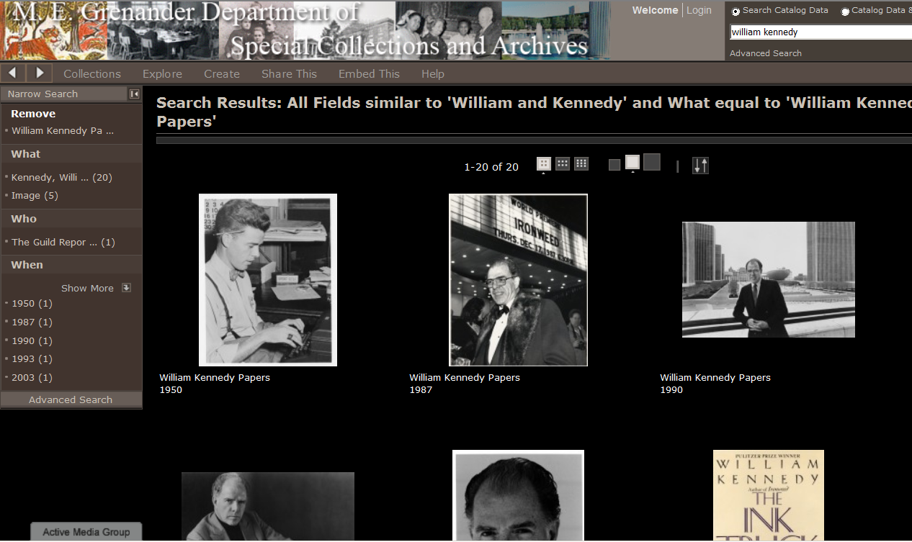
We Need Descriptive Metadata for Discovery

Slide 4
Archives Principles are Designed for Terrible Minimal Metadata
Hierarchy
describe things once
describe by grouping, top-down
Original Order
context aids discovery

Slide 5
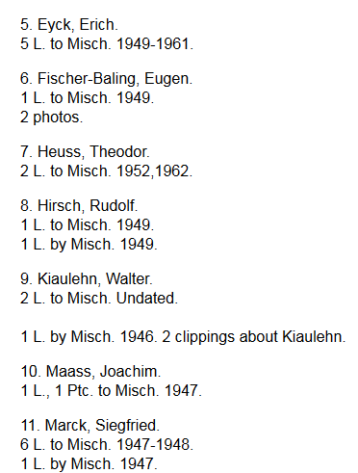
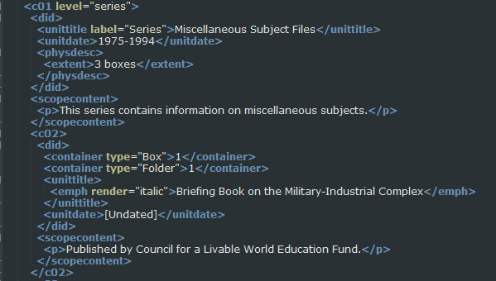
Archival Collections Already Have Metadata!
(But it’s terrible)

Slide 6
Archival Metadata
Uncontrolled at lower levels
Messy history of finding aids
Legacy data (yuck)
doesn’t meet current standards
Technical Barriers
may not be machine-readable
may not be easily discoverable at low levels

Slide 7
Getting Archival Metadata in Shape for Automation
STRICT Format Controls
Hierarchical relationships must be machine-readable
Each archival object at every level must have unique identifier
Hierarchical and automated
nam_ua150-3.1_155.3

Slide 8
EADValidator
Python script packaged as .EXE
Produces HTML report
Line by line rule-based validation
300+ Detailed Rules:
183 at collection-level
34 at series-level
47 at file-level
25 at item-level
12 for each @normal date
Not all data is standardized
Documented set of elements that can be automated

Slide 9
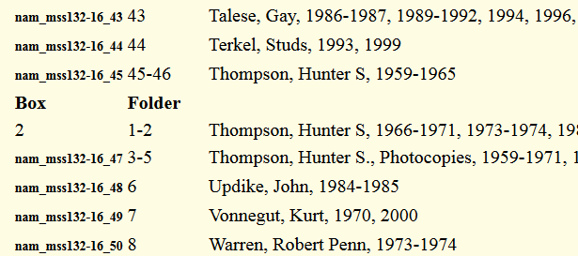

AutoUpload.py
ID is entered as filename
Script runs hourly to check for new files
Finds matching object record in EAD XML

Slide 10
AutoUpload.py
Manages digital object
Uses Bag-it to make preservation copy
For preservation TIFFs uses ImageMagik to make PDF access files
Moves access copy web server

Slide 11
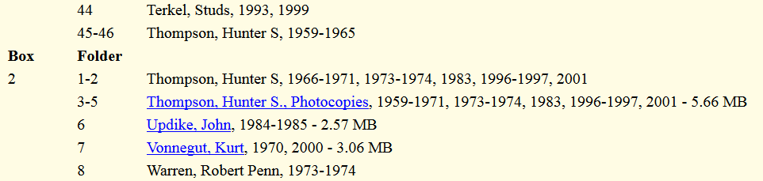
AutoUpload.py
Edits metadata record
Updates running XML log of all actions
Stores copy of original EAD XML
Enters digital object record in EAD
Transforms to EAD to live HTML

Slide 12
Mass Digitization on Demand
Selection based on actual use
Benefits of making our body of materials more accessible as a whole
Making our collections more valuable but giving them a wider reach

