Slide 1
Managing Descriptive Metadata with Open XML
Gregory Wiedeman
University Archivist
University at Albany, SUNY
GWiedeman@albany.edu
@GregWiedeman

Slide 2
Why not ArchivesSpace?
Legacy unstructured HTML finding aids
Finishing large EAD conversion project
Challenging migration of local accession database
Costly: disproportionate membership fee
Little public documentation for automation
Costly: metadata normalization
No ArchiveSpace, yet…

Slide 3
Opportunity
Develop basic metadata infrastructure first, implement more complex tools second
Modularize metadata management
adapt to constant change in tools
Control over exactly how strict to make metadata controls in the immediate term
Yet had to address problems developing systems with open XML
inadequate data controls

Slide 4
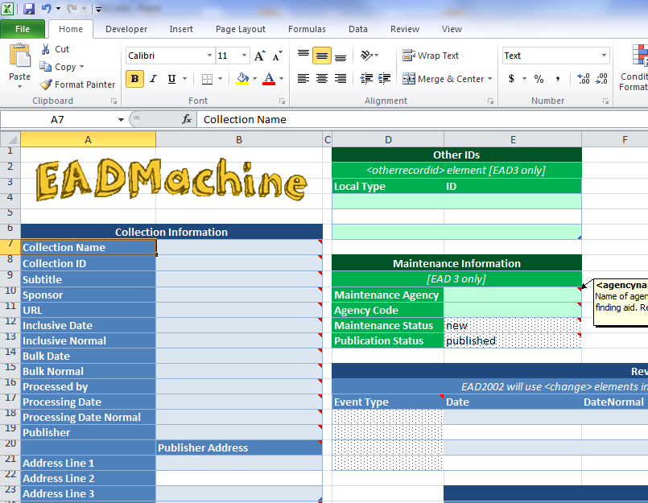
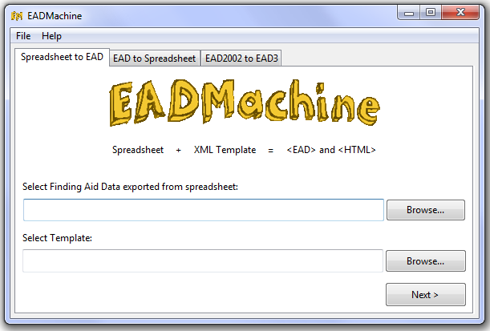

Consistent Creation: EADMachine
Converts between Excel spreadsheet and complete EAD
Creates flat HTML access file
Written in Python, complied to C, runs on any machine without dependencies
Matches local EAD implementation
Basic GUI interface
Works with complex hierarchies up to <c12> (not recommended)
Compatible with EAD2002 and EAD3
https://github.com/gwiedeman/eadmachine

Slide 5
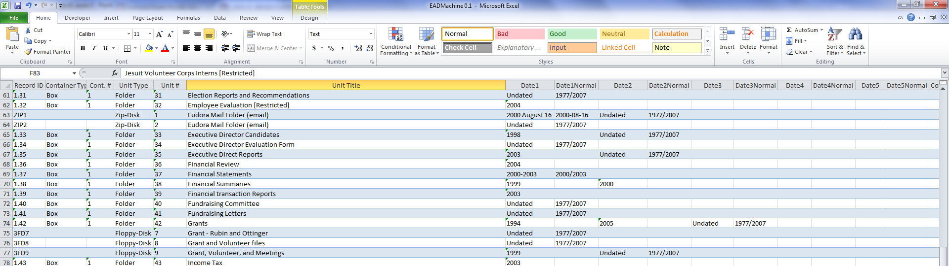
Consistent Creation: EADMachine
Successes and difficulties
First large-scale project, lots of bad code
Long time to develop
Very easy to implement and use in our specific environment
Creates standardized EAD
https://github.com/gwiedeman/eadmachine

Slide 6
Strict Control: EADValidator
Python rule-based validation tool
.EXE file reads all EAD XML files in directory and produces Bootstrap HTML report
Architecture designed also for automated processes
Mandates many DACS rules
300+ Detailed Rules:
183 at collection-level
34 at series-level
47 at file-level
25 at item-level
12 for each @normal date
Does one thing, easy to develop, ~20 hours
Not all data is standardized but have a documented set of what is standardized
https://github.com/UAlbanyArchives/EADValidator

Slide 7
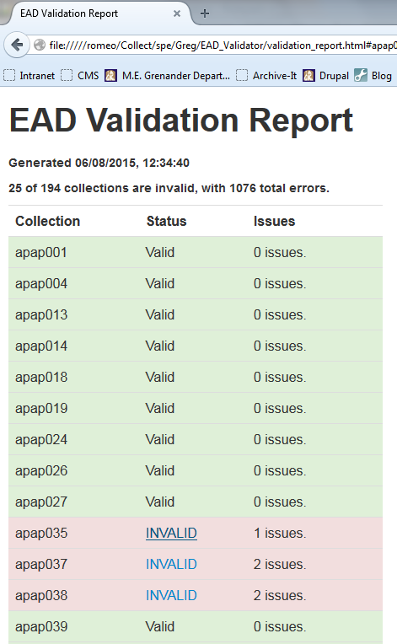
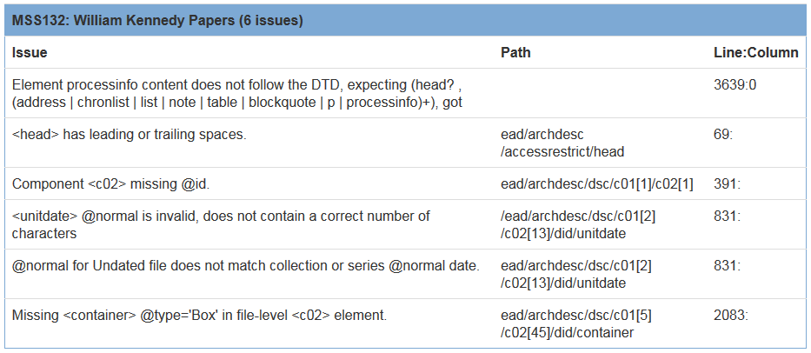
Strict Control: EADValidator
Legacy <physdesc>
<extent> is controlled
<physfacet> is uncontrolled
<extent @unit=”cubic ft.”>23.5</extent>
<physfacet>29 folders and 1 giraffe</physfacet>

Slide 8
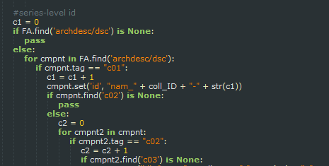
Unique Identification
Simple script to insert ids based on collection ids and context in hierarchy
independent of containers
nam_ua629-1_132
nam_apap101-1.2_49

Slide 9
Automated Records: AutoUpload
AutoUpload.py
Automatically uploads PDF scans based on ID in filename
Archivists reviews scans for restrictions, etc. and copies to upload folder
Automatically updates EAD
Detects new file
Creates log
Logs original finding aid
Bags preservation copy
Uploads access copy
Copies finding aid to working directory
Inserts <dao>
Logs both original and modified record
Validates finding aid
Writes finding aid
converts to HTML
Any errors freezes process, dumps to error folder, sends email
https://github.com/UAlbanyArchives/AutoUpload

Slide 10
Automated Records: AutoUpload
AutoUpload.py
Enables mass digitization based on use
Simple to initially develop, 20-25 hours, more time for testing
Further potential
Automated requests from finding aids
Automated post to twitter?
https://github.com/UAlbanyArchives/AutoUpload

Slide 11

Metadata Infrastructure
Modular system based on simple functional needs
Strict controls enable automation
Can later implement larger tools
New access system in development
Need to adopt preservation system, new accession system.
Can easily adapt to automated description of born-digital records
Gregory Wiedeman
University Archivist
University at Albany, SUNY
Gwiedeman@albany.edu
@GregWiedeman
https://github.com/gwiedeman
https://github.com/UAlbanyArchives

