Slide 1
Customer Churn Prediction
Using Machine Learning to identify at-risk customers
Nosayaba Godswill Osayi

Slide 2
What inspired you to choose this project?
To assess strategies for identifying high risk customers prior to churn.
To implement an end-to-end data science workflow encompassing data cleaning, modeling, and explainability.
Maximize revenue retention by prioritizing early intervention

Slide 3
What did you do?
Customer Churn Prediction
Data Cleaning
Feature Engineering
Modelling
Evaluation

Slide 4
Tools and libraries used
The following tools and libraries were used in this project
Data & Modelling Visualisation Environment
pandas, numpy matplotlib JupyterLab
scikit-learn, xgboost seaborn, shap Python 3.13

Slide 5
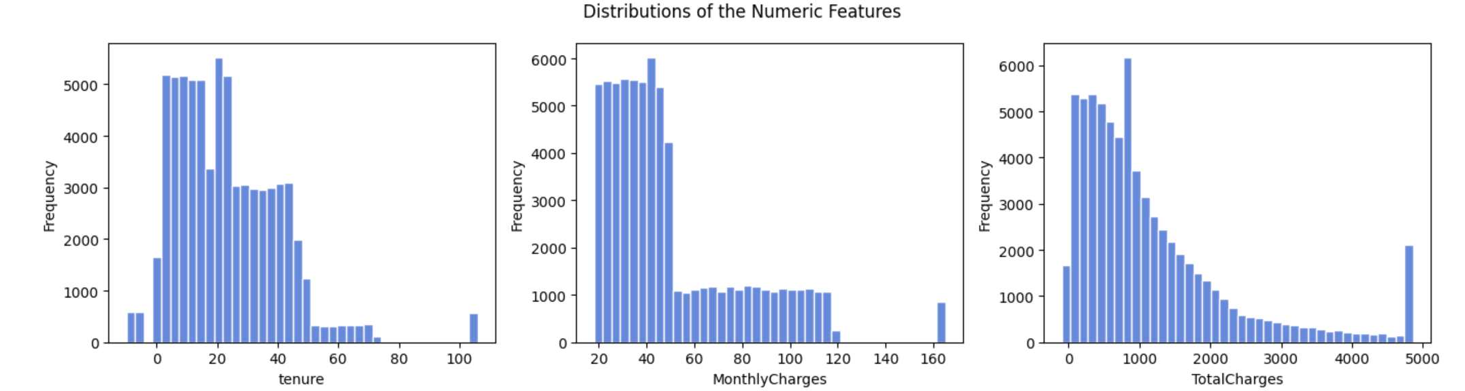
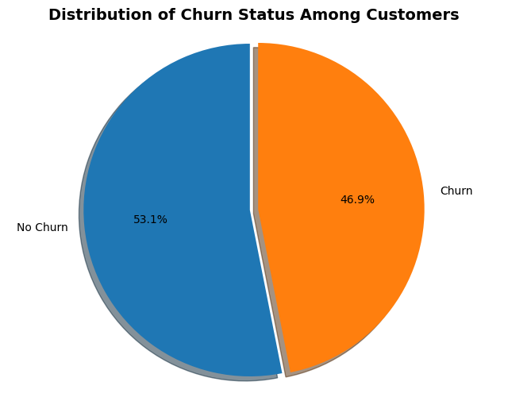
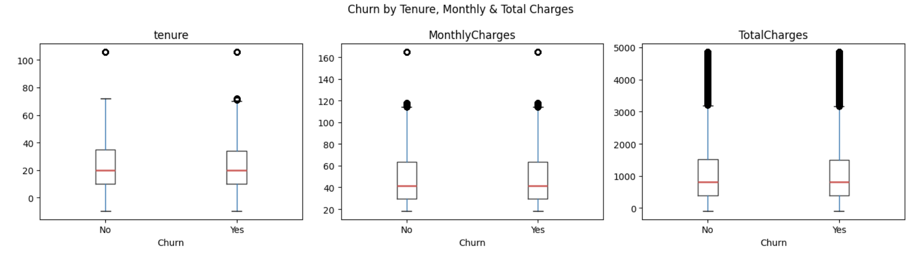
Customer profile and churn behaviour

Slide 6
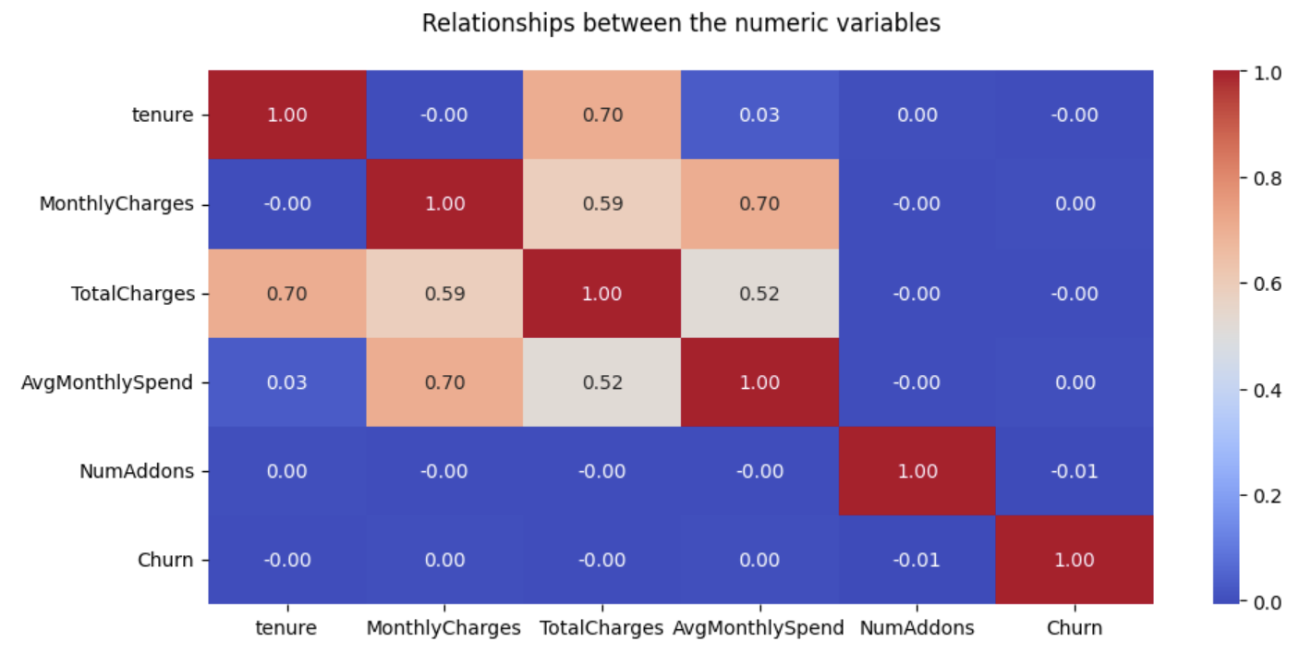
Relationship between the numeric variable

Slide 7
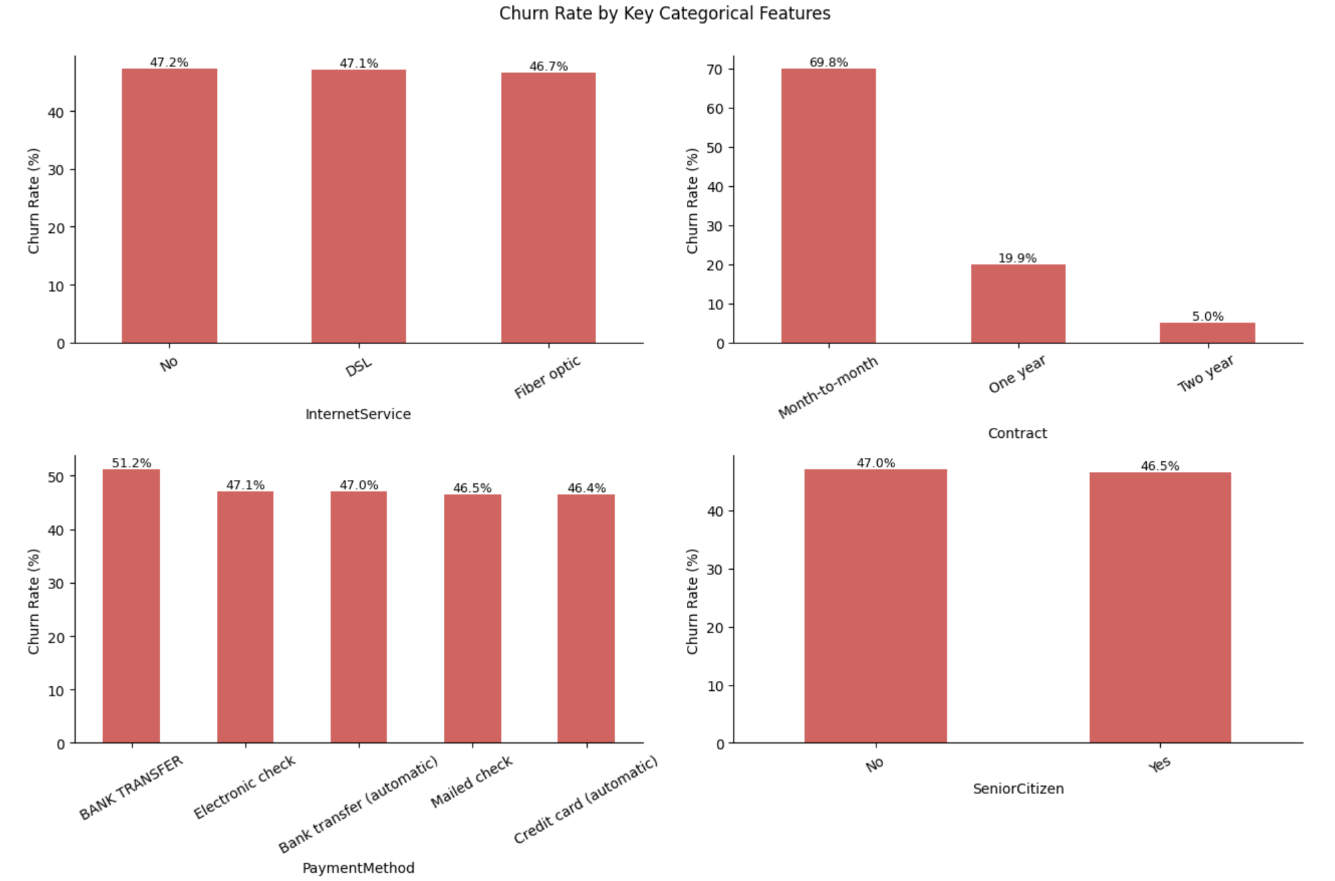
Contract type drives churn
Monthly customer have the highest churn rate

Slide 8
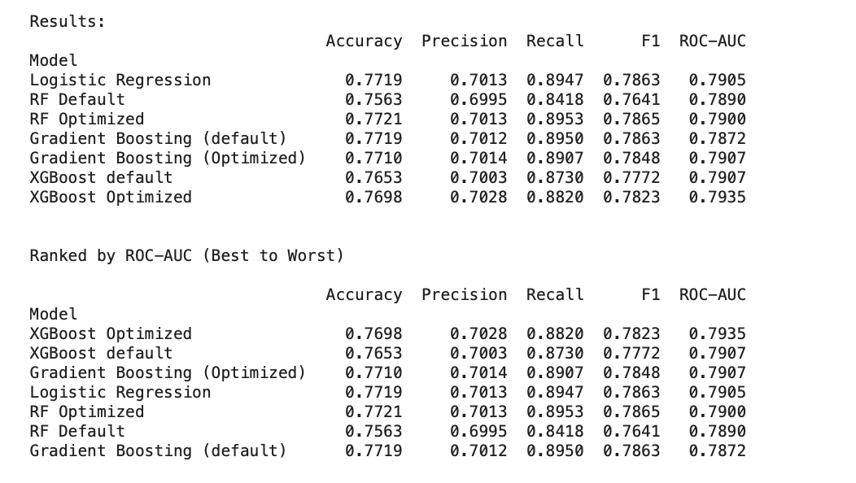
Full model comparison

Slide 9
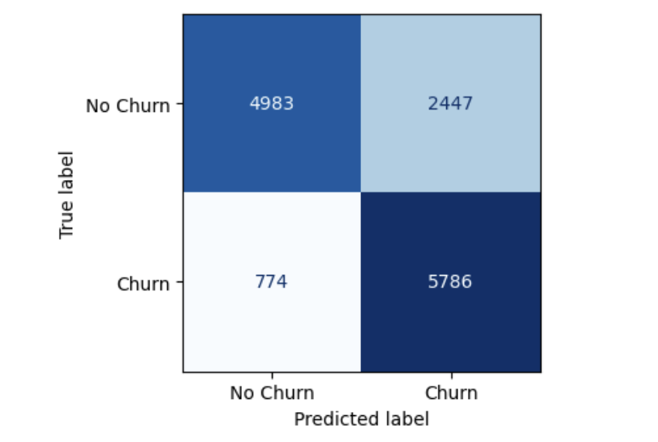
Confusion matrices of Xgboost optimized
Predicted: No Churn Predicted: Churn
Actual: No Churn TN FP
Actual: Churn FN TP

Slide 10
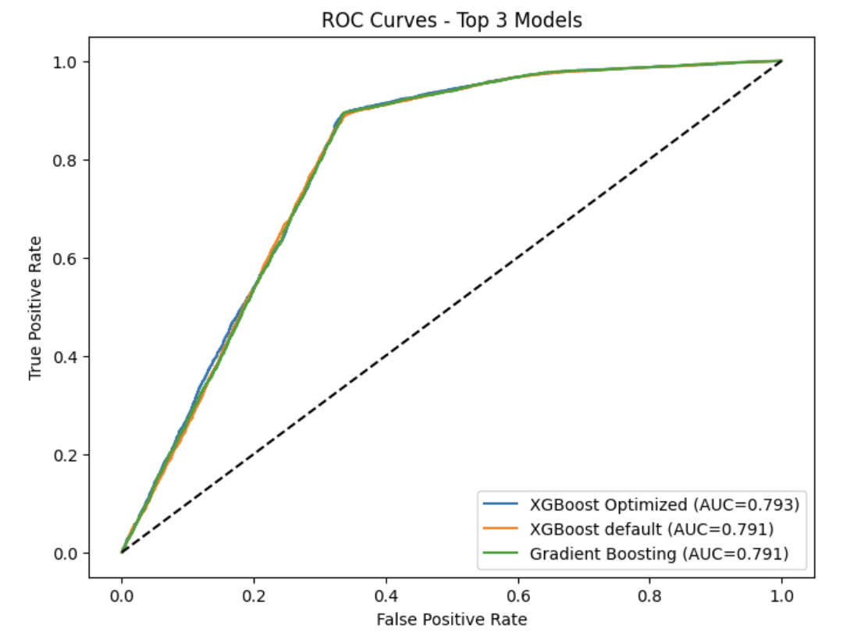
ROC curves of top three models
All three models perform similarly, with XGBoost optimized showing a marginal advantage

Slide 11
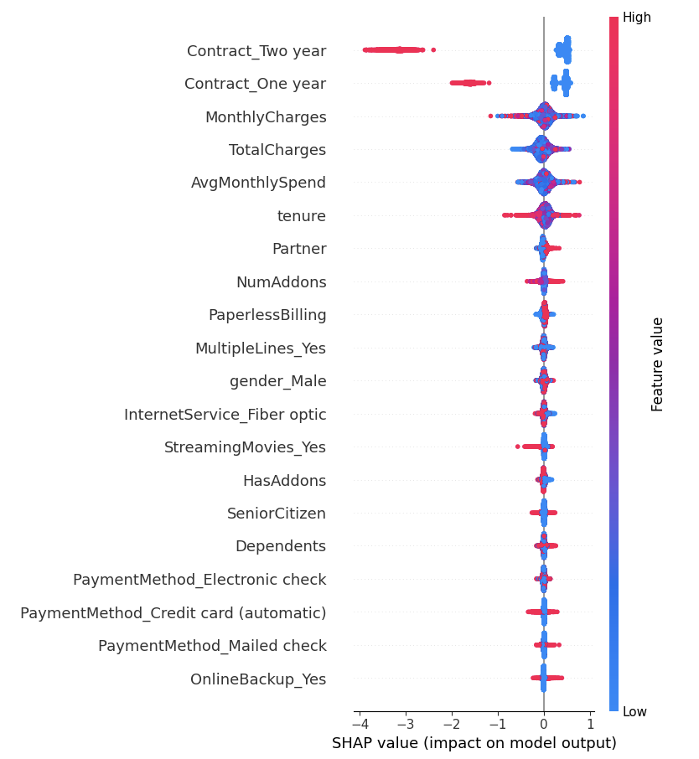
SHAP Feature Importance for XGBoost Optimized

Slide 12
Key Takeaways
Data quality is the foundation — 35 % of effort was cleaning alone
Contract type and tenure are the strongest churn signals
No single model dominates
XGBoost wins on AUC, Logistic Regression wins on recall
Problem-solving and critical thinking

Slide 13
Limitations
No date stamps for sign-up, churn, or billing. This prevents time-to-churn analysis.
Internet service type (Fiber optic) and payment method (Electronic check) correlate with income level.
Very early churners who left before data capture are absent.

Slide 14

Next steps
Deploy model via API to identify at-risk customers in real time
Run A/B tests on retention offers for predicted high risk customer to determine the most effective strategy
Monitor model drift monthly as customer behavour shifts
Expand to multi-class prediction (why customers churn, not just if)

Slide 15
Thank you!

