Slide 1
Would you rather

Slide 2
Would you rather
Agenda
Planning the application
Building the application
Improve the design!
Create test cases
Refactoring

Slide 4
Design Template
Primary
Secondary
#19647e
#37392E
#595b51
#19647e
#28afb0
#FAD4D8
#F9A620
#b2b2b2
https://coolors.co
Big Header
Sub Header
This is for the text

Slide 5
Header and Footer
Primary
Secondary
#19647e
#37392E
#595b51
#19647e
#28afb0
#b2b2b2
#F9A620
https://coolors.co
Big Header
Sub Header
This is for the text
Would you rather
Would you rather
Ask questions and get answers
Ask questions and get answers
Home | New question | Leader Board | Hello, John | Logout
© All rights reserved. Designed by Gustav Willig

Slide 8
Primary
Secondary
#19647e
#37392E
#595b51
#19647e
#28afb0
#FAD4D8
#F9A620
Would you rather
Would you rather
Ask questions and get answers
Ask questions and get answers
Sarah Edo asks:
Home | New question | Leader Board | Hello | Logout
Log In
Select User
Submit

Slide 9
Primary
Secondary
#19647e
#37392E
#595b51
#19647e
#28afb0
#FAD4D8
#F9A620
Would you rather
Would you rather
Ask questions and get answers
Ask questions and get answers
Sarah Edo asks:
Home | New question | Leader Board | Hello | Logout
Log In
Select User
Submit

Slide 10

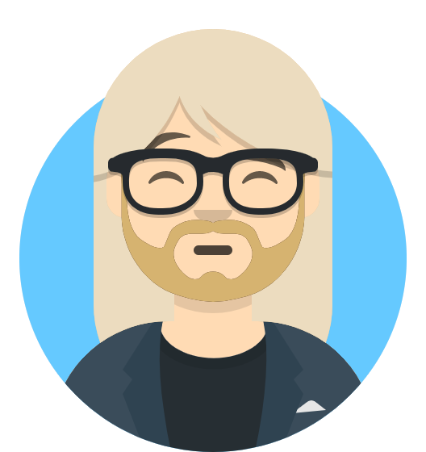
Primary
Secondary
#19647e
#37392E
#595b51
#19647e
#28afb0
#FAD4D8
#F9A620
Would you rather
Would you rather
Ask questions and get answers
Ask questions and get answers
Sarah Edo asks:
Home | New question | Leader Board | Hello | Logout
Unanswered Questions
Answered Questions
John Doe asks:
Would you rather be a react…
View Poll
Tyler McGinnis asks:
Would you rather be a front-end…
View Poll

Slide 11

Primary
Secondary
#19647e
#37392E
#595b51
#19647e
#28afb0
#FAD4D8
#F9A620
Would you rather
Would you rather
Ask questions and get answers
Ask questions and get answers
Sarah Edo asks:
Home | New question | Leader Board | Hello | Logout
Answered Questions
John Doe
Answered questions: 7
Created questions: 3
Score: 10 (First Place)
Tyler McGinnis
Answered questions: 4
Created questions: 3
Score: 7 (Second Place)
Sarah Doe
Answered questions: 3
Created questions: 3
Score: 6 (Third Place)

Slide 12
Primary
Secondary
#19647e
#37392E
#595b51
#19647e
#28afb0
#FAD4D8
#F9A620
Would you rather
Would you rather
Ask questions and get answers
Ask questions and get answers
Sarah Edo asks:
Home | New question | Leader Board | Hello | Logout
John Doe asks:
Would you rather …
Would you rather find $50 yourself?
66% ( 2 out of 3)
My
Vote
View Poll
Would you rather have your best friend find $500?
33% ( 1 out of 3)
View Poll

Slide 13
Primary
Secondary
#19647e
#37392E
#595b51
#19647e
#28afb0
#FAD4D8
#F9A620
Would you rather
Would you rather
Ask questions and get answers
Ask questions and get answers
Sarah Edo asks:
Home | New question | Leader Board | Hello, John | Logout
Create New Question
Would you rather…
Enter Option One
OR
Enter Option Two
Submit

Slide 14
Primary
Secondary
#19647e
#37392E
#595b51
#19647e
#28afb0
#FAD4D8
#F9A620
Would you rather
Would you rather
Ask questions and get answers
Ask questions and get answers
Sarah Edo asks:
Home | New question | Leader Board | Hello | Logout
Unanswered Questions
Answered Questions
John Doe asks:
Would you rather be a healthy…
View Poll
Tyler Mcginnis asks:
Would you rather be a teacher…
View Poll

