Slide 1
Would you rather

Slide 2
Would you rather
Agenda
Planning the application
Building the application
Improve the design!
Create test cases
Refactoring

Slide 3
Would you rather
Agenda
Planning our application
Create design template
Draw all views of the app (create a Wireframe):
Draw boxes around every component
Break Each View Into a Hierarchy of Components:
Code your application
Building a static application (mockup)
Determine What events happened for each component
Define which data each component need (define the store for each component)
Create a Redux store. Connect logger middleware (optional) and Redux Thunk middleware (alternatively, you can use Redux Saga, etc.).
Create for
Building the application
Improve the design!
Create test cases
Refactoring

Slide 4
Apps.js
Events
Get all users
Sort question
Answered
Unanswered
Calculate the Score
Get current login user
Home:
Displays all questions (to categories)
Answered question
Unanswerted question All Users
New Question:
Saves created question
Need the name of the current user
Leader_board: All Users
Login:
Need Name of user

Slide 5
Apps.js
Events
Get all users
Sort question
Answered
Unanswered
Calculate the Score
Get current login user
Home:
Displays all questions (to categories)
Answered question
Unanswerted question All Users
New Question:
Saves created question
Need the name of the current user
Leader_board: All Users
Login:
Need Name of user

Slide 6
Apps.js
Events
Get all users
Sort question
Answered
Unanswered
Calculate the Score
Get current login user
Home:
Displays all questions (to categories)
Answered question
Unanswerted question All Users
New Question:
Saves created question
Need the name of the current user
Leader_board: All Users
Login:
Need Name of user

Slide 7
Store
Define store
authUser
Question
Define function for “getInitialData”
export function getInitialData () { return Promise.all([ _getUsers(), _getQuestions(), ]).then(([users, questions]) => ({ users, questions, })) }

Slide 9
Design Template
Primary
Secondary
#19647e
#37392E
#595b51
#19647e
#28afb0
#FAD4D8
#F9A620
#b2b2b2
https://coolors.co
Big Header
Sub Header
This is for the text

Slide 10
Header and Footer
Primary
Secondary
#19647e
#37392E
#595b51
#19647e
#28afb0
#b2b2b2
#F9A620
https://coolors.co
Big Header
Sub Header
This is for the text
Would you rather
Would you rather
Ask questions and get answers
Ask options and get answers
Home | New question | Leader Board | Hello, John | Logout
© All rights reserved. Designed by Gustav Willig

Slide 13
Component Architecture
Header
H1 – Name of the App
H3 – Slogan
Nav
Footer
Div with Copyright
Login
Card

Slide 14
Primary
Secondary
#19647e
#37392E
#595b51
#19647e
#28afb0
#FAD4D8
#F9A620
<Header>
Would you rather
Would you rather
Ask questions and get answers
Ask questions and get answers
Sarah Edo asks:
Nav
Home | New question | Leader Board | Hello | Logout
Log In
Login form
Select User
Submit

Slide 15
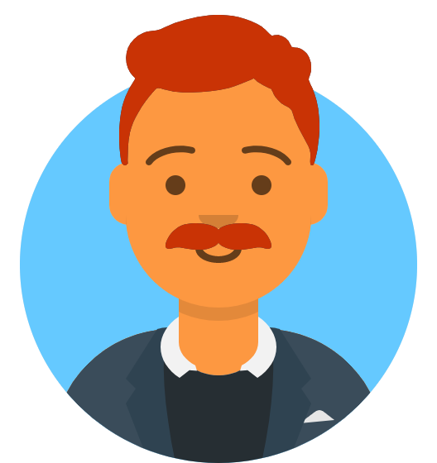
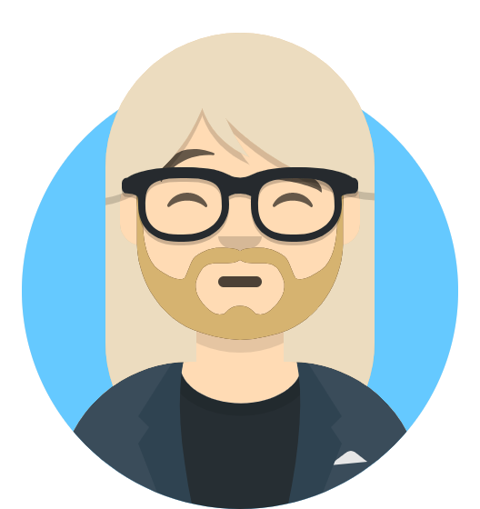
Primary
Secondary
#19647e
#37392E
#595b51
#19647e
#28afb0
#FAD4D8
#F9A620
Would you rather
Would you rather
Ask questions and get answers
Ask questions and get answers
Sarah Edo asks:
Home | New question | Leader Board | Hello | Logout
Unanswered Questions
Answered Questions
John Doe asks:
Would you rather be a react…
Question Card
View Poll
Tyler McGinnis asks:
Would you rather be a front-end…
View Poll
Question_Overview

Slide 16
Primary
Secondary
#19647e
#37392E
#595b51
#19647e
#28afb0
#FAD4D8
#F9A620
Would you rather
Would you rather
Ask questions and get answers
Ask questions and get answers
Sarah Edo asks:
Home | New question | Leader Board | Hello | Logout
John Doe asks:
Would you rather …
Would you rather find $50 yourself?
Would you rather have your best friend find $500?
My Vote
Card
Submit

Slide 17
Primary
Secondary
#19647e
#37392E
#595b51
#19647e
#28afb0
#FAD4D8
#F9A620
Would you rather
Would you rather
Ask questions and get answers
Ask questions and get answers
Sarah Edo asks:
Home | New question | Leader Board | Hello | Logout
John Doe asks:
Would you rather …
Would you rather find $50 yourself?
Would you rather have your best friend find $500?
My Vote
Card
Submit

Slide 18
Primary
Secondary
#19647e
#37392E
#595b51
#19647e
#28afb0
#FAD4D8
#F9A620
Would you rather
Would you rather
Ask questions and get answers
Ask questions and get answers
Sarah Edo asks:
Home | New question | Leader Board | Hello | Logout
Unanswered Questions
Answered Questions
John Doe asks:
Would you rather be a healthy…
View Poll
Tyler Mcginnis asks:
Would you rather be a teacher…
View Poll

Slide 19
Primary
Secondary
#19647e
#37392E
#595b51
#19647e
#28afb0
#FAD4D8
#F9A620
Would you rather
Would you rather
Ask questions and get answers
Ask questions and get answers
Sarah Edo asks:
Home | New question | Leader Board | Hello | Logout
John Doe asks:
Would you rather …
Question
Type:div
Class: Card
Result
Would you rather find $50 yourself?
66% ( 2 out of 3)
My Vote
View Poll
Would you rather have your best friend find $500?
33% ( 1 out of 3)
View Poll

Slide 20
Primary
Secondary
#19647e
#37392E
#595b51
#19647e
#28afb0
#FAD4D8
#F9A620
Would you rather
Would you rather
Ask questions and get answers
Ask questions and get answers
Sarah Edo asks:
Home | New question | Leader Board | Hello, John | Logout
Create New Question
Would you rather…
Enter Option One
OR
Enter Option Two
Submit

Slide 21

Primary
Secondary
#19647e
#37392E
#595b51
#19647e
#28afb0
#FAD4D8
#F9A620
Would you rather
Would you rather
Ask questions and get answers
Ask questions and get answers
Sarah Edo asks:
Home | New question | Leader Board | Hello | Logout
Type:Card
Class: Card
Result
Answered Questions
John Doe
Answered questions: 7
Created questions: 3
Score: 10 (First Place)
Tyler McGinnis
Answered questions: 4
Created questions: 3
Leader Board List
Score: 7 (Second Place)
Sarah Doe
Answered questions: 3
Created questions: 3
Score: 6 (Third Place)

