Slide 1
Would you rather

Slide 2
Project approach
Planning our application
Create design template
Draw all views of the app (create a Wireframe):
Draw boxes around every component
Break Each View Into a Hierarchy of Components:
Code your application
Building a static application (mockup)
Determine What events happened for each component
Define which data each component need (define the store for each component)
Create a Redux store. Connect logger middleware (optional) and Redux Thunk middleware (alternatively, you can use Redux Saga, etc.).
Create for
Building the application
Improve the design!
Create test cases
Refactoring

Slide 3
Component Hierarchy
Apps.js
Footer.js
Header.js
Home.js
Home.js
QuestionCard.js
ResultCard.js
LeaderBoard.js
LeaderBoard.js
UserCard.js
Login.js
NewQuestion.js

Slide 4
Design Template
Secondary
Primary
#19647e
#37392E
#595b51
#19647e
#28afb0
#FAD4D8
#F9A620
#b2b2b2
https://coolors.co
Big Header
Sub Header
This is for the text

Slide 5
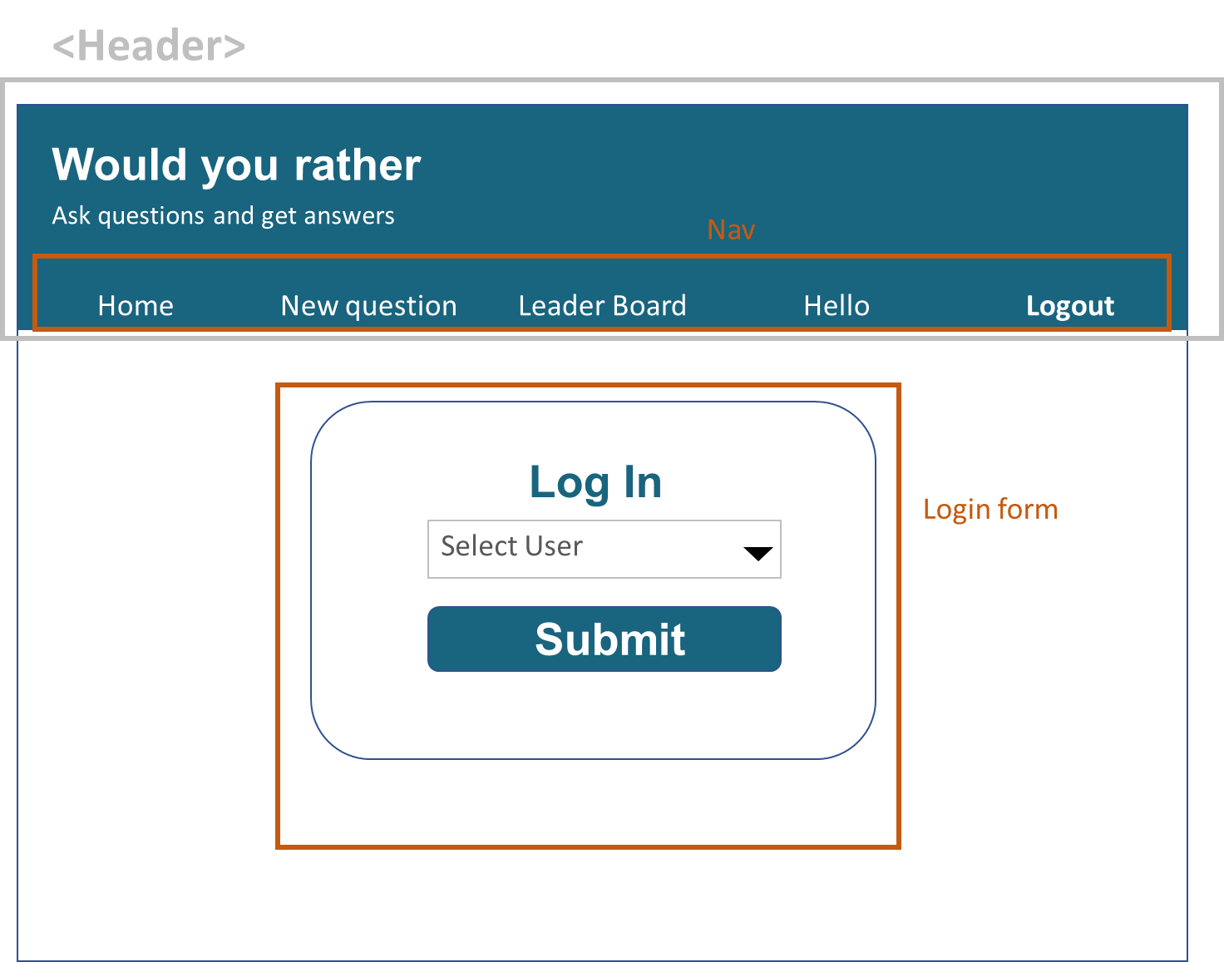
Login.js

Slide 6

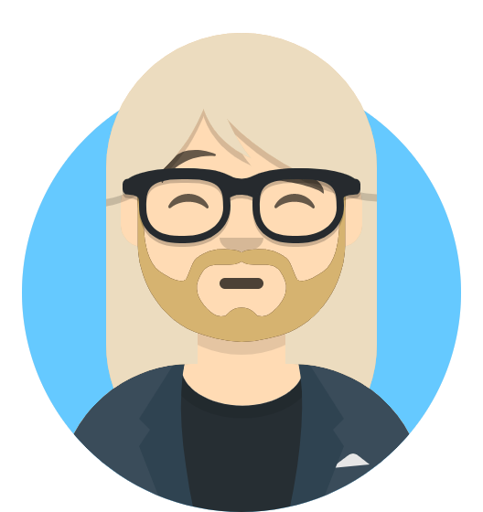
Home.js
Primary
Secondary
#19647e
#37392E
#595b51
#19647e
#28afb0
#FAD4D8
#F9A620
Would you rather
Would you rather
Ask questions and get answers
Ask questions and get answers
Sarah Edo asks:
Home | New question | Leader Board | Hello | Logout
Unanswered Questions
Answered Questions
John Doe asks:
Would you rather be a react…
Question Card
View Poll
Tyler McGinnis asks:
Would you rather be a front-end…
View Poll
Question_Overview

Slide 7
Primary
Secondary
#19647e
#37392E
#595b51
#19647e
#28afb0
#FAD4D8
#F9A620
Home.js
Would you rather
Would you rather
Ask questions and get answers
Ask questions and get answers
Sarah Edo asks:
Home | New question | Leader Board | Hello | Logout
John Doe asks:
Would you rather …
Would you rather find $50 yourself?
Would you rather have your best friend find $500?
My Vote
Card
Submit

Slide 8
Primary
Secondary
#19647e
#37392E
#595b51
#19647e
#28afb0
#FAD4D8
#F9A620
Home.js
Would you rather
Would you rather
Ask questions and get answers
Ask questions and get answers
Sarah Edo asks:
Home | New question | Leader Board | Hello | Logout
John Doe asks:
Would you rather …
Would you rather find $50 yourself?
Would you rather have your best friend find $500?
My Vote
Card
Submit

Slide 9
Primary
Secondary
#19647e
#37392E
#595b51
#19647e
#28afb0
#FAD4D8
#F9A620
Home.js
Would you rather
Would you rather
Ask questions and get answers
Ask questions and get answers
Sarah Edo asks:
Home | New question | Leader Board | Hello | Logout
Unanswered Questions
Answered Questions
John Doe asks:
Would you rather be a healthy…
View Poll
Tyler Mcginnis asks:
Would you rather be a teacher…
View Poll

Slide 10
Primary
Secondary
#19647e
#37392E
#595b51
#19647e
#28afb0
#FAD4D8
#F9A620
Home.js
Would you rather
Would you rather
Ask questions and get answers
Ask questions and get answers
Sarah Edo asks:
Home | New question | Leader Board | Hello | Logout
John Doe asks:
Would you rather …
Question
Type:div
Class: Card
Result
Would you rather find $50 yourself?
66% ( 2 out of 3)
My Vote
View Poll
Would you rather have your best friend find $500?
33% ( 1 out of 3)
View Poll

Slide 11
Primary
Secondary
#19647e
#37392E
#595b51
#19647e
#28afb0
#FAD4D8
#F9A620
NewQuestion.js
Would you rather
Would you rather
Ask questions and get answers
Ask questions and get answers
Sarah Edo asks:
Home | New question | Leader Board | Hello, John | Logout
Create New Question
Would you rather…
Enter Option One
OR
Enter Option Two
Submit

Slide 12

LeaderBoard.js
Would you rather
Would you rather
Ask questions and get answers
Ask questions and get answers
Sarah Edo asks:
Home | New question | Leader Board | Hello | Logout
Type:Card
Class: Card
Result
Answered Questions
John Doe
Answered questions: 7
Created questions: 3
Score: 10 (First Place)
Tyler McGinnis
Answered questions: 4
Created questions: 3
Leader Board List
Score: 7 (Second Place)
Sarah Doe
Answered questions: 3
Created questions: 3
Score: 6 (Third Place)

