Slide 1

https://about.chartipedia.com/

Slide 2
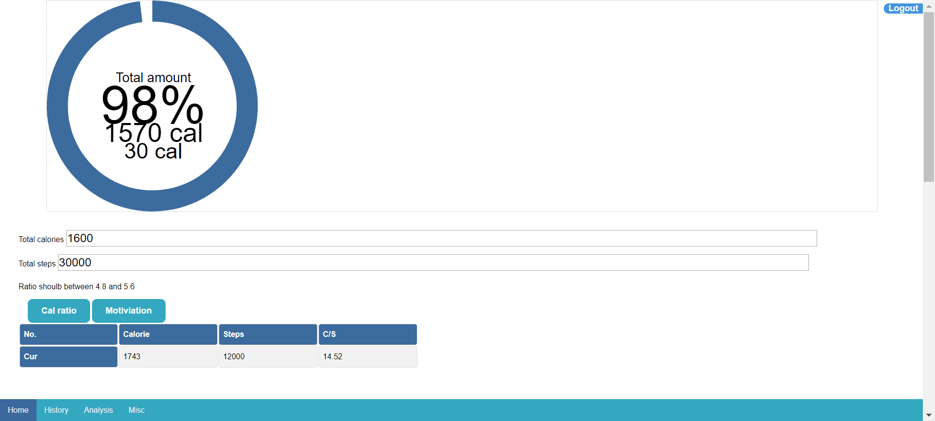

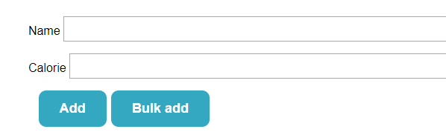


Slide 4
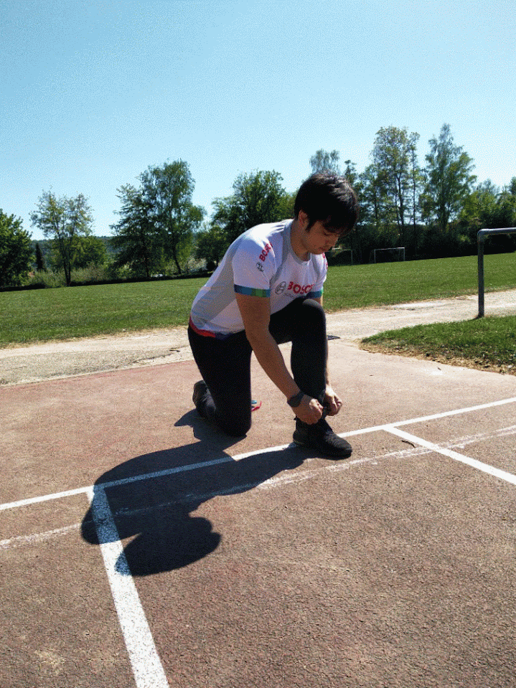
Welcome
https://codepen.io/pen/?&editable=true=https%3A%2F%2Fcodepen.io%2Felectricgarden%2Fembed%2FoNNjbqZ%3Fheight%3D603%26theme-id%3Ddefault%26slug-hash%3DoNNjbqZ%26default-tab%3Dresult%26animations%3Drun%26editable%3D%26embed-version%3D2%26preview%3Dtrue%26user%3Delectricgarden%26name%3Dcp_embed_1

Slide 6


Slide 7
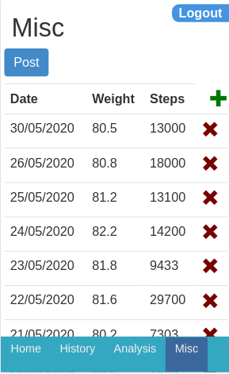

Technical implementation:
New url to get the strike information:
Based on a weight it returns the information:
##Current Strike##:
#1.Step Query all data
#2. Step: Sort by data
#3. Step: Loop for days,
Check if previous day is still under the “weight” if not stop the loop
##Streak Attempts##
#1.Step:try bins
## Longest Strike##
#1.Step:try bins
## Shortest Strike##
#1.Step:try bins
Weight:
Weight_R:
Current Streak: 0 days
Streak Target: 0 days
Streak Attempts: 0 days
Longest Strike: 0 days
Shortest Strike: 0 days

