Slide 1
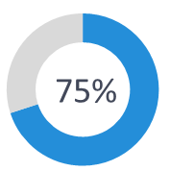


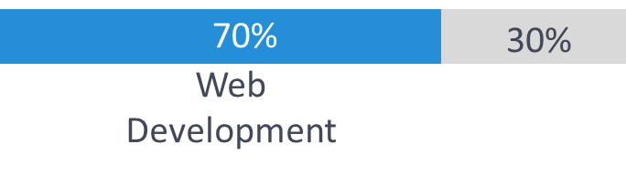
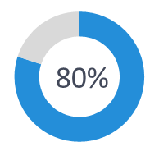
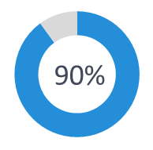
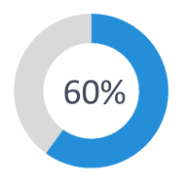
70%
30%
70%
30%
Web Development
Machine Learning (ML)
Web Development
Machine Learning (ML)
80%
90%
90%
90%
80%
80%
HTML/CSS
JavaScript
Python
Deep Learning
Data Engineering
Data Engineering
75%
60%
60%
60%
Image Processing
Natural Language Processing
Natural Language Processing
70%
30%
Web Development
Machine Learning (ML)

Slide 2
80%
90%
60%
60%

