Slide 1
Lec 8: Notable Eclipses in History
© Gerard Williger 2023 U Louisville
Eclipses give exact dates
USEFUL in ancient world
Somewhat predictable in ancient world
Often associated with predictions of bad events
Affected decisions in history!

Slide 2
Confirming Dates with Eclipses
© Gerard Williger 2023 U Louisville
https://www.britannica.com/science/eclipse/Uses-of-eclipses-for-chronological-purposes
Ptolemy’s list of kings (Babylon, Persia, Alexandria, Rome) 910 BC – 30 BC and onward
Babylonians: Dates of death of Xerxes (465 BC, Persia) and Alexander the Great (June 13, 323 BC)

Slide 3
Ancient Eclipse Observations
© Gerard Williger 2023 U Louisville
120 useful timings from Babylonians, 700 - 50 BC
Unfortunately, many more texts are fragmentary
80 by Chinese, mainly 400-600 AD and 1000-1300, more after 1500 (Ming Dynasty)
Nearly 50 by Arabs, 800-1000 AD, Hakemite Tables (Ibn Yunus)
A number (not recorded here) by Greeks
Some descriptions are good to one to a few minutes in time
Help with Earth’s rotation rate changes!

Slide 4
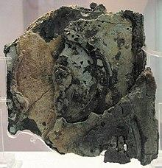
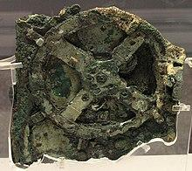
Predictions: Saros Cycle
© Gerard Williger 2023 U Louisville
Combination of cycles of Moon’s phases, regression of line of nodes and advancement of “argument” (position) of perigee
18 years, 11 days, 8 hours
In Greek Antikythera Mechanism (2nd cent. BC)
For both solar, lunar eclipses
Chinese knew about cycle c. 1000 BC
Babylonians also knew cycle several centuries BC
Mayans in 12th cent. predicted 11 July 1991 eclipse (Bricker & Bricker, 2011, “Astronomy in the Maya Codices”, link)
Antikythera Mechanism

Slide 5
Use of Saros Cycle
© Gerard Williger 2023 U Louisville
Great for lunar eclipses – seen by entire night half of Earth
Hard for solar eclipses
Eclipse path long+narrow (~6000x100 miles)
Cycle has 1/3 of day, so 18 years later, next eclipse will differ by 120 deg of longitude (1/3 of Earth) and also slowly change in latitude
Americas, Europe and Asia didn’t communicate well till last few centuries!

Slide 6
22 Oct 2137 BC
© Gerard Williger 2023 U Louisville
Annular solar, China
Ho and Hi, the Drunk Astronomers, failed to predict it
Story may be fictitious or misinterpreted

Slide 7
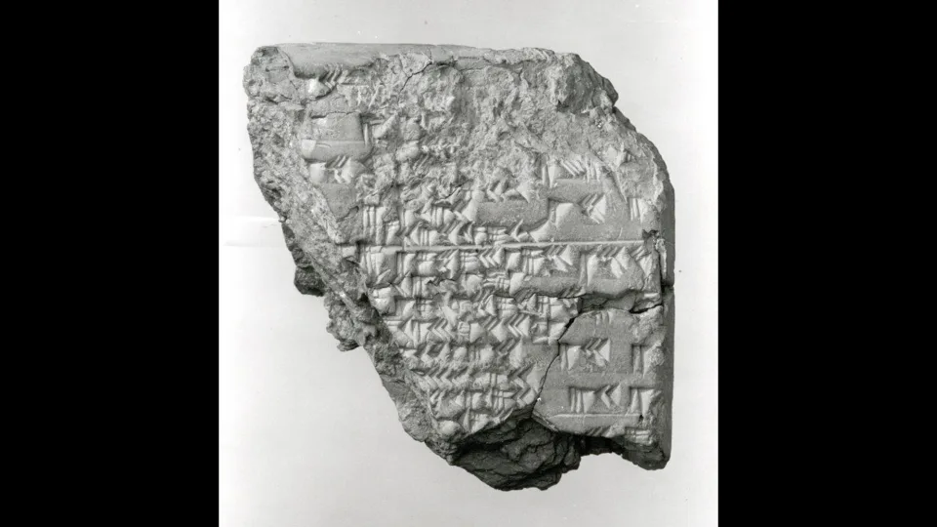
2300-1800 BC
© Gerard Williger 2023 U Louisville
Babylon / Mesopotamia
Could somewhat predict eclipses
Solar eclipse → king would die
Substitute king (criminal) “appointed” for 100 days, king would live as “farmer”
After 100 days, substitute king killed to fulfill prophecy
Backfired c. 1850 BC when real king died by chance
Criminal kept throne
Metropolitan Museum of Art
Eclipses were mysterious
thought to be caused by gods, dragons eating Moon etc.

Slide 8
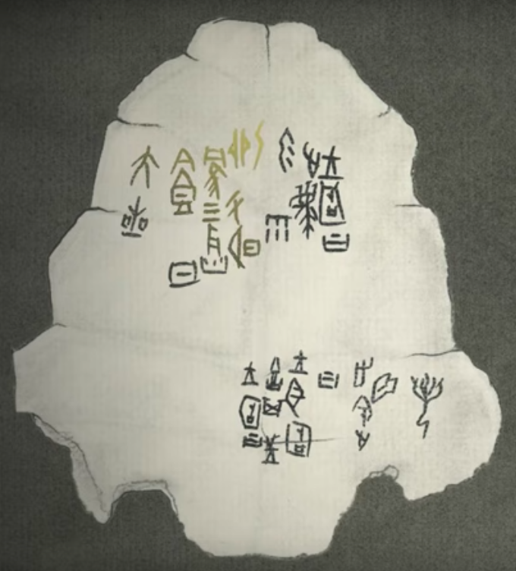
5 June 1302 BC
© Gerard Williger 2023 U Louisville
Total solar, Yin, China
Record carved on a tortoiseshell
“Three flames ate the Sun, and big stars were seen.”
Kevin D. Pang, JPL: probably coronal streamers and planets + bright (“big”) stars
The Chinese could eventually predict eclipses to some degree.

Slide 9
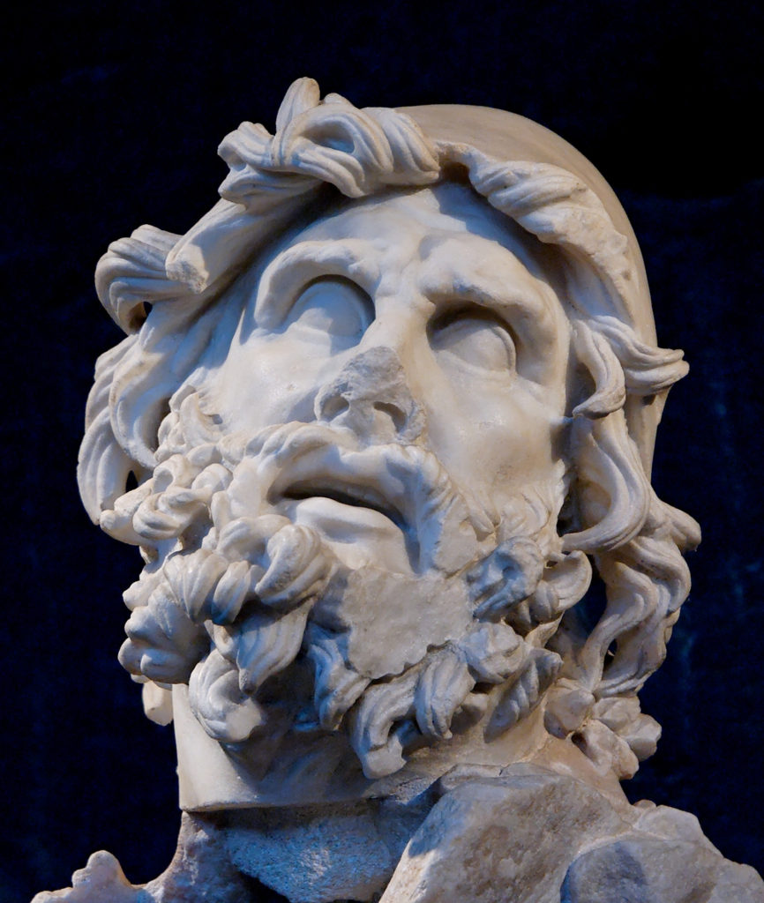
16 Apr 1178 BC
© Gerard Williger 2023 U Louisville
Total solar, Greece-Asia Minor
“Odyssey Eclipse”
" . . . and the Sun has perished out of heaven, and an evil mist hovers over all."
Homer, The Odyssey
Homer, 8th century BC
FYI 4.1’ video, Big Think

Slide 10
21 Apr 899 BC – Double Sunrise
© Gerard Williger 2023 U Louisville
Annular solar, China
“Bamboo Chronicle”, text from 3rd cent. AD from tomb of King Wei Xiang (5th cent. BC)
“During the first year of King Yi, the day dawned twice at Zheng.”
Eclipse was just after sunrise, enough to darken sky again!

Slide 11
6 Apr 647 BC
© Gerard Williger 2023 U Louisville
Solar, Greece, “Archilochus’ Eclipse”
“Zeus, the father of the Olympic Gods, turned mid-day into night, hiding the light of the dazzling Sun; and sore fear came upon men.”
“After this, men can believe anything, expect anything. Don't any of you be surprised in future if land beasts change places with dolphins and go to live in their salty pastures…”
Notes:
FIND REFERENCE SOURCE!!

Slide 12
28 May 585 BC – chance prediction?
© Gerard Williger 2023 U Louisville
Solar, Greece - Asia Minor
allegedly predicted by Thales, acc. to Herodotus
Battle of Medes & Lydians
Eclipse gave message that gods were displeased by war, the two sides made peace.
Probably was lucky prediction!
Need data on Moon’s orbit, depends on narrowness of Moon’s shadow, times between solar eclipses too long
Peace terms:
Alyattes's daughter Aryenis was married to Cyaxares's son Astyages
Halys River established as border between two nations
5.9’ video: The Eclipse that Stopped a War

Slide 13
5th cent. BC – an explanation
© Gerard Williger 2023 U Louisville
Greek Philosopher Anaxagoras was 1st to explain that eclipses were Moon’s shadow on Earth.
Could calculate size of shadow (and Moon) just by asking sailors what they saw in other places
But the Athenians took him to trial and charged him with impiety (sacrilege) and he was sent into exile for the rest of his life
from Brad Schaefer, LSU astronomer

Slide 14
431-430 BC – Peloponnesian War
© Gerard Williger 2023 U Louisville
3 Aug 431 BC -- Oldest European record of a verifiable solar eclipse (annular) -- by the Greek historian Thucydides
430 BC -- The army of Sparta looted Attica for a second time, but Pericles was not daunted and refused to revise his initial strategy. He again led a naval expedition to plunder the coasts of the Peloponnese
Plutarch: just before the sailing of the ships an eclipse of the sun frightened the crews, but Pericles used the astronomical knowledge he had acquired from Anaxagoras to calm them.

Slide 15
28 Aug 413 BC -
© Gerard Williger 2023 U Louisville
Lunar eclipse, 2nd Battle of Syracuse
Athenians sailed to battle. Nicias (superstitious acc. to Thucydides), consulted priests
Recommended waiting 27 days
Syracusans attacked
killed many Athenians/took many ships.
"And when all were in readiness, and none of the enemy had observed them, not expecting such a thing, the moon was eclipsed in the night, to the great fright of Nicias and others, who, for want of experience, or out of superstition, felt alarm at such appearances.”
Should have listened to Anaxagoras!
30 yrs later, Athenians ignored eclipse and didn’t stop

Slide 16
c 383 BC – lesson learned
© Gerard Williger 2023 U Louisville
When the Athenians went on an expedition to Syracuse 30 years later and encountered yet another lunar eclipse, they didn't stop.

Slide 17
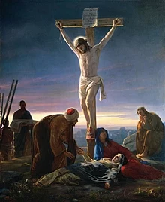
29 or 33 AD – Crucifixion of Jesus?
© Gerard Williger 2023 U Louisville
24 Nov 29 AD or 19 Mar 33 AD
"From noon on, darkness came over the whole land [or, earth] until three in the afternoon.” – Matthew
“the sixth hour, or around noon, and darkness fell over all the land, or all the world” – Mark
“It was now about noon, and darkness came over the whole land [or, earth] until three in the afternoon, while the sun's light failed” -- Luke
Problem: Jesus was crucified the day before Passover, which is at Full Moon

Slide 18
24 Nov 569 – birth of Mohammed
© Gerard Williger 2023 U Louisville
Eclipse noted at birth of Mohammed.
But the world's first Muslims didn't believe that eclipse was a sign from God. Instead, according to Islamic texts called the Hadiths, Mohammed proclaimed "the sun and the moon do not suffer eclipse for any one's death or life."

Slide 19
27 Jan 632 – death of Ibrahim
© Gerard Williger 2023 U Louisville
"When his beloved son Ibrahim died, an eclipse occurred, and rumours of God's personal condolence quickly arose." - prayers of Muhammad
After c. 800 AD, Medieval monasteries began to record eclipses more regularly
Beware: there can be many chronological errors in the records

Slide 20
22 Dec 968 – 1st account of Corona
© Gerard Williger 2023 U Louisville
Leo the Deacon (Byzantine, born c. 950)
"At the winter solstice there was an eclipse of the Sun such as has never happened before... It occurred on the 22nd day of the month of December, at the 4th hour of the day, the air being calm. Darkness fell upon the Earth and all the brighter stars revealed themselves. Everyone could see the disk of the Sun without brightness, deprived of light, and a certain dull and feeble glow, like a narrow headband, shining round the extreme parts of the edge of the disk.”

Slide 21
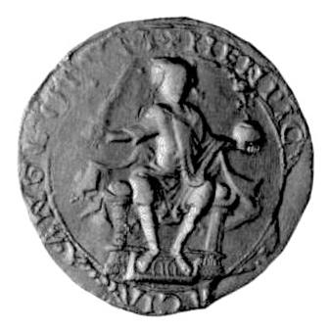
2 Aug 1133 – King Henry I
© Gerard Williger 2023 U Louisville
Henry I of England sailed to Normandy during an eclipse – predicted to die within the year
Year is unclear in records, could be another eclipse in 1135
“hideous darkness agitated the hearts of men” – William of Malmesbury
“… the king died on the following day after St Andrew's Mass-day, Dec 2 [1135] in Normandy” (Anglo-Saxon Chronicle)
In Germany, eclipse there was regarded to predict the sacking of the city of Augsburg and the massacre of its inhabitants by Duke Frederick.
Henry I royal seal (Wikimedia)

Slide 22
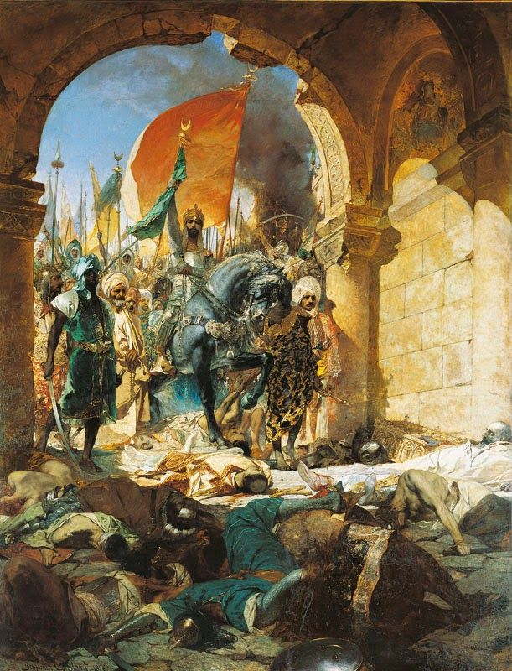
22 May 1453 – Fall of Constantinople
© Gerard Williger 2023 U Louisville
Lunar eclipse during siege by Ottomans, 5 Apr – 29 May
fulfilled a prophecy in the mind of the superstitious when the city fell to the Ottoman Turks seven days later.
Fall of Constantinople, Jean-Joseph Benjamin-Constant, 1876
FYI: 1’ video by William Stickevers

Slide 23
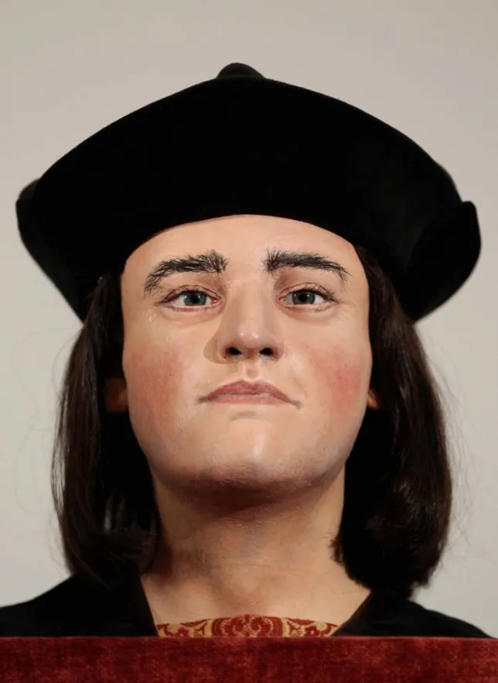
15 Mar 1485 – Richard III died
© Gerard Williger 2023 U Louisville
Solar eclipse
Wife of King Richard III – bad omen
But maybe attributed to bad after the fact
Richard III died at Battle of Bosworth by end of year
Lunar eclipse occurred after he died, may have had much dust in atmosphere to make it red
From Germany: “During meal-time, the Sun was totally eclipsed. This produced such horrid darkness on our horizon for the space of half an hour that stars appeared in the sky. Crazed birds fell from the sky and bleating flocks and fearful herds of oxen unexpectedly began to return from their pastures to their stables."
Richard III, public domain

Slide 24
1 Mar 1504 – Columbus
© Gerard Williger 2023 U Louisville
Lunar eclipse, during 4th voyage, Jamaica
Columbus induced the inhabitants of Jamaica to continue provisioning him and his hungry men, successfully intimidated them by correctly predicting a total lunar eclipse
Used an almanac authored by Regiomontanus of astronomical tables covering the years 1475-1506
Son Ferdinand wrote, “with great howling and lamentation came running from every direction to the ships laden with provisions, praying to the Admiral to intercede with his god on their behalf...”
Columbus got lucky – underestimated size of Atlantic!

Slide 25
1584 – Size of Atlantic
© Gerard Williger 2023 U Louisville
Lunar eclipse
Observed by Sir Walter Raleigh from Roanoke Island, Virginia
Time beginning, end of eclipse
allowed calculation of longitude difference with England
(one of) first determinations of true size of Atlantic Ocean

Slide 26
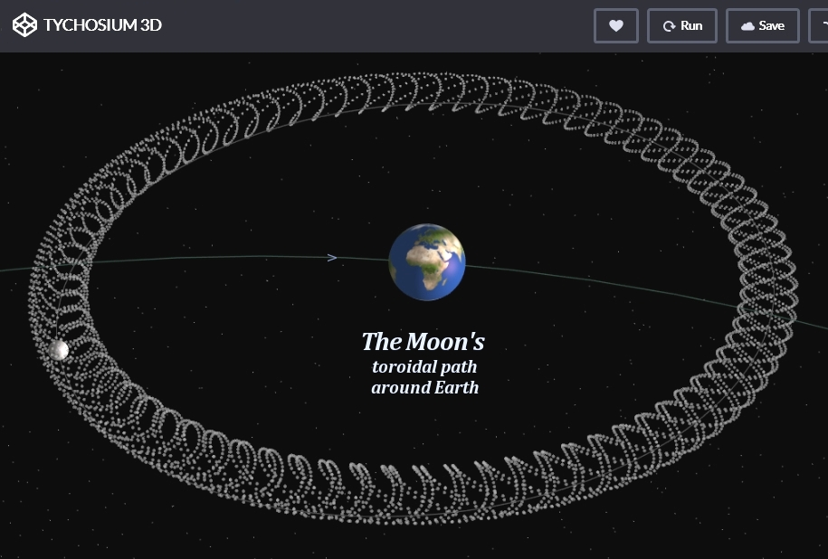
1680 – Newton & Moon’s Motion
© Gerard Williger 2023 U Louisville
“Sir Isaac Newton is supposed to have told his friend Halley that lunar theory ‘made his head ache and kept him awake so often that he would think of it no more.” – “Dynamics of the Sun-Earth-Moon System”, S.M. Alladin & G.M. Ballabh (2005)
Hipparchus (Greece, c. 190-120 BC) knew about apsidal motion (advancement of argument of perigee) ; used in Antikythera Mechanism
Earth-Moon system is torqued (twisted) by tides from Sun, Venus, Jupiter etc. Orbit is not a closed loop!
🡪 Regression of line of nodes, advancement of argument of perigee

Slide 27
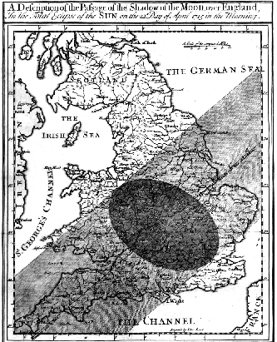
3 May 1715 – Halley predicts
© Gerard Williger 2023 U Louisville
1686 – Edmond Hally named Saros cycle after Suda, a Byzantine lexicon of 11th century
Solar eclipse of 1715, “Halley’s Eclipse” – used Newton’s theory to predict time and path predicted to within 4 minutes in time and 20 miles for path location
Recorded Baily’s Beads, correctly identified as arising in lunar valleys
“… the remaining part of the Sun was reduced to a very fine Horn, whose Extremeties seemed to lose their Acuteness, and to become round like Stars ... which Appearance could proceed from no other Cause but the Inequalities of the Moon's Surface, there being some elevated parts thereof near the Moon's Southern Pole, by whose Interposition part of that exceedingly fine Filament of Light was intercepted.” - Pasachoff, J. 1999, J Astron. Hist. & Heritage

Slide 28
1766, 1777, 1805 – Capt. Cook + Lewis & Clark Expeditions
© Gerard Williger 2023 U Louisville
Total solar, 5 Aug 1766, Capt. Cook
Off coast of Newfoundland, timed start and finish
Compared to timings in England to calculate longitude of Newfoundland more accurately
Cook, J. & Bevis, J., 1767, Phil Transactions of the Roy Soc of London, 57, 215
Total solar, 5 July 1777, Capt. Cook
Tongatapu, Tonga
Lunar eclipse, 1805, Lewis & Clark
Timed eclipse, calculated longitude of N Dakota

Slide 29
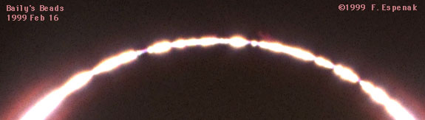
8 July 1842 – Description of Baily’s Beads
© Gerard Williger 2023 U Louisville
Annular, Jedburgh, Scotland
“… when the cusps of the sun were about 40 degrees asunder, a row of lucid points, like a string of beads, irregular in size, and distance from each other, suddenly formed around that part of the circumference of the moon that was about to enter on the sun's disc.” – Francis Baily, 1836, Monthly Notices of the Roy. Astron. Soc., 4, 2

Slide 30
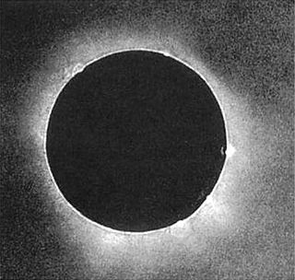
28 July 1851– 1st Daguerrotype
© Gerard Williger 2023 U Louisville
Total, Königsberg, Prussia
By Julius Berkowski
6cm telescope, 84 sec exposure
Daguerrotype: a method of recording images on silver-plated copper, developed by Louis Daguerre and introduced in 1839.
Other observers: Robert Grant, William Swan, Karl Ludwig von Littrow – deduced that prominences were part of sun, because Moon covered/uncovered them

Slide 31
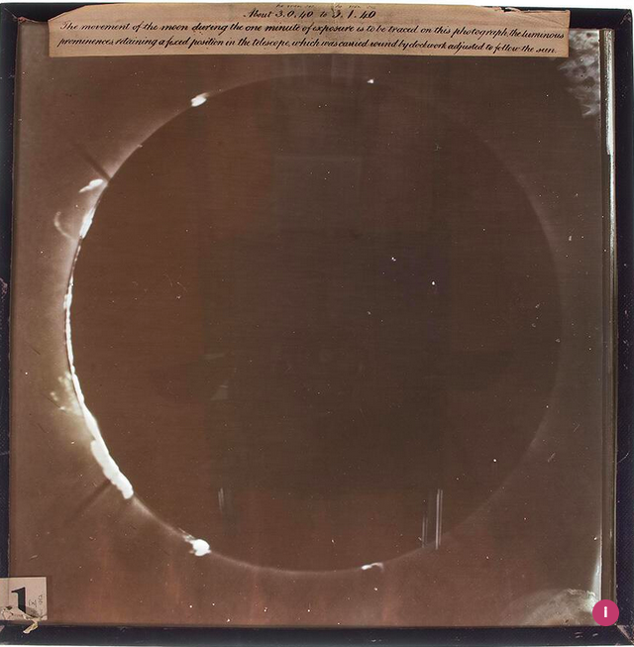
18 July 1860 –1st photo
© Gerard Williger 2023 U Louisville
Total, France + Spain
Wet plate photo, Warren de la Rue
Photograph proved that prominences looked same from all over Earth 🡪 solar in origin
de la Rue’s family had printing business – makes all of UK’s bank notes, contribute to 1/3 of world’s banknote security features

Slide 32
18 Aug 1868, 7 Aug 1869 – More Discoveries
© Gerard Williger 2023 U Louisville
1868 – south Asia
Led to discovery of helium
Predicted by King Mongkut (Rama IV of Siam) to better accuracy than French astronomers who went to observe it
1869 – Alaska, W Canada, NE USA
Charles A Young & William Harkness independently discovered new emission line
Called “coronium”
Identified in 1941 as iron ionized 13 times (by Bengt Edlen, Sweden) → corona has to be hot!

Slide 33
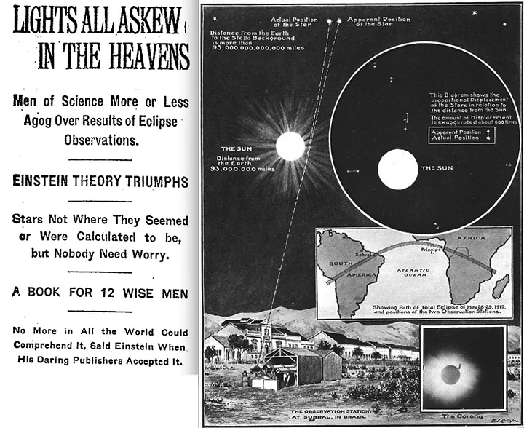
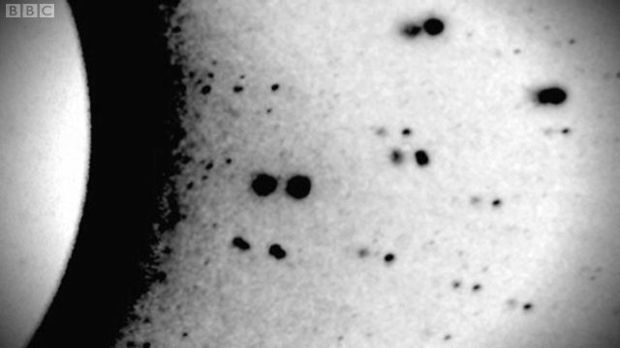
19 May 1919 – Einstein’s Eclipse
© Gerard Williger 2023 U Louisville
Brazil, Africa
Confirmed theory of general relativity
Positions of stars deflected by 1.75 arcseconds during eclipse – exactly as predicted

Slide 34
1970s – Eclipse Hunters & Concord
© Gerard Williger 2023 U Louisville
7 Mar 1970 -- Total solar, up east coast of USA
Huge crowds saw it
Much media coverage
Birth of “Eclipse Hunters” and “Umbraphiles”
Finally dispelled (for many people) suspicion of eclipses, popularized observations
10 July 1972 – 1st eclipse cruise, N Atlantic
30 June 1973
Concord supersonic transport used to observe totality for 74 minutes off coast of Africa
Normal maximum from ground is 7 minutes

Slide 35
Information Age
© Gerard Williger 2023 U Louisville
11 Aug 1999 – Europe
Viewed by millions of people
21 Aug 2017 – USA, coast-to-coast
10 million in path, 20 million travelled for better view
154 million directly saw partial or total eclipse
61 million more electronically saw it (LINK)
Most photographed/videoed eclipse to date
Giant traffic jams
Good 6.1’ summary video – How Eclipses Changed History – from National Public Radio’s Skunk Bear, 2017
3.3’ FYI video on eclipses throughout history – Time Magazine (automated voice)

Slide 36
SUMMARY
© Gerard Williger 2023 U Louisville
Eclipses allow us to date events
Depend on accuracy of records
Eclipses originally feared
Associated with bad omens/events
Influenced decisions in history
Saros cycle known since antiquity
Great for lunar eclipses, hard for solar eclipses
Explanation of eclipses as Moon’s or Earth’s shadow did not dispel superstitions for centuries
Newtonian mechanics allowed accurate predictions of solar eclipses
Led to eclipse expeditions, science discoveries
Photography led to even more scientific discoveries
Eclipses have captured public in Space + Information Age

