Slide 1
Lec 11: A Sampling of Eclipses in Myths/Folklore, Music, Film, TV
© Gerard Williger 2023, U Louisville
Folklore: mostly bad things, some good
Pop Music: used to illustrate darkness, sadness, also luxury tourism
Film/TV:
1st film 1907 - comedy
Through 1980 – mostly drama
Since 1980 - much horror, fantasy, some children’s works
Main themes: predicting eclipses (lost world), supernatural events, punctuating events

Slide 2
Myths/Folklore I – The Bad
© Gerard Williger 2023, U Louisville
Fear
Beast attacks Sun: Chippewa, Peru, Armenia
Demon eats Sun: India, Indonesia (Rahu)
Sun-god angry, sad, ill: Norse
Sun angry due to men’s behavior: Transylvania
Precipitation/ill health
Poison falls from sky: Japan
Eclipse causes plague: Transylvania
Pregnancy/eating
Food cooked during an eclipse is poisonous: India
Women warned to stay inside, not eat, not carry sharp objects (no specific place found)
Beast bites Sun, same fate for unborn baby: Aztecs

Slide 3
Myths/Folklore II – The Good
© Gerard Williger 2023, U Louisville
Celestial Romance
Male Moon chases female Sun: Australia, Germany
Female Moon and male Sun: Benin (“switch out lights”)
Unclear who is who: Tahiti
Good Luck
Finding gold: Bolivia
Nature cleans house: Native North Americans
Inspiring Peace-Making, Order in World
Make peace: Colombia, Togo, Benin
Restore balance in life/Universe: Navajo
LINK: C. Boeckmann, Old Farmers’ Almanac 2024
LINK: Earth Storiez, Chinese and other Mythology
LINK: timeanddate.com: eclipse myths
LINK: J. Deutsch 15 Aug 2017, Smithsonian Magazine
LINK: S. Robinson, 26 July 2018, buzzfeed (lunar eclipses)
LINK: AP, 13 Oct 2023, The Guardian

Slide 4
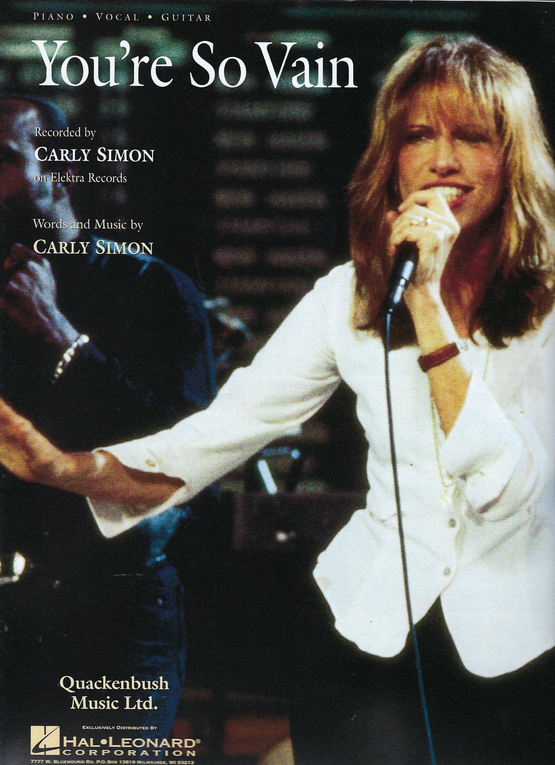
1972 – You’re So Vain (Music)
© Gerard Williger 2023, U Louisville
Written & performed by Carly Simon, No Secrets album, Elektra
Reached #1 in UK
Mentions July 10, 1972 eclipse in N. Atlantic – one of first for tourism by the rich with their own planes
Wikipedia
4.4’,G Lyrics VIDEO, eclipse lyrics at 3:00-3:20
“Well I hear you went up to Saratoga and your horse naturally won Then you flew your Lear jet up to Nova Scotia To see the total eclipse of the sun”

Slide 5
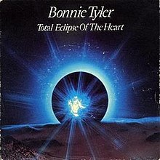
1983 – Total Eclipse of the Heart (Music)
© Gerard Williger 2023, U Louisville
Written by Jim Steinman, performed by Bonnie Tyler, Faster Than the Speed of Night album, CBS-Columbia
#1 in US, went Platinum in 2001
Wikipedia
Steinman: [originally] “vampire love song” … “all about … the power of darkness, love’s place in the dark”
Artwork for UK and some European releases. Columbia.
“…Together we can take it to the end of the line Your love is like a shadow on me all of the time (all of the time)
...
Once upon a time there was light in my life But now there's only love in the dark Nothing I can say A total eclipse of the heart…”
4.5’ VIDEO, Bonnie Tyler, eclipse lyrics throughout, e.g. 3:40-3:20
Eclipse: symbolizes darkness, sadness

Slide 6
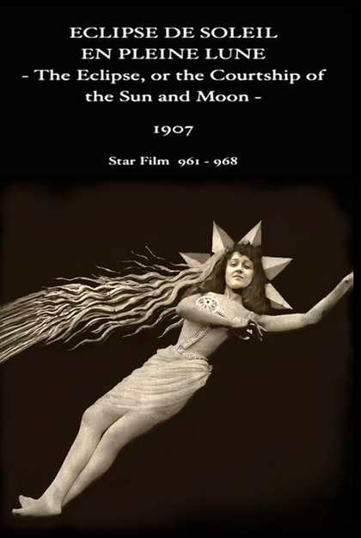
1907 – The Eclipse
© Gerard Williger 2023, U Louisville
French-US, Dir.+Star Georges Méliès, silent, United Global Pictures, IMDB, Wikipedia
Comedy: Courtship of the Sun and Moon
"Plot (IMDB): As the clock strikes twelve, a weary astronomer attempts to answer the impertinent enquiries of his young students by scrutinising an impending lunar eclipse”
Méliès’ film catalogue describes the “man in the sun” and “dainty Diana”, despite 2 male actors
9.5’ VIDEO, astronomers 2:30-4:45, then again 7:45
Eclipse is left to right – as in southern hemisphere!
Meliés also made A Trip to the Moon (1902) - IMDB

Slide 7
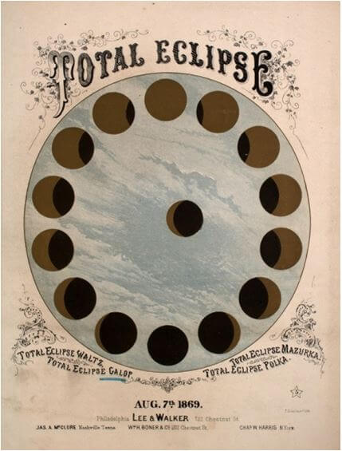
1919 – The Total Eclipse Gallop (Music)
© Gerard Williger 2023, U Louisville
E. Mack, publ. Lee & Walker
Commemorates Aug. 7, 1869 eclipse across Canada and US (incl. Louisville!)
Full band score
1.1’ VIDEO/MUSIC

Slide 8
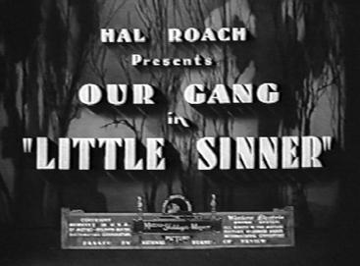
1935 – Little Sinner, Our Gang (short)
© Gerard Williger 2023, U Louisville
Little Rascals, comedy / children, Dir. Gus Meins; Stars George McFarland, Billie Thomas, Eugene Lee; MGM; IMDB, Wikipedia
Plot: Rather than go to church, Spanky decides to go fishing - with disastrous results.
eclipse marks a moment of baptism in a river
Eclipse 1.2’ VIDEO
Total 17.3’ VIDEO
Eclipse is left to right – as in southern hemisphere!
Note: This is from 1935, and does not show society as it is today. It is optional to watch and will not be on any test.
Notes:
Edits

Slide 9
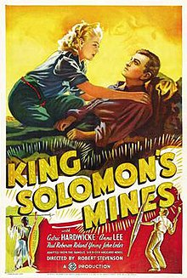
1937 – King Solomon’s Mines
© Gerard Williger 2023, U Louisville
Drama, book adaption, UK, Dir. R Stevenson & G Barkas; Stars Paul Robeson, Cedric Hardwicke, Anna Lee; Gaumont Brit. Pict. Corp, IMDB, Wikipedia
Considered most faithful to book. Lost world genre.
Plot (IMDB): “Fortune hunter Patrick O'Brien has left his daughter Kathy and guide Umbopa to trek across the desert in hopes of finding the fabled diamond mines of Solomon. Worried about her father, Kathy persuades hunter Allan Quartermain to lead a party to rescue him.”
1h17m VIDEO, eclipse at 56:20; 58:40-1:01:04
Other versions 1950, 1985, 2004
Only totality is shown
Eclipse gives explorers chance to show power to natives

Slide 10
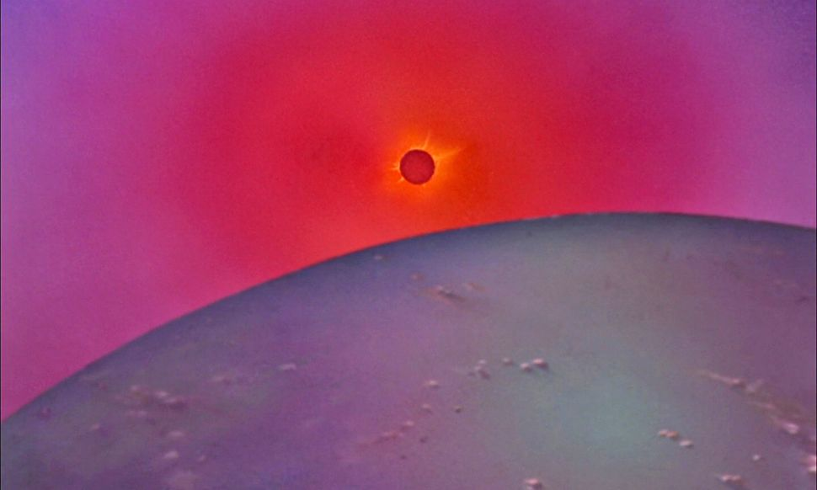
1940 – Fantasia
© Gerard Williger 2023, U Louisville
Children, US, Walt Disney Corp, IMDB, Wikipedia
“The solar eclipse makes the erasure of dinosaur bones by strong earthquakes and tumultuous winds more dramatic, showing that their existence had come and gone.”
LINK for quote
Image credit: Walt Disney Corp. Shown during Stravinsky’s “The Rite of Spring”

Slide 11
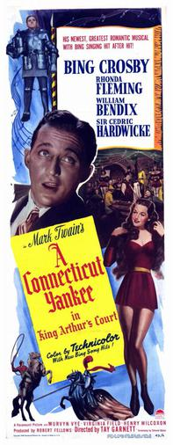
1949 – A Connecticut Yankee in King Arthur’s Court
© Gerard Williger 2023, U Louisville
Comedy/musical, book adaption, US., Dir. Tay Garnett; Stars B Crosby, Sir Cedric Hardwicke, Rhonda Fleming, Paramount, IMDB, Wikipedia
Plot: “Hank Martin, an American mechanic, is knocked out and wakes up in the land of King Arthur"
0.8’ eclipse VIDEO, chance to show power over Sun to locals
Other versions 1970 (1h13m video, anim., CBS), 1978 (58’ video, PBS Once Upon a Classic, won Peabody Award); no eclipse scene found in either
1989 (1h35m video, NBC movie): eclipse 1:24:30-1:27:00, wrong way from England!
Eclipse shown in right direction!
Notes:
Sir Cedric Hardwicke was in “King Solomon’s Mines” (1937), too!

Slide 12
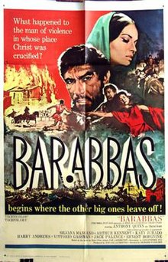
1953, 1961 – Barrabas
© Gerard Williger 2023, U Louisville
1953 Drama, book adaption, Sweden, Dir. Alf Sjöberg; Star Ulf Palme, Sandrews Corp, IMDB, Wikipedia
1h40m video NO ECLIPSE SCENE
1961 US, Dir. Richard Fleischer, Stars Anthony Quinn, Ernest Borgnine, Columbia Pictures, IMDB, Wikipedia
Plot: Story of thief spared when Jesus Christ was crucified.
7.6’ VIDEO, eclipse at 2:10-6:15, marks death of Jesus Christ
Complete 2h17m VIDEO in Spanish, with subtitles
Crucifixion scene delayed to be shot during real solar eclipse in Italy, Feb. 15, 1961! Moon goes from UPPER RIGHT TO LOWER LEFT – CORRECT!

Slide 13
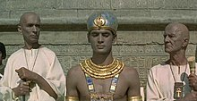
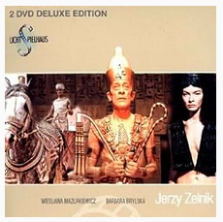
1966 – Pharaoh
© Gerard Williger 2023, U Louisville
Drama, book adaption, Polish, Dir. Jerzy Kawalerowicz; Star Jerzy Zelnik, IMDB, Wikipedia
Plot: “The young pharaoh Ramesses XIII, intends to reform Ancient Egypt. Herhor the priest opposes him [using] … the Solar eclipse … to subdue the crowds.” (Wikipedia.)
2h32m VIDEO, eclipse at 2:17:30-2:21:30, note sharp shadows!
*6.7’ Analysis VIDEO of eclipse scene, in English (VERY good!)
Dysentery broke out among the 1000s of Soviet soldiers involved in the filming
Publicity still
Eclipse never actually shown, just fearful behavior of people while priest acts like he is controlling it.
IMDB

Slide 14
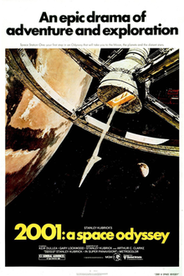
1968 – 2001: A Space Odyssey
© Gerard Williger 2023, U Louisville
Drama, Sci-Fi, short story adaption The Sentinel by A.C. Clarke, US, Dir. Stanley Kubrick; Stars Keir Dullea, Gary Lockwood; MGM; IMDB, Wikipedia
Plot: A voyage to Jupiter to investigate alien artifacts, hijacked by rogue computer
1.7’ VIDEO, opening eclipse of Sun by BOTH Moon and Earth, starts 0:20-1:30
Thus viewed from a moving spacecraft
Eclipse part of visual symbolism. Rising sun? Alignment?
Theatrical release poster by Robert McCall. MGM.

Slide 15
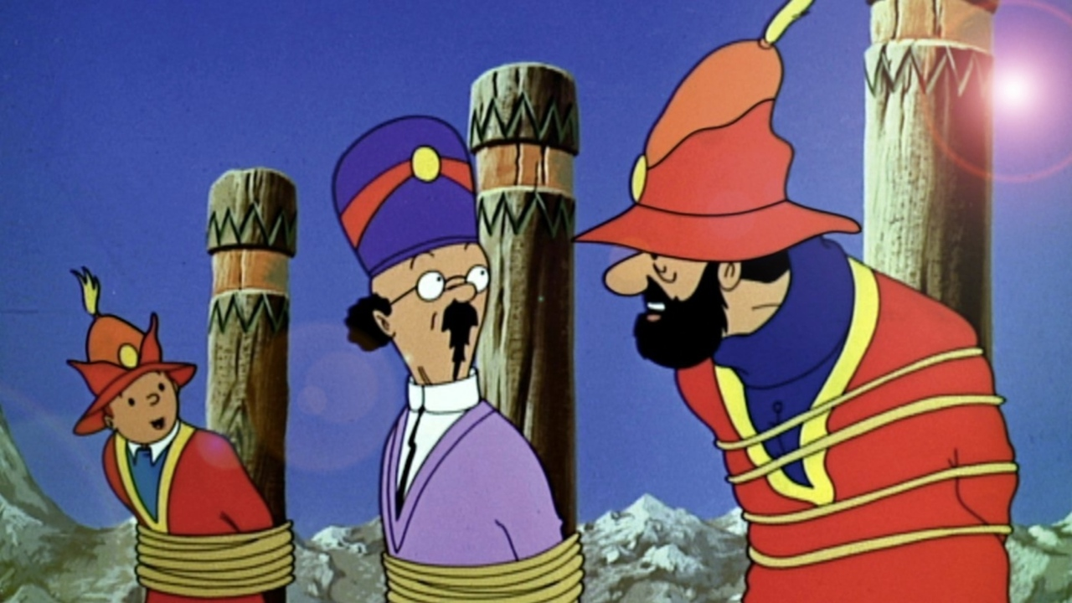
1969, 1991 – TinTin: Prisoners of the Sun
© Gerard Williger 2023, U Louisville
1969 Drama, animated, comic series adaption, French, Prod. Raymond Leblanc; Engl. Stars Michael Williams, Peter Hawkins; Belvision; IMDB, Wikipedia
1991-92 Drama, animated, comic series adaption, French-Belg-Can, Prod. Robert Rea; Engl. Stars Colin O’Meara, David Fox; Nelvant Ltd; IMDB, Wikipedia
Plot: Tintin and Capt. Haddock go to Peru to rescue their friend, Dr. Calculus
Eclipse: used to show power, lost world genre
Image from 1969 film, from vodcaster.telerama.fr
Moon goes right to left – correct if viewing Sun to south, though most of time Sun is in NORTH from Peru
46.4’ VIDEO, 1991-92 TV episode, eclipse 41:00-44:00

Slide 16
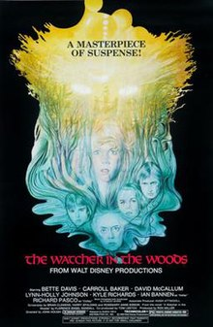
1980 – Watcher in the Woods
© Gerard Williger 2023, U. Louisville
Horror, US/UK, book adaptation, Dir. John Hough & Vincent McEveety; Stars Bette Davis, Carroll Baker; Walt Disney; IMDB, Wikipedia
Plot: When a family moves to a country home, the young girls experience strange happenings that have a link to an occult event years past.
Eclipse: Supernatural plot device, to recreate ceremony done when a young woman disappeared 30 years previously
Based on 1976 novel, F.E. Randall
1h24m complete VIDEO, eclipse at 1:20:30-1:21:10
Moon goes right to left (correct for UK, but rare without up-down motion)

Slide 17
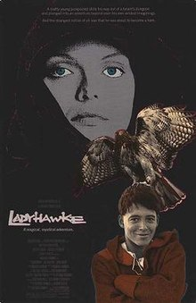
1985 – Ladyhawke
© Gerard Williger 2023, U Louisville
Medieval fantasy, US, Dir. Richard Donner; Stars Matthew Broderick, Rutger Hauer, Michelle Pfeiffer; Warner Bros/20th Cent. Fox; IMDB, Wikipedia
Plot: An evil bishop is spurned by a woman. He turns her into a hawk by day, and her lover a wolf by night.
Eclipse: Supernatural plot device, allows “both day and night”
No eclipse video found, sorry!

Slide 18

1986 – Little Shop of Horrors
© Gerard Williger 2023, U Louisville
Horror/comedy/musical, US, Dir. Frank Oz; Stars Rick Moranis, Ellen Green, Steve Martin; Warner Bros; IMDB, Wikipedia
Plot: A plant is hit by green (evil) solar eclipse ``energy”.
Supernatural plot device
3.1’ VIDEO, eclipse starts 1:10
Moon goes right to left (correct for US, but rare without up-down motion)

Slide 19
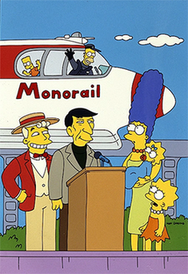
1993 – The Simpsons
© Gerard Williger 2023, U Louisville
Comedy, Animated TV series, US, Marge vs. the Monorail, Dir. Rich Moore; Writer Conan O’Brien; Stars Dan Castellaneta, Julie Kavner, Leonard Nimoy; Fox; IMDB, Wikipedia
Plot: “After receiving a considerable donation of money, Springfield builds a monorail system with Homer as the conductor.” (IMDB) [It goes run-away, stopping – temporarily – during a solar eclipse.]
Eclipse: Comic device
Video is proprietary, Season 4, Episode 12
Promotional artwork. Fox.
Eclipse has Moon go right to left (correct for US), no up/down motion. It appears as a surprise to the town, and is a gag device to temporarily stop the solar-powered train.

Slide 20
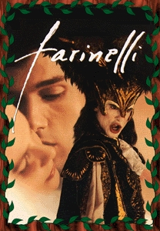
1994 – Farinelli
© Gerard Williger 2023, U Louisville
Drama, French-Italian, Dir. Gérard Corbiau; Stars Stefano Dionisi, Enrico Lo Verso, Elsa Zylberstein; Sony; IMDB, Wikipedia
Plot: “the life and career of the 18th-century Italian opera singer Carlo Broschi, known as Farinelli, considered the greatest castrato singer of all time” - Wikipedia
Carlo sings for King Philip of Spain during a solar eclipse, to mark a moment of forgiveness for his composer brother. Plot device: dramatic moment.
Theatrical release poster. Sony Pictures Classics.
Moon goes left to right, incorrect for Italy!
Golden Globe, Best Foreign Film 1995
3.9’ VIDEO, eclipse at very beginning
Notes:
Eclipse as a spectacle reminiscent of art showing Leipzig 1715, Vienna 1842 eclipses

Slide 21

1995 – Dolores Claiborne
© Gerard Williger 2023, U Louisville
Drama, US, Dir. Taylor Hackford; Stars Katy Bates, Jennifer J Leigh, David Strathairn; Columbia Pictures; IMDB, Wikipedia
Plot: abused wife causes her husband’s death during an eclipse
Eclipse: used to mark a time of death
4.5’ VIDEO, eclipse starts 1:55-4:30
Theatrical release poster. Columbia Pictures.
Moon goes from lower right to upper left – good from US.
Goof: She is shown driving the night before under a Full Moon – impossible!

Slide 22
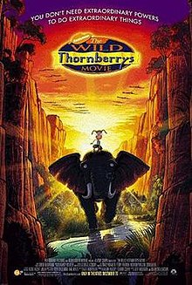
2002 – Wild Thornberrys
© Gerard Williger 2023, U Louisville
Children, US, Dir. Jeff McGrath & Cathy Malkasian; Stars Lacey Chabert, Tom Kane, Lynn Redgrave; Paramount + Nickelodeon; IMDB, Wikipedia
Plot: family expedition to film an eclipse runs into adventure
Eclipse: shows a destination for travel
1.6’ VIDEO, eclipse starts 1:00
Theatrical release poster. Paramount + Nickelodeon
Moon goes from left to right – very possible from Kenya (tropics).

Slide 23
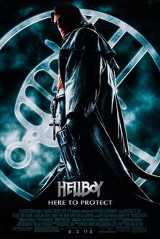
2004 – Hellboy
© Gerard Williger 2023, U Louisville
Superhero, US, Dir. Guillermo del Toro; Stars Ron Perlman, Selma Blair, John Hurt; Sony, Columbia, Revolution Studios; IMDB, Wikipedia
Plot: “A demon raised from infancy after being conjured by and rescued from the Nazis, grows up to become a defender against the forces of darkness.” (IMDB)
LUNAR Eclipse: enables supernatural powers
10.3’ VIDEO, eclipse at 3:30-3:45
Theatrical release poster. Sony, Columbia, Revolution Studios

Slide 24
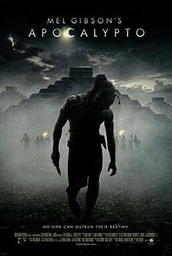
2006 – Apocalypto
© Gerard Williger 2023, U Louisville
Drama/Historical Action, US, Dir. Mel Gibson; Stars Rudy Youngblood, Raoul Trujillo; Buena Vista Pictures; IMDB, Wikipedia
Plot: “In 1502, a young man is captured and brought to a Mayan city for human sacrifice.” (Wikipedia)
Solar Eclipse: a sign from the gods to spare men being sacrificed
5.1’ VIDEO, eclipse at 1:40-4:40
Theatrical release poster. Buena Vista Pictures.
Moon goes right to left, mostly good for Mayan lands, needs up-down motion

Slide 25


2006-17 Other TV Series
© Gerard Williger 2023, U Louisville
2006-10; 2015 Heroes
Eclipses enable/take away magic powers
Exec Producers Tim Kring et al., Stars Hayden Panettiere et al., NBC + Universal, IMDB, Wikipedia
1’ TRAILER 2015 Heroes Reborn
2014-17 The Strain
Eclipse: supernatural, enables vampires to spread a virus
0.5’ VIDEO trailer – eclipse goes wrong way!
Exec Producers Guillermo del Toro, Chuck Hogan et al., Stars Corey Stoll et al., FX
IMDB, Wikipedia
Logo, Heroes, NBC + Universal
Title card, The Strain, FX

Slide 26


2017/23 – Verónica, Sr. Death, The Eclipse
© Gerard Williger 2023, U Louisville
Horror, Span., Dir. Paco Plaza; Apache Films
Verónica: stars Sandra Escacena,: IMDB, Wikipedia (2017)
Supernatural events start in Madrid during a 1991 eclipse – in reality July 11, 1991 eclipse was in Central/S America!
Sr. Death: prequel, stars Aria Bedmar, IMDB, Wikipedia (2023)
Sr. Death: A novice nun has supernatural powers
The Eclipse, 2022 TV Series, an eclipse is connected to a curse, IMDB
Theatrical release posters, IMDB – LINK –Véronica, LINK – Sr. Death

Slide 27
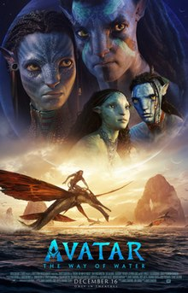
2022 – Avatar: The Way of Water
© Gerard Williger 2023, U Louisville
Science Fiction, US, Dir. James Cameron; Stars Sam Worthington, Zoe Saldaña, Sigourney Weaver, Steven Lang, Kate Winslet; 20th Cent. Studios; IMDB, Wikipedia
Plot: “A blue-skinned humanoid, under … human threat, seeks refuge [on] Pandora” (Wikip.)
Eclipse is seen from a habitable moon, regularly, used for dramatic effects e.g. during a battle LINK
0.5’ VIDEO, good illustration
Theatrical release poster. 20th Century Studios

Slide 28
Still More (unfiltered) Eclipse Movies/TV
© Gerard Williger 2023, U Louisville
Wikipedia list (with links, Feb. 23, 2024)
1981 Bloody Birthday (Horror), 1981 Dragonslayer (Fantasy), 1988 Seventh Sign (H)
1994 Eclipse (Mockumentary), 1998 Knight in Camelot (F), 1999 Almanach 1999-2000 (M), 1999 From Dusk till Dawn 2: Texas Blood Money (H), 1999 Judy Berlin (Drama)
2000 Pitch Black (H), 2001 Lara Croft: Tomb Raider (Sci-Fi), 2002 Darkness (H), 2003 Land Before Time X (Children) , 2005 Wolf Creek (H), 2009 House of the Devil (H)
2016 Rogue One: A Star Wars Story (SF), 2017 Gerald’s Game (D), 2017 Perfect Strangers (Comedy), 2019 The Kid Who Would be King (F)

Slide 29
SUMMARY
© Gerard Williger 2023, U Louisville
Eclipses in film, music for > 100 years
Before 1970:
comedy, adaptations of classic books
Eclipses used in lost world or prediction contexts
Science fiction for “2001, A Space Odyssey”
Since 1980:
Many horror, fantasy, science fiction movies
Also comedy, historical fiction
Eclipses often used as supernatural events or to punctuate moments
Many portrayals reflect folklore themes
A number of eclipses shown in wrong direction!

