Slide 1
BB84 Protocol
Graeme Jacobson

Slide 2
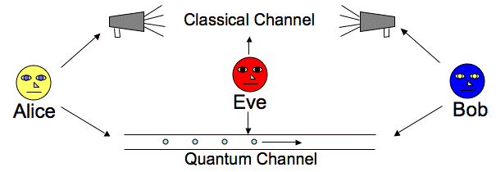
General Overview
Secure method of key creation and distribution
Can pass encrypted messages on classical channel
Create private key on quantum channel
Utilizes non-cloning theorem and measuring observables

Slide 3
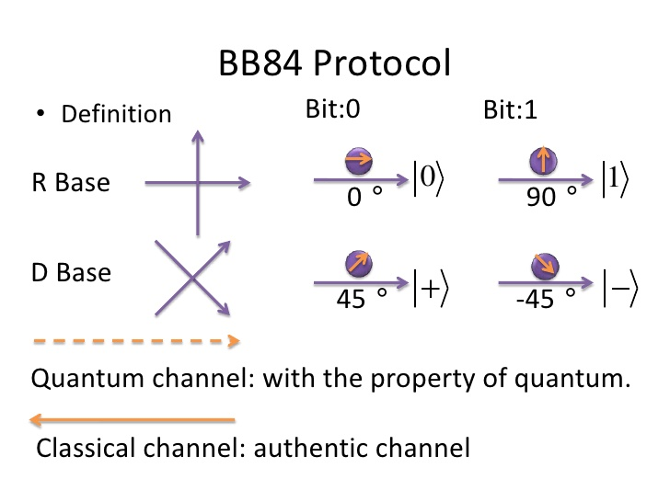
Algorithm
Alice creates string random bits, 0 or 1
Alice will choose a basis for each qubit, computational or hadamard
Alice sends her qubits on the quantum channel to Bob
Bob will choose a basis for each qubit, computational or hadamard
Bob measures each qubit with his chosen basis
Bob and Alice discuss choice of basis on classical channel
Keep bits where they use same basis, discard the others
Use remaining bits as private key, if uncompromised
Notes:
Why does using same basis give same polarization?

Slide 4
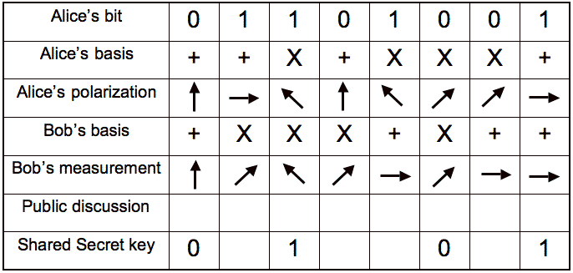
Algorithm

Slide 5
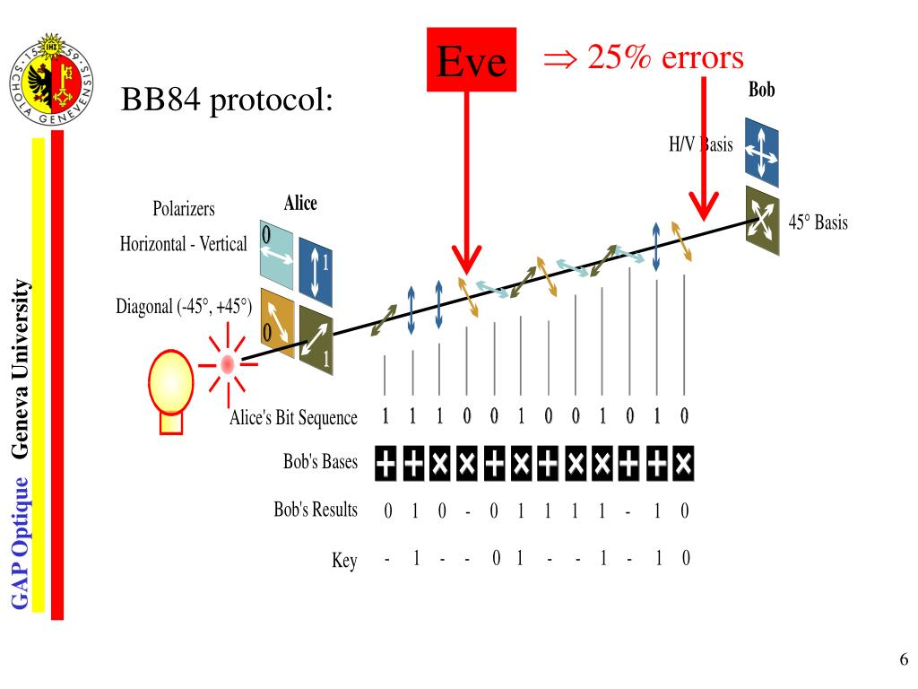
Security of BB84
Goal is to detect eavesdropper using quantum properties
Bob should measure qubits ~50% correctly
Eve must measure qubits, cannot clone qubit
Alice will select random sequence from chosen bit string to compare with Bob
If too many measurements don’t agree (<25%), there was eavesdropper
Restart process
Notes:
Difficult to determine if noisy or eavesdropper

Slide 6
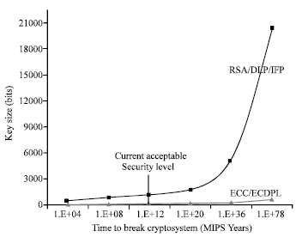
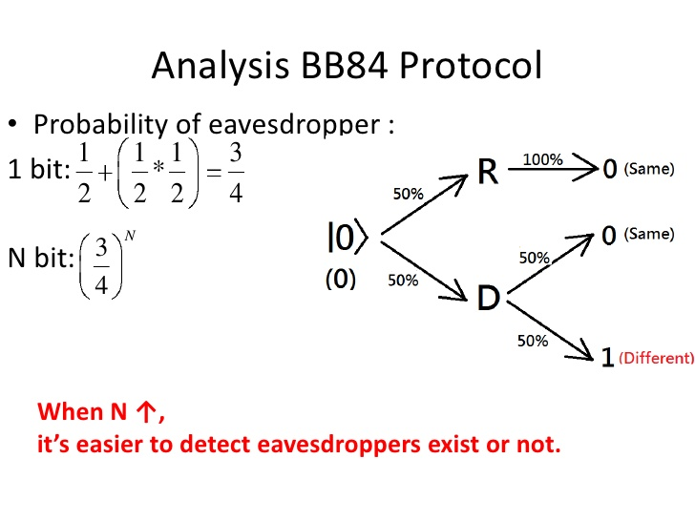
Classical Comparison
RSA
Relies on factoring
Secure for bits > 2048
Cannot share private key
No way to detect Eve
BB84
Measuring quantum states
Security based on judgement
Can securely share private key
Can detect Eve

Slide 7
References
McMahon, D. (2008). Quantum Computing Explained. Hoboken: John Wiley & Sons.
Haitjema, M. (2007, December 2). A Survey of the Prominent Quantum Key Distribution Protocols. Retrieved October 01, 2020, from https://www.cse.wustl.edu/~jain/cse571-07/ftp/quantum/
Intrigano. (2017, November 18). “Quantum Optic-Quantum Cryptography the BB84 QKD scheme”. Retrieved September 24, 2020 from https://www.youtube.com/watch?v=MlsrCzDdAbE
Shor, Peter & Preskill, John. (2000). Simple Proof of Security of the BB84 Quantum Key Distribution Protocol. Physical review letters. 85. 441-4. 10.1103/PhysRevLett.85.441.
Bennett, C. H. (2010, July 26). 陳君翰 BB84 0718. Retrieved October 01, 2020, from https://www.slideshare.net/converse2006/bb84-0718
Gisin, N. (2014, October 06). Quantum Communication. Retrieved October 01, 2020, from https://www.slideserve.com/rusty/quantum-communication-nicolas-gisin

