Slide 1
Linux Effective Shell Skills
Victor Li

Slide 2

Agenda
Shell history
Bash feature
Shell expansion
Command execution
Command line editing
Auto-complete
Editing mode
Command history
troubleshoot
Text process
Regular expression
Tools collections
References
This Photo by Unknown Author is licensed under CC BY-SA

Slide 3
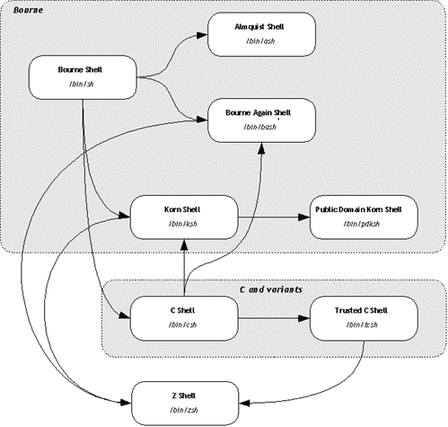
Shell families and history
Csh 1978
Ksh 1983
Bash 1988
Zsh 1990

Slide 4
Bash command flow
Lexical Analysis and Parsing
Expansion
Command Execution
Input
Exit Status
Variable and Parameter Expansion,
Command substitution
Process substitution
Arithmetic substitution
Braces Expansion
Tilde Expansion
Word Splitting
Filenames
Generation

Slide 5
Shell expansion
Braces expansion
Tilde expansion
Variable expansion
parameter expansion
Command Substitution
Process Substitution
Arithmetic Substitution

Slide 6

Braces expansion
$\text{(}\text{a}\text{,}\text{b}\text{)∗(}\text{x}\text{,}\text{y}\text{,}\text{z}\text{)=>(}\text{a}\text{,}\text{x}\text{),(}\text{a}\text{,}\text{y}\text{),(}\text{a}\text{,}\text{z}\text{),(}\text{b}\text{,}\text{x}\text{),(}\text{b}\text{,}\text{y}\text{),(}\text{b}\text{,}\text{z}$)
$ echo {1..10}
1 2 3 4 5 6 7 8 9 10
$ echo {a..e}
a b c d e
$ echo {1..10..3}
1 4 7 10
$ echo {a..j..3}
a d g j
$ mkdir -p Top/{a,b}/{i,k}
$ find Top
Top
Top/a
Top/a/i
Top/a/k
Top/b
Top/b/i
Top/b/k
cp filename{,.bak}
bash$ ls
grub.cfg
bash$ cp grub.cfg{,.bak}
bash$ ls
grub.cfg grub.cfg.bak
scp -p xxx/{a,c,d,e} user@host:dest/
ls *.{jpg,jpeg,png} # expands to *.jpg *.jpeg *.png

Slide 7
Tilde Expansion
~ The value of $HOME
~/foo #$HOME/foo
~fred/foo #The subdirectory foo of the home directory of the user fred
~+/foo $PWD/foo

Slide 8
Variable substituion
No blank space before and after =
varname=”value”
Variable substitution
$varname
${varname}
Save you long filepath to variable
Save you common command in variable
$ mydu="du -csh“
$ $mydu .

Slide 9
Parameter Expansion
# Default value
${parameter:=word}
# Length
${#parameter}
# String slice
${parameter:offset}
${parameter:offset:length}
# Replace
${parameter/pattern/string}
# loweracase
${parameter^pattern}
${parameter,pattern}
#uppercase
${parameter^^pattern}
${parameter,,pattern}
# Delete from left
${parameter#word}
${parameter##word}
# delete from right
${parameter%word}
${parameter%%word}

Slide 10
Command Substitution
Command substitution allows the output of a command to replace the command itself
$(command) or `command`
Example
create log directory with time_stamp
log_20190330204008
bash~$ date +%Y%m%d%H%M%S
20190330203926
bash~$ mkdir log_$(date +%Y%m%d%H%M%S)
bash~$ ls
log_20190330204008
bash~$

Slide 11
Process Substitution
Process substitution allows a process’s input or output to be referred to using a filename.
<(list) or >(list)
Example
diff the two directory layout
diff <(ls $first_directory | sort) <(ls $second_directory | sort)

Slide 12
Arithmetic Expansion
Arithmetic expansion allows the evaluation of an arithmetic expression and the substitution of the result.
$(( expression ))
Example
$(( 1+2 ))
Not support Float

Slide 13
Word Splitting
How the results of expansion are split into separate arguments
The shell scans the results of parameter expansion, command substitution, and arithmetic expansion that did not occur within double quotes for word splitting
$IFS
<space><tab><newline>

Slide 14
Filename Expansion
* any
** recursive match
? 0,1
[...] charter range
?(pattern-list) 0,1
*(pattern-list) any
+(pattern-list) 1+
@(pattern-list) only one
!(pattern-list) not match
bash$ ls
Bash$ ls /etc/pam.d/
atd gdm-autologin login postlogin-ac smtp system-auth
chfn gdm-fingerprint other ppp smtp.postfix system-auth-ac
chsh gdm-launch-environment passwd remote sshd systemd-user
config-util gdm-password password-auth runuser sssd-shadowutils vlock
crond gdm-pin password-auth-ac runuser-l su vmtoolsd
cups gdm-smartcard pluto setup sudo xserver
fingerprint-auth ksu polkit-1 smartcard-auth sudo-i
fingerprint-auth-ac liveinst postlogin smartcard-auth-ac su-l
bash$ cp /etc/pam.d/gdm-+(auto|pass)* .
bash$ ls
gdm-autologin gdm-password
bash$
bash$ vim /etc/pa*ac
bash$ vim **/*READ* #open the README at any subfolder

Slide 15
Command execution
Command
Command list
Compound command
Grouping command
Pipeline
IO redirection

Slide 16
Command
Command list
bash$ apt update && apt install python-pip buildessential
command1;comand2
command1 && command2
command1 || command2

Slide 17
Compound command
bash$ cat test.sh
for i in 10.19.189.{1..255};
do
(ping -c 1 $i &)
done 2>&1 | grep "ttl"
64 bytes from 10.19.189.1: icmp_seq=1 ttl=249 time=99.9 ms
64 bytes from 10.19.189.2: icmp_seq=1 ttl=249 time=107 ms
64 bytes from 10.19.189.3: icmp_seq=1 ttl=248 time=102 ms
64 bytes from 10.19.189.59: icmp_seq=1 ttl=57 time=92.2 ms
64 bytes from 10.19.189.69: icmp_seq=1 ttl=121 time=86.8 ms
64 bytes from 10.19.189.74: icmp_seq=1 ttl=56 time=86.6 ms
64 bytes from 10.19.189.177: icmp_seq=1 ttl=56 time=99.5 ms
64 bytes from 10.19.189.179: icmp_seq=1 ttl=57 time=95.5 ms
64 bytes from 10.19.189.207: icmp_seq=1 ttl=56 time=188 ms
64 bytes from 10.19.239.1: icmp_seq=1 ttl=249 time=94.5 ms
Looping : for,while,until
Conditional: If,case
Command Grouping
( list ) #/executed in a subshell
{ list; } #at current shell context
Example:
Quick found how many machine is live of our lab.

Slide 18
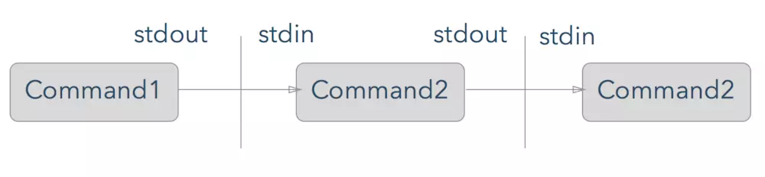
Pipeline
find -iname ".c"| xargs grep "open"
Command1 | command2
Command2 |& command2
ps –ef | grep “perl"
make|& grep –ie “error\|fail"

Slide 19

IO Redirection
Stdin(0)
Program
Stdout(1)
args
Stderr(2)
1>filename
# Redirect stdout to file "filename."
1>>filename
# Redirect and append stdout to file "filename."
2>filename
# Redirect stderr to file "filename."
2>>filename
# Redirect and append stderr to file "filename."
&>filename
# Redirect both stdout and stderr to file "filename."
# This operator is now functional, as of Bash 4, final release.
I/O

Slide 20
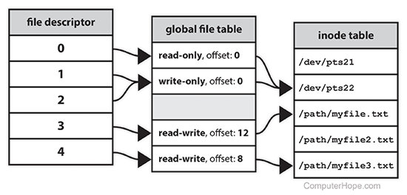
IO Redirection
[j]<>filename
# Open file "filename" for reading and writing,
#+ and assign file descriptor "j" to it.
# If "filename" does not exist, create it.
# If file descriptor "j" is not specified, default to fd 0, stdin.
#
# An application of this is writing at a specified place in a file.
echo 1234567890 > File # Write string to "File".
exec 3<> File # Open "File" and assign fd 3 to it.
read -n 4 <&3 # Read only 4 characters.
echo -n . >&3 # Write a decimal point there.
exec 3>&- # Close fd 3.
cat File # ==> 1234.67890
Multiple file descriptors can refer to the same file table entry (e.g., as a result of the dup system call^{[3]:104}
Multiple file table entries can in turn refer to the same inode (if it has been opened multiple times)
the inode table is still simplified because it represents inodes by file names, even though an inode can have multiple names.

Slide 21
Command execution
# Read 3 lines from a file
{ read line1
read line2
read line3
} < /etc/fstab
Symbol | Remark
> | M>filename
>> | append
< | read
<< | Here doc
<<< | Here string
&[n] | File descriptor
ftp << EOF
ftp cmd list
EOF
Counting network interfaces
wc -w <<<$(netstat -i | cut -d" " -f1 | egrep -v "^Kernel|Iface|lo")

Slide 22
IO redirection
# /lib/udev/write_net_rules
write_rule() {
local match="$1"
local name="$2"
local comment="$3"
{
if [ "$PRINT_HEADER" ]; then
PRINT_HEADER=
echo "# This file was automatically generated by the $0"
echo "# program, run by the persistent-net-generator.rules rules file."
echo "#"
echo "# You can modify it, as long as you keep each rule on a single"
echo "# line, and change only the value of the NAME= key."
fi
echo ""
[ "$comment" ] && echo "# $comment"
echo "SUBSYSTEM==\"net\", ACTION==\"add\"$match, NAME=\"$name\""
} >> $RULES_FILE
}
{ code-block} >> output.log
Examples: the scripts to generate
/etc/udev/rules.d/70-persistent-net.rules

Slide 23
Command Editing
Auto-complete
Path complete
Command complete
Parameter complete
Spell-autocorrect
Editing mode vi/emacs
set –o vi
History search
!n Refer to command line n.
!-n Refer to the command n lines back.
!! Refer to the previous command. This is a synonym for `!-1'.
!string Refer to the most recent command starting with string.
!!:s/string1/string2/. Quick Substitution. Repeat the last command, replacing string1 with string2.
!:n the nth parameter of the previous command
!:$ the last parameter of the previous command

Slide 24
troubleshoot debug
set –eux
set -e cmd1 && cmd2 && cm3 = set -e ;cmd1;cmd2;cmd3
set -u The shell prints a message to stderr when it tries to expand a variable that’s is not set.Also it immediately exits.
set -x print each command in sript to stderr before running it.
set -o pipefail Pipelines failed on the first command which failes instead of dying later on down the pipepline.
Most has command has verbose or debug options
strace
strace -o cmd.log cmd args

Slide 25
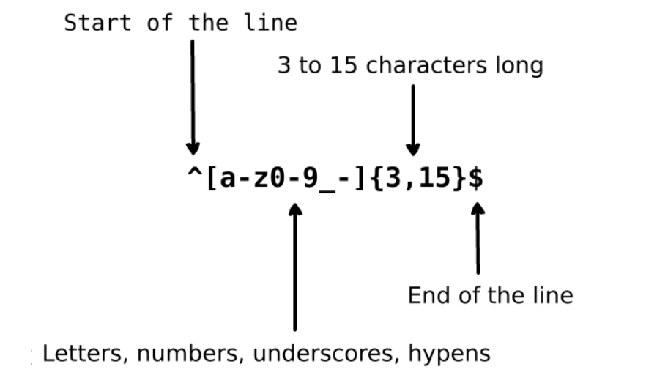
Text Process
regexp

Slide 26
Text Process
Meta character | Description
. | Period matches any single character except a line break.
[ ] | Character class. Matches any character contained between the square brackets.
[^ ] | Negated character class. Matches any character that is not contained between the square brackets
* | Matches 0 or more repetitions of the preceding symbol.
+ | Matches 1 or more repetitions of the preceding symbol.
? | Makes the preceding symbol optional.
{n,m} | Braces. Matches at least "n" but not more than "m" repetitions of the preceding symbol.
(xyz) | Character group. Matches the characters xyz in that exact order.
| | Alternation. Matches either the characters before or the characters after the symbol.
\ | Escapes the next character. This allows you to match reserved characters [ ] ( ) { } . * + ? ^ $ \ |
^ | Matches the beginning of the input.
$ | Matches the end of the input.

Slide 27
Text Process
$ cat employee.txt
manager 5000
clerk 4000
employee 6000
peon 4500
director 9000
guard 3000
$ sort -k 2n employee.txt
guard 3000
clerk 4000
peon 4500
manager 5000
employee 6000
director 9000
Tools collections
diff,sort/tsort,uniq,join,paste,join,wc,
expand,cut,head,tail,look,sed,awk,tr,grep
fold,fmt,col,column,nl,pr
Common practice
A U B cat
A + B cat |sort |uniq -c |grep -e “^2”
A-B or B-A diff
A
AUB B

Slide 28
END

Slide 29
Command execution
Command
Command list
Compound command
Grouping command
Pipeline
IO redirection

Slide 30
Command execution
Command
Command list
Compound command
Grouping command
Pipeline
IO redirection

Slide 31
Shell expansion
Braces expansion
Tilde expansion
Variable expansion
parameter expansion
Command Substitution
Process Substitution
Arithmetic Substitution

Slide 32
IO Redirection
echo 1234567890 > File # Write string to "File".
exec 3<> File # Open "File" and assign fd 3 to it.
read -n 4 <&3 # Read only 4 characters.
echo -n . >&3 # Write a decimal point there.
exec 3>&- # Close fd 3.
cat File # ==> 1234.67890
# Random access, by golly.

Slide 33

Agenda
What’s Shell and Shell history
Bash feature
Shell expansion
Command execution
Command line editing
Auto-complete
Editing mode
Command history
troubleshoot
Text process
Regular expression
Tools collections
References

Slide 34
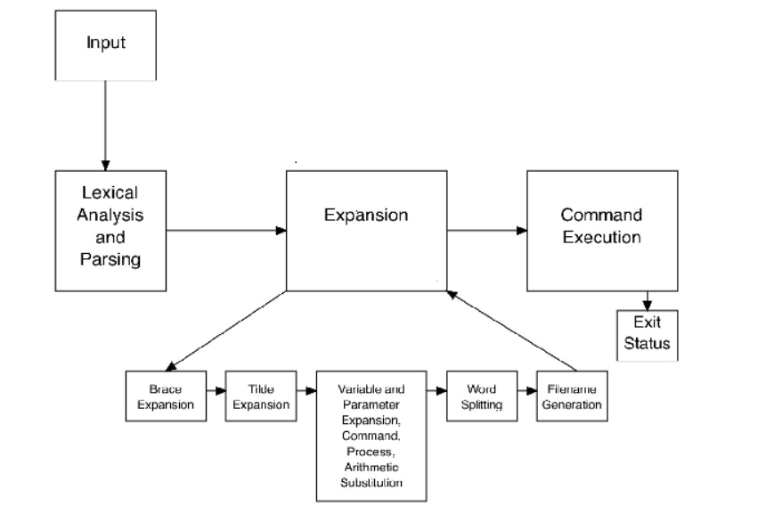
Bash command flow
Command Execution
Input
Lexical Analysis and Parsing
Expansion
Exit Status
Variable and Parameter Expansion,
Command substitution
Process substitution
Arithmetic substitution
Braces Expansion
Tilde Expansion
World Spiliting
Filenames
Generation

