Slide 1
NLP – Dependency Parsing
Quick Introduction
Feb 1st, 2019

Slide 2

References
https://web.stanford.edu/~jurafsky/slp3/15.pdf
State-of-the-art methods:http://nlpprogress.com/english/dependency_parsing.html

Slide 3
Classical vs deep learning-based NLP
Goal: we want to understand the grammatical structure of a sentence, similar to context-free constituent parsing
In contrast to constituent parsing, not based on rules for the structure of the sentence, but more flexible, well-suited for example for languages like Russian, which have a flexible word order. DPs abstracts over word order ...

Slide 4
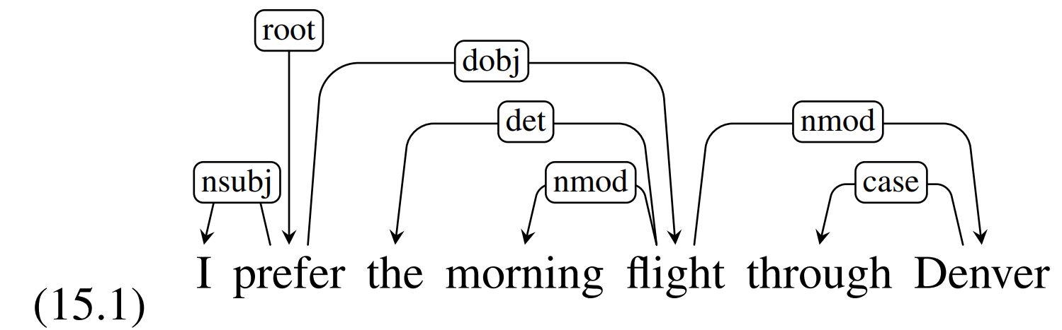
Example

Slide 5
Basics
We look at binary relationships between words.
The relations are always between a head and a dependant
The relationships are directed and labelled
The label show the type of grammatical relationships
There is always one root node (the predicate of the sentence)

Slide 6
Motivation – Why DP?
Question answering: Who invented the light bulb? → If we understand the structure of the sentence, we can more easily answer the query. When was the light bulb invented → modifier.
Information extraction
Co-reference resolution
→ this information is very helpful / necessary for many NLP problems

Slide 7
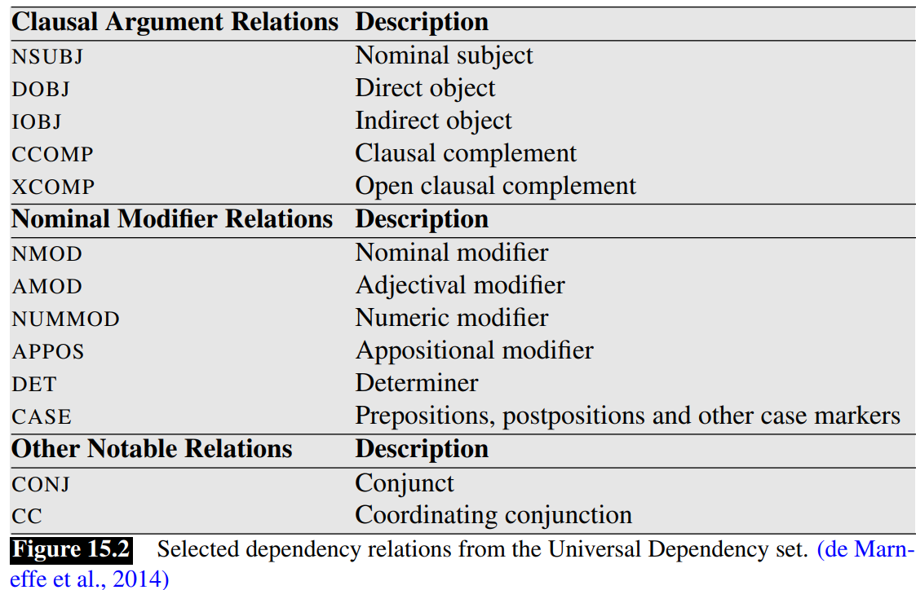
Relation types
There is a fix number of relation types
.

Slide 8
Universal dependency set (UD) / Treebanks
Standardized set of labels
linguistically motivated, computationally useful, cross-linguistically applicable
See example on previous slide
Treebanks are basically datasets with manually or semi-automatically labelled examples
They can be used for training and evaluation of algorithms

Slide 9
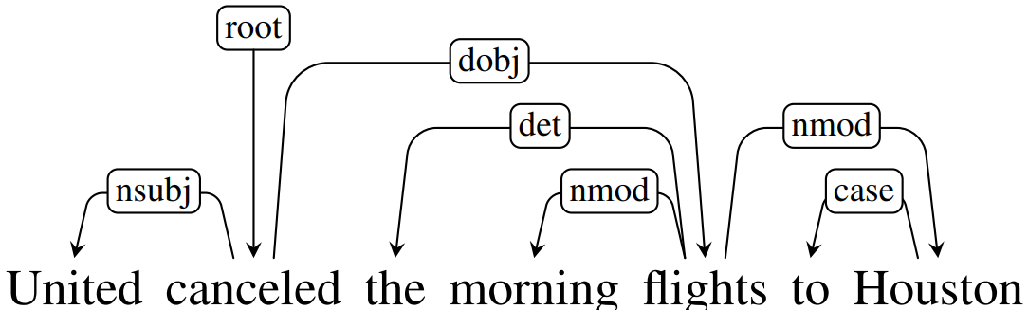
Another Example

