Slide 1
Building your first mobile app with Angular and the Ionic Framework 10/12/2017, 1:30pm
Steve Michelotti
steve.michelotti@microsoft.com

Slide 2
What is Ionic?
Mobile-optimized open source framework for building cross-platform apps (HTML/JS/CSS)

Slide 3
Web Development Tools

Slide 4
Built on Angular

Slide 5
Built for Native Cordova Apps

Slide 6
What is Cordova?
JavaScript API “wraps” native API
Native Mobile Apps (HTML/JS/CSS)
Plugin Ecosystem
Millions of Downloads

Slide 7
Why Ionic?
Angular/TypeScript
Navigation
Platform Theming
Build Tools
Performance

Slide 8
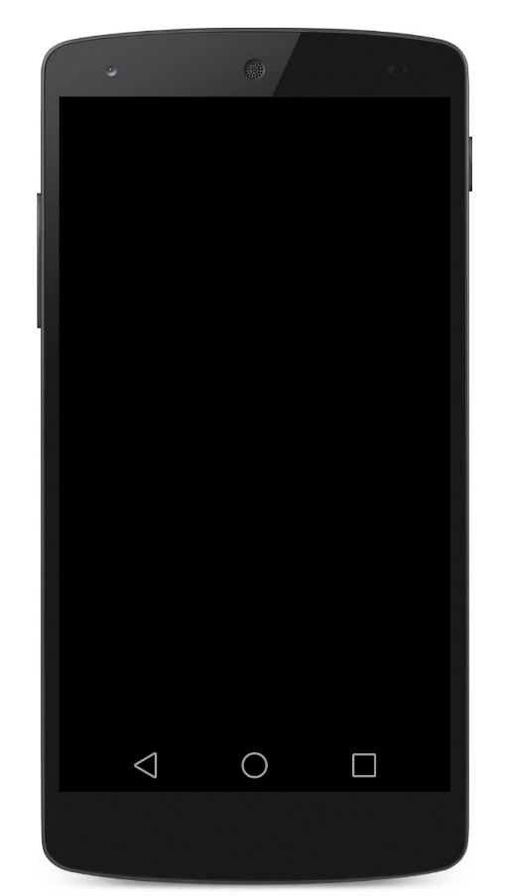
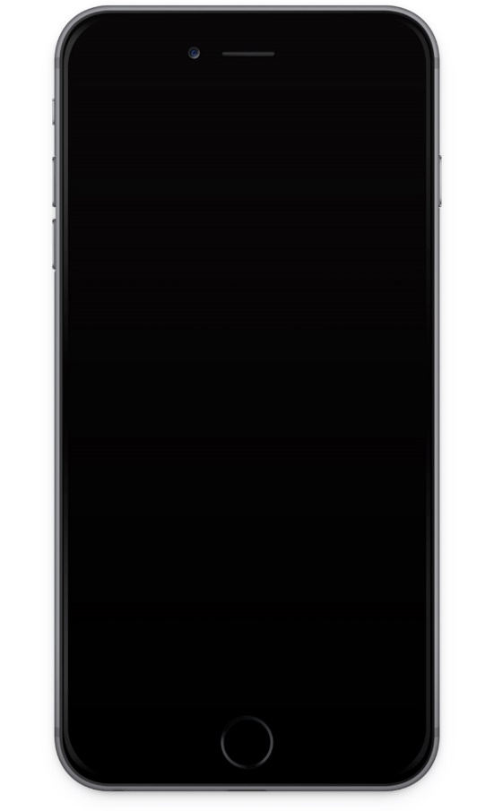
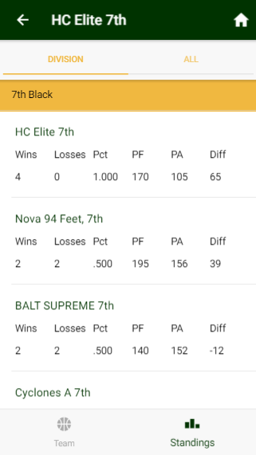
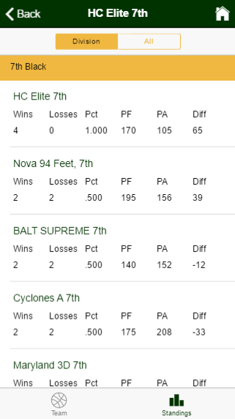
Multi-Platform Theming

Slide 9
Let’s Get Started!

Slide 10
Demo
Buttons
Navigation

Slide 11
Demo
Cards
Badges
Input
Toolbars
Grid System

Slide 12
Demo
Services
Third-Party Libraries

Slide 13
Demo
Toasts
Alerts
Modals
Lists

Slide 14
Demo
Virtual Scroll
Searchbar

Slide 15
Demo
Ionic Native

Slide 16
Go Build Great Apps!!

Slide 17
References
https://ionicframework.com/
https://ionicframework.com/docs/native/
@smichelotti
steve.michelotti@micrsoft.com

Slide 18
Please use EventsXD to fill out a session evaluation.
Thank you!

