Slide 1
Control Statistics
Gun Woo Park
22 DEC 2015

Slide 2
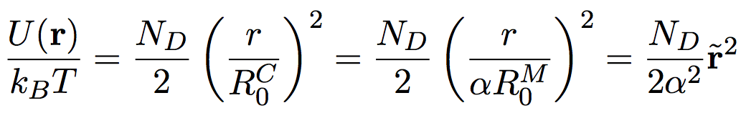

With Scale Factors
RMS of end-to-end vector of associable chain (flower of micelle)
diameter of micelle
(characteristic distance)
Alpha = 0.5
scale factor = 1/alpha

Slide 3
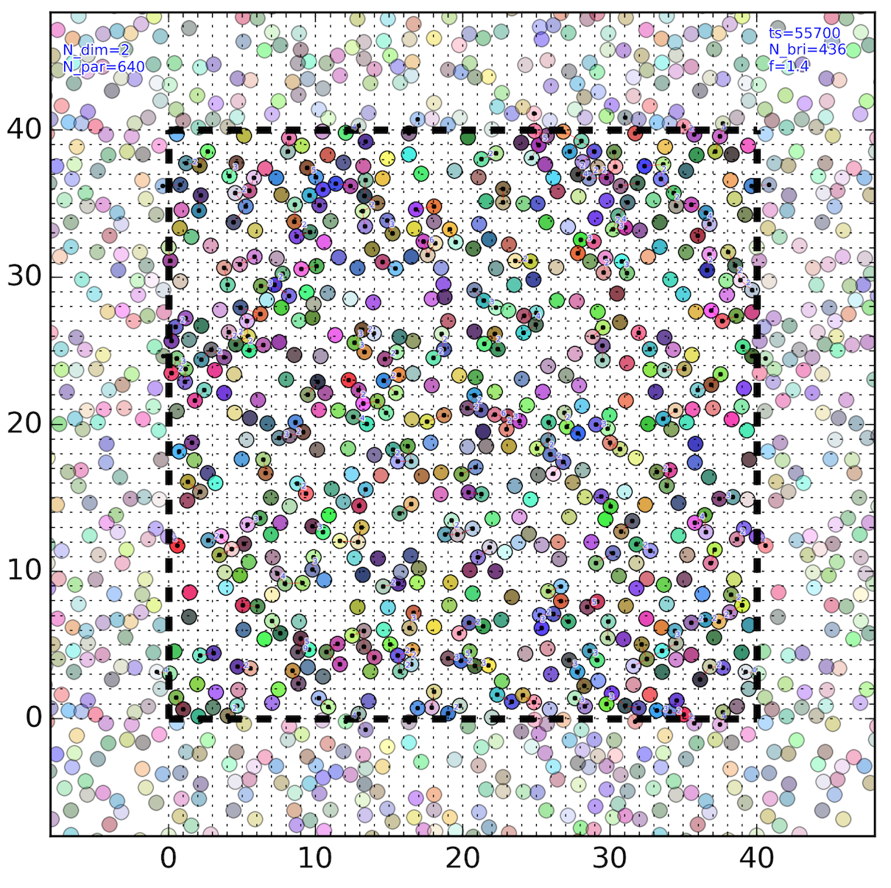
Equilibration

Slide 4
Works in Progress
Solving poor statistics with higher scale factor (lowering alpha)
Inheritance statistics
Code-refactoring and re-build automated infrastructure
Comparison exactly soluble example

