Slide 1
3D Stochastic Simulation
Gun Woo Park
02 FEB 2016

Slide 2
Np=3200, Ld=20
Number Density = 0.4 (3200Np/(20Ld)³)
Micelle concentration ~ 0.210 based on unity length scale

Slide 3
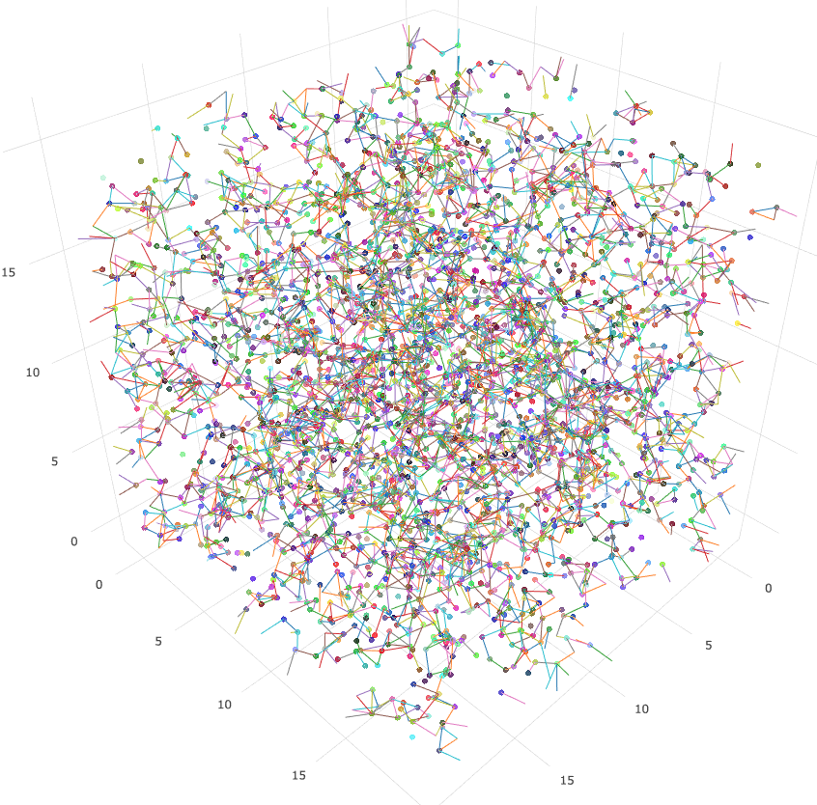
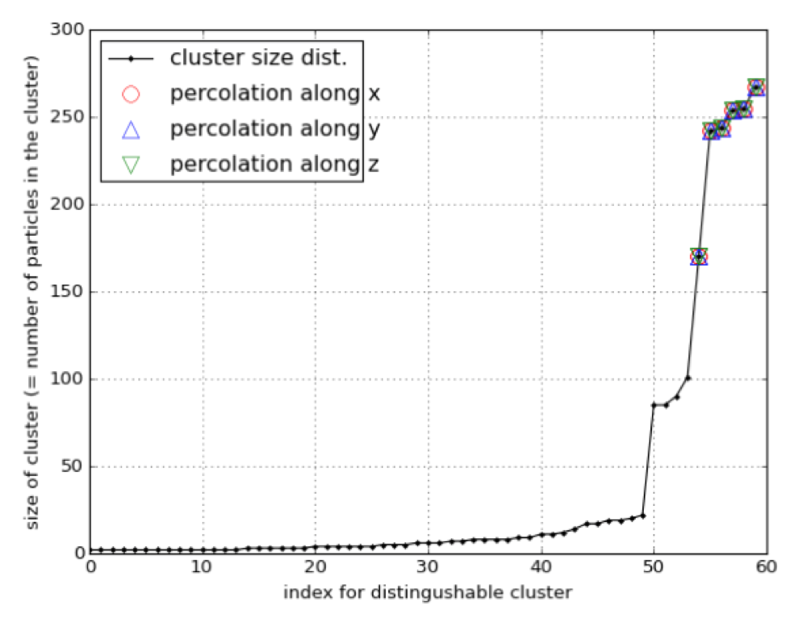
Percolations and Cluster Size Distribution
SF=1.5 (12.2% association)
percolation cluster (root 1):
percolation axis: x, y, z

Slide 4
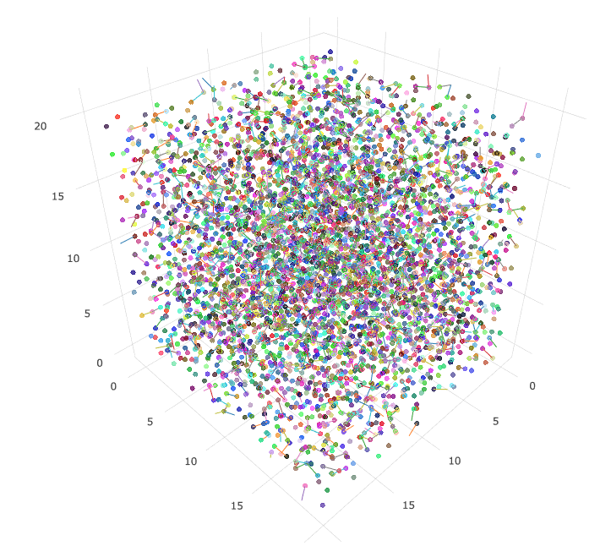
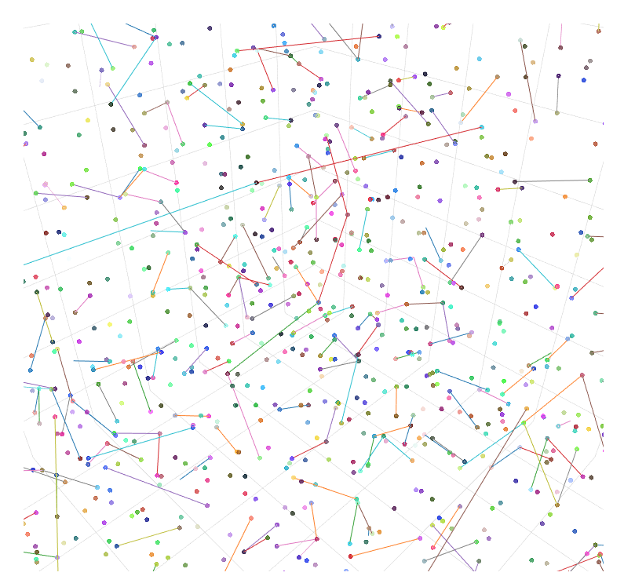
Np=4800, Ld=20
SF2.0 (NO percolation)
Number Density = 0.6 (4800Np/(20Ld)³)
Micelle concentration ~ 0.314 based on unity length scale

Slide 5
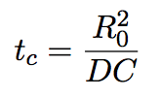

Mean Square Displacement
D_{n} = 0.4
C_{m} ~ 1.675
D_{n} = 0.0125
C_{m} ~ 0.05
Reference Line for Pure Brownian Motion
Repulsive coefficient C=100
Micelle cencentrations:
0.210 for 3200 particles
0.314 for 4800 particles
D_{n} = 0.6
C_{m} ~ 2.512
Constrained diffusion

Slide 6
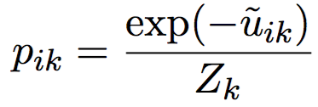


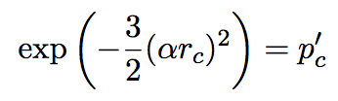
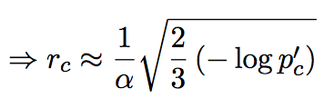
Cell Lists
Related Factors for Cut-off Radius
Repulsive potential ~ length scale 1
Cumulating Boltzmann factor
Associated chain interaction
1 | 2 | 3 | 4 | 5
6 | 7 | 8 | 9 | 10
11 | 12 | 13 | 14 | 15
16 | 17 | 18 | 19 | 20
21 | 22 | 23 | 24 | 25
L_{d}
Computing cut-off radius based on Boltzmann factor
Set minimum probability
Compute cut-off distance from inequality:
Pairs for the particles inside box 13 (yellow): set of all particles inside box in blue
Example: 3d dimensionless Gaussian potential
Length of cell > cut-off radius
When alpha=1
Minimum probability | 0.001 | 0.005 | 0.01
Cut-off radius | 2.15 | 1.88 | 1.75
Pros: Higher number of cells increase efficiency
Cons: Lower number of cells less powerful than neighbor list

Slide 7
Works on Progress
Implementation Cell List
Implementation Shear Flow into PBC box (boundary driven algorithm)
Travel Algorithm for directly connected PBC box

