Slide 1
Parallel Stochastic Simulation
Gun Woo Park
1 DEC 2015

Slide 2
Working Flow Chart (original)
Starting Simulation
MC steps
Time evolution
Finish
OMP
Compute normalized and sorted CDF (based on trajectory)
Compute forces
Basic test condition:
(single process)
160(s) ~ 2.6(m)
OMP
Select beads
Time Evolution
Select specific chains from probability inside beads
check output frequency
Select new ends from sorted CDF
Determine action
Writing results
Update information
Time step check
IDENT MC EQ.

Slide 3
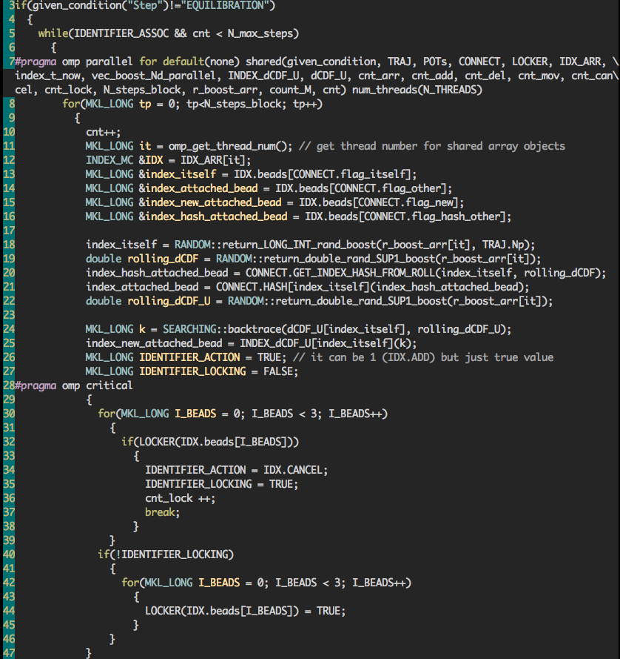
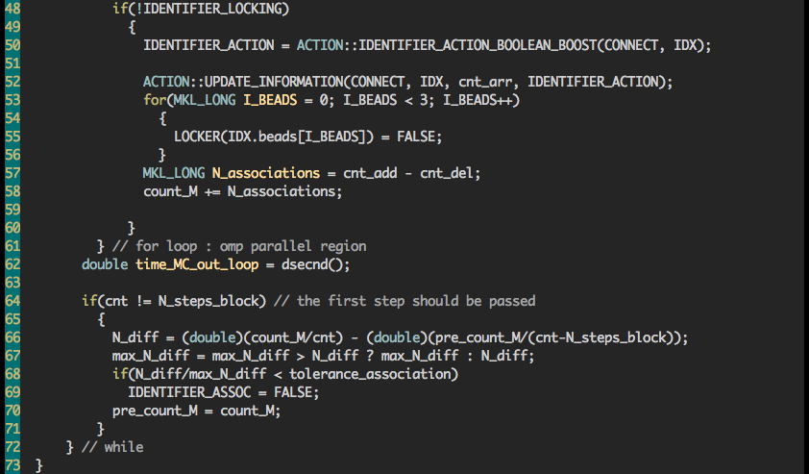
OMP for Stochastic Steps

Slide 4
Working Flow Chart (Parallel)
MC steps
Compute normalized and sorted CDF (based on trajectory)
INIT OMP
Select beads
Select beads
Select specific chains from probability inside beads
Select specific chains from probability inside beads
Select new ends from sorted CDF
Select new ends from sorted CDF
OMP
Check LOCKING
Critical Directive
LOCKING
Determine action
Determine action
Update information
Update information
UNLOCKING
UNLOCKING
IDENT MC EQ.

Slide 5
Works in Progress
Single processor test (deterministic random numbers) have been done
Equilibrium Identifier for multi-thread case should be re-defined
Statistical Verification
Note that the multiple thread does not allowing single stream for random number generator, which means we cannot compare random numbers in deterministic ways

