Slide 1
Identify Percolation and Data Structure for Connectivity Map
Gun Woo Park
19 JAN 2016

Slide 2
Objectives: Criterion of Percolation
Defining percolation transition is not clear up to now
Measuring cluster size distribution (CSD) and/or number of clusters (NC) is good way to identify
Observation point (in equilibrium):
Changes of CSD in terms of time
Changes of NC in terms of time
Fluctuations of CSD or NC in terms of time

Slide 3
2-Dimensional Arrays in Scientific Data Structure
2-dimensional array, basic form
2-dimensional array, 1-dimensional form
index j
0 | 1 | 2 | 3 | 4 | 5 | 6 | 7 | 8 | 9
0, 0 | 0, 1 | 0, 2 | 0, 3 | 0, 4 | 0, 5 | 1, 0 | 1, 1 | 1, 2 | 1, 3
0 | 1 | 5 | 0 | 0 | 0 | 1 | 0 | 1 | 0
10 | 11 | 12 | 13 | 14 | 15 | 16 | 17 | 18 | 19
1, 4 | 1, 5 | 2, 0 | 2, 1 | 2, 2 | 2, 3 | 2, 4 | 2, 5 | 3, 0 | 3, 1
0 | 0 | 5 | 1 | 0 | 0 | 0 | 1 | 0 | 0
20 | 21 | 22 | 23 | 24 | 25 | 26 | 27 | 28 | 29
3, 2 | 3, 3 | 3, 4 | 3, 5 | 4, 0 | 4, 1 | 4, 2 | 4, 3 | 4, 4 | 4, 5
0 | 0 | 1 | 0 | 0 | 0 | 0 | 1 | 0 | 0
30 | 31 | 32 | 33 | 34 | 35
5, 0 | 5, 1 | 5, 2 | 5, 3 | 5, 4 | 5, 5
0 | 0 | 1 | 0 | 0 | 0
 | 0 | 1 | 2 | 3 | 4 | 5
0 | 0 | 1 | 5 | 0 | 0 | 0
1 | 1 | 0 | 1 | 0 | 0 | 0
2 | 5 | 1 | 0 | 0 | 0 | 1
3 | 0 | 0 | 0 | 0 | 1 | 0
4 | 0 | 0 | 0 | 1 | 0 | 0
5 | 0 | 0 | 1 | 0 | 0 | 0
index i
Benefit:
Internal interfacial design (it can be generazed by n-dimensional array into 1-dimensional array with inexfunction)
Compatibility: BLAS, LaPACK, MKL, GSL, …

Slide 4
Adjacency Matrix and List
bead index
 | 1 | 2 | 3 | 4 | 5 | 6
1 | N1 | 1 | 5 | 0 | 0 | 0
2 | 1 | N2 | 1 | 0 | 0 | 0
3 | 5 | 1 | N3 | 0 | 0 | 1
4 | 0 | 0 | 0 | N4 | 1 | 0
5 | 0 | 0 | 0 | 1 | N5 | 0
6 | 0 | 0 | 1 | 0 | 0 | N6
bead index
Adjacency matrix: easily understandable but more space complex (Np*Np/2)
undirected graph structure
1
4
1
hash index
weight index
1
2
5
5
0 | 1 | 2 | 3
1 | 2 | 3 | 0
2 | 1 | 3 | 0
3 | 1 | 2 | 6
4 | 5 | 0 | 0
5 | 4 | 0 | 0
6 | 3 | 0 | 0
 | 0 | 1 | 2 | 3
1 | N1 | 1 | 5 | 0
2 | N2 | 1 | 1 | 0
3 | N3 | 5 | 1 | 1
4 | N4 | 5 | 0 | 0
5 | N5 | 4 | 0 | 0
6 | N6 | 3 | 0 | 0
1
3
1
Adjacency list: handling need complicate task but less space complex (2*Np*Ncol). For weighted graph, weight list is necessary
bead index
bead index
6

Slide 5
Compression for Adjacency Matrix
Adjacency matrix, basic form
bead index
Without compression:
Space complex: Np*Np/2
Travel Time complex: overhead through non-zero identification
With compression:
Partitioned matrix: reduced space complex (depends on sparseness of the given matrix)
Travel Time complex: similar with adjacency list. If space complex is not matter, we can simply apply hash table rather than partitioning
 | 1 | 2 | 3 | 4 | 5 | 6
1 | N1 | 1 | 5 | 0 | 0 | 0
2 | 1 | N2 | 1 | 0 | 0 | 0
3 | 5 | 1 | N3 | 0 | 0 | 1
4 | 0 | 0 | 0 | N4 | 1 | 0
5 | 0 | 0 | 0 | 1 | N5 | 0
6 | 0 | 0 | 1 | 0 | 0 | N6
Adjacency matrix, compressed form
bead index
 | 1 | 2 | 3 | 6 | 4 | 5
1 | N1 | 1 | 5 | 0 | 0 | 0
2 | 1 | N2 | 1 | 0 | 0 | 0
3 | 5 | 1 | N3 | 1 | 0 | 0
6 | 0 | 0 | 1 | N6 | 0 | 0
4 | 0 | 0 | 0 | 0 | N4 | 1
5 | 0 | 0 | 0 | 0 | 1 | N5
bead index
bead index
The advantage of compressed adjacency matrix is quite minor in comparison with adjacency list

Slide 6
Measuring Cluster Size with Adjacency List
Counting all the distinguishable association network from given adjacency list
Identical to solve problem of travel algorithm for undirected graph structure
Brute-force algorithm for travel in adjacency matrix without hash table is too time consuming because of sparseness of the adjacency matrix
Algorithm to travel graph is based on a spanning tree:
Basically, it iterate with different beads as a root into spanning tree
Because spanning tree is not unique, the algorithm matter for the time complex. Depth-first search (DFS) is the first point

Slide 7
Spanning Tree
0
depth 0 (root)
undirected graph structure
1
3
depth 1
0
3
one of spanning tree
2
4
depth 2
1
4
2
5
depth 3
5
Without cross edge, the given structure is well matched with tree structure (linear graph). DFS is good algorithm to find the node travel on this aspect.
Bead index started with 0 for compatibility with code

Slide 8
Depth-First Search (DFS) for Graph (w/o Periodicity)
hash index
0
 | 1 | 2 | 3
0 | 1 | 3 | -1
1 | 0 | 2 | -1
2 | 1 | 4 | 5
3 | 0 | 4 | -1
4 | 2 | 3 | 5
5 | 2 | 4 | -1
depth 0 (root)
undirected graph structure
1
depth 1
0
3
bead index
2
depth 2
1
4
2
4
DFS type for spanning tree
depth 3
5
3
5
depth 4
Because bead index started with 0 for compatibility with code, the null hash value should be -1 rather than 0
DFS sequence: 0 -> 1 -> 2 -> 4 -> 3 -> 5

Slide 9
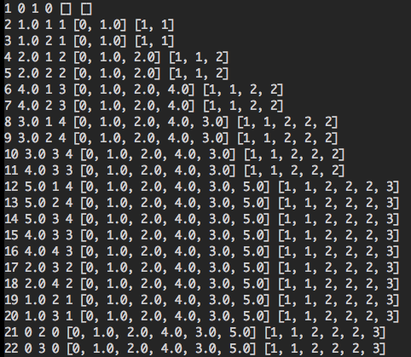
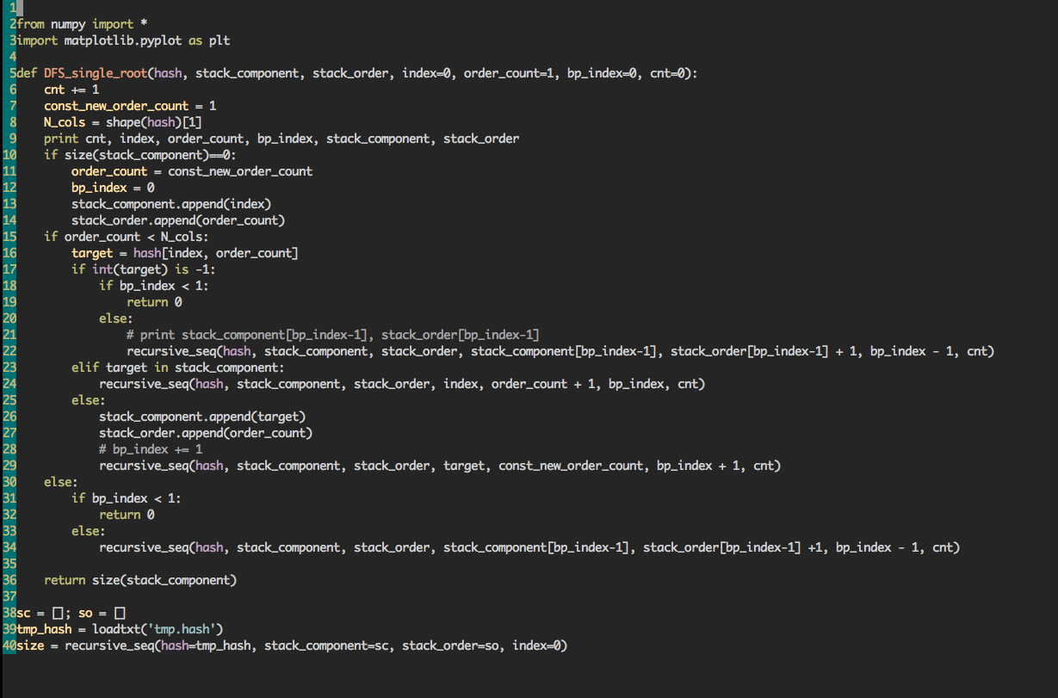
Crude DFS code
DFS sequence: 0 -> 1 -> 2 -> 4 -> 3 -> 5

Slide 10
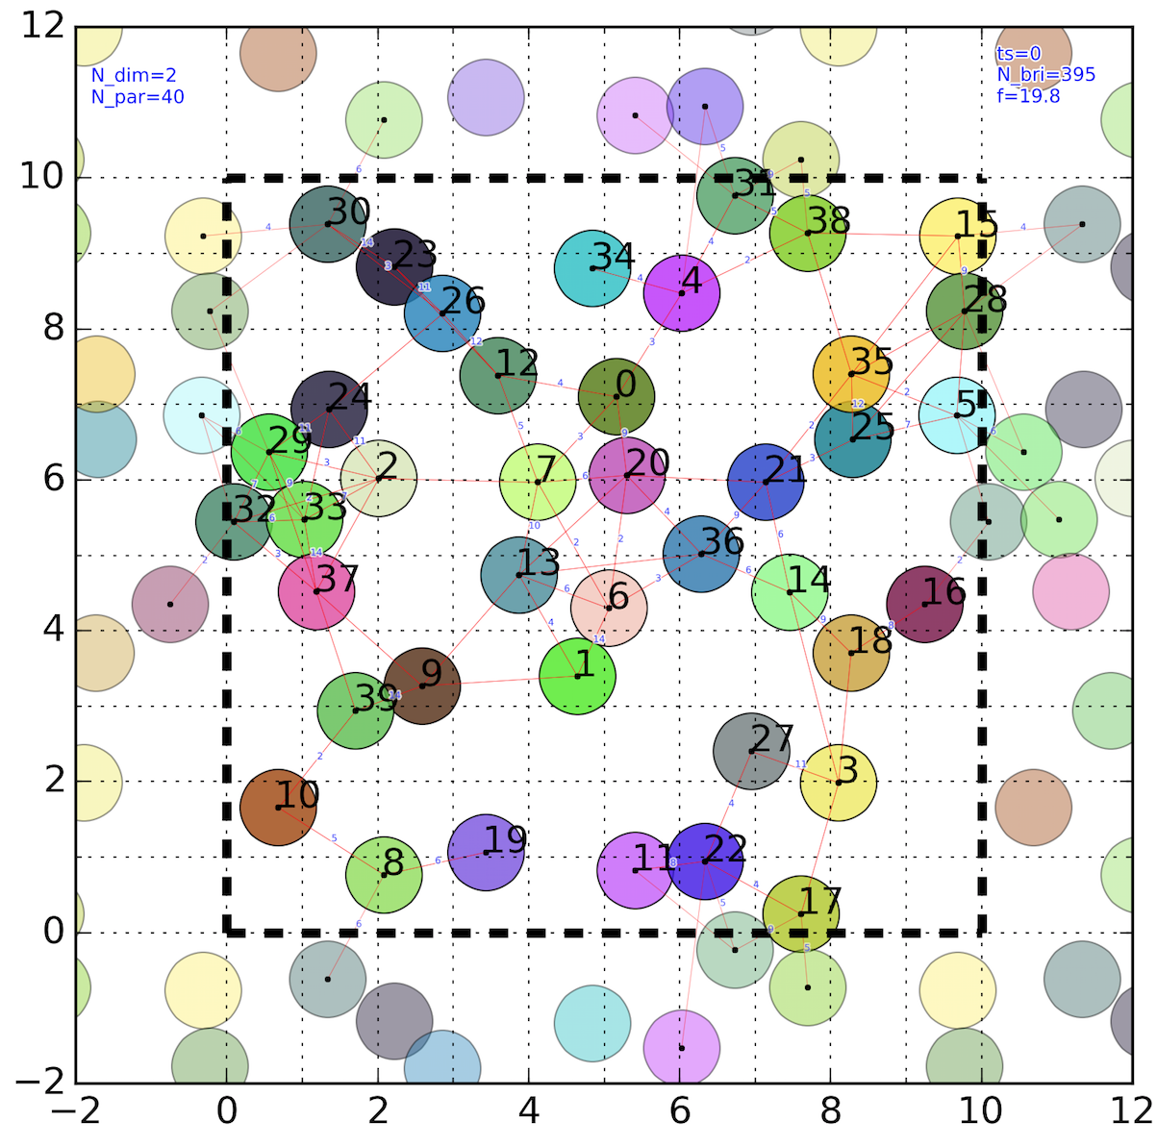



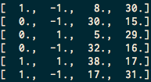
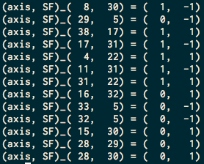
Identification Travel Beyond Box
SF=-1
SF=0
L_{D}
SF=+1
0
0
1
2
0
1
2
0
1
2
k-th axis
shift set
component-wise minimum distance
relative vector of minimum distance
Vertex travel
Vertex travel with edge check
k
SF
i
j
j
k
i
SF

Slide 11
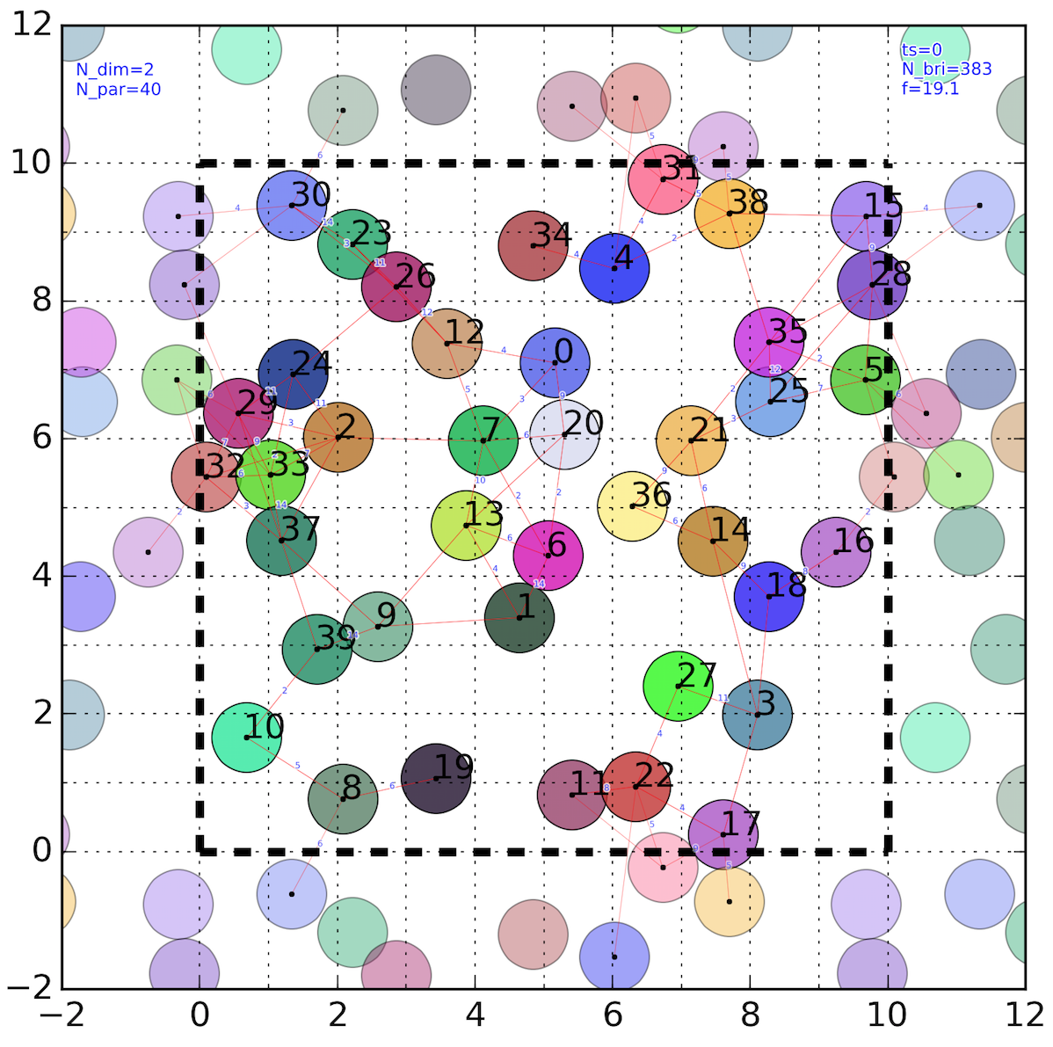
Travel Beyond Box: Same Results

Slide 12
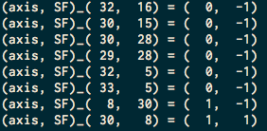
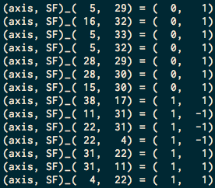
Travel inside Box: Percolation Identification
cluster 1 (root 0)
All travel through boundary (x=0 or x=Ld) is restricted on left side (-1)
cluster 2 (root 4)
All travel through boundary (x=0 or x=Ld) is restricted on right side (1)
Percolation through y-axis

Slide 13
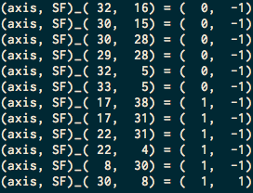
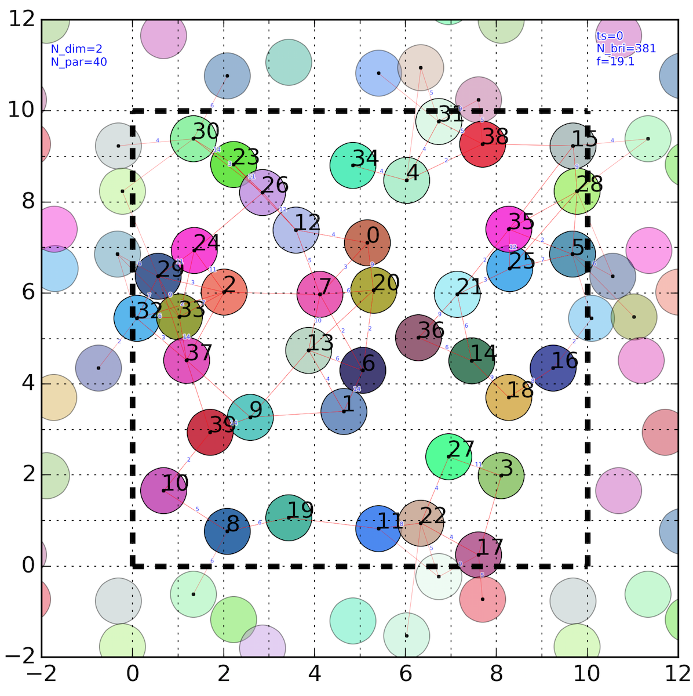
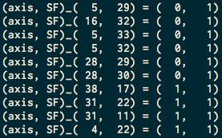
Cluster Separation
Percolation through x-axis?
Isolation line exist.
Percolation outside the subjected box cannot be captured by given algorithm

Slide 14
Works on Progress
Restricted box algorithm but allows connections outside the box
Minor changes for restriction algorithm
From recursive form to iterative form (recursive depth limitation)
Stability test
Implementation to the main code

