Slide 1
DEBUGGING LOG, FENE Connector Problem
Gun Woo Park

Slide 2
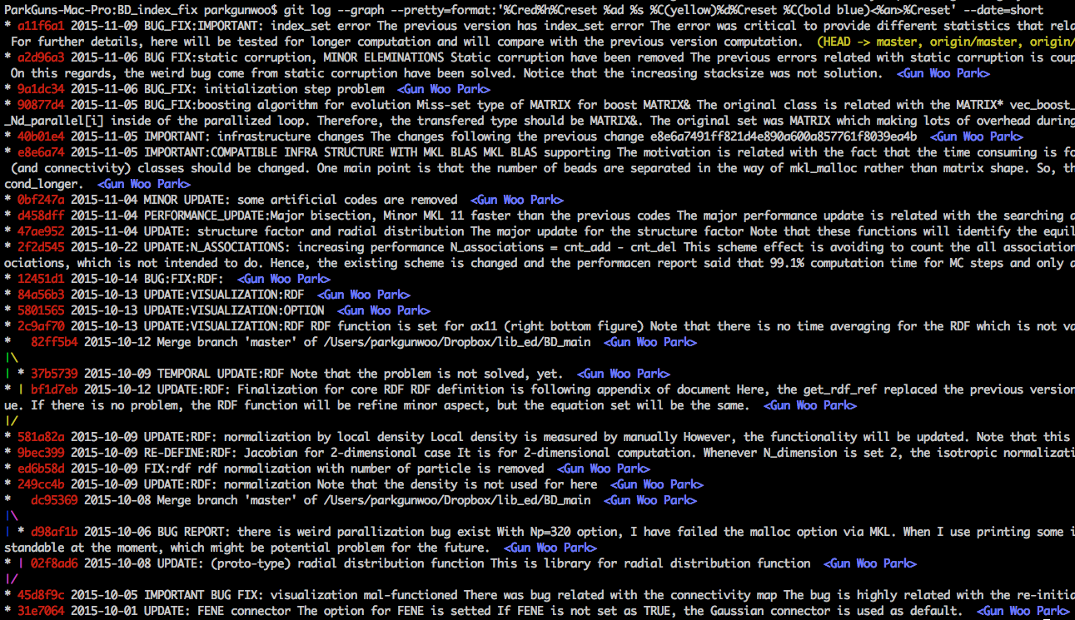

Slide 3
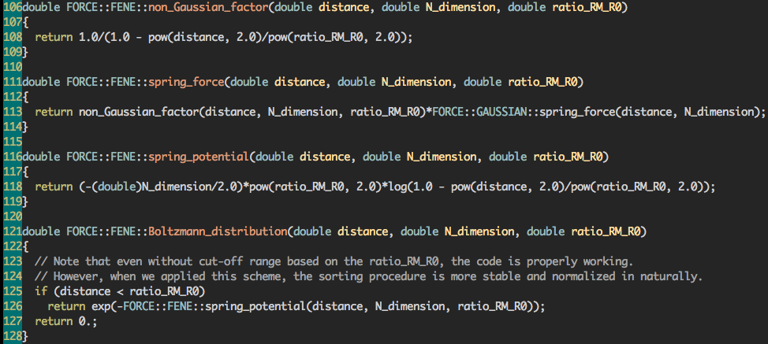

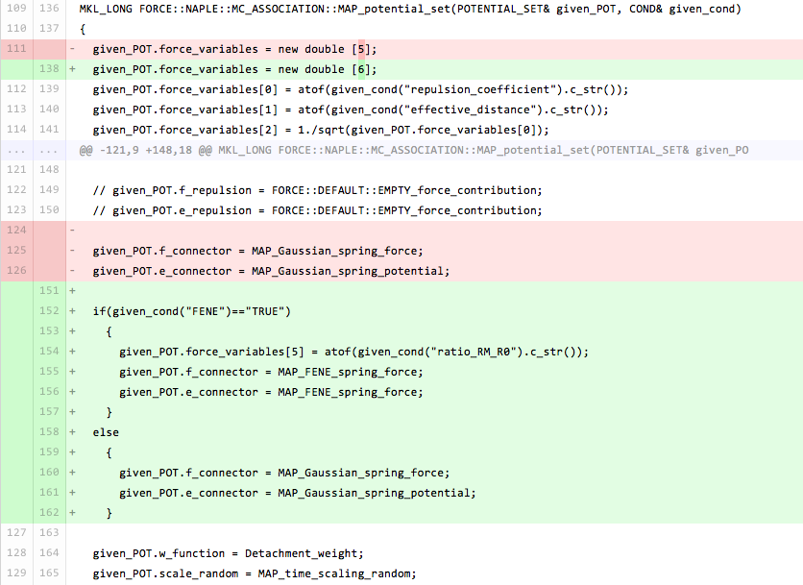
FENE Connector

