Slide 1



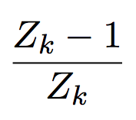
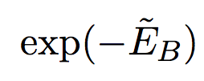

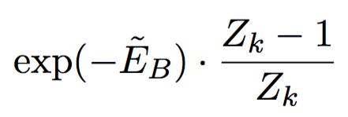

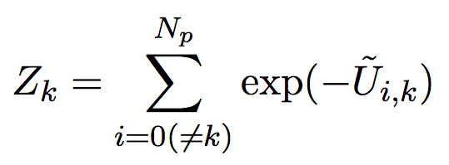
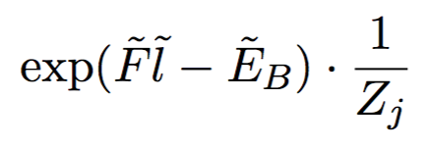
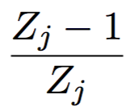






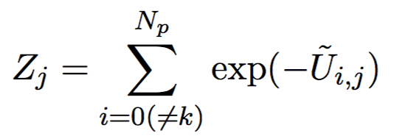
Schematic diagram for the flux in example case
Simplified Markov chain diagram
From roof state
Roof
Bridge
Attached to k-th bead
Transition state (active)
Bridge
From bridge state
Attached to k-th bead
Transition state (active)
Roof
Bridge
Bridge
Attached to j-th bead

