Slide 1
Topological and Brownian Time Scales
Gun Woo Park
03 FEB 2016

Slide 2
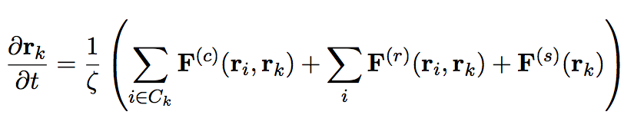
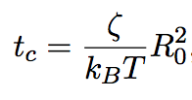

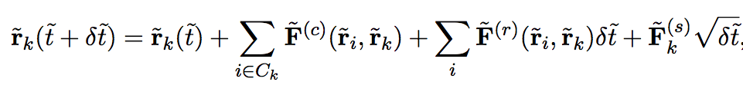
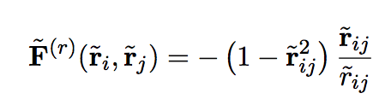
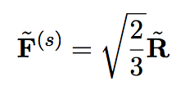

Original Approach
Evolution equation for Positions
Connection force
Repulsion
Brownian update (Wiener process)
C_{k} including all the topological information (association) is given by independent stochastic steps
Simple Euler Integrator
Topological steps
Brownian time evolution

Slide 3
Finite Ratio of Time Scales between Brownian and Topology
Time scales are not independent between Brownian and topological ones
In the real time step, skipping algorithm is way of approximation (Even if this will be used for further approaches, it is of importance involvement of each time step)

Slide 4

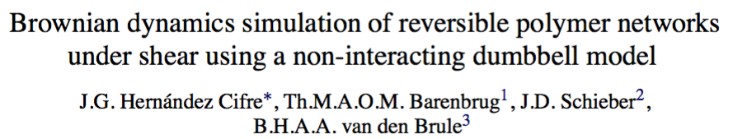




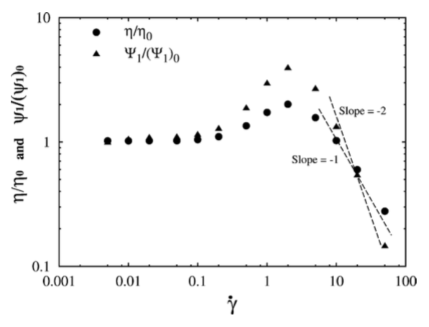

Unlike our simulation, positions are not regarded as state variable. But we can have some clue to implementation of two different time steps: update for Smoluchowski equation and update of association/dissociation information
Time step to update the evolution equation
For given shear rate, the whole process repeated up to steady-state.
From Smoluchowski equation to Brownian dynamics simulation
After each Brownian update, the all dumbbells are subject to update based on the given transition probability.
Note that the transition probabilities have dependency with Brownian time step.
Dimensionless shear rate

